Slide 1
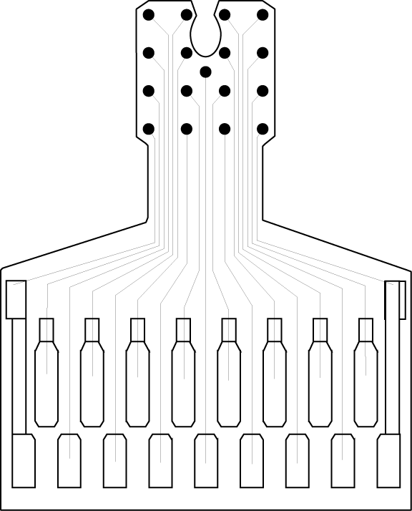
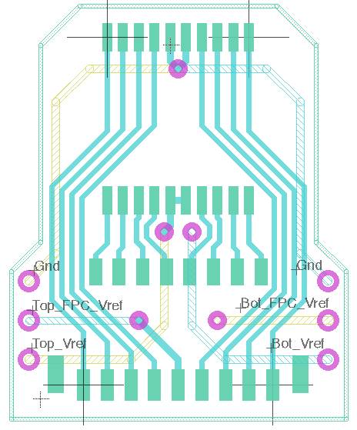
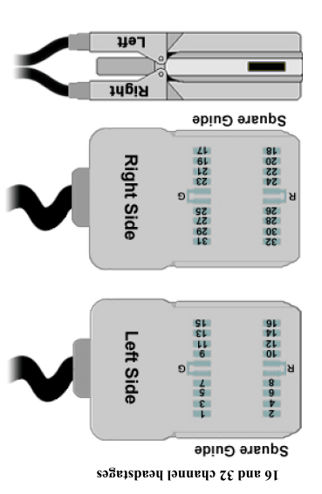
Mice uECoG
(electrode side down) viewed from above
Rh
Re
G
15
13
11
9
Re
7
5
3
1
16
14
12
10
8
6
4
2
1
3
5
7
Re
9
11
13
15
2
4
6
8
10
12
14
16
2
4
6
8
Rh
Rh
10
12
14
16
1
3
5
7
G
G
9
11
13
15
15 16 13 14
9 10 12 11
7 8 6 5
1 2 3 4
Mice ZIF uECoG
notch towards nose & electrode on left
or notch towards tail & electrode on right
channels 1-16
Electrode site diameter: 150 μm

Slide 2
Rat uECoG
(electrode side down) viewed from above
15
13
11
9
Re
7
5
3
1
16
14
12
10
8
6
4
2
15 16 13 14
9 12 11 10
7 6 5 8
1 2 3 4
Rat ZIF uECoG
notch towards nose & electrode on left
or notch towards tail & electrode on right
channels 1-16
Electrode site diameter: 200 μm

Slide 3
Penetrating electrode
(electrode side down) viewed from above
15
13
11
9
Re
7
5
3
1
16
14
12
10
8
6
4
2
15 16 13 14
12 9 10
9 10 12 11
Re
Width:
500 μm
7 8 6 5
1 2 3 4
6 7 8
Pitch: 600 μm 470 μm
Electrode site diameter: 100 μm

