Slide 1
Upload videos of faces and with their respective labels (i.e. names of the person in the video)
Cloud Run Services. A container app on flask. It has it’s on temp folder where the videos are stored.
We could also add the output/permission in this section and generate a file (like json/dictionary)
{roles:
{“Joaquin “: “Access granted”}
}
1
A file with the faces of people that appeared in the videos. (note: we would ask the user to upload videos with only one person in it)
The photos are already labeled using the name introduced by the user.
Simple python script running on the CRS
Steps
First – Python functions (locally)
Second - Lambda Functions
There are 3 option:
- Use Google Vision
- Use Sage Maker to train and deploy
- Run a PyTorch/Keras NN on the container
2
Train a NN that recognize faces
3
Another container or
APP engine.
It would use the model trained on 3 to classify the picture. It would have a page with configuration/settings to :
Accept inputs from users (photos) and recognize the person in the photo
4
Generate an output (i.e. ‘Access granted’) depending on the face showed/recognized
Steps
First – Python function
Second – Lambda Function
5

Slide 2
Train a NN that recognize faces
There are 3 option:
- Use Google Vision
- Use Sage Maker to train and deploy
- Run a PyTorch/Keras NN on the container
Google Vision:
We could store the output of on 1 & 2 on an external bucket.
Cons
I am sure it’s going to be difficult to store the output of a container outside the container. We could always download the file.
An external user would need to know how to use Google Vision. This makes the project less ‘automatic’. It would end up being a two step process. One for the IT people of a company for example, and the other part as a front/end app that users could use. For example a door with a camera.
I don’t know how easy would it be to export the trained model from GV to the final app
Pros
Users could send request to identify a face from different devices
SageMaker
Idem GV. I do knot know how easy would be to move the photos from the first app (1&2) to SageMaker. Maybe it would be easy but I need to be sure that I would be able to interact with the deployed model on my final app (4&5)
Pros
Users could send request to identify a face from different devices
- Run a PyTorch/Keras NN on the container
Maybe the easier one but the slower one.
It would run all in the container (check for scalability)
It would have a web page format with a first step (upload videos) and train the model, second step(configure the outputs) and third step upload a photo and receive an output.
Cons
It could be slow.
Pros
We will not need to deal with moving files and models from one service.
It could work as an isolated fully independent app. The only problem of this is that it will ‘forget’ the model as soon the user close the webpage (we could offer to download a the model, and maybe a script that will run it)

Slide 3
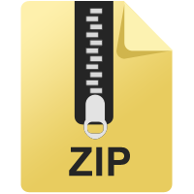

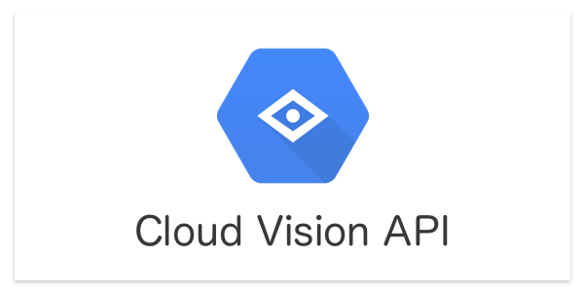
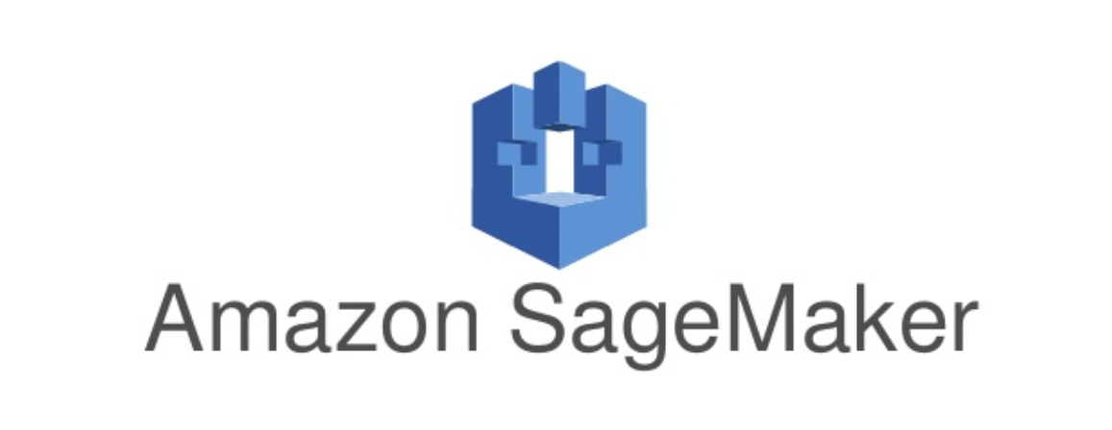
Upload video
Select file
1
Who is this?
Or Container
…
2
Who is this?
Joaquin

Slide 4
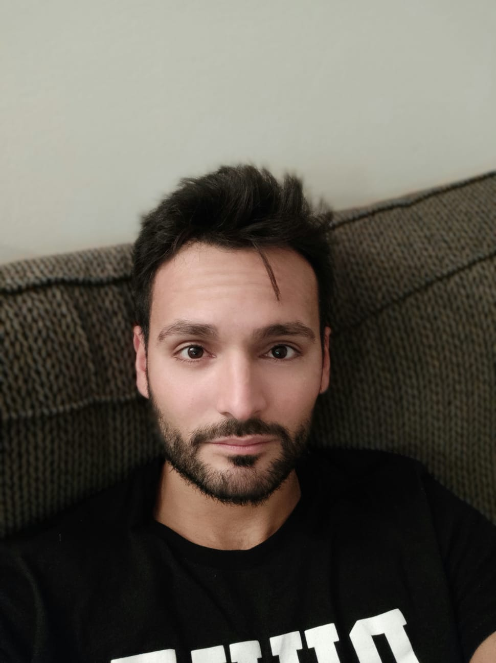
Configure access permissions
Person 1
Permission/Role
Person 2
Access Granted
Upload photo
Select file
Person 2
Access Granted

