Slide 1


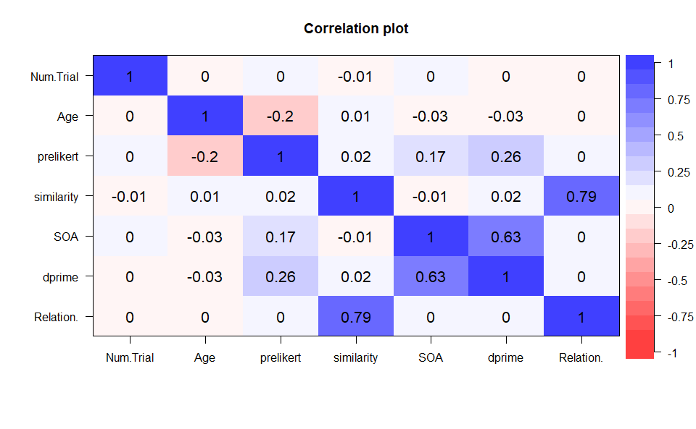
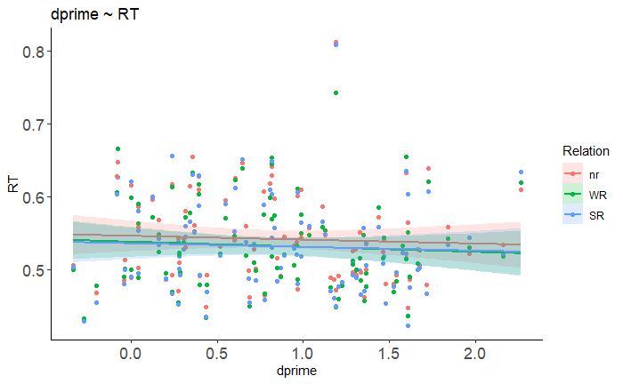
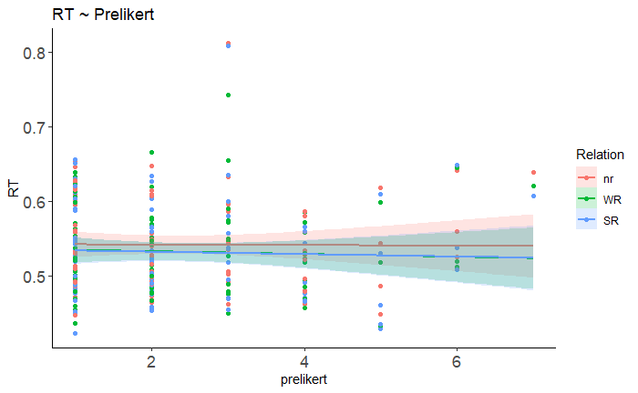
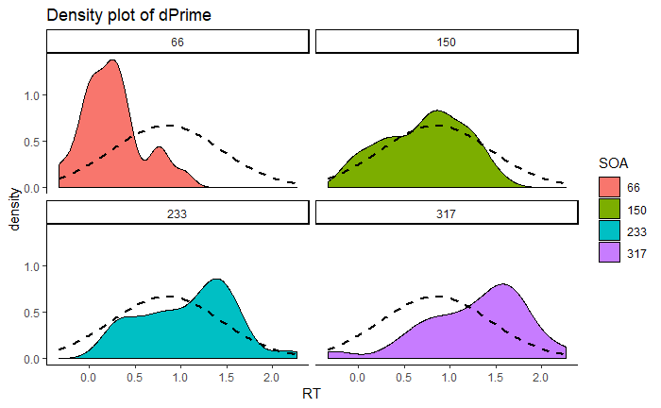
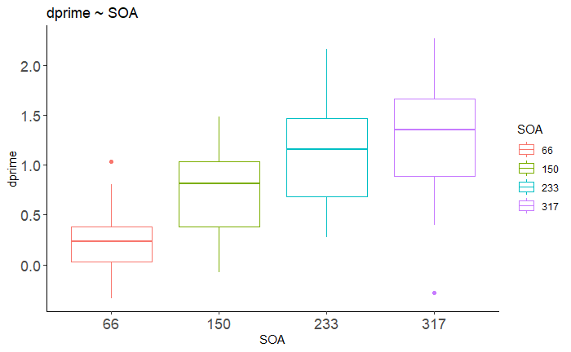
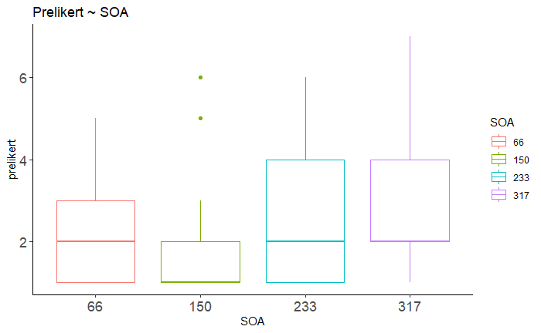
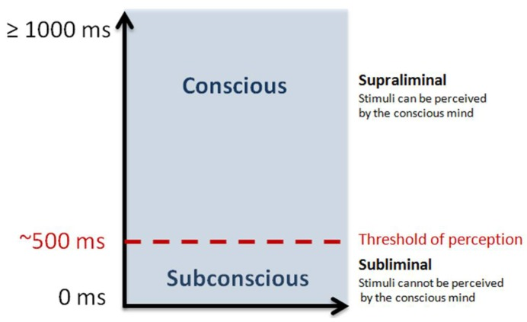
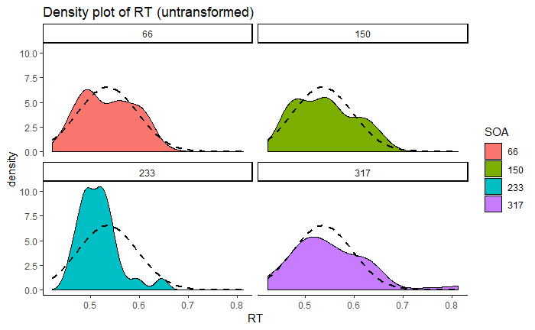
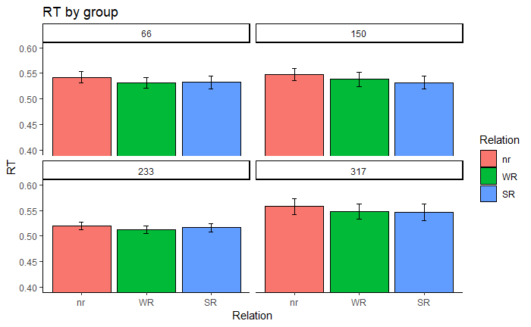
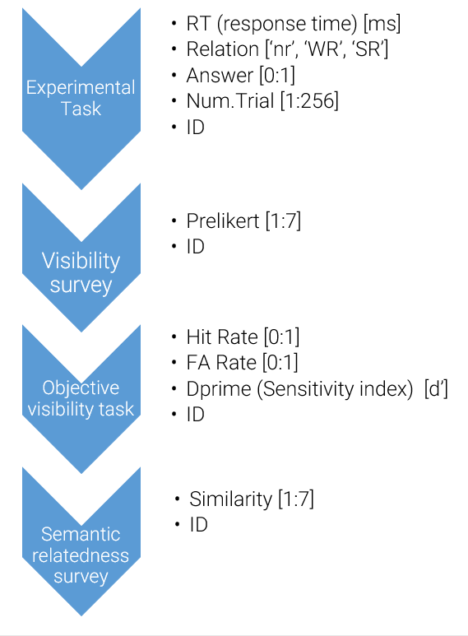
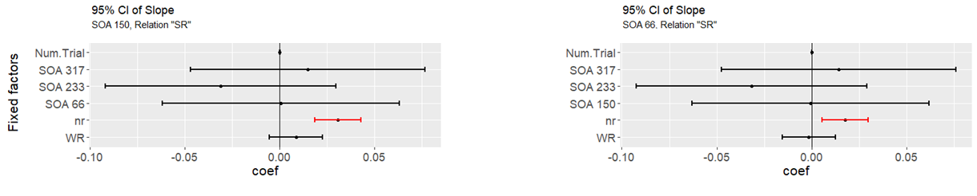
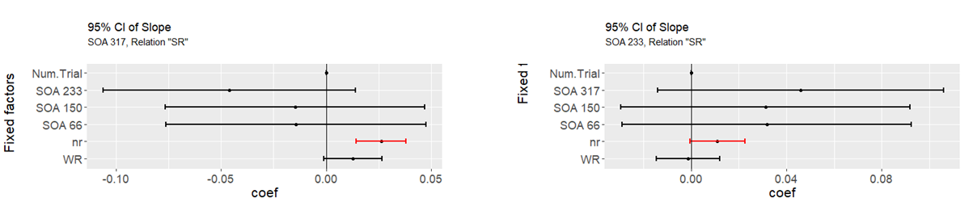



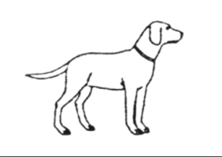
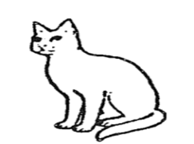
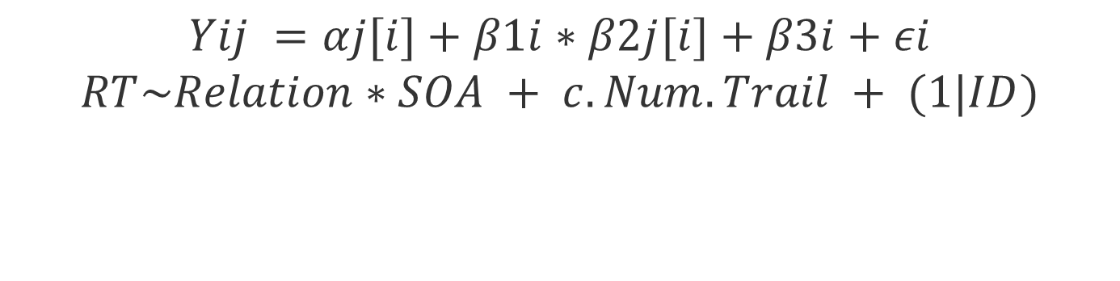
Influence of Semantic Similarity and Stimulus Onset Asynchrony on Semantic Subliminal Processing
Course : IDS 702: Modeling and Representation of Data Professor: Jerome Ritter Author: Joaquin Menendez (jm622@duke.edu)
Introduction
Exploratory Analysis
Studies employing a masked priming paradigm have observed that subliminal stimuli could be processed on a semantic level. Semantic categorization of a consciously perceived stimulus could be facilitated by the presentation of a former stimulus that was not consciously perceived (subliminal). This facilitation is usually measured as the reaction time employed to respond to a task. When this facilitation occurs between congruent pairs of stimuli (from the same category) and does not occur between incongruent pairs (from different categories) is called congruency priming effect. Two principal factors modulate the subliminal priming effect, the semantic similarity between stimuli and the SOA. Semantic similarity refers to the similarity in meaning or overlap of features between two words. The greater the similarity, the bigger the facilitation. Another factor that modulates priming effect is the interval between the onset of the first stimulus and the onset of the second stimulus of the par (SOA: stimulus onset asynchrony), showing that the bigger the SOA, the lower priming effect.
Despite the fact that these two phenomena have been extensively studied, it has not been studied the influence of semantic strength has not been studied together with SOA duration.
dprime
Group | n | mean | sd | median | trimmed | max
66 | 24 | 0.25 | 0.33 | 0.24 | 0.24 | 1.03
150 | 24 | 0.72 | 0.45 | 0.82 | 0.73 | 1.48
233 | 27 | 1.07 | 0.5 | 1.16 | 1.07 | 2.16
317 | 25 | 1.27 | 0.56 | 1.35 | 1.31 | 2.26
prelikert
group | n | mean | sd | median | min | max
66 | 24 | 2.21 | 1.22 | 2 | 1 | 5
150 | 24 | 1.96 | 1.46 | 1 | 1 | 6
233 | 27 | 2.52 | 1.45 | 2 | 1 | 6
317 | 25 | 2.72 | 1.43 | 2 | 1 | 7
aov(formula = dprime ~ SOA, data = multiple_data)
 | Df | Sum Sq | Mean Sq | F value | Pr(>F)
SOA | 3 | 14.69 | 4.898 | 22.29 | 4.88e-11 ***
Residuals | 96 | 21.09 | 0.22
Kruskal-Wallis rank sum test
X2 | df | p-value
6.759 | 3 | 0.0799
1.1 Research Question
The goal of this study was to observe if semantic relatedness (strongly and weakly related pairs) could modulate congruency priming effect duration. To evaluate this, both semantic relatedness (strong and weak) and SOA were manipulated in a subliminal semantic priming task.
We performed a Kruskall Wallis test to compare the means of prelikert scores between groups. The test did not show a statistical trend (X2= 6.575, p = .079). The Wilcoxon rank sum test shows that there is no difference between groups. We could claim that there is no evidence of difference among groups for prelikert values.
We performed a One-Way ANOVA to compare the mean of dprime scores between groups. There is statistical evidence of a difference between dprime per group F(3,96)=22.29 p < .001. The bigger the SOA, the bigger the dprime.
The RT distribution between groups was not homogeneous and did not present a normal distribution. Logarithmic and inverse transformation were not able to homogenize the data. The original intention of the experimental design was to realize a Mixed ANOVA 4x3 where:
IV between: SOA
IV within: Relation
DV: RT
We performed individual Friedman Test for each group in order to compare the RT over the different types of semantic relatedness (Relation).
Given the mentioned limitations a multilevel model using ID as a grouping factor was applied. This model allowed to work with normally distributed data given the fact that it was not necessary to average the RT of each subject per condition (the standard procedure on this type of experiments) allowing to work with all the trials of each subject.
2. Methods
Friedman rank sum test
Groups | Stats
SOA 66 | Friedman chi-squared = 12.333, df = 2, p-value = 0.002098
SOA 150 | Friedman chi-squared = 7, df = 2, p-value = 0.0302
SOA 233 | Friedman chi-squared = 2.7407, df = 2, p-value = 0.254
SOA 317 | Friedman chi-squared = 6.72, df = 2, p-value = 0.03474
4. Results
$$Yij =αj[i]+β1i∗β2j[i]+β3i+εi$$
$$RT\sim Relation∗SOA + c.Num.Trail + (1|ID)$$
Random effects
Groups | Name | Variance | Std.Dev.
ID | (Intercept) | 0.01155 | 0.1075
Residual |  | 0.03878 | 0.1969
Number of obs: 25073, groups: ID, 100
2.1 Experimental Task
Fixed effects
 | Estimate | Std. Error | df | t value | Pr(>|t|)
(Intercept) | -0.6148 | 0.02223 | 98.54 | -27.654 | < 2e-16 | ***
RelationWR | -0.01923 | 0.00619 | 24960 | -3.107 | 0.00189 | **
RelationSR | -0.01762 | 0.0062 | 24960 | -2.844 | 0.00446 | **
SOA 150 | 0.01245 | 0.03144 | 98.58 | 0.396 | 0.69306
SOA 233 | -0.03833 | 0.03056 | 98.56 | -1.254 | 0.21273
SOA 317 | 0.02276 | 0.03113 | 98.53 | 0.731 | 0.4664
c.Num.Trial | 7.1E-05 | 1.7E-05 | 24960 | 4.225 | 2.39E-05 | ***
Fixation (500 ms)
TARGET
+
Forward Mask
(100 ms)
Unrelated
PRIME
(33.5 ms)
4. Conclusion and Limitations
Forward Mask
(variable)
Weekly Related
In summary, the four experimental groups shown statistical differences depending on the semantic relatedness between the prime and the target stimulus. There was a reduction on the RT for every group when the pair of stimuli were Weak or Strong related in comparison to not being related. However, we did not find evidence of a Group effect. Different SOA values did not reduce nor increase RT for any Relation level.
A possible limitation to generalize these results is the fact that subject performed above-chance on the visibility test. Also, we found a group effect on the d'prime score, the bigger the SOA, the bigger the dprime score. Nevertheless, Ortells et. al (2016) also reported differences among groups on the dprime. Given the fact that dprime nor SOA presented an influence on the RT, and If we take in count the lack of difference on the subjective report (Prelikert), we could suggest that the different SOA interval has a differential effect over the conscious processing of the prime stimuli only during the objective visibility test but no effect during the experimental task (priming task). Given the fact that the attention has a crucial role on conscious processing, it could be that the short period of time between stimulus combined with an attentional focus on the processing of the target stimuli would be interfering on the processing of the prime stimuli.
TRIAL
Prime-Target SOA (variable)
Strongly Related
References
Ortells, J. J., Kiefer, M., Castillo, A., Megías, M., & Morillas, A. (2016). The semantic origin of unconscious priming: Behavioral and event-related potential evidence during category congruency priming from strongly and weakly related masked words. Cognition, 146, 143–157. https://doi.org/10.1016/j.cognition.2015.09.012
Bruno, N., Díaz Rivera, M., Embon, I., Iorio, A. (2016). Procesamiento Subliminal Según El Grado De Relación Semántica. VIII Congreso Internacional de Investigación y Práctica Profesional en Psicología. Facultad de Psicología - Universidad de Buenos Aires, Buenos Aires.

