Slide 1
Primitive Annotations
For sklearn

Slide 2
-Scalability: runtime is measured with either a larger sample size or more features
-Resilience to noise: this is done by artificially adding white noise to the data and measuring the effect it has on predictive performance.
-Resilience to missing data and resilience to irrelevant or redundant features : is done similar by removing or adding values and measuring the predictive accuracy.
-Bias variance profiling: measuring the percentage of bias and variance error
-Ontological descriptions; handling of missing values: does the algorithm handle missing value.

Slide 3
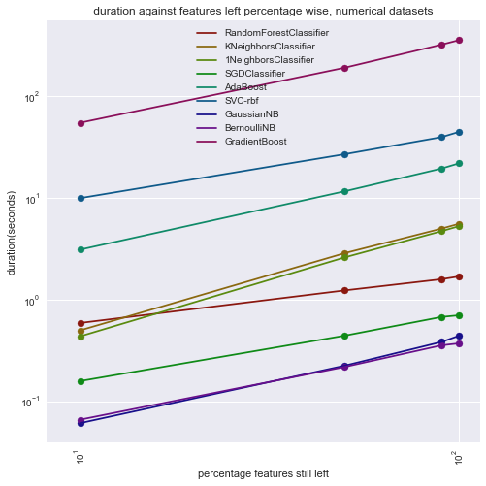
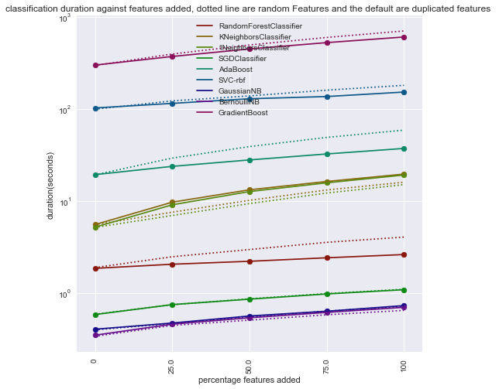
Scalability

Slide 4
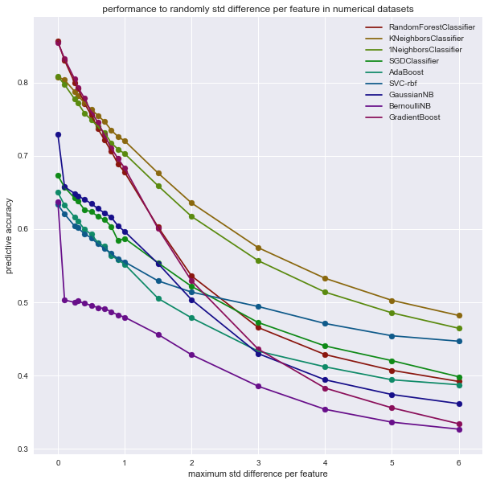
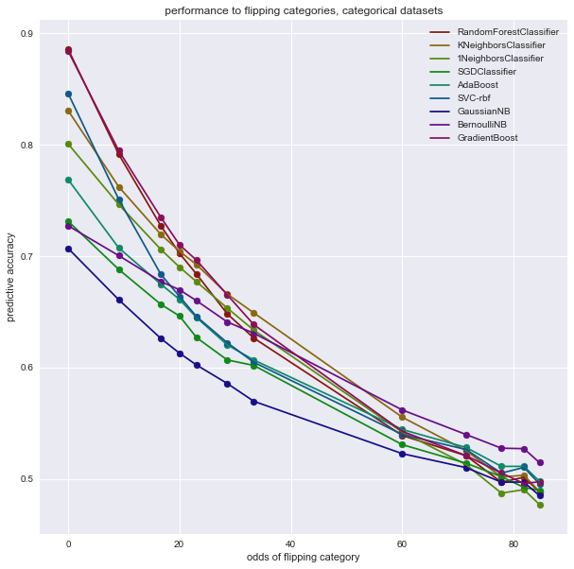
Resilience to noise

Slide 5
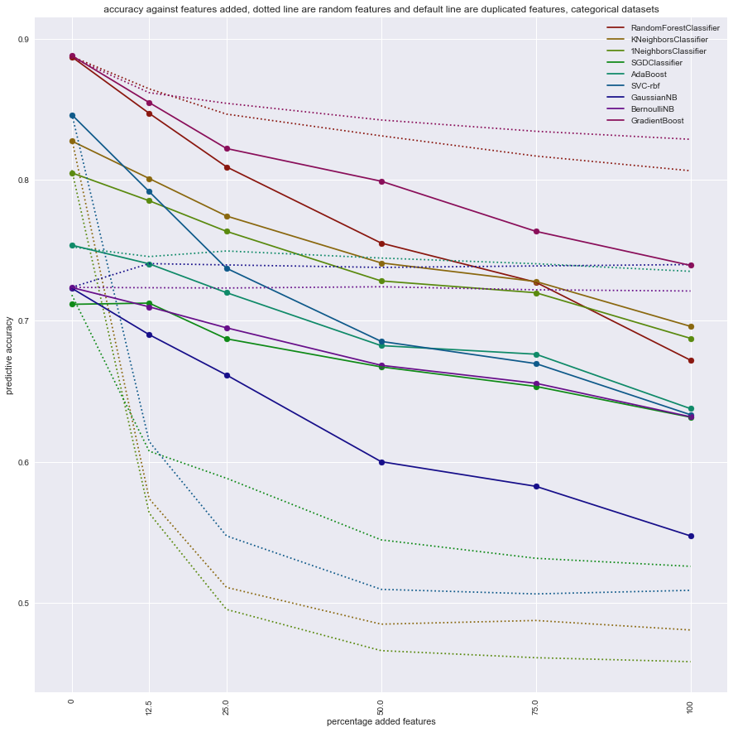
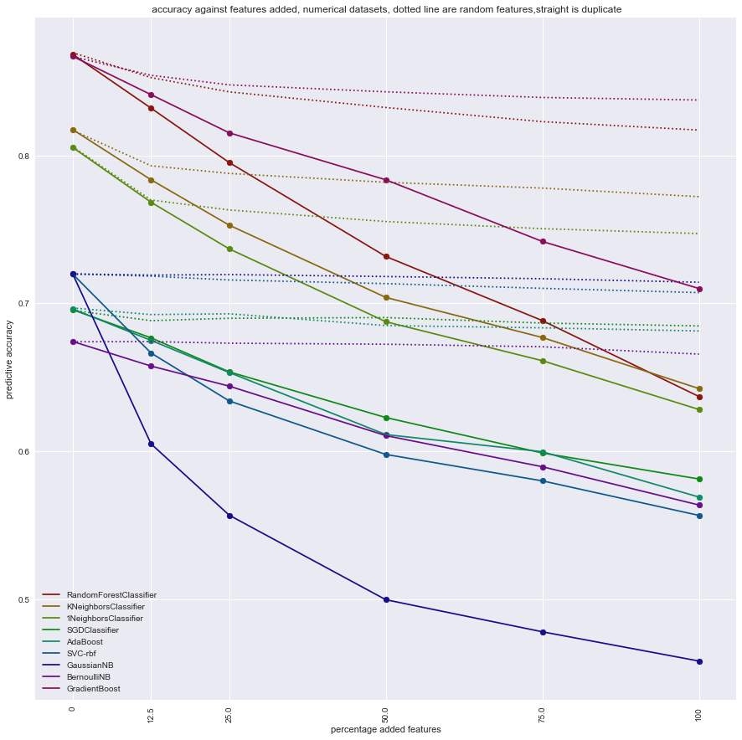
Resilience to irrelevant or redundant features

