Slide 1


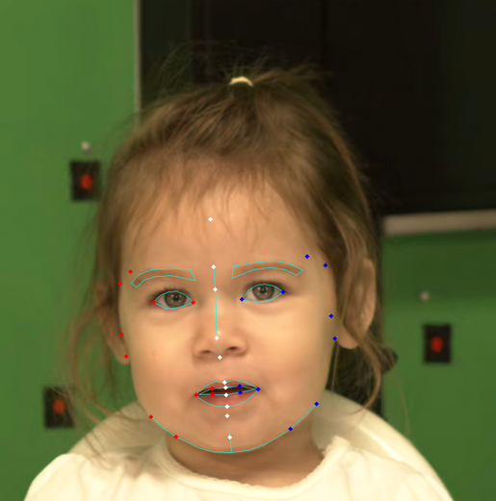
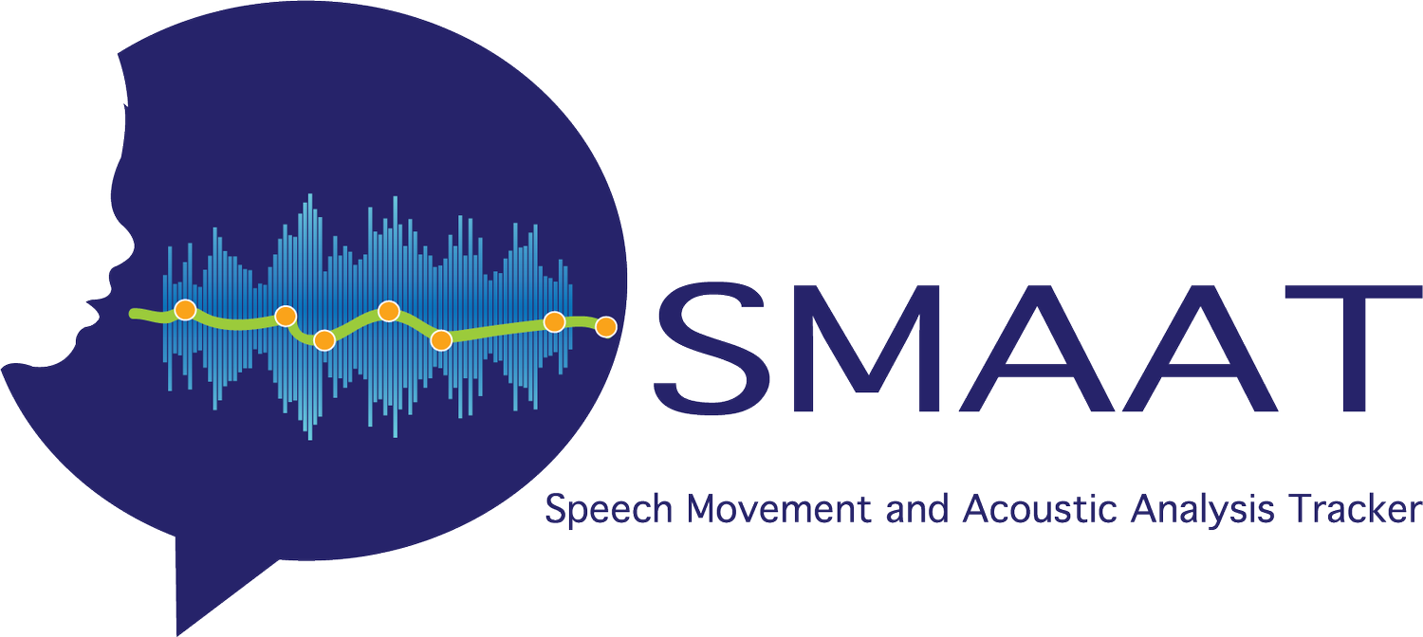
Computer vision
Speech Movement and Acoustic Analysis Tracking. Adapted from Speech Movement and Acoustic Analysis Tracking (SMAAT), 2020 (https://www.smaat.org/).

Slide 2
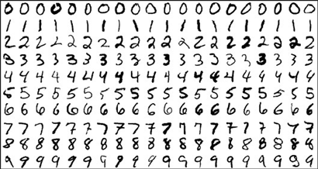
Handwritten digits recognition
Implementing a Neural Network from Scratch in C++ with the MNIST Dataset

Slide 3
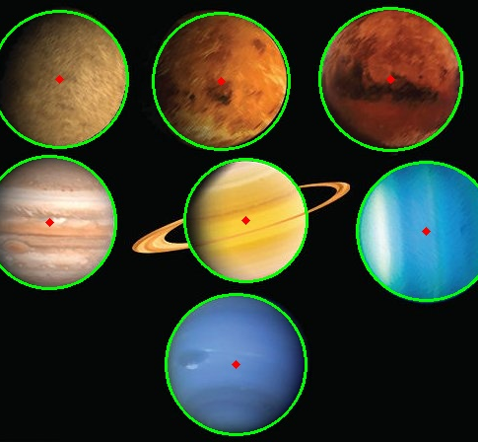
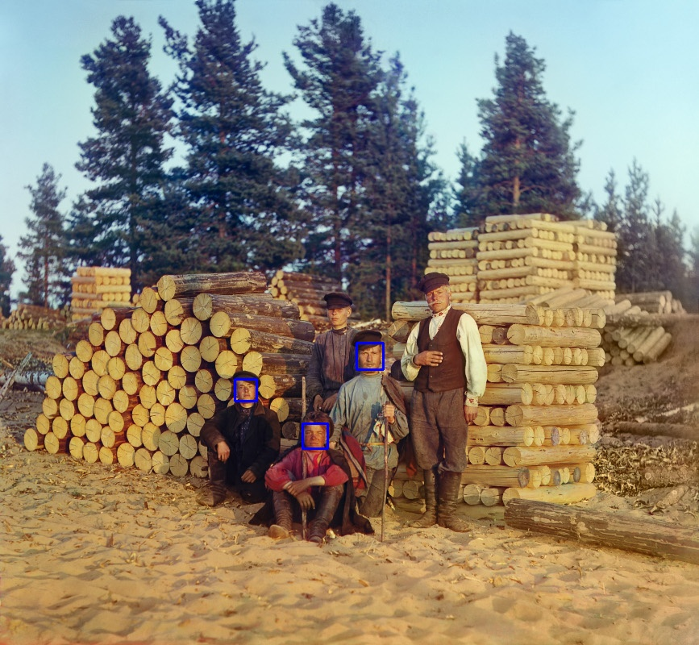
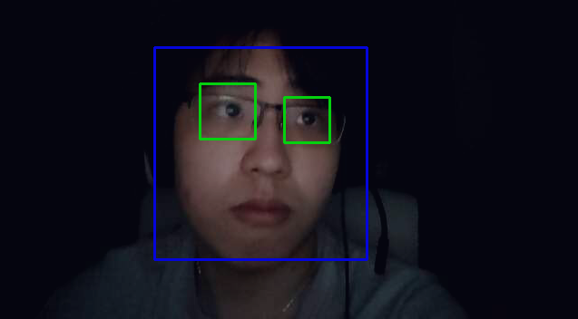
Opencv library

Slide 4
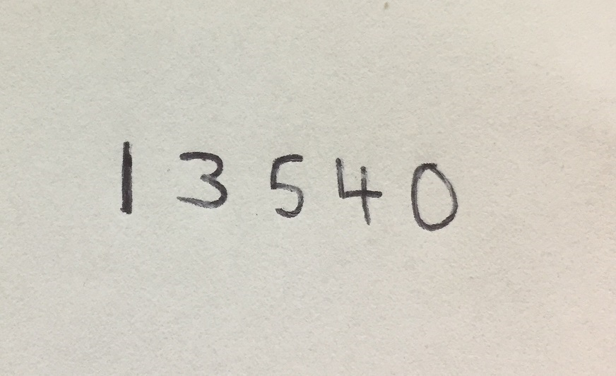
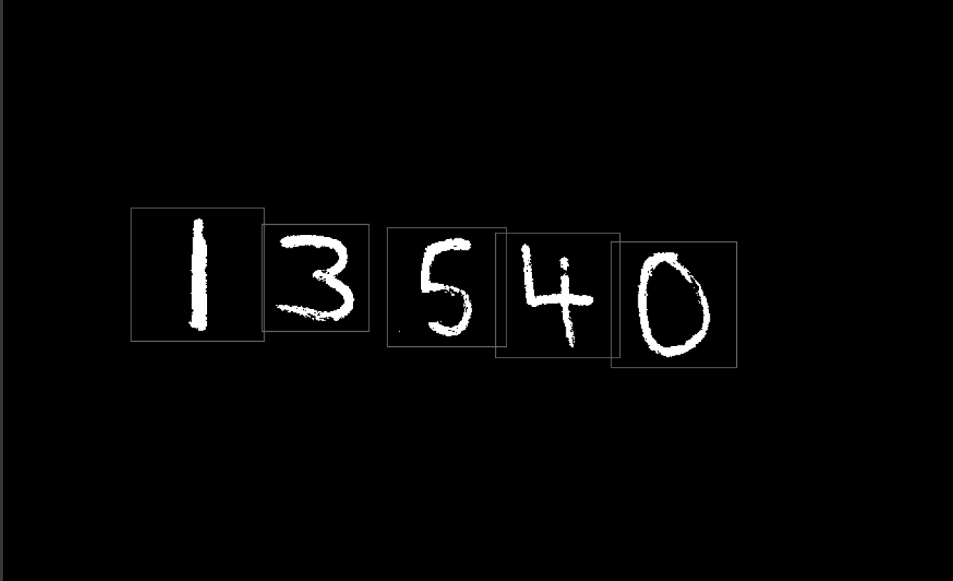
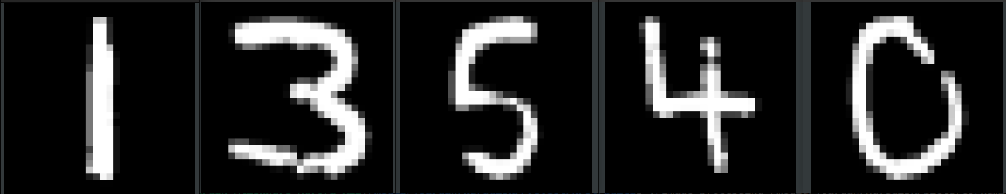
Process
1. Transform coloured image into greyscale
2. Locate and box in numbers
3. Cut and blur to 28x28 pixels

Slide 5
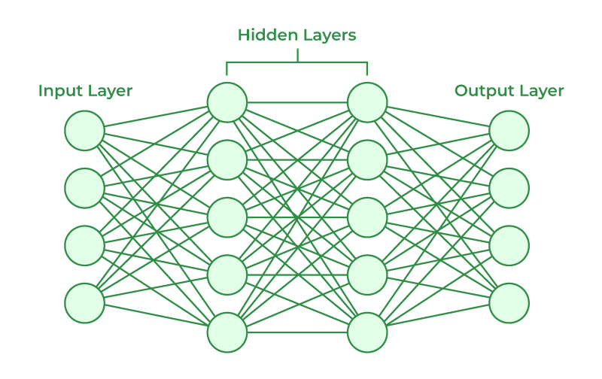
784 Neurons
10 Neurons
16 Neurons
16 Neurons
Artificial Neural Networks and its Applications. Adapted from Harkiran, 2023, GeeksforGeeks (https://www.geeksforgeeks.org/artificial-neural-networks-and-its-applications/).

Slide 6
Results
Correct: 17608, out of 20000
Correct: 17652, out of 20000
Correct: 17669, out of 20000
Total of 52929 out of 60000 correct predictions
Average Accuracy: 88.215 %

Slide 7
timeline
Tuning of Neural Network
Convert Code into object-oriented design
Deployment of application
Add more method of accuracy evaluation

Slide 8
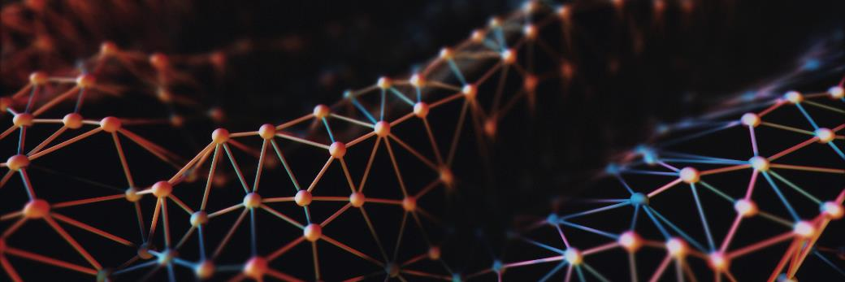
Thank you
https://github.com/joardan/NPSC
Speech Movement and Acoustic Analysis Tracking (SMAAT). (2020). Speech Movement and Acoustic Analysis Tracking (SMAAT). SMAAT. https://www.smaat.org/​
Harkiran. (2023, June 2). Artificial neural networks and its applications. GeeksforGeeks. https://www.geeksforgeeks.org/artificial-neural-networks-and-its-applications/

