Slide 1
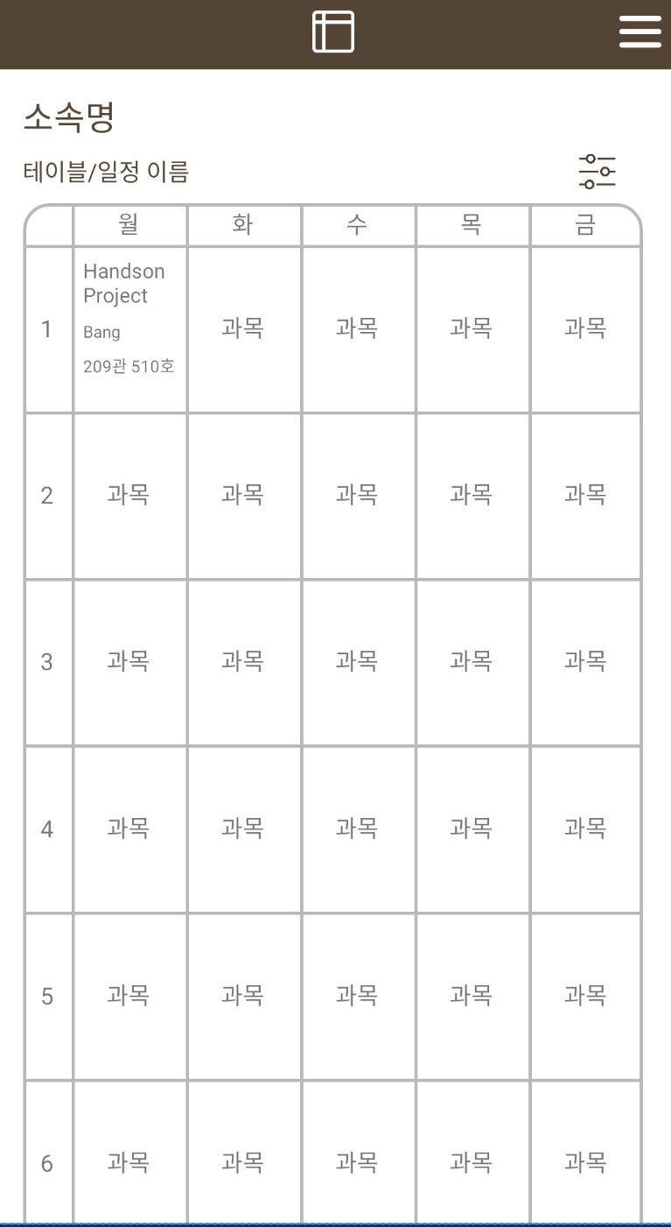
Handson Project
Professor : Bang-Yung-Se
click
Room : 209관 501호
Time : Monday 1, 2, 3
Learning Object : Understanding of software technology and industry

Slide 2
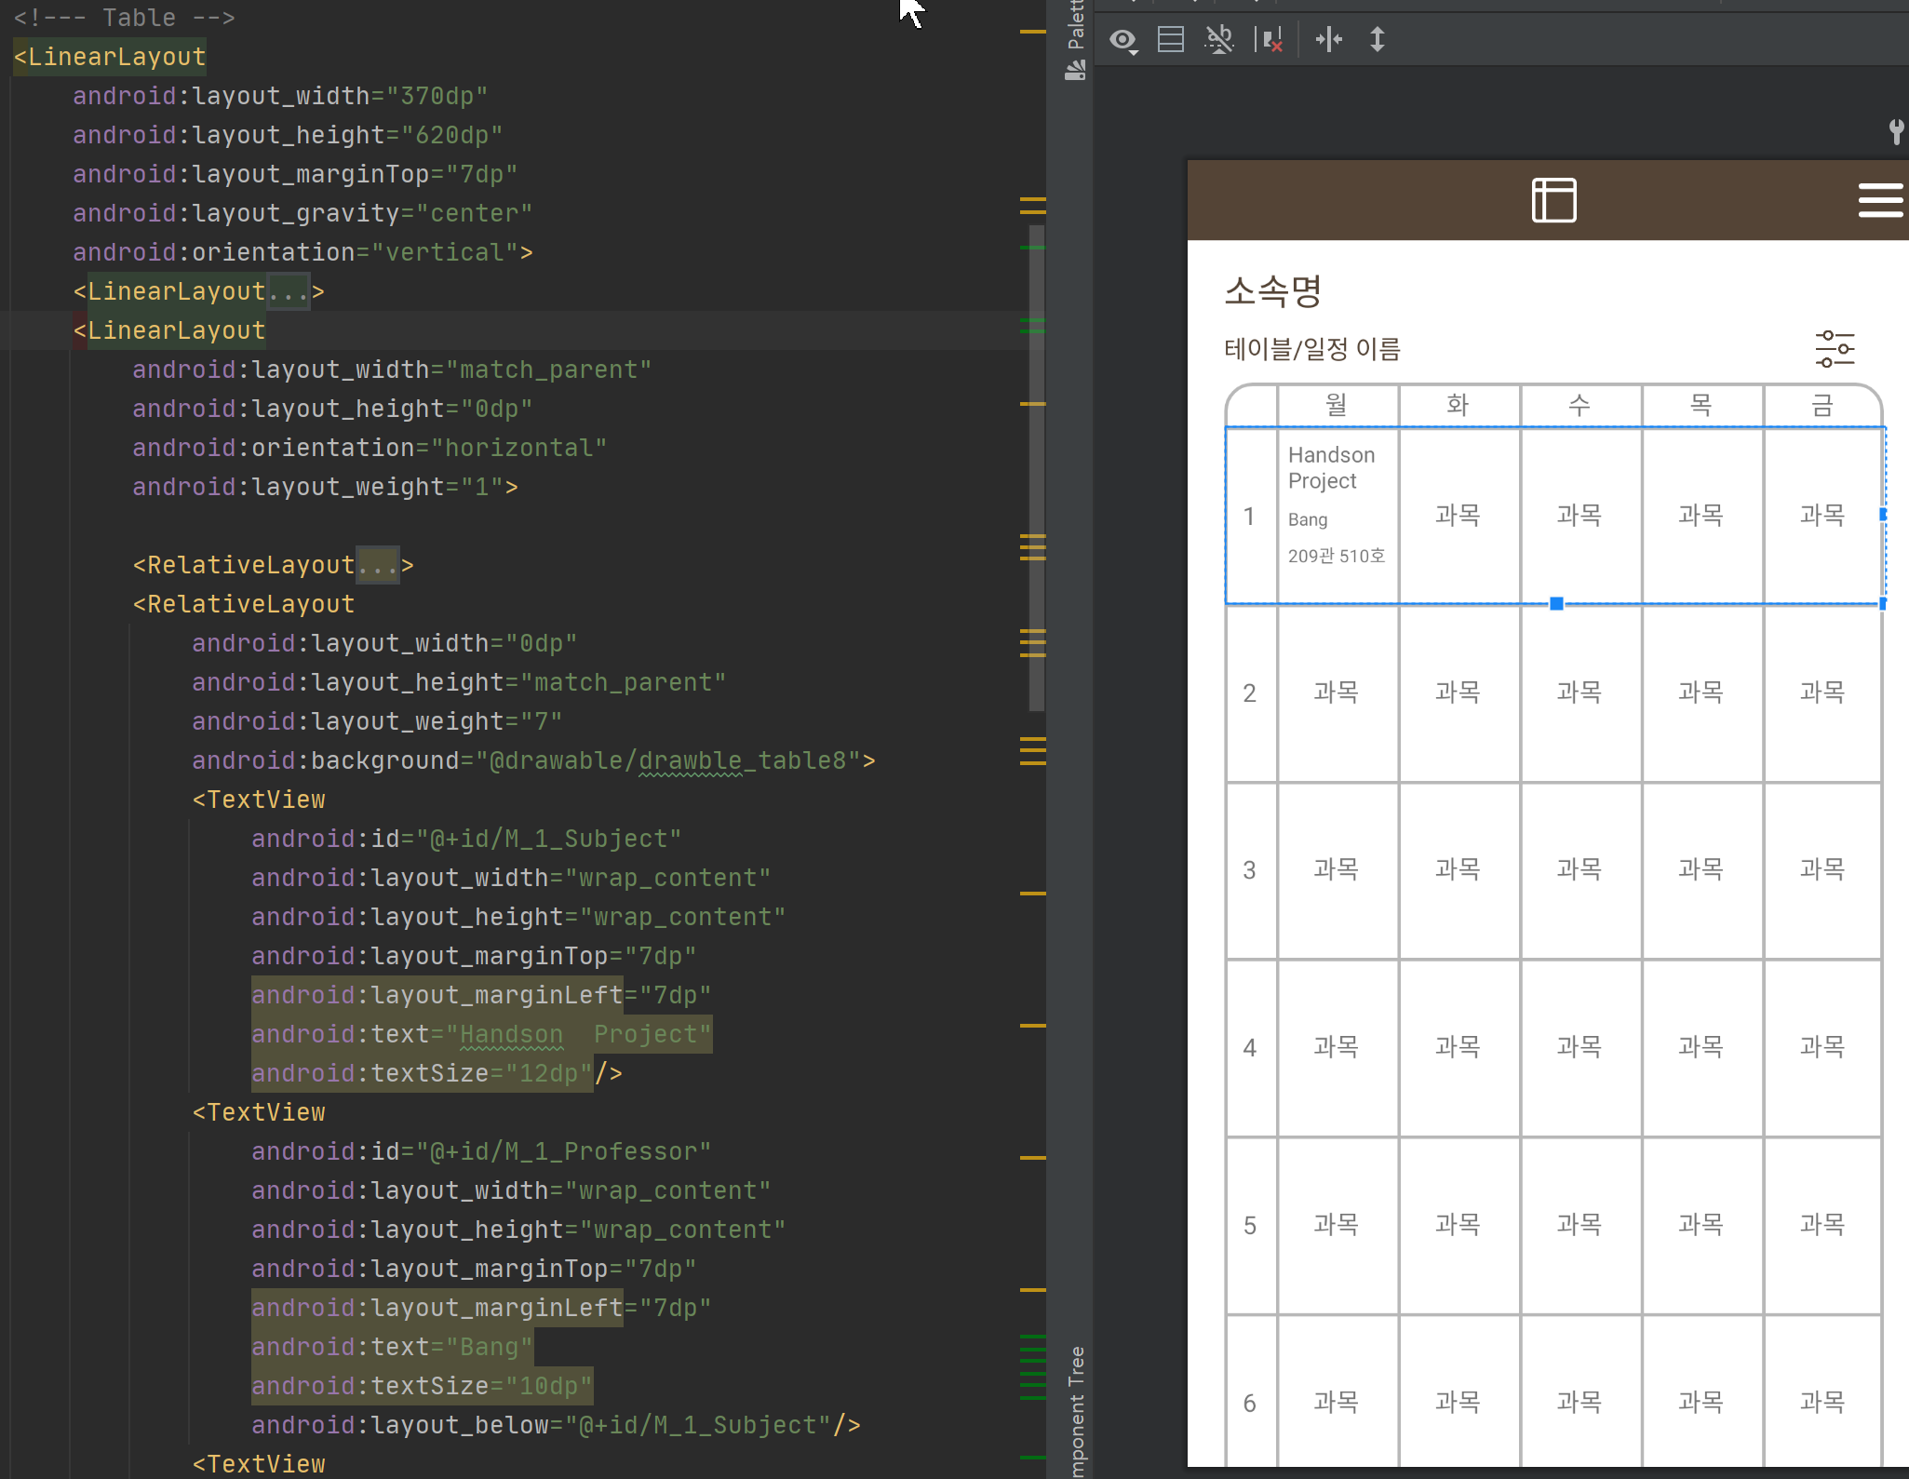
Reference : Part of code of (activity_tabler)

Slide 3
click
일정 추가
일정 추가
과목 명을 찾아 일정에 추가하세요.
과목 명을 찾아 일정에 추가하세요.
HandsOn Project
project
HandsOn Project
UI Project
X Project
…
Handson Project
Professor : Bang-Yung-Se
Room : 209관 501호
Click to
auto-complete
Time : Monday 1, 2, 3
You can see detail
Learning Object : Understanding of software technology and industry
일정 추가
과목 명을 찾아 일정에 추가하세요.
Click
HandsOn Project

Slide 4
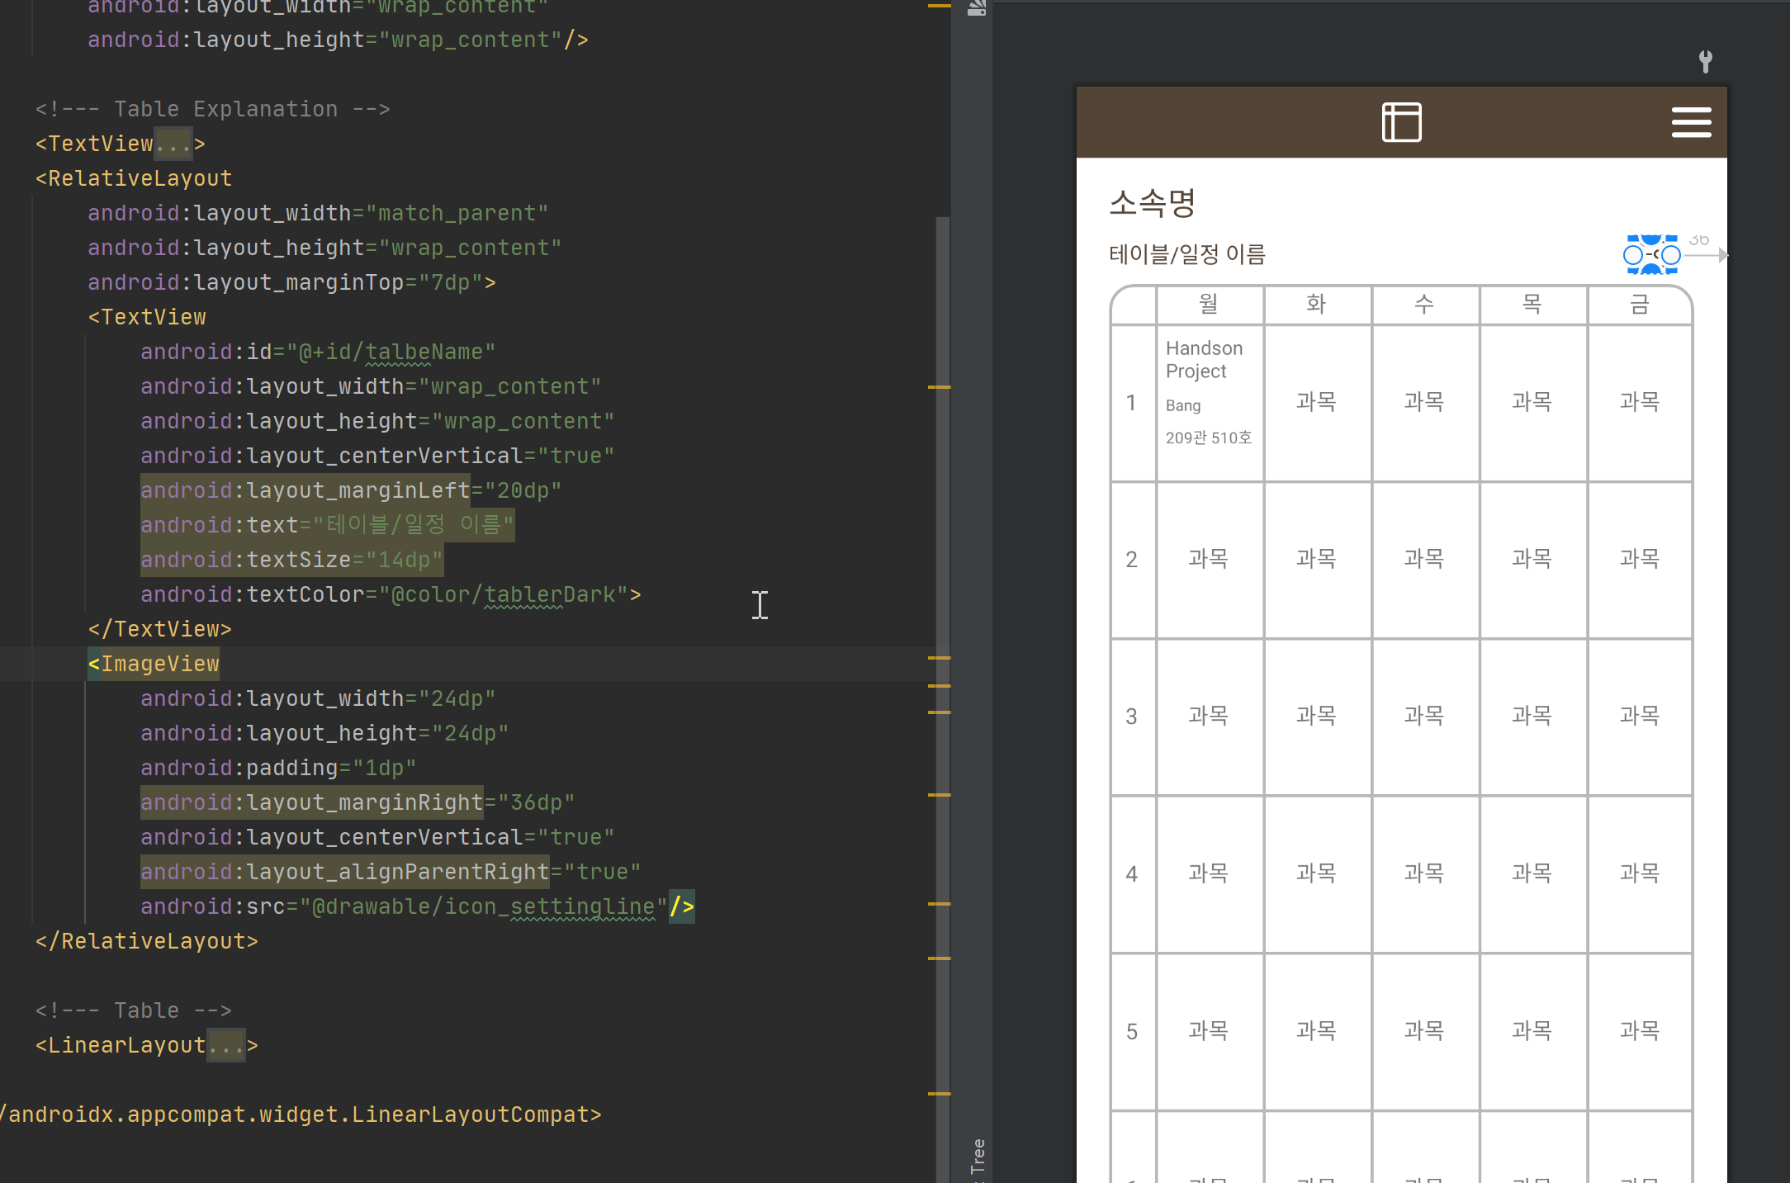
Reference : Part of code of (activity_tabler)

