Slide 1

IS460 MACHINE LEARNING · PROJECT PROPOSAL
Predicting Airline Passenger Satisfaction via Deep Tabular Ensembles: Evaluating Synthetic Fidelity and Explainable Drivers
GROUP 03
DATA 829,515 PASSENGERS
METRIC ROC AUC
MODELS 3 FAMILIES
Chai Yichen · Chetan s/o Haresh Kishnani · Lee Jia Le · Joash Lau Rong Wei · Cody Loo Yee · Tristan Ang Boon Yew
Notes:
1

Slide 2
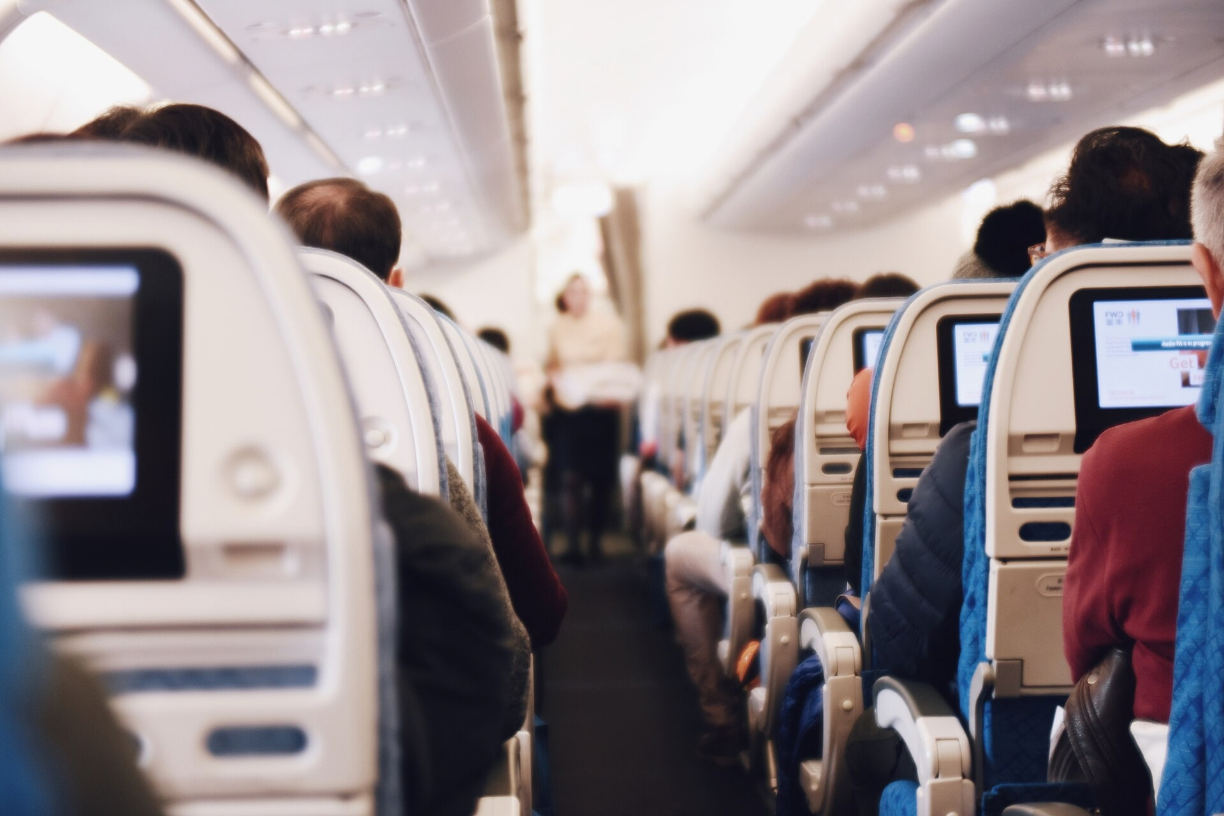
INTRODUCTION
Problem Statement
A post-flight survey tells an airline who was unhappy after the fact. We predict each passenger's probability of being satisfied, and explain which services drive it.
INPUT
21 features [1]: 4 traveller, 4 trip and 13 service-rating fields
OUTPUT
P(satisfied) for each passenger, plus the services that move it
METRIC
ROC AUC: the chance a satisfied passenger is ranked above an unsatisfied one [2]
DATA
699,635 synthetic passengers, generated from 129,880 real survey responses [1]
02
Photo: Suhyeon Choi / Unsplash, CC0
[1] Y. Yan, W. Reade, and E. Park, "Predicting Airline Satisfaction," Kaggle Playground Series S6E10, 2026.
[2] J. A. Hanley and B. J. McNeil, "The meaning and use of the area under a receiver operating characteristic (ROC) curve," Radiology, vol. 143, no. 1, 1982.
Notes:
2

Slide 3
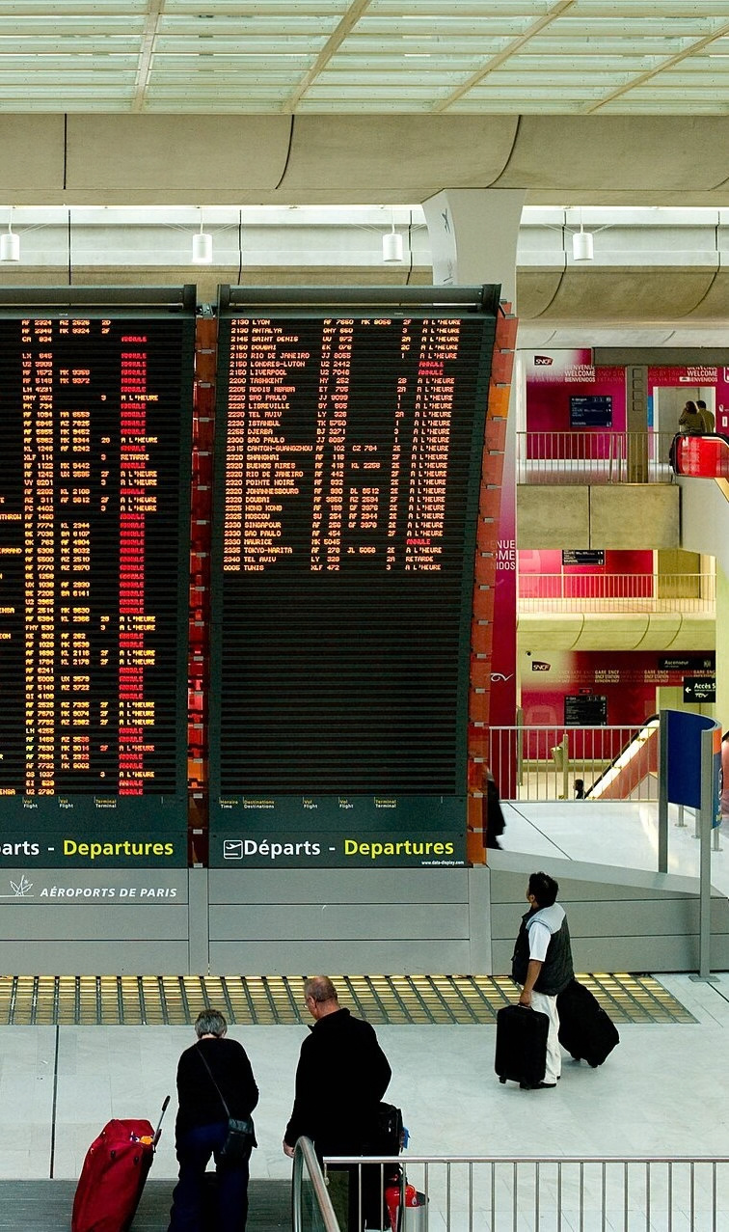
INTRODUCTION
Motivation
5.1 bn
US$4.5
76/100
5–25×
air passengers expected in 2026, with a record 84% of seats filled [3]
forecast net profit per passenger in 2026, down from US$9.1 [4]
US airline satisfaction in 2026; in-flight internet ratings up 20% [5]
more costly to win a new customer than to keep one [6]
Satisfied passengers fly again and recommend the airline [7]. On margins this thin, knowing which service to fix first is worth real money.
03
Photo: Joi Ito, CC BY 2.0, cropped
[3] IATA, "Middle East disruptions and high fuel prices halve airline industry profitability," press release, Jun. 7, 2026.
[4] IATA, "Industry statistics fact sheet," Jun. 2026.
[5] ACSI, "ACSI Travel Study 2026," press release, Apr. 21, 2026.
[6] A. Gallo, "The value of keeping the right customers," Harvard Business Review, Oct. 29, 2014.
[7] M. Kos Koklic, M. Kukar-Kinney, and S. Vegelj, "An investigation of customer satisfaction with low-cost and full-service airline companies," J. Bus. Res., vol. 80, 2017.
Notes:
3

Slide 4
LITERATURE REVIEW · 1 OF 4
Service Quality and Satisfaction
1988
2004
2008
2009
2020
2022
Parasuraman et al.
Park et al.
Chen
An and Noh
Bellizzi et al.
Noviantoro and Huang
Satisfaction tracks the gap between expected and perceived service [8].
Service value and satisfaction drive passengers' future intentions [9].
Perceived value builds satisfaction, which drives loyalty [10].
What drives satisfaction differs by cabin class [11].
Review of airline service-quality survey studies [12].
Data mining ranks online boarding and Wi-Fi as top levers [13].
[8] A. Parasuraman, V. A. Zeithaml, and L. L. Berry, "SERVQUAL: A multiple-item scale for measuring consumer perceptions of service quality," J. Retailing, vol. 64, no. 1, 1988.
[11] M. An and Y. Noh, "Airline customer satisfaction and loyalty: Impact of in-flight service quality," Service Business, vol. 3, no. 3, 2009.
[12] M. G. Bellizzi, L. Eboli, and G. Mazzulla, "Air transport service quality factors: A systematic literature review," Transp. Res. Procedia, vol. 45, 2020.
[9] J.-W. Park, R. Robertson, and C.-L. Wu, "The effect of airline service quality on passengers' behavioural intentions: A Korean case study," J. Air Transp. Manag., vol. 10, no. 6, 2004.
[13] T. Noviantoro and J.-P. Huang, "Investigating airline passenger satisfaction: Data mining method," Res. Transp. Bus. Manag., vol. 43, 2022.
[10] C.-F. Chen, "Investigating structural relationships between service quality, perceived value, satisfaction, and behavioral intentions for air passengers: Evidence from Taiwan," Transp. Res. A, vol. 42, 2008.
04
Notes:
4

Slide 5
LITERATURE REVIEW · 2 OF 4
Machine Learning on This Survey
STUDY
MODELS
BEST REPORTED
Jiang et al., 2022 [14]
Random forest + feature elimination, LR, KNN, NB
RF: accuracy 0.963
Zhang, 2024 [15]
LR, random forest, AdaBoost, XGBoost + SHAP
XGBoost: AUC 0.987
Lee, 2024 [16]
Bagging, boosting and stacking ensembles
Stacking: accuracy 0.963
Bilgin, 2025 [17]
Gradient-boosted trees vs deep nets (DNN, GRU)
LightGBM and GRU best
Hyassat et al., 2026 [18]
Gradient-boosted trees with SHAP importance
LightGBM: AUC 0.994
Takeaway: tuned boosted trees reach AUC 0.98–0.99; SHAP studies agree Wi-Fi and online boarding are leading predictors [15], [18].
[14] X. Jiang, Y. Zhang, Y. Li, and B. Zhang, "Forecast and analysis of aircraft passenger satisfaction based on RF-RFE-LR model," Sci. Rep., vol. 12, 2022.
[17] S. N. Bilgin, "Prediction of airline passenger satisfaction using machine learning and deep learning approaches," in Proc. IEEE ASYU, 2025.
[15] Y. Zhang, "Satisfaction analysis of airline passenger experience," in Proc. EMITI, 2024, pp. 141–152.
[18] A. S. Hyassat, M. O. Hiari, and M. M. Abualhaj, "From data to strategy: Explainable AI insights for enhancing airline passenger satisfaction and loyalty," J. Artif. Intell. Technol., vol. 6, 2026.
[16] M. Lee, "Comparison of bagging, boosting, and stacking ensemble models for airline customer satisfaction analysis," FaST, vol. 8, no. 1, 2024.
05
Notes:
5

