Slide 1
Architecture (intended)

Slide 2






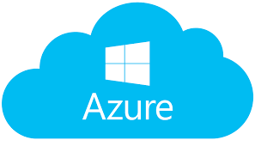

Physical architecture
Open AI
Open NLP
Training models
Internal AI
External AI
Calendar data
Tokens
Browsers
Search for social events
Active Directory
Websites (e.g. BriteEvent)

Slide 3
Software architecture
ASP.Net CORE Web application
Views
Libraries
references
Azure AD token
Controllers
Microsoft Graph
Models
Services
Open AI
Open NLP
Event websites

