Slide 1
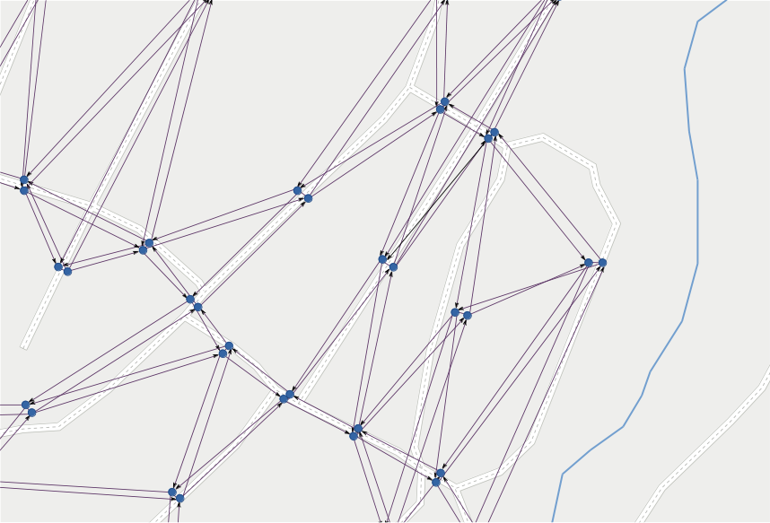
LineGraph
Utility
for
a software module
use in
routing
flexible
public transportation
of
Jonas Bergman, jobe0900@student.miun.se
Notes:
This is a module, part of bigger project
I have no overview of complete project.
Aim: (I think)
No waiting at bus stops
Vehicles gets directed to customers
Drivers needs real-time directions
Updated with current traffic situation

Slide 2
requirements

Slide 3
load map data
in:
build line graph
out:

Slide 4
1
load map data
4
build line graph

Slide 5
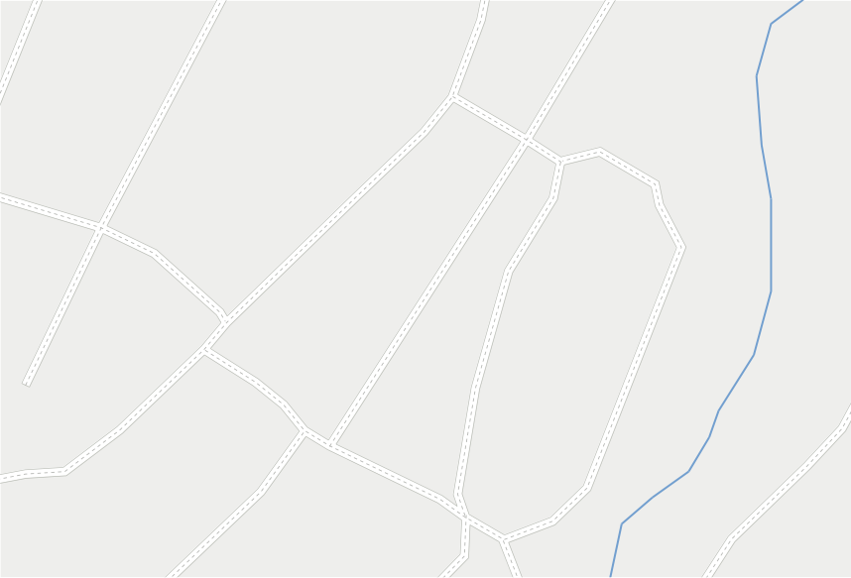
1. map

Slide 6
1. map
source:
OpenStreetMap
www.openstreetmap.org
load:
$ osm2pgsql -U user -d map_db -s -k mapdata.osm
store:
PostGIS
PostgreSQL + spatial data extension
www.postgis.net
Notes:
Open street map:
- crowdsourced, open data
- xml file format
PostgreSQL
+ geometric & geographic data
Osm2pgsql
Commandline tool
Load map data in postgis
Parsing .osm file

Slide 7
1
load map data
2
build topology
Notes:
What is a map?
- a “projection” of reality on flat surface?
- geometry / looks
- semantics about the connections of roads?
- in routing YES

Slide 8
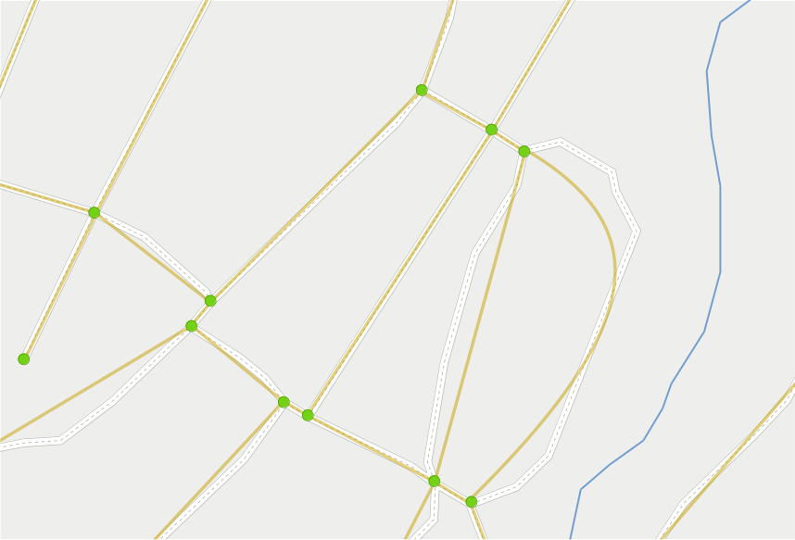
2. topology
Notes:
BUT:
- Only relations are important
- Not geometry
Topology = undirected graph
Stating relations between roads/edges

Slide 9
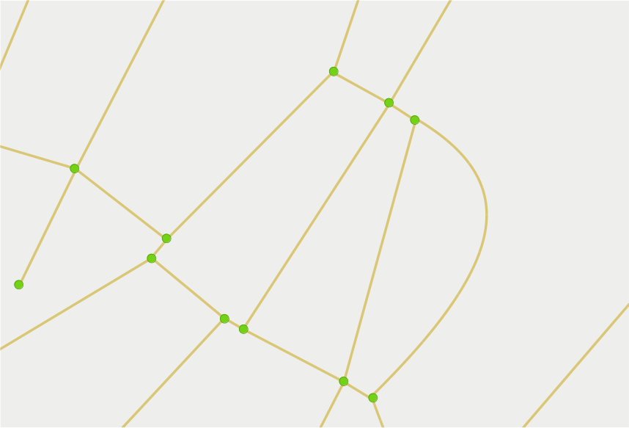
2. topology
tool:
postgis_topology
vertex
edge
Notes:
Terminology (no standard):
- vertices = nodes, points, dots
- edges = lines, arcs
When building/analyzing:
- cleaning up data
- healing misses
Chosen tool:
- extension to PostGIS
- functions to analyze and build topology
Topology should be static.
- road network : not much change
Variations reflected by costs and restrictions.

Slide 10
1
load map data
2
build topology
3
apply restrictions
Notes:
Restrictions can be static and dynamic
Restrictions: STATIC
- road signs
- traffic lights
- speed bumps
Restrictions: DYNAMIC
- accident
- road work
How to apply restriction on topology?
Preliminary step: directed graph

Slide 11
3. restrictions (directed graph)
Notes:
The topology is an undirected graph, no sense of direction.
Routing needs directions : needs directed graph.
Each lane of a road gets its own edge

Slide 12
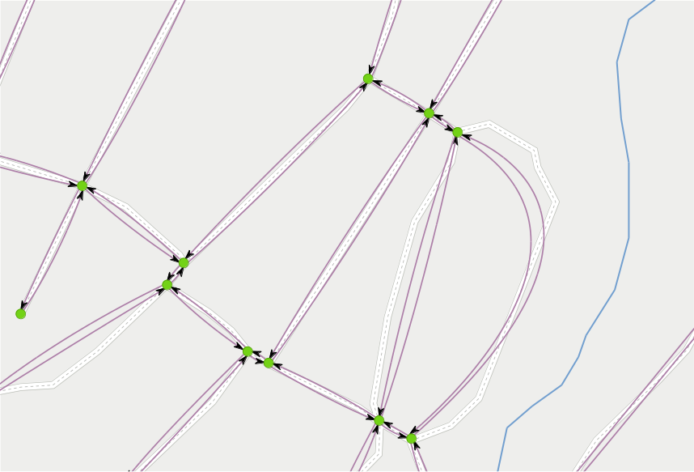
3. restrictions (directed graph)
Notes:
Now have DIRECTED graph
One edge per LANE
One-way = one edge

Slide 13
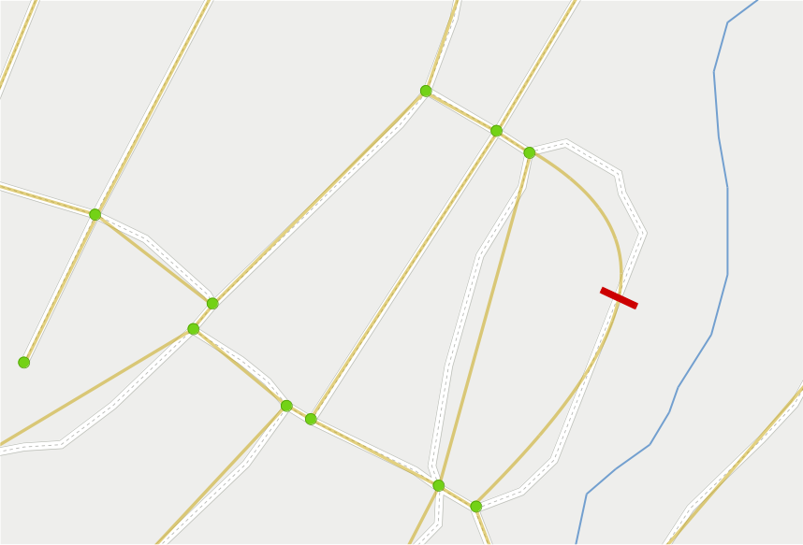
3. restrictions
Notes:
Back to restrictions:
Does not affect topology
Barrier stops travel via the road = no edge

Slide 14
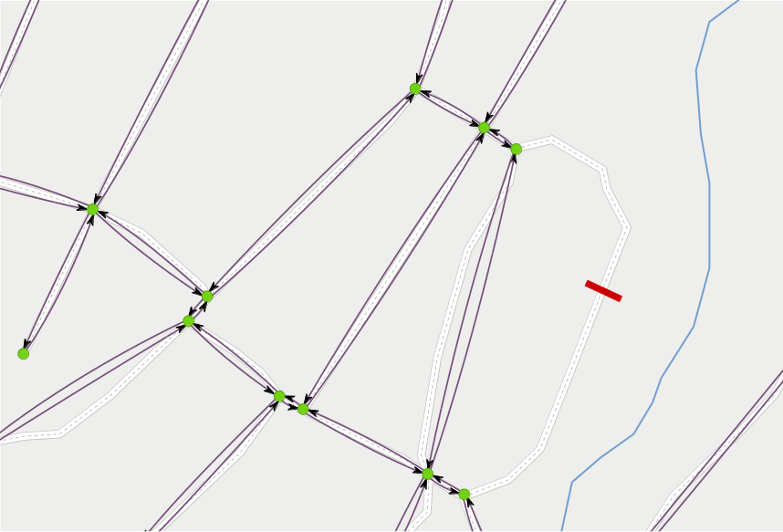
3. restrictions
Notes:
Barrier stops travel via the road = no edges
QUESTION:
What if target of route is among those edges?
- This line graph routing needs to be supplemented with short distance routing.

Slide 15
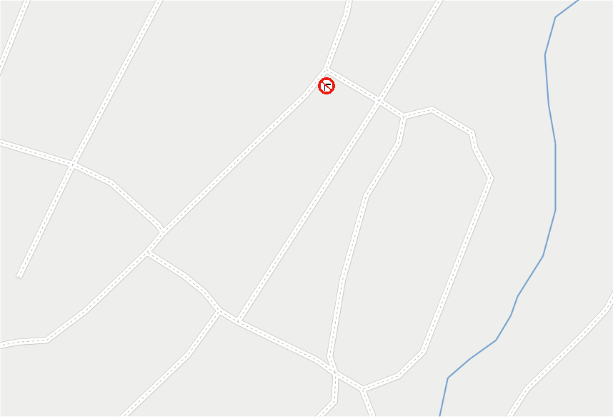
3. restrictions
Notes:
Turn restriction is different:
- RELATION between edges, not applied to ONE edge.

Slide 16
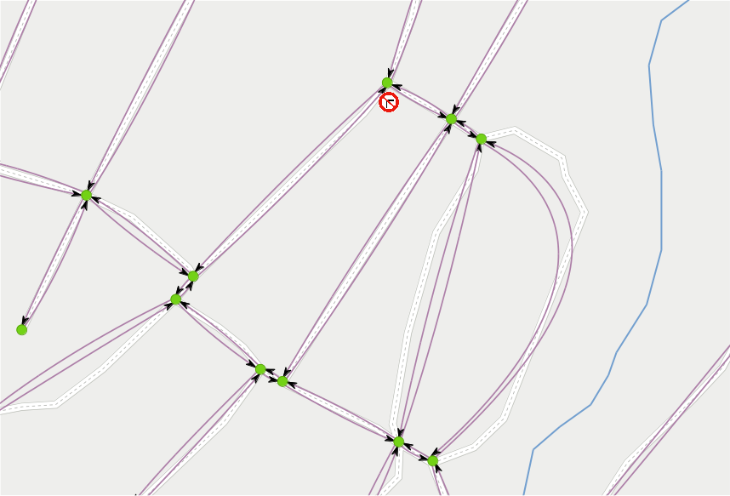
3. restrictions
Notes:
Turn restriction is different:
- RELATION between edges, not applied to ONE edge.
Means edges in graph does not disappear.

Slide 17
1
load map data
2
build topology
3
apply restrictions
4
build line graph
Notes:
Now we have a directed graph, with restrictions.
Time to build a line graph.
A line graph is a transformation of a graph.

Slide 18
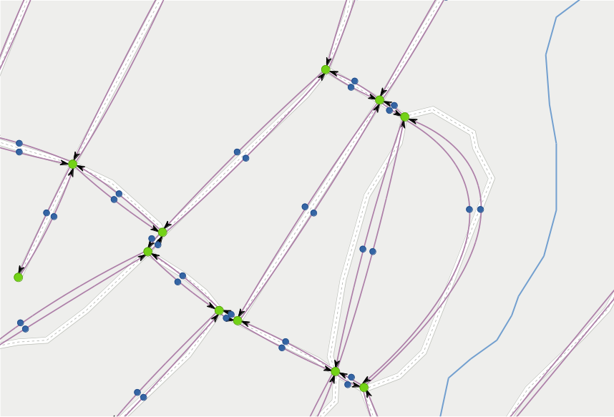
4. line graph
Notes:
The transformation:
Each edge in the graph is made to a “node” in the line graph.

Slide 19
4. line graph
Notes:
Then the nodes are connected with directed lines where travel is possible.
(Note: U-turns)
See: a lot more lines than there were edges → increase in space needs.
Line graph is not the most efficient technology.

Slide 20
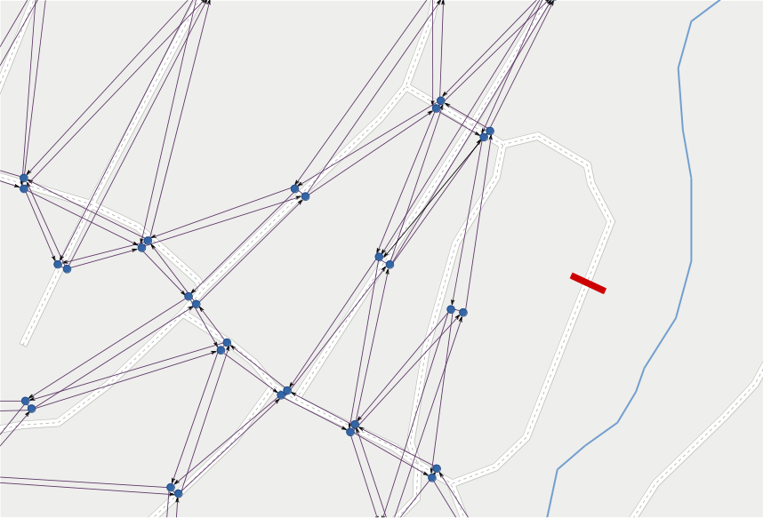
4. line graph
Notes:
When barrier: no edges → no nodes → no lines

Slide 21
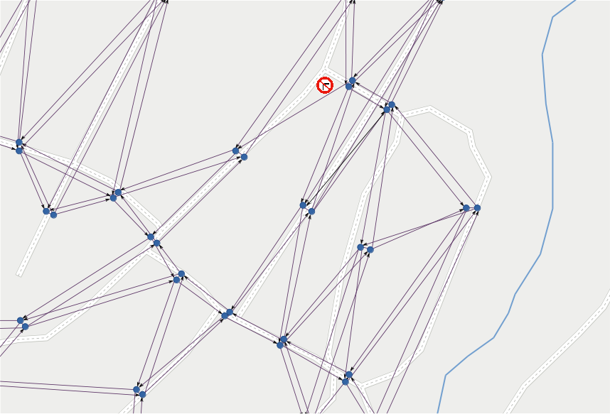
4. line graph
Notes:
When turn restriction: only affected line = turn disappears.

Slide 22
4. line graph
tool:
Boost graph library
typedef boost::adjacency_list
< boost::listS, boost::vecS, boost::directedS,
LineGraphNode, LineGraphLine >
LineGraphType;
Notes:
Module developed in c++
Requirement:
- Return line graph as a BOOST GRAPH data structure.
First time with boost.
- long template expressions,
- typedefs are necessary

Slide 23
remarks
Notes:
Solution:
Some remarks about solution

Slide 24
preliminary
load map data
build topology
on demand
apply restrictions
build line graph
Notes:
Preliminary:
Each time a new map is introduced or new roads are built (permanent changes to topology).
Might take some seconds per city.
On demand:
On each request by calling application.
This takes a couple hundred milliseconds.
Configurable:
Topology CAN be built on demand (but is slow).

Slide 25
configurable
json file
for settings
database, vehicle properties,
road speeds, surfaces,
restrictions and costs, ...
Notes:
Module should be configurable
Takes all settings from a json file

Slide 26
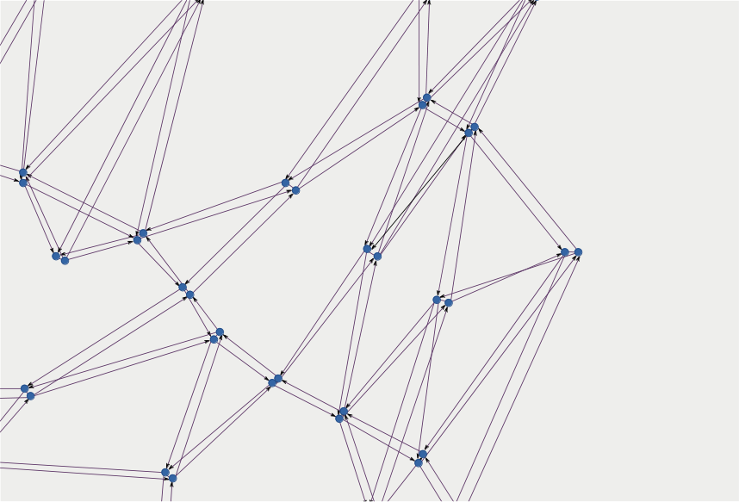
mapping IDs
OSM +
topology +
graph +
line graph
Notes:
Several layers of IDs.

Slide 27
restrictions
values:
yes, no, permissive, designated, private, discouraged, delivery, customers ...
routing:
one-way (explicit / implicit), lanes ...
transportation mode:
all, foot, vehicle, bicycle, motor_vehicle, motorcycle, motorcar, goods, hgv ...
by use:
psv, car_sharing, emergency, hazmat, disabled ...
dimensions:
max height, weight, width ...
Notes:
The hardest part in this project.
Not all implemented yet. Needs remodeling.
Hgv = heavy goods vehicle
Psv = Public service vehicle = bus, taxi

Slide 28
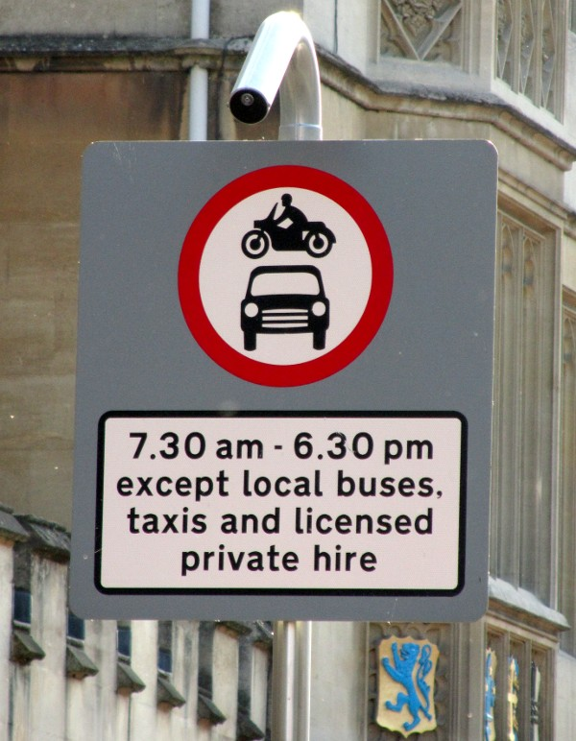
conditional
restrictions
Photo (cropped): Achadwick. ©CC-SA 2.0
http://wiki.openstreetmap.org/wiki/File:UK_motor_restriction_sign_with_exceptions.jpg
motor_vehicle=no
motor_vehicle:conditional=yes @ (18:30-07:30)
psv=yes
Notes:
Not implemented at all yet.

Slide 29
conditional
restrictions
maxspeed=none
maxspeed:conditional=
120 @ (06:00-20:00);
100 @ (22:00-06:00)
Notes:
Not implemented at all yet.
German highway.

Slide 30
turning
restrictions
Relation:
from → via → to
Notes:
Turning restrictions are RELATIONS,
Handled differently.
Problem for me as the importer tool
Osm2pgsql did not handle relations well.
Needs some parsing.
FROM edge
VIA vertex OR edge(s).
Difficult to handle edge case since the LGU cannot does not know enough about the route
TO edge

Slide 31
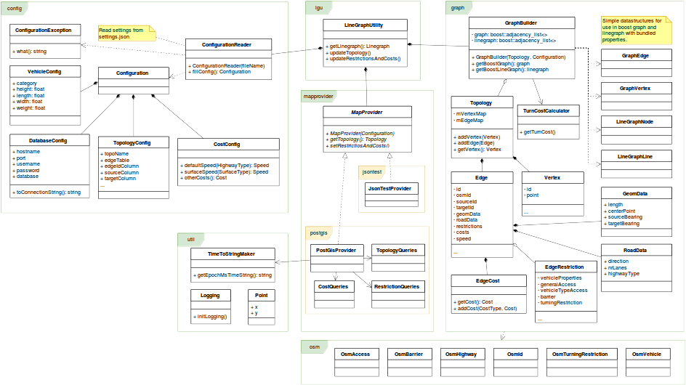
solution
class diagram
Notes:
Small look at the class diagram to give a view of the solution.
Packages:
- config
- graph
- lgu
- mapprovider
- osm
- util

Slide 32
LineGraph
Utility
Jonas Bergman, jobe0900@student.miun.se
Notes:
Have given overview of project:
Requirements, background and remarks about the solution.
Conclusion
OSM is messy = real traffic is messy?
Restrictions are hard. Need to rework them in the LineGraphUtility.

