Slide 1
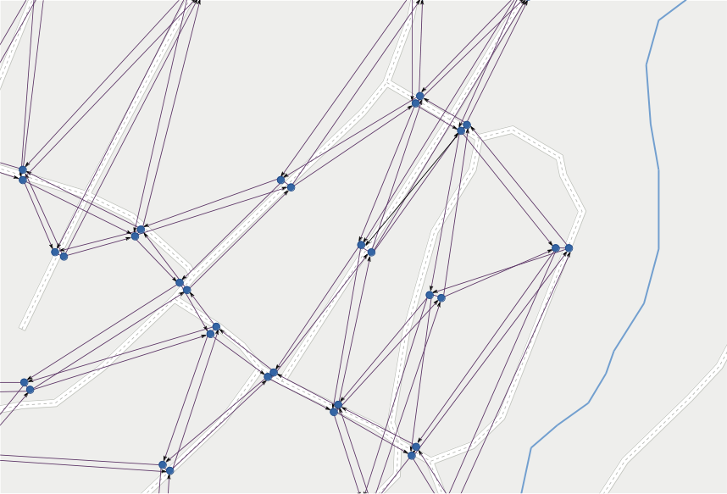
LineGraph
Utility
for
a software module
routing
public transportation
of
Jonas Bergman, jobe0900@student.miun.se
Notes:
This is a module,
I have no overview of complete project.
Aim: (I think)
No waiting at bus stops
Vehicles gets directed to customers
Drivers needs real-time directions
Updated with current traffic situation

Slide 2
1
background

Slide 3
1. background
flexible
managing
public transportation
Notes:
Flexible:
no timetables
customers ask for ride via app or phone
System calculates best routes
Drivers gets real-time instructions
Gain:
Company / World
Efficient use of fleet (less idle vehicles)
Environment++
Economy
Customers
Less waiting

Slide 4
1. background
no
flexible public transportation:
timetables
Notes:
Flexible:
no timetables
customers ask for ride via app or phone
System calculates best routes
Drivers gets real-time instructions
Gain:
Company / World
Efficient use of fleet (less idle vehicles)
Environment++
Economy
Customers
Less waiting

Slide 5
1. background
flexible public transportation:
- no timetables
commission
rides
Notes:
Flexible:
no timetables
customers order ride via app or phone
System calculates best routes
Drivers gets real-time instructions
Gain:
Company / World
Efficient use of fleet (less idle vehicles)
Environment++
Economy
Customers
Less waiting

Slide 6
1. background
flexible public transportation:
- no timetables
- commission rides
calculate
routes
Notes:
Flexible:
no timetables
customers order ride via app or phone
System calculates best routes
Drivers gets real-time instructions
Gain:
Company / World
Efficient use of fleet (less idle vehicles)
Environment++
Economy
Customers
Less waiting

Slide 7
1. background
flexible public transportation:
- no timetables
- commission rides
- calculate routes
update driving
instructions
Notes:
Flexible:
no timetables
customers order ride via app or phone
System calculates best routes
Drivers gets real-time instructions
Gain:
Company / World
Efficient use of fleet (less idle vehicles)
Environment++
Economy
Customers
Less waiting

Slide 8
1. background
flexible public transportation:
- no timetables
- commission rides
- calculate routes
- update driving instructions
gain?
Notes:
Flexible:
no timetables
customers order ride via app or phone
System calculates best routes
Drivers gets real-time instructions
Gain:
Company / World
Efficient use of fleet (less idle vehicles)
Environment++
Economy
Customers
Less waiting

Slide 9
1. background
flexible public transportation: gain?
less
+ economy
+ environment
idle vehicles
Notes:
Flexible:
no timetables
customers order ride via app or phone
System calculates best routes
Drivers gets real-time instructions
Gain:
Company / World
Efficient use of fleet (less idle vehicles)
Environment++
Economy
Customers
Less waiting

Slide 10
1. background
flexible public transportation: gain?
less
- less idle vehicles
waiting
Notes:
Flexible:
no timetables
customers order ride via app or phone
System calculates best routes
Drivers gets real-time instructions
Gain:
Company / World
Efficient use of fleet (less idle vehicles)
Environment++
Economy
Customers
Less waiting

Slide 11

1. background > maps & graphs
Notes:
Before moving on:
About MAPS & GRAPHS
Map:
Projection of reality on 2D-surface. Geometry.
Semantics about connection of roads.

Slide 12
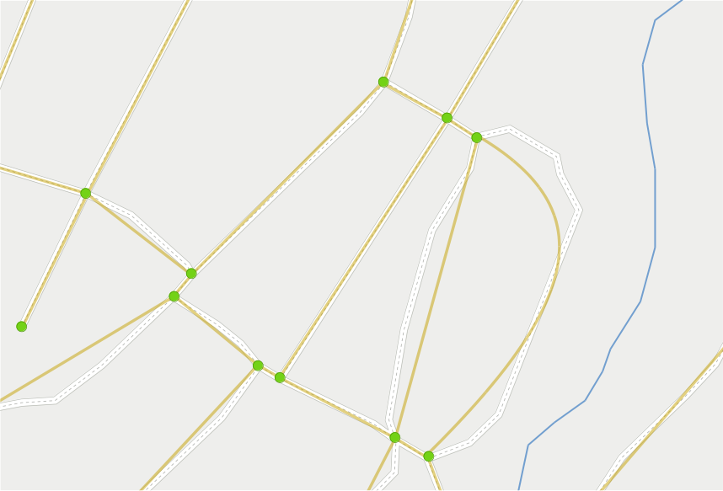
1. background > maps & graphs > topology
Notes:
When routing:
Interesting:
Connections
Relations
Not:
Geometry
TOPOLOGY
Undirected graph
Static as road network is stable
Terminology
Vertex = node, point, dot
Edge = arc, line

Slide 13
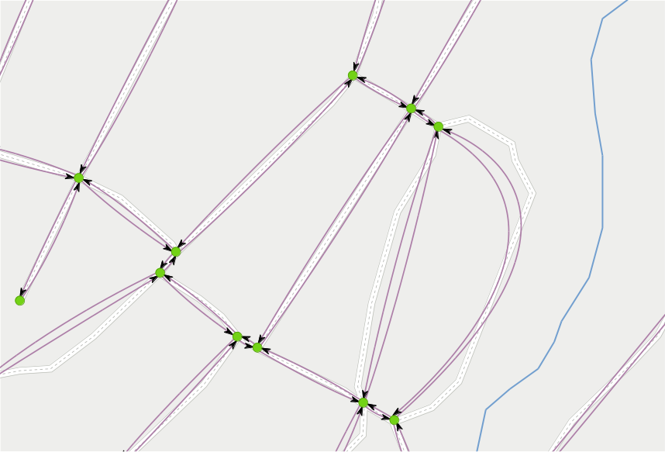
1. background > maps & graphs > directed graph
Notes:
To be able to apply dynamic restrictions to the static topology we construct a DIRECTED graph.
Specifies possible travel on roads in the map.
Each lane becomes an edge in correct direction.
One-way road = edge in one direction.
Several lanes = several parallel edges.

Slide 14
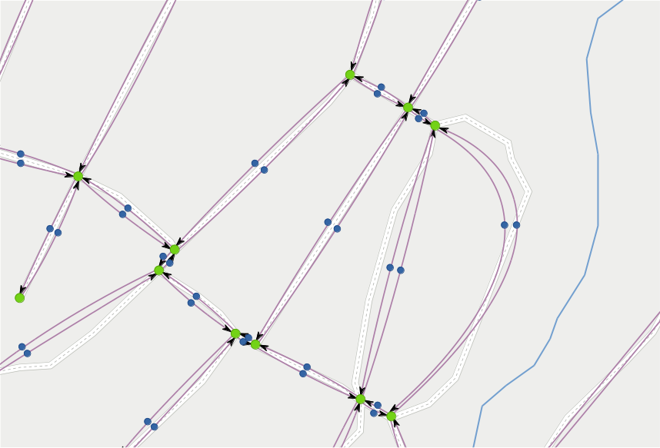
1. background > maps & graphs > line graph
Notes:
Last step: transform directed graph to LINE graph.
Specifies possible turns in the map.
Edge -> Node

Slide 15
1. background > maps & graphs > line graph
Notes:
Nodes connected with Lines where travel is allowed.
NOTE terminology:
Node + Line
Instead of
Vertex+ Edge

Slide 16
2
problem
statement

Slide 17
2. problem statement
software module
exposing a function
data
returning a
structure
for routing
in soft real-time
Notes:
Software module exposing function, returning data structure for routing in soft real-time.
Load map data.
Build topology
Consider restrictions and conditions.
Directed graph.
Restrictions.
Return data structure for routing decisions.
LineGraph.
Given set of tools:
C++, Boost Graph Library,
OpenStreetMap (crowd sourced, open).
PostGis (PostgreSQL + spatial data).
BDD/TDD

Slide 18
2. problem statement
software module
exposing a function
data
returning a
structure
for routing
in soft real-time
Notes:
Software module exposing function, returning data structure for routing in soft real-time.
Load map data.
Build topology
Consider restrictions and conditions.
Directed graph.
Restrictions.
Return data structure for routing decisions.
LineGraph.
Configurable settings in JSON.

Slide 19
2. problem statement
sequential operation:
load map data
build topology
apply restrictions
build directed graph
return line graph
Notes:
HOW:
Sequential operation:
Preliminary step:
Load map data.
Build topology
On demand
Consider restrictions and conditions.
Directed graph.
Restrictions.
Return data structure for routing decisions.
LineGraph.
Calculate costs =
Travel time on from edge
(length + speed + surface) +
Restriction costs (speed bumps...) +
Turn costs (angle + vehicle props ...)

Slide 20
2. problem statement
sequential operation:
load map data
build topology
apply restrictions
build directed graph
return line graph
Notes:
Diversion:
Applying restrictions to the graphs.

Slide 21
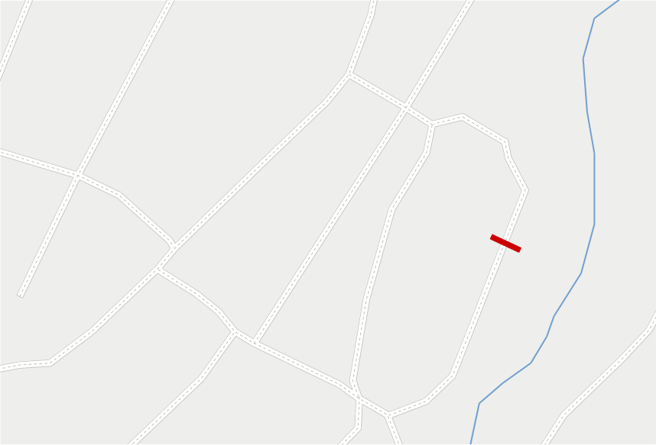
2. problem statement > applying restrictions > map
Notes:
Dynamic restriction like road work = closed road.

Slide 22
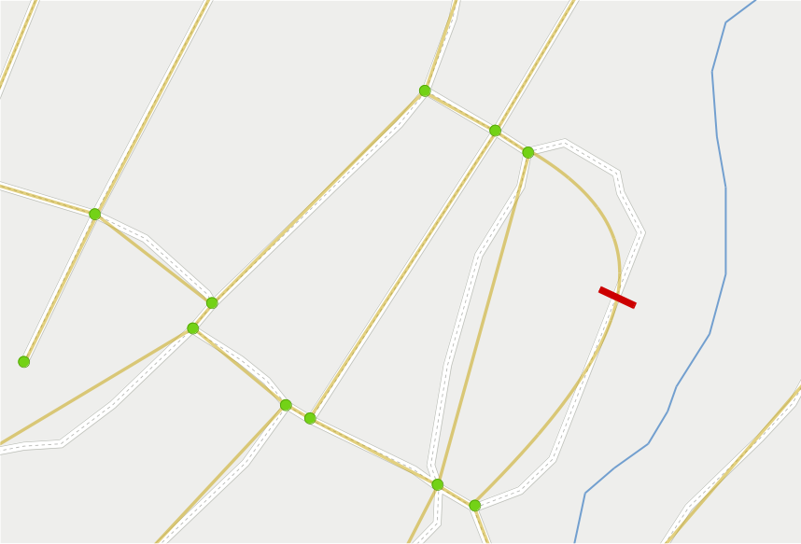
2. problem statement > applying restrictions > topology
Notes:
Dynamic restriction like road work = closed road.
Topology not affected.

Slide 23
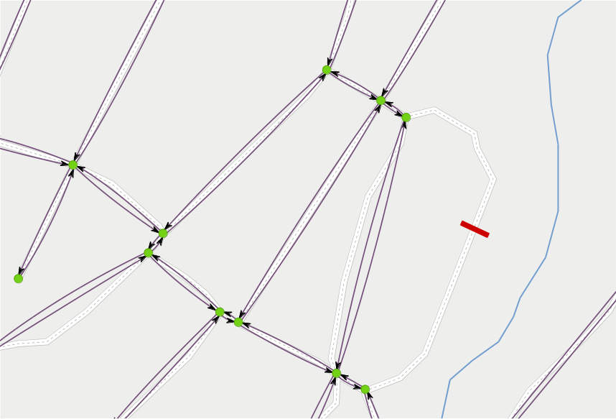
2. problem statement > applying restrictions > directed graph
Notes:
Dynamic restriction like road work = closed road.
Topology not affected
Directed graph = travel along roads → no edges.

Slide 24
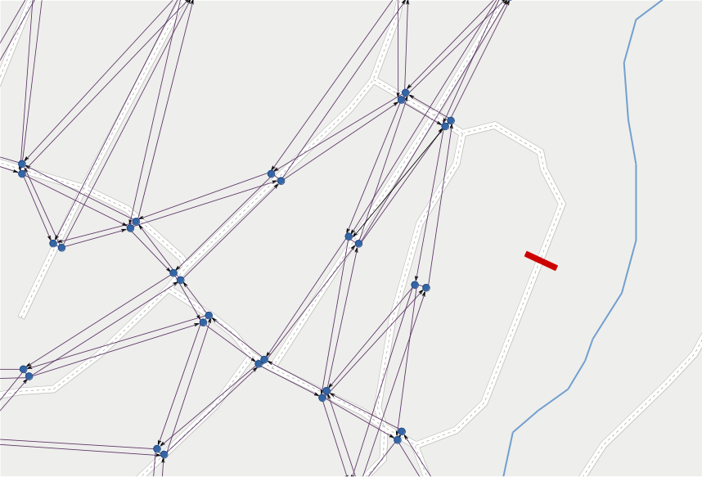
2. problem statement > applying restrictions > line graph
Notes:
Dynamic restriction like road work = closed road.
Topology not affected
Directed graph = travel along roads → no edges.
Line graph = transformed graph.
No edges → no nodes → no lines

Slide 25
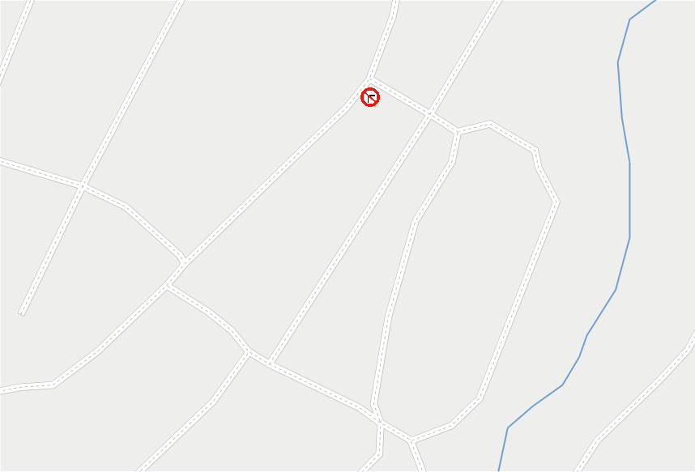
2. problem statement > applying restrictions > map
Notes:
Static restriction like “No turn”
Topology not affected

Slide 26
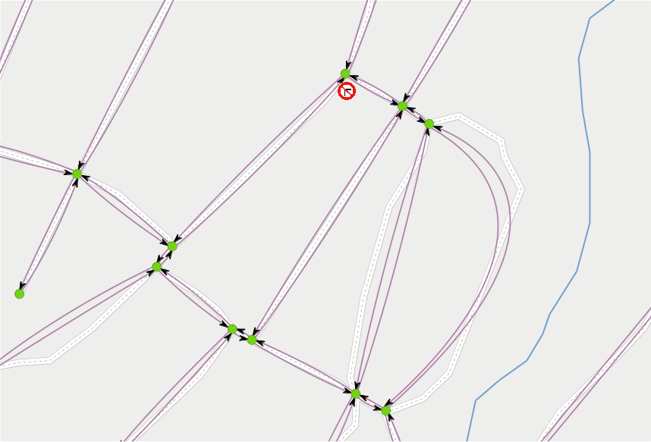
2. problem statement > applying restrictions > directed graph
Notes:
Static restriction like “No turn”
Topology not affected
Directed graph = travel along roads → not affected.

Slide 27
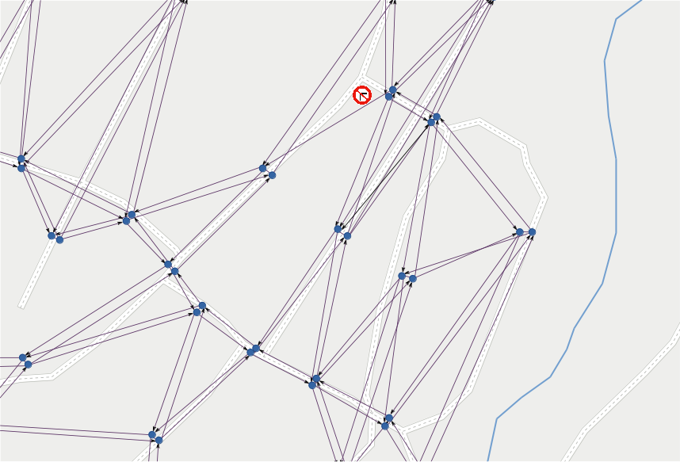
2. problem statement > applying restrictions > line graph
Notes:
Static restriction like “No turn”
Topology not affected
Directed graph = travel along roads → not affected.
Line graph = allowed turns.
Edges → nodes
BUT
Not allowed turn→ no line

Slide 28
2. problem statement
sequential operation:
load map data
preliminary
build topology
apply restrictions
build directed graph
return line graph
Notes:
HOW:
Sequential operation:
Preliminary step: (static road network)
Load map data.
Build topology
On demand: (dynamic)
Consider restrictions and conditions.
Directed graph.
Restrictions.
Return data structure for routing decisions.
LineGraph.

Slide 29
2. problem statement
sequential operation:
load map data
build topology
apply restrictions
build directed graph
on demand
return line graph
Notes:
HOW:
Sequential operation:
Preliminary step: (static road network)
Load map data.
Build topology
On demand: (dynamic)
Consider restrictions and conditions.
Directed graph.
Restrictions.
Return data structure for routing decisions.
LineGraph.

Slide 30
C++
2. problem statement
required tools:
Notes:
Given set of tools:
C++, Boost Graph Library,
OpenStreetMap (crowd sourced, open).
PostGis (PostgreSQL + spatial data).

Slide 31
2. problem statement
required tools:
map data
Notes:
Given set of tools:
C++, Boost Graph Library,
OpenStreetMap (crowd sourced, open).
PostGis (PostgreSQL + spatial data).

Slide 32
2. problem statement
required tools:
map data
OpenStreetMap
Notes:
Given set of tools:
C++, Boost Graph Library,
OpenStreetMap (crowd sourced, open).
PostGis (PostgreSQL + spatial data).

Slide 33
2. problem statement
required tools:
map data
OpenStreetMap
PostGIS
Notes:
Given set of tools:
C++, Boost Graph Library,
OpenStreetMap (crowd sourced, open).
PostGis (PostgreSQL + spatial data).

Slide 34
2. problem statement
required tools:
graph data structures
Notes:
Given set of tools:
C++, Boost Graph Library,
OpenStreetMap (crowd sourced, open).
PostGis (PostgreSQL + spatial data).

Slide 35
2. problem statement
required tools:
graph data structures
Boost
graph
library
Notes:
Given set of tools:
C++, Boost Graph Library,
OpenStreetMap (crowd sourced, open).
PostGis (PostgreSQL + spatial data).

Slide 36
3
method

Slide 37
3. method
requirement:
behavior
test
or
driven
development
(BDD/TDD)
Notes:
Requirement
BDD or TDD

Slide 38
3. method
behavior
(BDD)
driven
development
Scenario: Vectors can be sized and resized
Given: A vector with some items
When: The size is increased
Then: The size and capacity change
Notes:
BDD test cases:
Scenario
Given
When
Then

Slide 39
3. method > tools
tools
Notes:
Tools
Some were given, others I have spent a lot of time investigating.

Slide 40
3. method > tools > BDD
Catch
#define CATCH_CONFIG_MAIN
#include "catch.hpp"
#include <vector>
SCENARIO ("Vectors can be sized and resized", "[vector]") {
GIVEN ("A vector with some items") {
std::vector<int> v(5);
REQUIRE (v.size() == 5);
REQUIRE (v.capacity() >= 5);
WHEN ("The size is increased") {
v.resize(10);
THEN ("The size and capacity change") {
REQUIRE (v.size() == 10);
REQUIRE (v.capacity() >= 10);
}
}
}
}
Notes:
Catch
Header only
Easy to use

Slide 41
3. method > tools > json
Boost Property Tree
#include <string>
#include <iostream>
#include <boost/property_tree/ptree.hpp>
#include <boost/property_tree/json_parser.hpp>
void readJsonFile(const std::string& filename) {
boost::property_tree::ptree pt;
boost::property_tree::read_json(filename, pt);
std::string host = pt.get<std::string>("host");
int port = pt.get<int>("port");
std::cout << "Host: " << host << ", port: " << port << std::endl;
}
Notes:
Reading settings from json
Boost Property Tree
As already using Boost in project

Slide 42
3. method > tools > load map data
osm2pgsql
source:
OpenStreetMap
load:
$ osm2pgsql -U user -d map_db -s -k mapdata.osm
store:
PostGIS
Notes:
Loading map data
From .osm file
Into PostGIS
Lots of different tools
Osm2pgsql OK, but weak on relations and conditional tags...

Slide 43
3. method > tools > load map data
osm2pgsql + postgis_topology
source:
OpenStreetMap
load:
$ osm2pgsql -U user -d map_db -s -k mapdata.osm
store:
PostGIS
build topology:
$ psql -U user -d map_db
-c "SELECT topology.CreateTopology(’roads_topo’, 900913);"
Notes:
Loading map data
Build topology
postgis_topology
Extension to PostGIS

Slide 44
3. method > tools > work with DB
libpqxx
#include <pqxx/pqxx>
//...
pqxx::connection conn(
"dbname=testdb"
"user=tester"
"password=tester"
"hostaddr=127.0.0.1"
"port=5432");
link:
$ g++ mytest.cpp -lpqxx -lpq -o mytest
Notes:
Work against DB
Libpqxx
Official library
Needs linking

Slide 45
3. method > tools > data structures
Boost Graph Library
property lists
typedef boost::adjacency_list<
boost::listS, boost::vecS, boost::bidirectionalS,
// Vertex properties
boost::property< boost::vertex_name_t, std::string,
boost::property< population_t, int,
boost::property< zipcodes_t, std::vector<int> > > >,
// Edge properties
boost::property< boost::edge_name_t, std::string,
boost::property< boost::edge_weight_t, double,
boost::property< edge_speed_limit_t, int,
boost::property< edge_lanes_t, int,
boost::property< edge_divided, bool> > > > > >
Map;
Notes:
BGL
Hard to read with property lists
Bundled templates...

Slide 46
3. method > tools > data structures
Boost Graph Library
bundled properties
struct City {
string name;
int population;
vector<int> zipcodes;
};
struct Highway {
string name;
double miles;
int speed_limit;
int lanes;
bool divided;
};
typedef boost::adjacency_list<
boost::listS, boost::vecS, boost::bidirectionalS,
City, Highway>
Map;
Notes:
BGL
Bundled properties are more understandable
Happy to have found them!

Slide 47
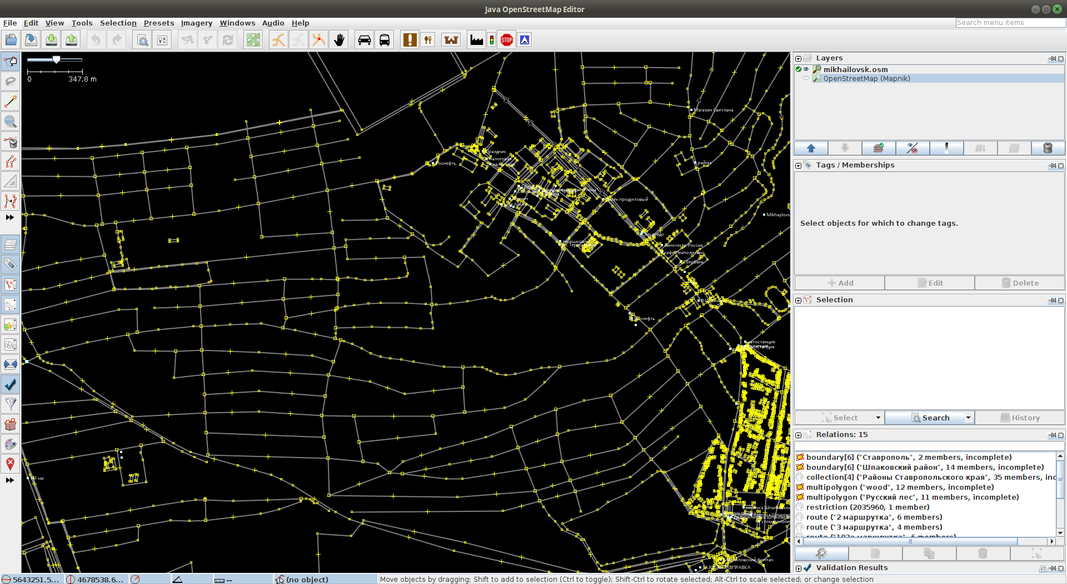
3. method > tools > edit map data
JOSM
Notes:
JOSM
Edit map data
Add restrictions for testing

Slide 48
4
results

Slide 49
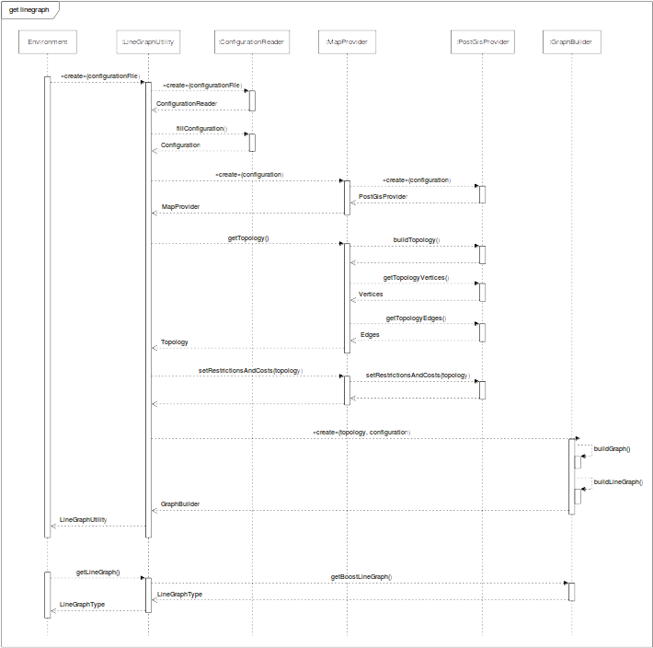
4. results >
design
Notes:
Main use case
Instantiate LineGraphUtility
Load Configuration
Instantiate correct MapProvider
Get Topology
Apply Restrictions and Costs
Instantiate GraphBuilder
Get LineGraph

Slide 50
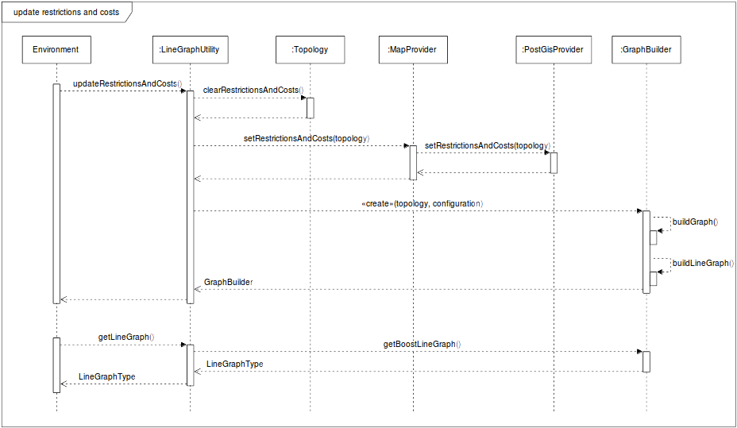
4. results > design
Notes:
Update Restrictions and Costs
Clear Restrictions and Cost from Topology
Apply Restrictions and Costs
Instantiate GraphBuilder
(Get LineGraph)

Slide 51
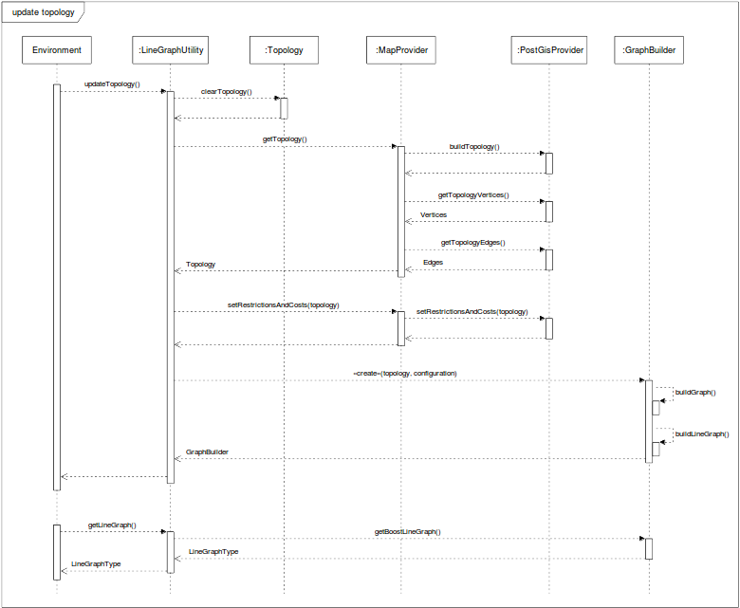
4. results > design
Notes:
Update Topology
Clear Topology
Read in new Topology
Apply Restrictions and Costs
Instantiate GraphBuilder
(Get LineGraph)

Slide 52
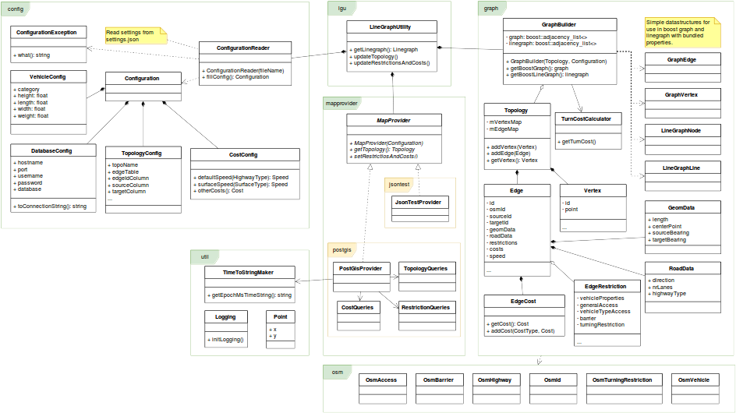
4. results > design
Notes:
Class diagram
Packages:
config
graph
lgu
mapprovider
osm
util

Slide 53
4. results
tests
Notes:
Results:
Tests performed during development asserts that software produces wished results.

Slide 54
4. results
specification fulfillment
restrictions
except
restrictions
most edge, no conditional ...
tests
Notes:
Results:
Tests performed during development asserts that software produces wished results.
The specification is fulfilled,
Except for Restrictions (conditional)

Slide 55
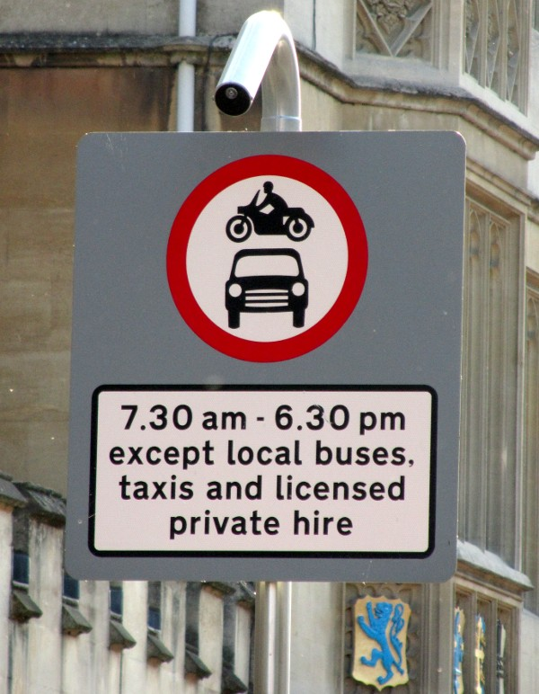
4. results
except
conditional
Photo (cropped): Achadwick. ©CC-SA 2.0
http://wiki.openstreetmap.org/wiki/File:UK_motor_restriction_sign_with_exceptions.jpg
restrictions
motor_vehicle=no
motor_vehicle:conditional=yes @ (18:30-07:30)
psv=yes
Notes:
Results:
Tests performed during development asserts that software produces wished results.
The specification is fulfilled,
Except for Restrictions (conditional)
Example conditional restriction

Slide 56
4. results
specification fulfillment
restrictions
except
restrictions
most edge, no conditional ...
conditions
tests
time of day, inclination ...
Notes:
Results:
Tests performed during development asserts that software produces wished results.
The specification is fulfilled,
Except for Restrictions (conditional)
And Conditions

Slide 57
4. results
specification fulfillment
restrictions
except
restrictions
most edge, no conditional ...
conditions
tests
time of day, inclination ...
performance
Notes:
Results:
Tests performed during development asserts that software produces wished results.
The specification is fulfilled,
Except for Restrictions (conditional)
And Conditions
Performance test

Slide 58
4. results
test graph sizes
 | Graph |  | Line graph
 | vertices | edges | nodes | lines
Mikhailovsk | 654 | 1618 | 1618 | 4758
Partille | 1645 | 2265 | 2265 | 5577
time to get line graph
average of 100 rounds
Topology |  | get LineGraph (s)
Mikhailovsk | pre-built | 0.143171
 | on demand | 4.936007
Partille | pre-built | 0.182152
 | on demand | 10.557756
performance
Notes:
Results:
Tests performed during development asserts that software produces wished results.
The specification is fulfilled,
Except for Restrictions (conditional)
And Conditions
Performance test
Result:
Fetch a Line Graph
Topology pre-built / on demand
Soft real-time?

Slide 59
4. results
specification fulfillment
restrictions
except
restrictions
most edge, no conditional ...
conditions
tests
time of day, inclination ...
performance
visual examination
Notes:
Results:
Tests performed during development asserts that software produces wished results.
The specification is fulfilled,
Except for Restrictions (conditional)
And Conditions
Performance test
Visual examination

Slide 60
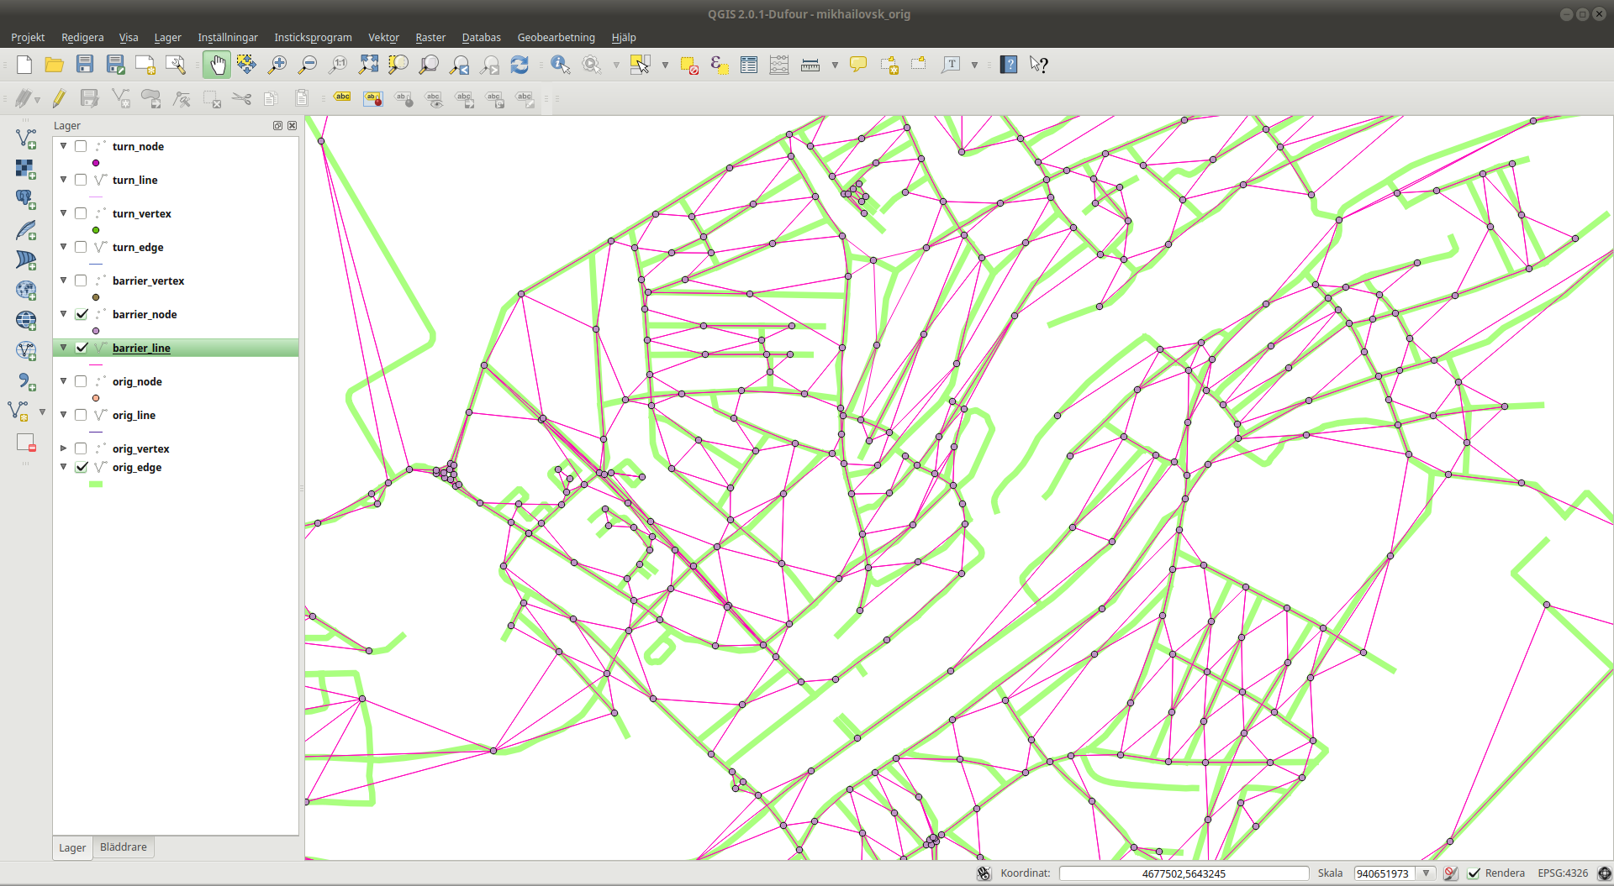
4. results
visual examination
QGIS
Notes:
Results:
Tests performed during development asserts that software produces wished results.
The specification is fulfilled,
Except for Restrictions (conditional)
And Conditions
Performance test
Visual examination
Load data in QGIS, looks correct?

Slide 61
5
conclusions

Slide 62
5. conclusions
working
incomplete
but
due to
time
late specification
complex restrictions
Notes:
Module:
Working but incomplete
Late from start
Stress, suboptimal decisions (?)
Business logic for restrictions
Much more complex than thought

Slide 63
6
future
work

Slide 64
6. future work
re-model
restrictions
<restriction-type>[:<transportation mode>][:<direction>]:conditional
= <restriction-value> @ <condition>[;<restriction-value> @ <condition>]
Notes:
What remains:
It is possible to keep on working with the restrictions, but needs re-modeling.
Possibly using the syntax as a base for a more generic restriction class.

Slide 65
LineGraph
Utility
Jonas Bergman, jobe0900@student.miun.se
Notes:
Have presented my exam project.

