Slide 1
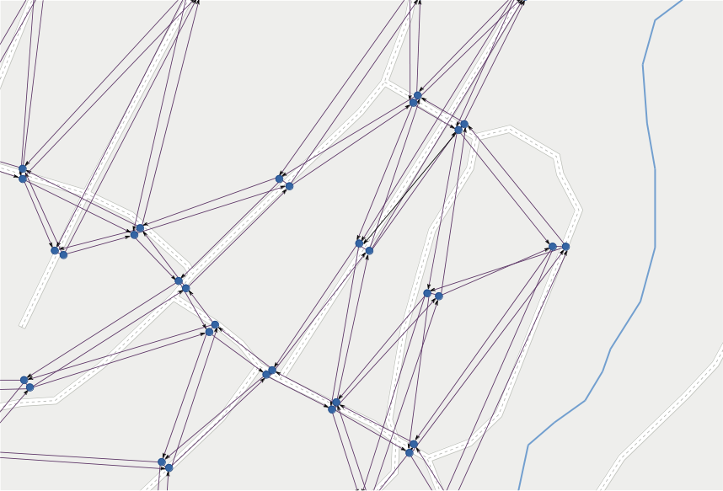
LineGraph
Utility
Jonas Bergman, jobe0900@student.miun.se
Notes:
This is a module,
I have no overview of complete project.
Aim: (I think)
No waiting at bus stops
Vehicles gets directed to customers
Drivers needs real-time directions
Updated with current traffic situation

Slide 2
LineGraph
Utility
a software module
Jonas Bergman, jobe0900@student.miun.se
Notes:
This is a module,
I have no overview of complete project.
Aim: (I think)
No waiting at bus stops
Vehicles gets directed to customers
Drivers needs real-time directions
Updated with current traffic situation

Slide 3
LineGraph
Utility
for
a software module
routing
Jonas Bergman, jobe0900@student.miun.se
Notes:
This is a module,
I have no overview of complete project.
Aim: (I think)
No waiting at bus stops
Vehicles gets directed to customers
Drivers needs real-time directions
Updated with current traffic situation

Slide 4
LineGraph
Utility
for
a software module
routing
public transportation
of
Jonas Bergman, jobe0900@student.miun.se
Notes:
This is a module,
I have no overview of complete project.
Aim: (I think)
No waiting at bus stops
Vehicles gets directed to customers
Drivers needs real-time directions
Updated with current traffic situation

Slide 5
1
background

Slide 6
1. background
flexible
managing
public transportation
Notes:
Flexible:
no timetables
customers ask for ride via app or phone
System calculates best routes
Drivers gets real-time instructions
Gain:
Company / World
Efficient use of fleet (less idle vehicles)
Environment++
Economy
Customers
Less waiting

Slide 7
1. background
no
flexible public transportation:
timetables
Notes:
Flexible:
no timetables
customers ask for ride via app or phone
System calculates best routes
Drivers gets real-time instructions
Gain:
Company / World
Efficient use of fleet (less idle vehicles)
Environment++
Economy
Customers
Less waiting

Slide 8
1. background
flexible public transportation:
- no timetables
commission
rides
Notes:
Flexible:
no timetables
customers order ride via app or phone
System calculates best routes
Drivers gets real-time instructions
Gain:
Company / World
Efficient use of fleet (less idle vehicles)
Environment++
Economy
Customers
Less waiting

Slide 9
1. background
flexible public transportation:
- no timetables
- commission rides
calculate
routes
Notes:
Flexible:
no timetables
customers order ride via app or phone
System calculates best routes
Drivers gets real-time instructions
Gain:
Company / World
Efficient use of fleet (less idle vehicles)
Environment++
Economy
Customers
Less waiting

Slide 10
1. background
flexible public transportation:
- no timetables
- commission rides
- calculate routes
update driving
instructions
Notes:
Flexible:
no timetables
customers order ride via app or phone
System calculates best routes
Drivers gets real-time instructions
Gain:
Company / World
Efficient use of fleet (less idle vehicles)
Environment++
Economy
Customers
Less waiting

Slide 11
1. background
flexible public transportation:
- no timetables
- commission rides
- calculate routes
- update driving instructions
gain?
Notes:
Flexible:
no timetables
customers order ride via app or phone
System calculates best routes
Drivers gets real-time instructions
Gain:
Company / World
Efficient use of fleet (less idle vehicles)
Environment++
Economy
Customers
Less waiting

Slide 12
1. background
flexible public transportation: gain?
less
idle vehicles
Notes:
Flexible:
no timetables
customers order ride via app or phone
System calculates best routes
Drivers gets real-time instructions
Gain:
Company / World
Efficient use of fleet (less idle vehicles)
Environment++
Economy
Customers
Less waiting

Slide 13
1. background
flexible public transportation: gain?
less
+ environment
idle vehicles
Notes:
Flexible:
no timetables
customers order ride via app or phone
System calculates best routes
Drivers gets real-time instructions
Gain:
Company / World
Efficient use of fleet (less idle vehicles)
Environment++
Economy
Customers
Less waiting

Slide 14
1. background
flexible public transportation: gain?
less
+ economy
+ environment
idle vehicles
Notes:
Flexible:
no timetables
customers order ride via app or phone
System calculates best routes
Drivers gets real-time instructions
Gain:
Company / World
Efficient use of fleet (less idle vehicles)
Environment++
Economy
Customers
Less waiting

Slide 15
1. background
flexible public transportation: gain?
less
- less idle vehicles
waiting
Notes:
Flexible:
no timetables
customers order ride via app or phone
System calculates best routes
Drivers gets real-time instructions
Gain:
Company / World
Efficient use of fleet (less idle vehicles)
Environment++
Economy
Customers
Less waiting

Slide 16

1. background > maps & graphs
Notes:
Before moving on:
About MAPS & GRAPHS
Map:
Projection of reality on 2D-surface. Geometry.
Semantics about connection of roads.

Slide 17
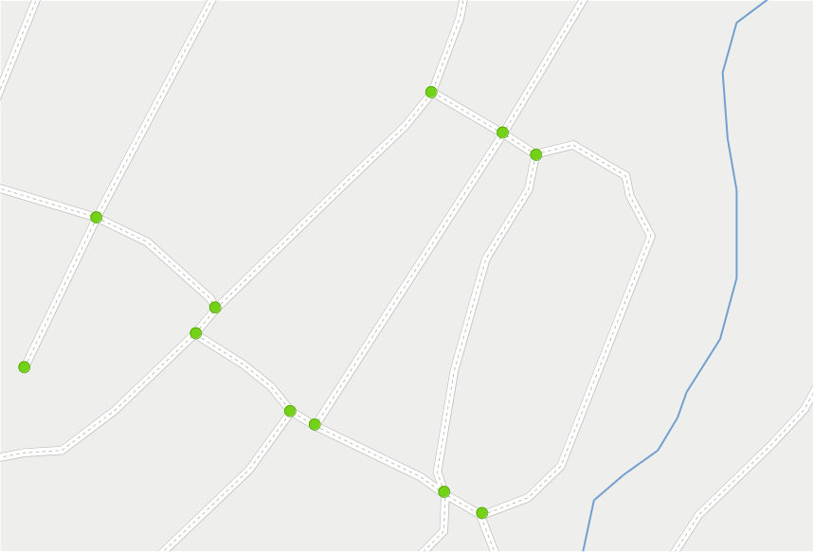
1. background > maps & graphs
Notes:
When routing:
Interesting:
Connections

Slide 18
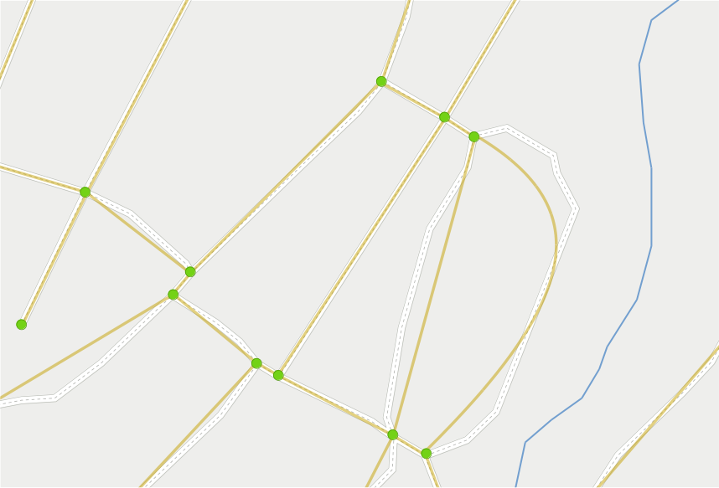
1. background > maps & graphs > topology
Notes:
When routing:
Interesting:
Connections
Relations
Not:
Geometry
TOPOLOGY
Undirected graph
Static as road network is stable

Slide 19
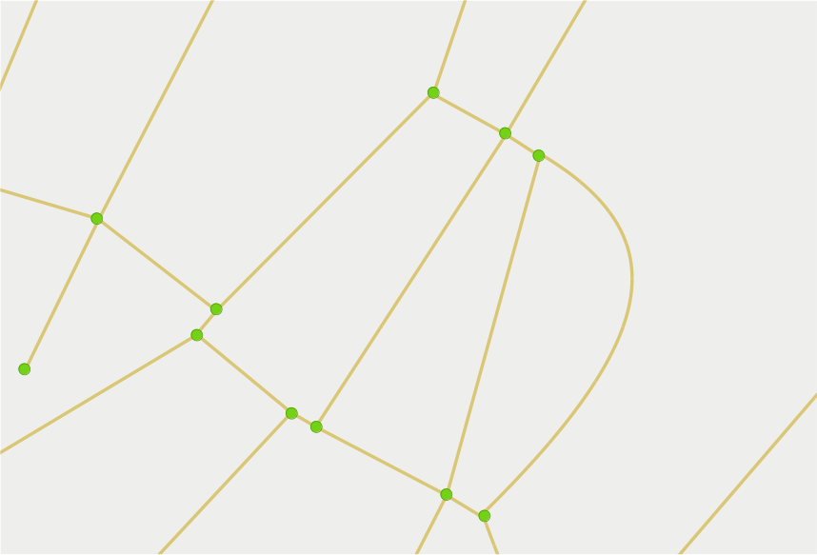
1. background > maps & graphs > topology
vertex
edge
Notes:
Terminology
Vertex = node, point, dot
Edge = arc, line

Slide 20
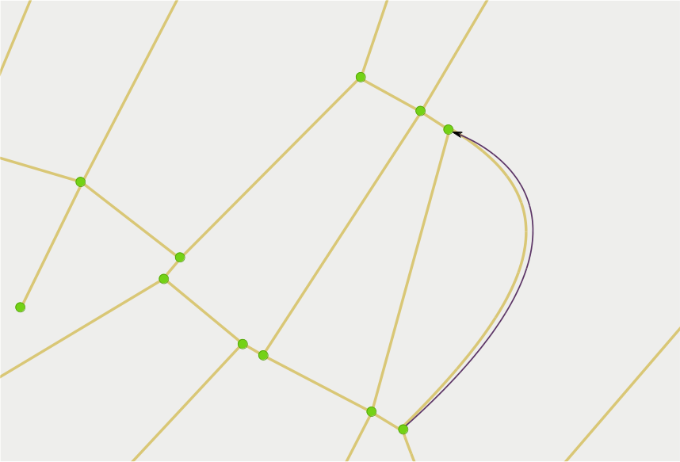
1. background > maps & graphs > directed graph
Notes:
To be able to apply dynamic restrictions to the static topology we construct a DIRECTED graph.
Specifies possible travel on roads in the map.
Each lane becomes an edge in correct direction.
One-way road = edge in one direction.
Several lanes = several parallel edges.

Slide 21
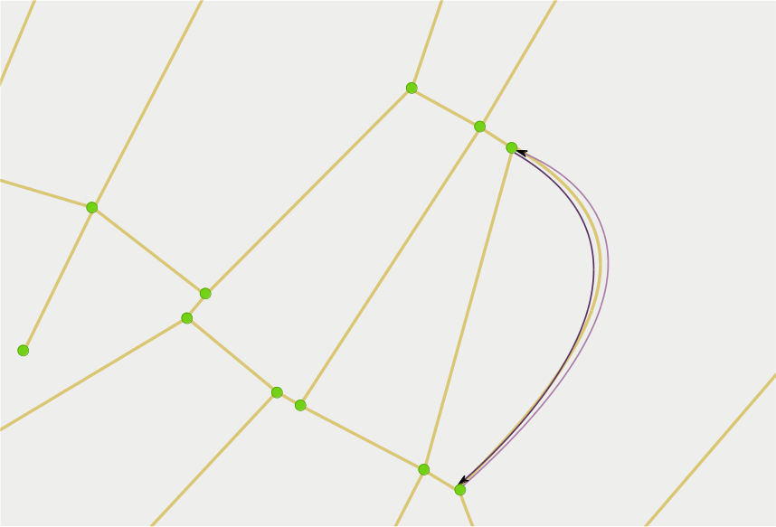
1. background > maps & graphs > directed graph
Notes:
To be able to apply dynamic restrictions to the static topology we construct a DIRECTED graph.
Specifies possible travel on roads in the map.
Each lane becomes an edge in correct direction.
One-way road = edge in one direction.
Several lanes = several parallel edges.

Slide 22
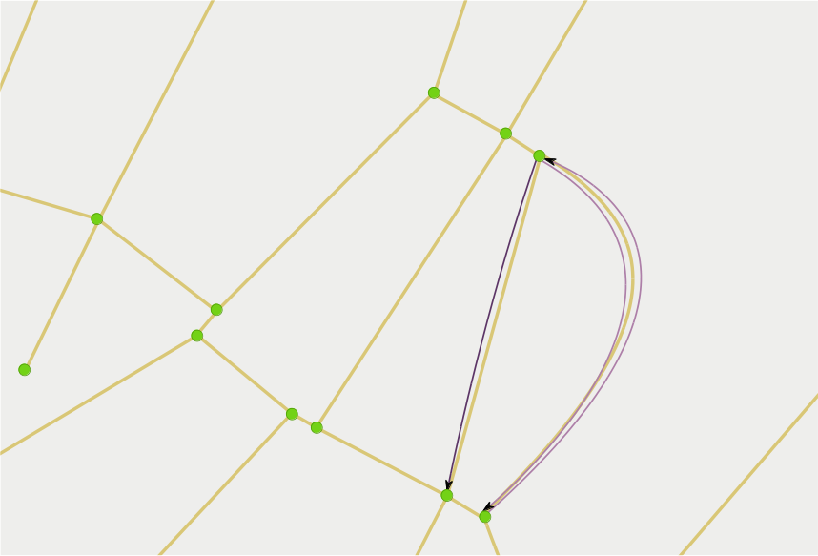
1. background > maps & graphs > directed graph
Notes:
To be able to apply dynamic restrictions to the static topology we construct a DIRECTED graph.
Specifies possible travel on roads in the map.
Each lane becomes an edge in correct direction.
One-way road = edge in one direction.
Several lanes = several parallel edges.

Slide 23
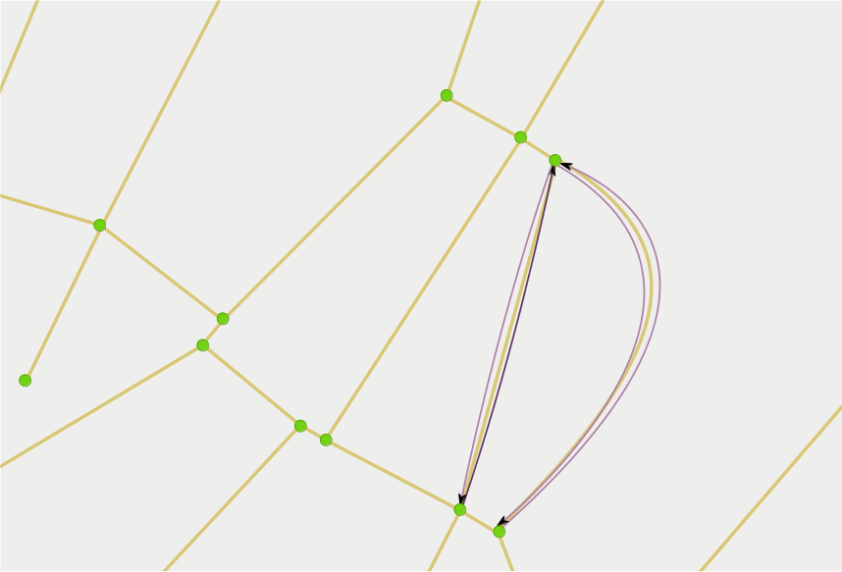
1. background > maps & graphs > directed graph
Notes:
To be able to apply dynamic restrictions to the static topology we construct a DIRECTED graph.
Specifies possible travel on roads in the map.
Each lane becomes an edge in correct direction.
One-way road = edge in one direction.
Several lanes = several parallel edges.

Slide 24
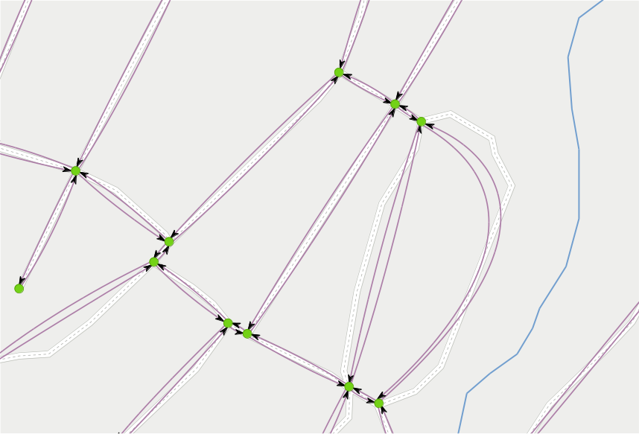
1. background > maps & graphs > directed graph
Notes:
To be able to apply dynamic restrictions to the static topology we construct a DIRECTED graph.
Specifies possible travel on roads in the map.
Each lane becomes an edge in correct direction.
One-way road = edge in one direction.
Several lanes = several parallel edges.

Slide 25

1. background > maps & graphs > line graph
Notes:
Last step: transform directed graph to LINE graph.
Specifies possible turns in the map.
Edge -> Node

Slide 26

1. background > maps & graphs > line graph
Notes:
Last step: transform directed graph to LINE graph.
Specifies possible turns in the map.
Edge -> Node

Slide 27

1. background > maps & graphs > line graph
Notes:
Last step: transform directed graph to LINE graph.
Specifies possible turns in the map.
Edge -> Node

Slide 28

1. background > maps & graphs > line graph
Notes:
Last step: transform directed graph to LINE graph.
Specifies possible turns in the map.
Edge -> Node

Slide 29
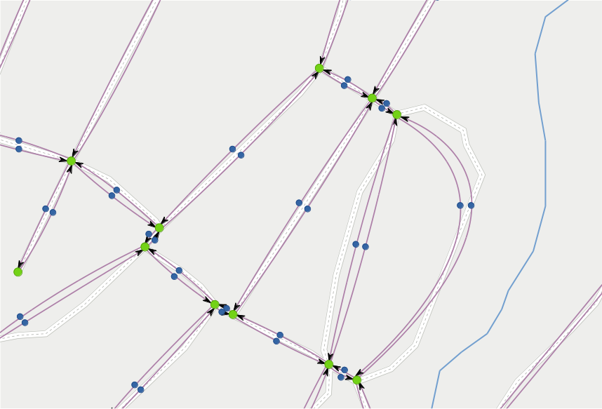
1. background > maps & graphs > line graph
Notes:
Last step: transform directed graph to LINE graph.
Specifies possible turns in the map.
Edge -> Node

Slide 30
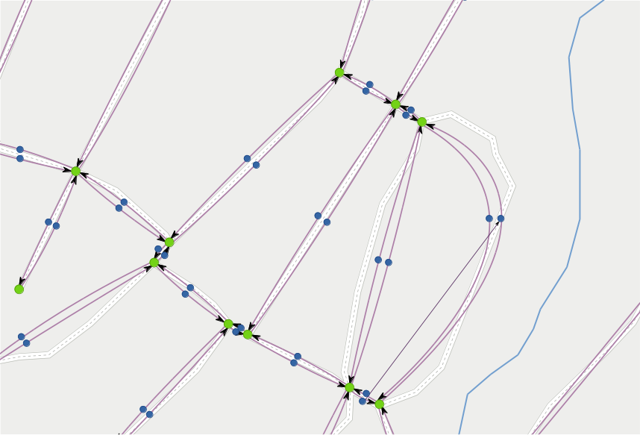
1. background > maps & graphs > line graph
Notes:
Nodes connected with Lines where travel is allowed.
NOTE terminology:
Node + Line
Instead of
Vertex+ Edge

Slide 31
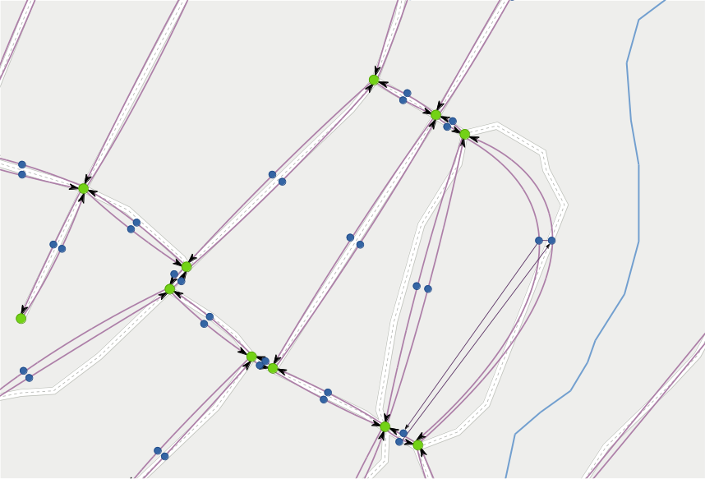
1. background > maps & graphs > line graph
Notes:
Nodes connected with Lines where travel is allowed.
NOTE terminology:
Node + Line
Instead of
Vertex+ Edge

Slide 32
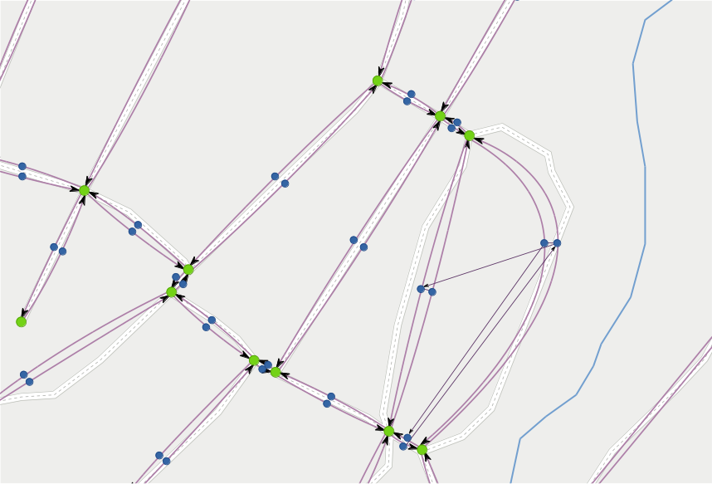
1. background > maps & graphs > line graph
Notes:
Nodes connected with Lines where travel is allowed.
NOTE terminology:
Node + Line
Instead of
Vertex+ Edge

Slide 33
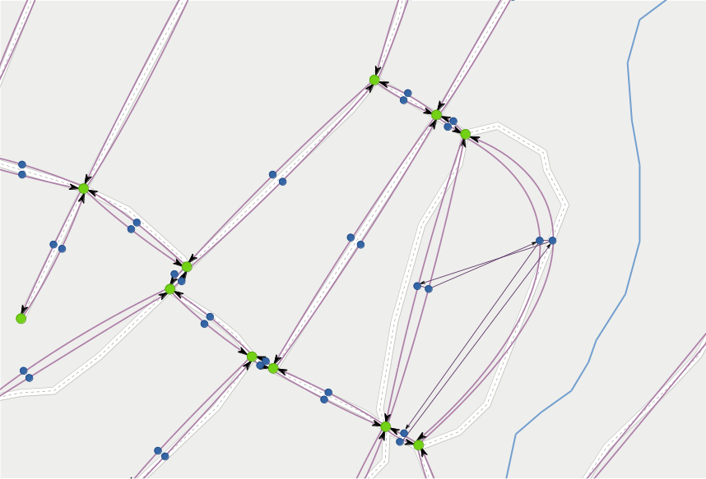
1. background > maps & graphs > line graph
Notes:
Nodes connected with Lines where travel is allowed.
NOTE terminology:
Node + Line
Instead of
Vertex+ Edge

Slide 34
1. background > maps & graphs > line graph
Notes:
Nodes connected with Lines where travel is allowed.
NOTE terminology:
Node + Line
Instead of
Vertex+ Edge

Slide 35
2
problem
statement

Slide 36
2. problem statement
software module
Notes:
Software module exposing function, returning data structure for routing in soft real-time.
Load map data.
Build topology
Consider restrictions and conditions.
Directed graph.
Restrictions.
Return data structure for routing decisions.
LineGraph.
Given set of tools:
C++, Boost Graph Library,
OpenStreetMap (crowd sourced, open).
PostGis (PostgreSQL + spatial data).
BDD/TDD

Slide 37
2. problem statement
software module
exposing a function
Notes:
Software module exposing function, returning data structure for routing in soft real-time.
Load map data.
Build topology
Consider restrictions and conditions.
Directed graph.
Restrictions.
Return data structure for routing decisions.
LineGraph.
Given set of tools:
C++, Boost Graph Library,
OpenStreetMap (crowd sourced, open).
PostGis (PostgreSQL + spatial data).
BDD/TDD

Slide 38
2. problem statement
software module
exposing a function
data
returning a
structure
Notes:
Software module exposing function, returning data structure for routing in soft real-time.
Load map data.
Build topology
Consider restrictions and conditions.
Directed graph.
Restrictions.
Return data structure for routing decisions.
LineGraph.
Given set of tools:
C++, Boost Graph Library,
OpenStreetMap (crowd sourced, open).
PostGis (PostgreSQL + spatial data).
BDD/TDD

Slide 39
2. problem statement
software module
exposing a function
data
returning a
structure
for routing
Notes:
Software module exposing function, returning data structure for routing in soft real-time.
Load map data.
Build topology
Consider restrictions and conditions.
Directed graph.
Restrictions.
Return data structure for routing decisions.
LineGraph.
Given set of tools:
C++, Boost Graph Library,
OpenStreetMap (crowd sourced, open).
PostGis (PostgreSQL + spatial data).
BDD/TDD

Slide 40
2. problem statement
software module
exposing a function
data
returning a
structure
for routing
in soft real-time
Notes:
Software module exposing function, returning data structure for routing in soft real-time.
Load map data.
Build topology
Consider restrictions and conditions.
Directed graph.
Restrictions.
Return data structure for routing decisions.
LineGraph.
Given set of tools:
C++, Boost Graph Library,
OpenStreetMap (crowd sourced, open).
PostGis (PostgreSQL + spatial data).
BDD/TDD

Slide 41
2. problem statement
software module
exposing a function
data
returning a
structure
for routing
in soft real-time
Notes:
Software module exposing function, returning data structure for routing in soft real-time.
Load map data.
Build topology
Consider restrictions and conditions.
Directed graph.
Restrictions.
Return data structure for routing decisions.
LineGraph.
Given set of tools:
C++, Boost Graph Library,
OpenStreetMap (crowd sourced, open).
PostGis (PostgreSQL + spatial data).
BDD/TDD
Configurable settings in JSON.

Slide 42
2. problem statement
sequential operation:
Notes:
HOW:
Sequential operation:
Preliminary step:
Load map data.
Build topology
On demand
Consider restrictions and conditions.
Directed graph.
Restrictions.
Return data structure for routing decisions.
LineGraph.

Slide 43
2. problem statement
sequential operation:
load map data
Notes:
HOW:
Sequential operation:
Preliminary step:
Load map data.
Build topology
On demand
Consider restrictions and conditions.
Directed graph.
Restrictions.
Return data structure for routing decisions.
LineGraph.

Slide 44
2. problem statement
sequential operation:
load map data
build topology
Notes:
HOW:
Sequential operation:
Preliminary step:
Load map data.
Build topology
On demand
Consider restrictions and conditions.
Directed graph.
Restrictions.
Return data structure for routing decisions.
LineGraph.

Slide 45
2. problem statement
sequential operation:
load map data
build topology
apply restrictions
Notes:
HOW:
Sequential operation:
Preliminary step:
Load map data.
Build topology
On demand
Consider restrictions and conditions.
Directed graph.
Restrictions.
Return data structure for routing decisions.
LineGraph.

Slide 46
2. problem statement
sequential operation:
load map data
build topology
apply restrictions
build directed graph
Notes:
HOW:
Sequential operation:
Preliminary step:
Load map data.
Build topology
On demand
Consider restrictions and conditions.
Directed graph.
Restrictions.
Return data structure for routing decisions.
LineGraph.

Slide 47
2. problem statement
sequential operation:
load map data
build topology
apply restrictions
build directed graph
return line graph
Notes:
HOW:
Sequential operation:
Preliminary step:
Load map data.
Build topology
On demand
Consider restrictions and conditions.
Directed graph.
Restrictions.
Return data structure for routing decisions.
LineGraph.
Calculate costs =
Travel time on from edge
(length + speed + surface) +
Restriction costs (speed bumps...) +
Turn costs (angle + vehicle props ...)

Slide 48
2. problem statement
sequential operation:
load map data
build topology
apply restrictions
build directed graph
return line graph
Notes:
Diversion:
Applying restrictions to the graphs.

Slide 49
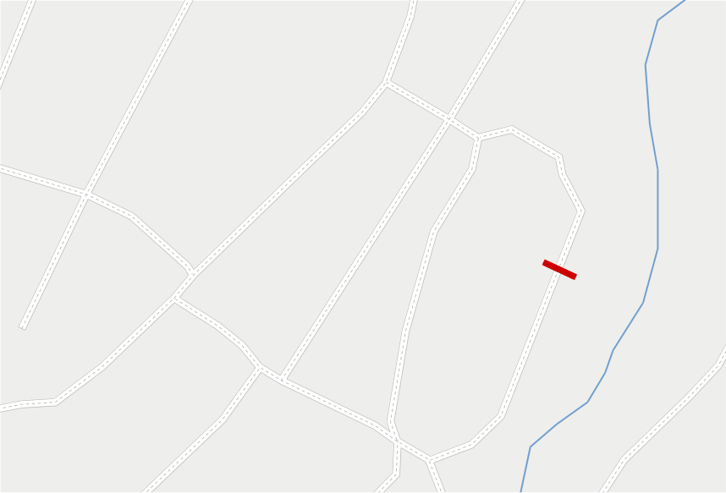
2. problem statement > applying restrictions > map
Notes:
Dynamic restriction like road work = closed road.

Slide 50
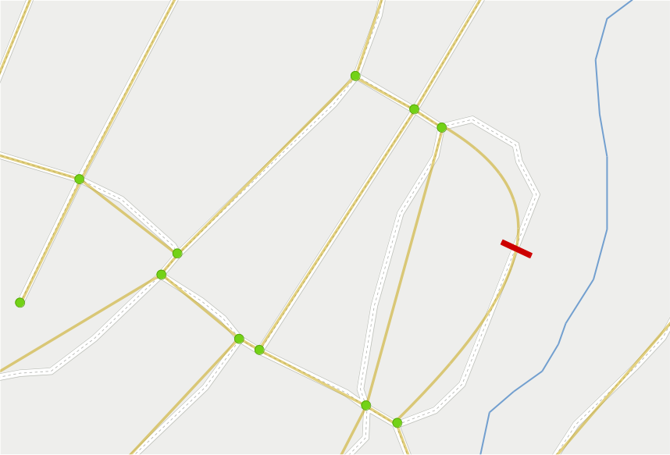
2. problem statement > applying restrictions > topology
Notes:
Dynamic restriction like road work = closed road.
Topology not affected.

Slide 51
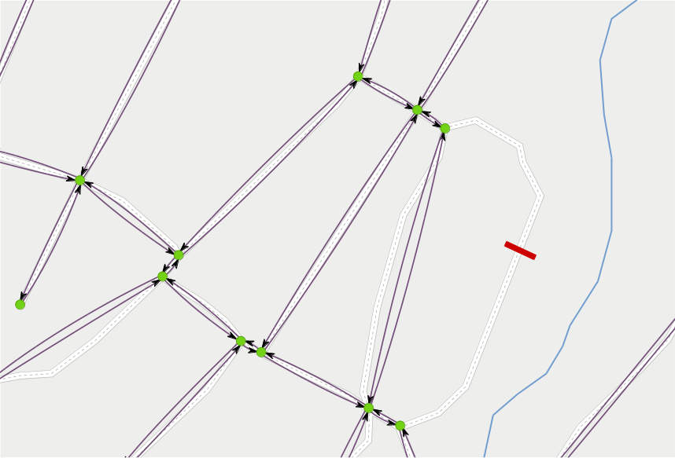
2. problem statement > applying restrictions > directed graph
Notes:
Dynamic restriction like road work = closed road.
Topology not affected
Directed graph = travel along roads → no edges.

Slide 52
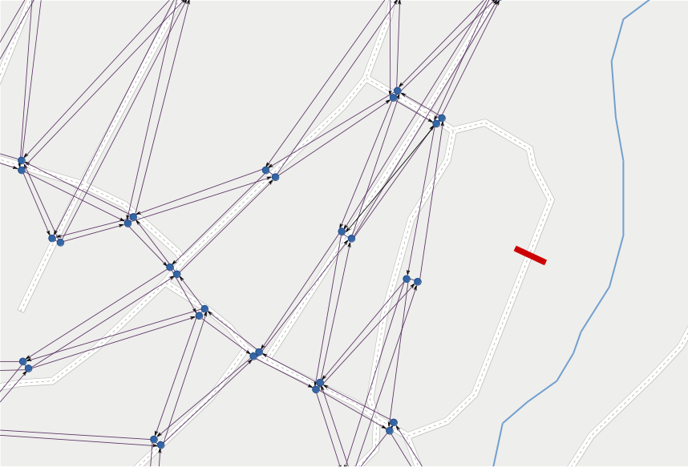
2. problem statement > applying restrictions > line graph
Notes:
Dynamic restriction like road work = closed road.
Topology not affected
Directed graph = travel along roads → no edges.
Line graph = transformed graph.
No edges → no nodes → no lines

Slide 53
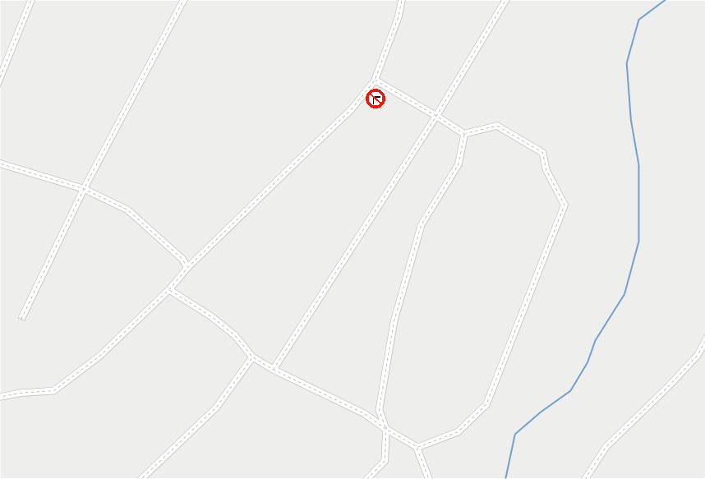
2. problem statement > applying restrictions > map
Notes:
Static restriction like “No turn”
Topology not affected

Slide 54
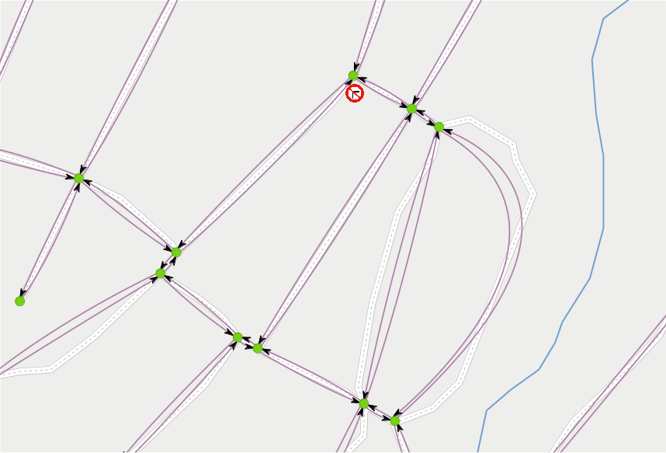
2. problem statement > applying restrictions > directed graph
Notes:
Static restriction like “No turn”
Topology not affected
Directed graph = travel along roads → not affected.

Slide 55
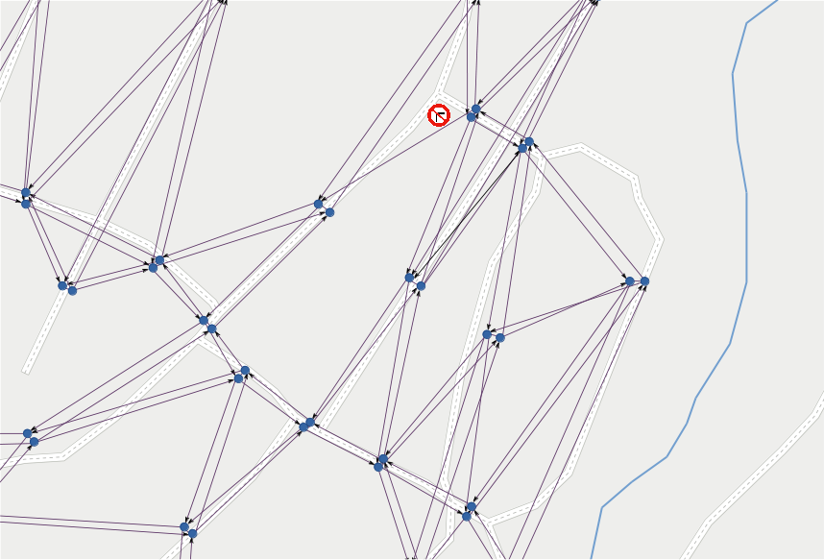
2. problem statement > applying restrictions > line graph
Notes:
Static restriction like “No turn”
Topology not affected
Directed graph = travel along roads → not affected.
Line graph = allowed turns.
Edges → nodes
BUT
Not allowed turn→ no line

Slide 56
2. problem statement
sequential operation:
load map data
preliminary
build topology
apply restrictions
build directed graph
return line graph
Notes:
HOW:
Sequential operation:
Preliminary step: (static road network)
Load map data.
Build topology
On demand: (dynamic)
Consider restrictions and conditions.
Directed graph.
Restrictions.
Return data structure for routing decisions.
LineGraph.

Slide 57
2. problem statement
sequential operation:
load map data
build topology
apply restrictions
build directed graph
on demand
return line graph
Notes:
HOW:
Sequential operation:
Preliminary step: (static road network)
Load map data.
Build topology
On demand: (dynamic)
Consider restrictions and conditions.
Directed graph.
Restrictions.
Return data structure for routing decisions.
LineGraph.

Slide 58
2. problem statement
required tools:
Notes:
Given set of tools:
C++, Boost Graph Library,
OpenStreetMap (crowd sourced, open).
PostGis (PostgreSQL + spatial data).

Slide 59
C++
2. problem statement
required tools:
Notes:
Given set of tools:
C++, Boost Graph Library,
OpenStreetMap (crowd sourced, open).
PostGis (PostgreSQL + spatial data).

Slide 60
2. problem statement
required tools:
map data
Notes:
Given set of tools:
C++, Boost Graph Library,
OpenStreetMap (crowd sourced, open).
PostGis (PostgreSQL + spatial data).

Slide 61
2. problem statement
required tools:
map data
OpenStreetMap
Notes:
Given set of tools:
C++, Boost Graph Library,
OpenStreetMap (crowd sourced, open).
PostGis (PostgreSQL + spatial data).

Slide 62
2. problem statement
required tools:
map data
OpenStreetMap
PostGIS
Notes:
Given set of tools:
C++, Boost Graph Library,
OpenStreetMap (crowd sourced, open).
PostGis (PostgreSQL + spatial data).

Slide 63
2. problem statement
required tools:
graph data structures
Notes:
Given set of tools:
C++, Boost Graph Library,
OpenStreetMap (crowd sourced, open).
PostGis (PostgreSQL + spatial data).

Slide 64
2. problem statement
required tools:
graph data structures
Boost
graph
library
Notes:
Given set of tools:
C++, Boost Graph Library,
OpenStreetMap (crowd sourced, open).
PostGis (PostgreSQL + spatial data).

Slide 65
3
method

Slide 66
3. method
requirement:
development
Notes:
Requirement
BDD or TDD

Slide 67
3. method
requirement:
behavior
driven
development
(BDD)
Notes:
Requirement
BDD or TDD

Slide 68
3. method
requirement:
behavior
test
or
driven
development
(BDD/TDD)
Notes:
Requirement
BDD or TDD

Slide 69
3. method
behavior
(BDD)
driven
development
Notes:
BDD test cases:
Scenario
Given
When
Then

Slide 70
3. method
behavior
(BDD)
driven
development
Scenario:
Notes:
BDD test cases:
Scenario
Given
When
Then

Slide 71
3. method
behavior
(BDD)
driven
development
Scenario:
Given:
Notes:
BDD test cases:
Scenario
Given
When
Then

Slide 72
3. method
behavior
(BDD)
driven
development
Scenario:
Given:
When:
Notes:
BDD test cases:
Scenario
Given
When
Then

Slide 73
3. method
behavior
(BDD)
driven
development
Scenario:
Given:
When:
Then:
Notes:
BDD test cases:
Scenario
Given
When
Then

Slide 74
3. method
behavior
(BDD)
driven
development
Scenario: Vectors can be sized and resized
Given:
When:
Then:
Notes:
BDD test cases:
Scenario
Given
When
Then

Slide 75
3. method
behavior
(BDD)
driven
development
Scenario: Vectors can be sized and resized
Given: A vector with some items
When:
Then:
Notes:
BDD test cases:
Scenario
Given
When
Then

Slide 76
3. method
behavior
(BDD)
driven
development
Scenario: Vectors can be sized and resized
Given: A vector with some items
When: The size is increased
Then:
Notes:
BDD test cases:
Scenario
Given
When
Then

Slide 77
3. method
behavior
(BDD)
driven
development
Scenario: Vectors can be sized and resized
Given: A vector with some items
When: The size is increased
Then: The size and capacity change
Notes:
BDD test cases:
Scenario
Given
When
Then

Slide 78
3. method > tools
tools
Notes:
Tools
Some were given, others I have spent a lot of time investigating.

Slide 79
3. method > tools > BDD
Catch
#define CATCH_CONFIG_MAIN
#include "catch.hpp"
#include <vector>
SCENARIO ("Vectors can be sized and resized", "[vector]") {
GIVEN ("A vector with some items") {
std::vector<int> v(5);
REQUIRE (v.size() == 5);
REQUIRE (v.capacity() >= 5);
WHEN ("The size is increased") {
v.resize(10);
THEN ("The size and capacity change") {
REQUIRE (v.size() == 10);
REQUIRE (v.capacity() >= 10);
}
}
}
}
Notes:
Catch
Header only
Easy to use

Slide 80
3. method > tools > json
Boost Property Tree
#include <string>
#include <iostream>
#include <boost/property_tree/ptree.hpp>
#include <boost/property_tree/json_parser.hpp>
void readJsonFile(const std::string& filename) {
boost::property_tree::ptree pt;
boost::property_tree::read_json(filename, pt);
std::string host = pt.get<std::string>("host");
int port = pt.get<int>("port");
std::cout << "Host: " << host << ", port: " << port << std::endl;
}
Notes:
Reading settings from json
Boost Property Tree
As already using Boost in project

Slide 81
3. method > tools > load map data
osm2pgsql
source:
OpenStreetMap
load:
$ osm2pgsql -U user -d map_db -s -k mapdata.osm
store:
PostGIS
Notes:
Loading map data
From .osm file
Into PostGIS
Lots of different tools
Osm2pgsql OK, but weak on relations and conditional tags...

Slide 82
3. method > tools > load map data
osm2pgsql + postgis_topology
source:
OpenStreetMap
load:
$ osm2pgsql -U user -d map_db -s -k mapdata.osm
store:
PostGIS
build topology:
$ psql -U user -d map_db
-c "SELECT topology.CreateTopology(’roads_topo’, 900913);"
Notes:
Loading map data
Build topology
postgis_topology
Extension to PostGIS

Slide 83
3. method > tools > work with DB
libpqxx
#include <pqxx/pqxx>
//...
pqxx::connection conn(
"dbname=testdb"
"user=tester"
"password=tester"
"hostaddr=127.0.0.1"
"port=5432");
link:
$ g++ mytest.cpp -lpqxx -lpq -o mytest
Notes:
Work against DB
Libpqxx
Official library
Needs linking

Slide 84
3. method > tools > data structures
Boost Graph Library
property lists
typedef boost::adjacency_list<
boost::listS, boost::vecS, boost::bidirectionalS,
// Vertex properties
boost::property< boost::vertex_name_t, std::string,
boost::property< population_t, int,
boost::property< zipcodes_t, std::vector<int> > > >,
// Edge properties
boost::property< boost::edge_name_t, std::string,
boost::property< boost::edge_weight_t, double,
boost::property< edge_speed_limit_t, int,
boost::property< edge_lanes_t, int,
boost::property< edge_divided, bool> > > > > >
Map;
Notes:
BGL
Hard to read with property lists
Bundled templates...

Slide 85
3. method > tools > data structures
Boost Graph Library
bundled properties
struct City {
string name;
int population;
vector<int> zipcodes;
};
struct Highway {
string name;
double miles;
int speed_limit;
int lanes;
bool divided;
};
typedef boost::adjacency_list<
boost::listS, boost::vecS, boost::bidirectionalS,
City, Highway>
Map;
Notes:
BGL
Bundled properties are more understandable
Happy to have found them!

Slide 86
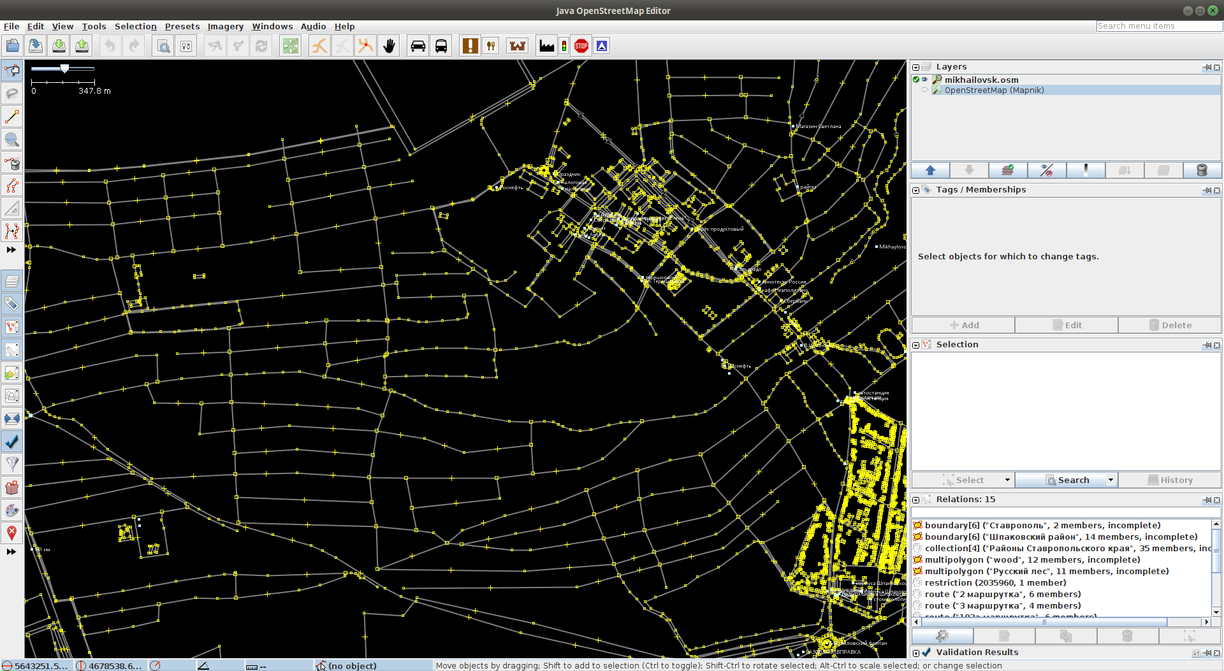
3. method > tools > edit map data
JOSM
Notes:
JOSM
Edit map data
Add restrictions for testing

Slide 87
4
results

Slide 88
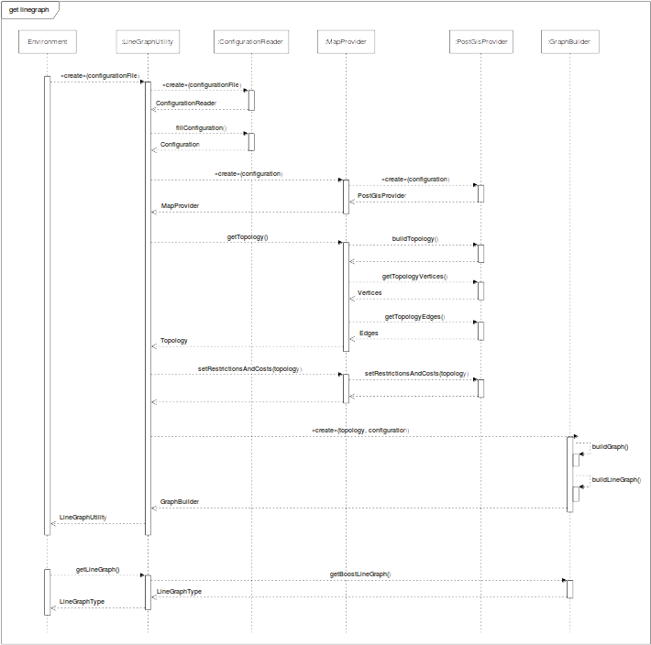
4. results >
design
Notes:
Main use case
Instantiate LineGraphUtility
Load Configuration
Instantiate correct MapProvider
Get Topology
Apply Restrictions and Costs
Instantiate GraphBuilder
Get LineGraph

Slide 89
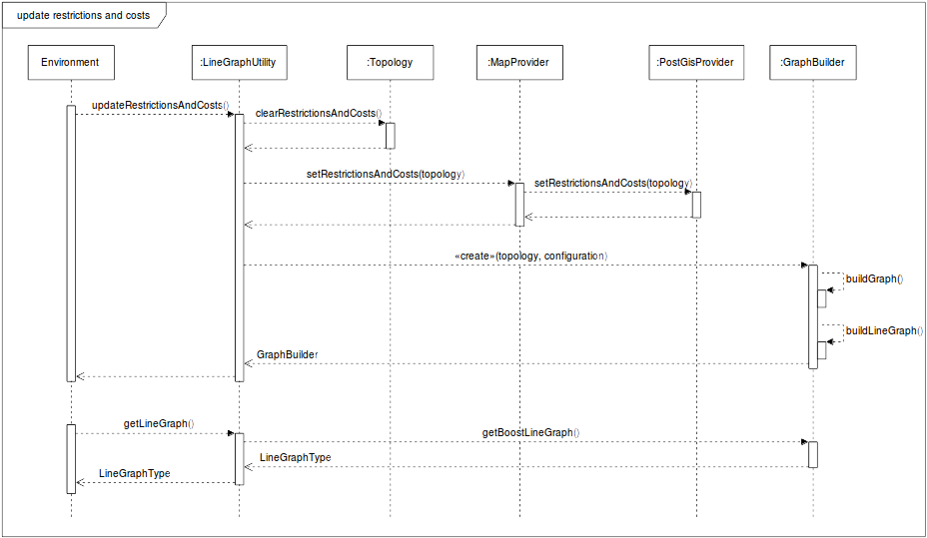
4. results > design
Notes:
Update Restrictions and Costs
Clear Restrictions and Cost from Topology
Apply Restrictions and Costs
Instantiate GraphBuilder
(Get LineGraph)

Slide 90
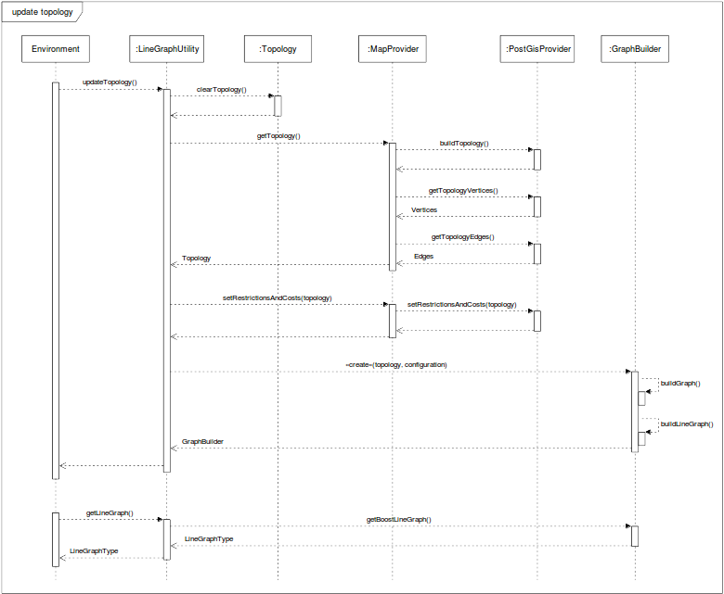
4. results > design
Notes:
Update Topology
Clear Topology
Read in new Topology
Apply Restrictions and Costs
Instantiate GraphBuilder
(Get LineGraph)

Slide 91
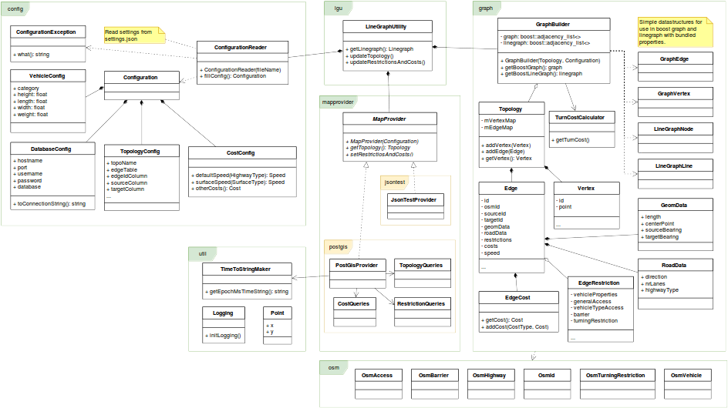
4. results > design
Notes:
Class diagram
Packages:
config
graph
lgu
mapprovider
osm
util

Slide 92
4. results
tests
Notes:
Results:
Tests performed during development asserts that software produces wished results.

Slide 93
4. results
specification fulfillment
tests
Notes:
Results:
Tests performed during development asserts that software produces wished results.
The specification is fulfilled,

Slide 94
4. results
specification fulfillment
restrictions
except
restrictions
most edge, no conditional ...
tests
Notes:
Results:
Tests performed during development asserts that software produces wished results.
The specification is fulfilled,
Except for Restrictions (conditional)

Slide 95
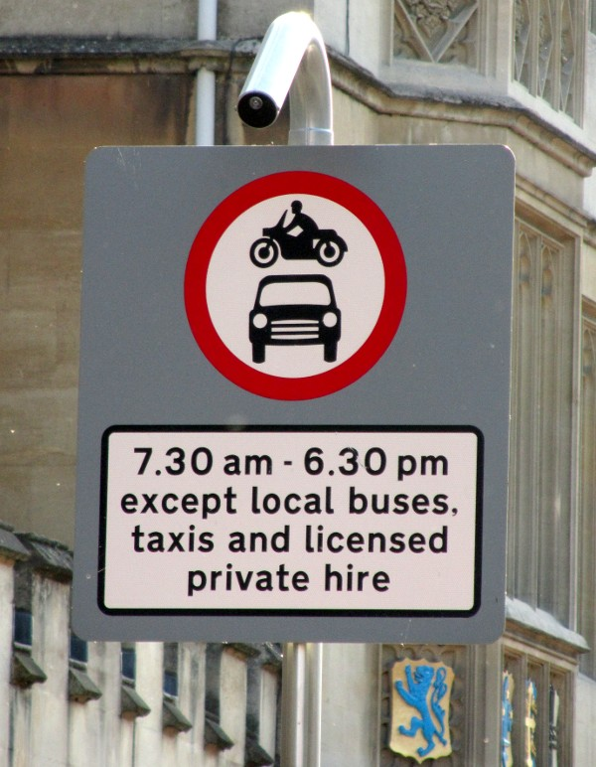
4. results
except
conditional
Photo (cropped): Achadwick. ©CC-SA 2.0
http://wiki.openstreetmap.org/wiki/File:UK_motor_restriction_sign_with_exceptions.jpg
restrictions
motor_vehicle=no
motor_vehicle:conditional=yes @ (18:30-07:30)
psv=yes
Notes:
Results:
Tests performed during development asserts that software produces wished results.
The specification is fulfilled,
Except for Restrictions (conditional)
Example conditional restriction

Slide 96
4. results
specification fulfillment
restrictions
except
restrictions
most edge, no conditional ...
conditions
tests
time of day, inclination ...
Notes:
Results:
Tests performed during development asserts that software produces wished results.
The specification is fulfilled,
Except for Restrictions (conditional)
And Conditions

Slide 97
4. results
specification fulfillment
restrictions
except
restrictions
most edge, no conditional ...
conditions
tests
time of day, inclination ...
performance
Notes:
Results:
Tests performed during development asserts that software produces wished results.
The specification is fulfilled,
Except for Restrictions (conditional)
And Conditions
Performance test

Slide 98
4. results
test graph sizes
 | Graph |  | Line graph
 | vertices | edges | nodes | lines
Mikhailovsk | 654 | 1618 | 1618 | 4758
Partille | 1645 | 2265 | 2265 | 5577
performance
Notes:
Results:
Tests performed during development asserts that software produces wished results.
The specification is fulfilled,
Except for Restrictions (conditional)
And Conditions
Performance test
Sizes of test graphs

Slide 99
4. results
test graph sizes
 | Graph |  | Line graph
 | vertices | edges | nodes | lines
Mikhailovsk | 654 | 1618 | 1618 | 4758
Partille | 1645 | 2265 | 2265 | 5577
time to get line graph
average of 100 rounds
Topology |  | get LineGraph (s)
Mikhailovsk | pre-built | 0.143171
 | on demand | 4.936007
Partille | pre-built | 0.182152
 | on demand | 10.557756
performance
Notes:
Results:
Tests performed during development asserts that software produces wished results.
The specification is fulfilled,
Except for Restrictions (conditional)
And Conditions
Performance test
Result:
Fetch a Line Graph
Topology pre-built / on demand
Soft real-time?

Slide 100
4. results
specification fulfillment
restrictions
except
restrictions
most edge, no conditional ...
conditions
tests
time of day, inclination ...
performance
visual examination
Notes:
Results:
Tests performed during development asserts that software produces wished results.
The specification is fulfilled,
Except for Restrictions (conditional)
And Conditions
Performance test
Visual examination

Slide 101
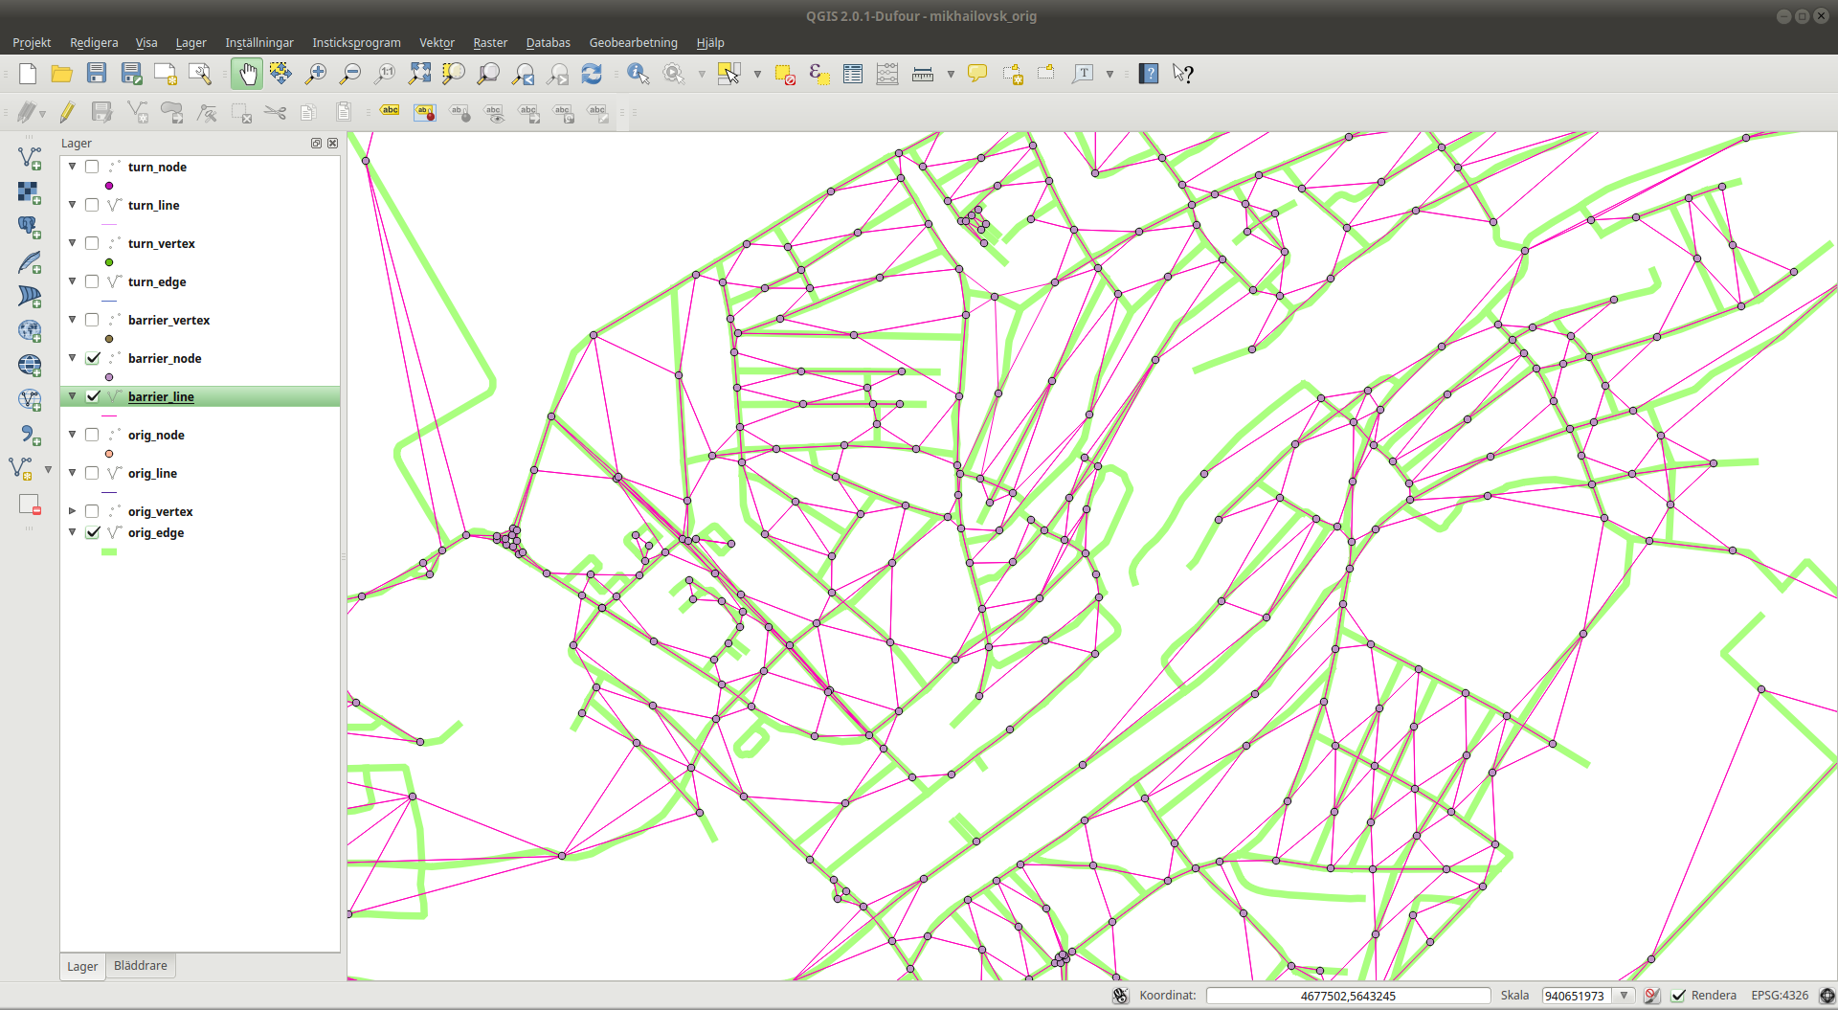
4. results
visual examination
QGIS
Notes:
Results:
Tests performed during development asserts that software produces wished results.
The specification is fulfilled,
Except for Restrictions (conditional)
And Conditions
Performance test
Visual examination
Load data in QGIS, looks correct?

Slide 102
4. results
specification fulfillment
restrictions
except
restrictions
most edge, no conditional ...
conditions
tests
time of day, inclination ...
performance
visual examination
Notes:
Results:
Tests performed during development asserts that software produces wished results.
The specification is fulfilled,
Except for Restrictions (conditional)
And Conditions
Performance test
Visual examination

Slide 103
5
conclusions

Slide 104
5. conclusions
working
Notes:
Module:
Working but incomplete
Late from start
Stress, suboptimal decisions (?)
Business logic for restrictions
Much more complex than thought

Slide 105
5. conclusions
working
incomplete
but
Notes:
Module:
Working but incomplete
Late from start
Stress, suboptimal decisions (?)
Business logic for restrictions
Much more complex than thought

Slide 106
5. conclusions
working
incomplete
but
due to
time
Notes:
Module:
Working but incomplete
Late from start
Stress, suboptimal decisions (?)
Business logic for restrictions
Much more complex than thought

Slide 107
5. conclusions
working
incomplete
but
due to
time
late specification
Notes:
Module:
Working but incomplete
Late from start
Stress, suboptimal decisions (?)
Business logic for restrictions
Much more complex than thought

Slide 108
5. conclusions
working
incomplete
but
due to
time
late specification
complex restrictions
Notes:
Module:
Working but incomplete
Late from start
Stress, suboptimal decisions (?)
Business logic for restrictions
Much more complex than thought

Slide 109
6
future
work

Slide 110
6. future work
re-model
restrictions
Notes:
What remains:
It is possible to keep on working with the restrictions, but needs re-modeling.
Possibly using the syntax as a base for a more generic restriction class.

Slide 111
6. future work
re-model
restrictions
<restriction-type>[:<transportation mode>][:<direction>]:conditional
= <restriction-value> @ <condition>[;<restriction-value> @ <condition>]
Notes:
What remains:
It is possible to keep on working with the restrictions, but needs re-modeling.
Possibly using the syntax as a base for a more generic restriction class.

Slide 112
LineGraph
Utility
Jonas Bergman, jobe0900@student.miun.se
Notes:
Have presented my exam project.

