Slide 1
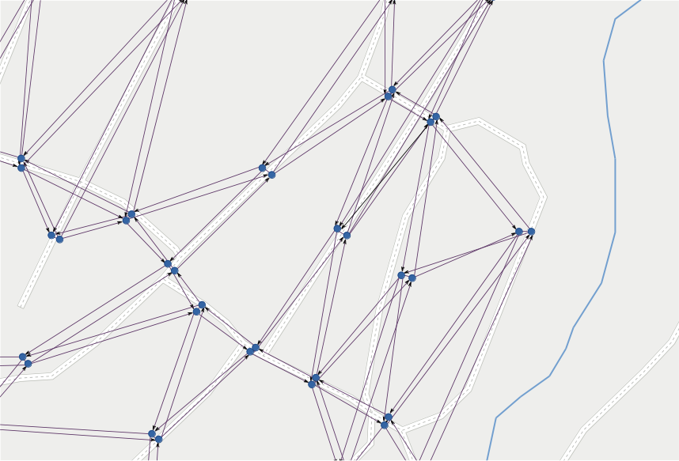
LineGraph
Utility
Jonas Bergman, jobe0900@student.miun.se
Notes:
This is a module,
I have no overview of complete project.
Aim: (I think)
No waiting at bus stops
Vehicles gets directed to customers
Drivers needs real-time directions
Updated with current traffic situation

Slide 2
LineGraph
Utility
a software module
Jonas Bergman, jobe0900@student.miun.se
Notes:
This is a module,
I have no overview of complete project.
Aim: (I think)
No waiting at bus stops
Vehicles gets directed to customers
Drivers needs real-time directions
Updated with current traffic situation

Slide 3
LineGraph
Utility
for
a software module
use in
routing
flexible
Jonas Bergman, jobe0900@student.miun.se
Notes:
This is a module,
I have no overview of complete project.
Aim: (I think)
No waiting at bus stops
Vehicles gets directed to customers
Drivers needs real-time directions
Updated with current traffic situation

Slide 4
LineGraph
Utility
for
a software module
use in
routing
flexible
public transportation
of
Jonas Bergman, jobe0900@student.miun.se
Notes:
This is a module,
I have no overview of complete project.
Aim: (I think)
No waiting at bus stops
Vehicles gets directed to customers
Drivers needs real-time directions
Updated with current traffic situation

Slide 5
requirements

Slide 6
load map data
in:

Slide 7
load map data
in:
build line graph
out:

Slide 8
1
load map data

Slide 9

1. map

Slide 10
1. map
source:
OpenStreetMap
www.openstreetmap.org
Notes:
Open street map:
- crowdsourced, open data
- xml file format

Slide 11
1. map
source:
OpenStreetMap
www.openstreetmap.org
store:
PostGIS
www.postgis.net

Slide 12
1. map
source:
OpenStreetMap
www.openstreetmap.org
store:
PostGIS
PostgreSQL + spatial data extension
www.postgis.net
Notes:
PostgreSQL
+ geometric &
Geographic data

Slide 13
1. map
source:
OpenStreetMap
www.openstreetmap.org
load:
$ osm2pgsql
store:
PostGIS
PostgreSQL + spatial data extension
www.postgis.net
Notes:
Commandline tool
Load map data in postgis
Parsing .osm file

Slide 14
1. map
source:
OpenStreetMap
www.openstreetmap.org
load:
$ osm2pgsql -U user -d map_db -s -k mapdata.osm
store:
PostGIS
PostgreSQL + spatial data extension
www.postgis.net
Notes:
Commandline tool
Load map data in postgis
Parsing .osm file

Slide 15
1
load map data
2
build topology

Slide 16
2. topology
Notes:
What is a map?
- a “projection” of reality on flat surface?
- geometry / looks

Slide 17
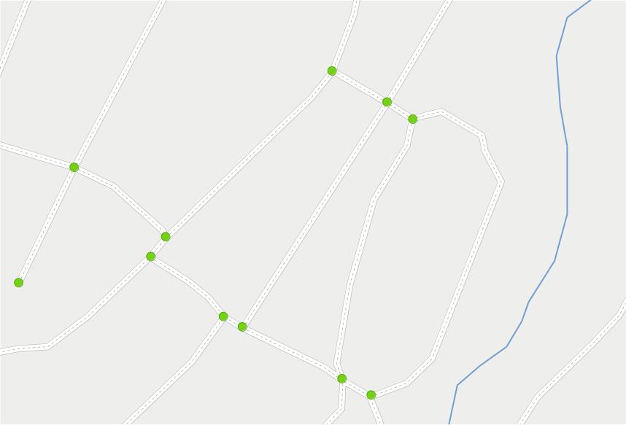
2. topology
Notes:
What is a map? (cont)
- semantics about the connections of roads?
- in routing YES
The topology is …
- vertices (ends and junctions of roads)

Slide 18
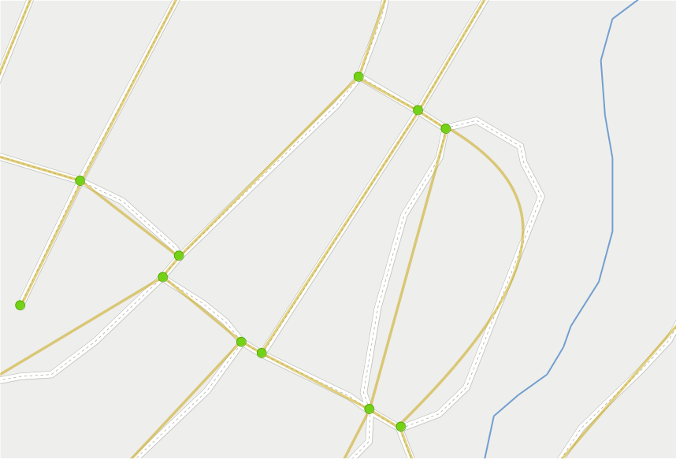
2. topology
Notes:
The topology is … (cont)
- edges (roads)
BUT:
- Only relations are important
- Not geometry

Slide 19
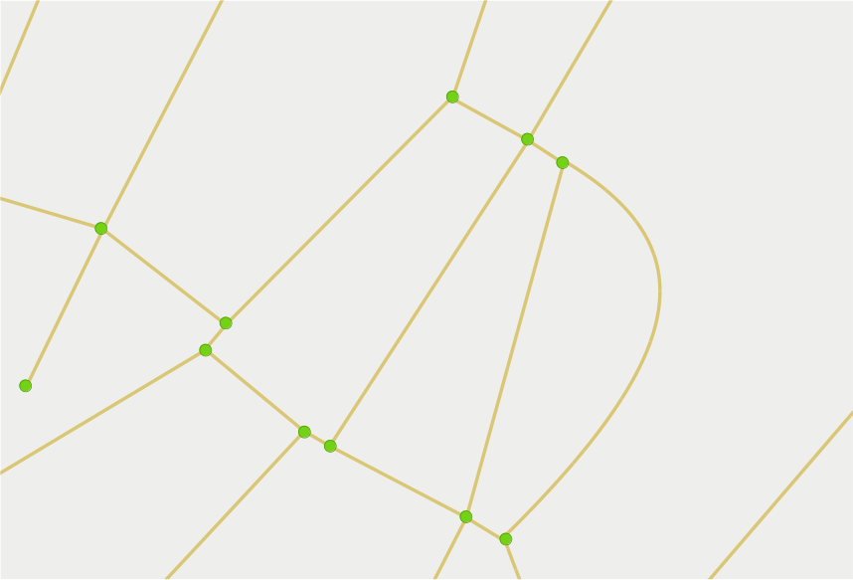
2. topology
Notes:
Topology = undirected graph
Stating relations between roads/edges

Slide 20
2. topology
vertex
Notes:
Terminology (no standard):
- vertices = nodes, points, dots

Slide 21
2. topology
edge
Notes:
Terminology (no standard):
- edges = lines, arcs

Slide 22
2. topology
tool:
postgis_topology
Notes:
When building/analyzing:
- cleaning up data
- healing misses
Chosen tool:
- extension to PostGIS
- functions to analyze and build topology
Topology should be static.
- road network : not much change
Variations reflected by costs and restrictions.

Slide 23
1
load map data
2
build topology
3
apply restrictions
Notes:
Restrictions can be static and dynamic

Slide 24
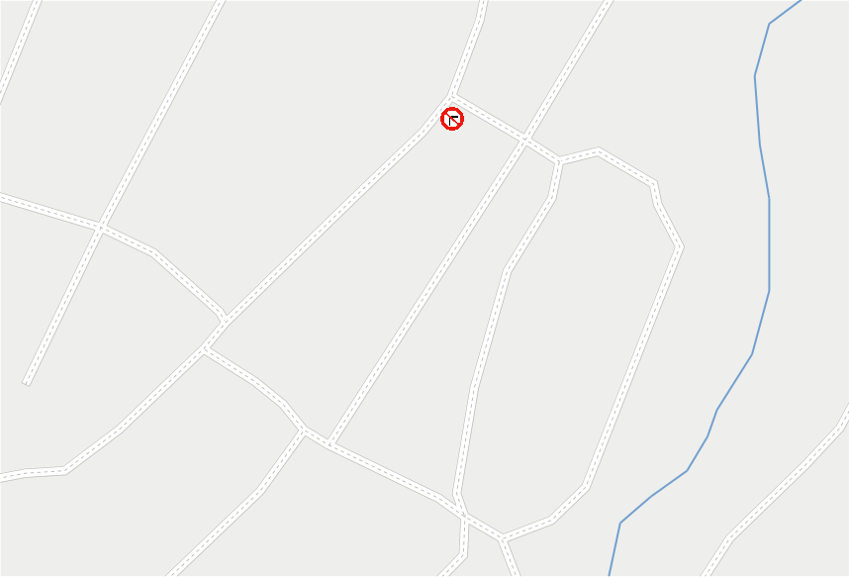
3. restrictions
Notes:
Restrictions: STATIC
- road signs
- traffic lights
- speed bumps

Slide 25
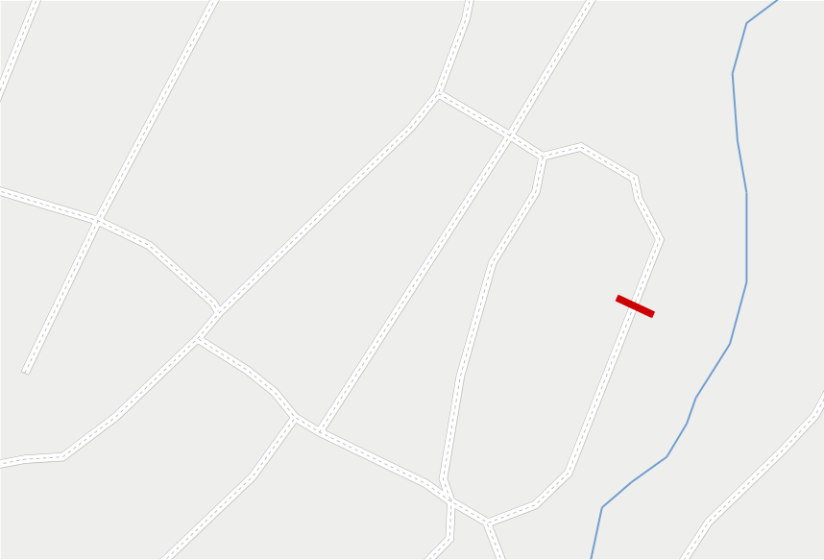
3. restrictions
Notes:
Restrictions: DYNAMIC
- accident
- road work
Modeled as barriers

Slide 26
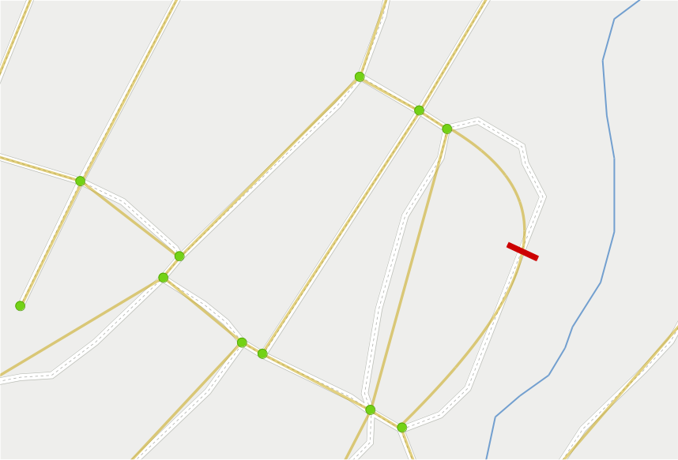
3. restrictions
Notes:
How to apply restriction on topology?
Preliminary step: directed graph

Slide 27
3. restrictions (directed graph)
Notes:
The topology is an undirected graph, no sense of direction.
Routing needs directions : needs directed graph.
Each lane of a road gets its own edge

Slide 28
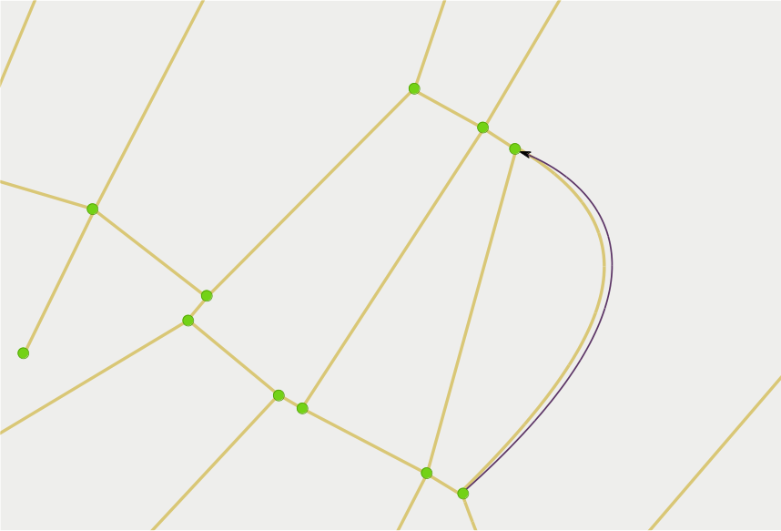
3. restrictions (directed graph)

Slide 29
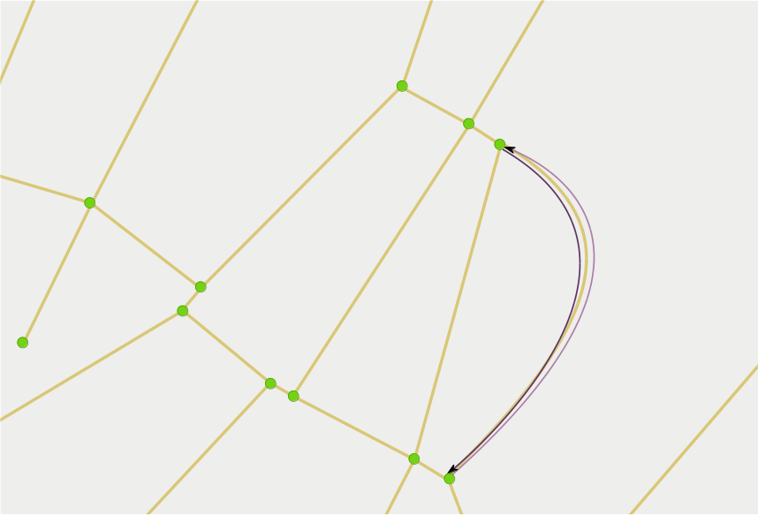
3. restrictions (directed graph)

Slide 30
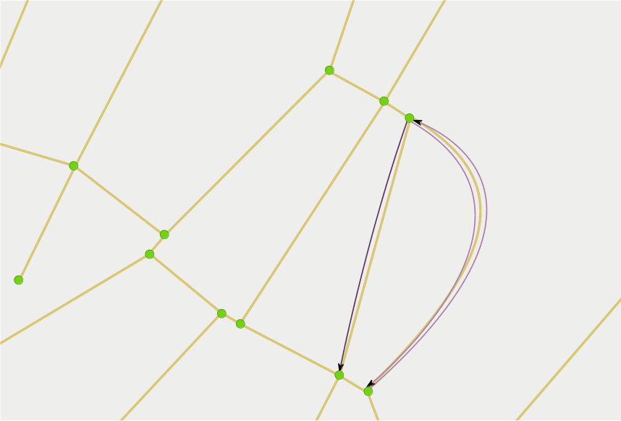
3. restrictions (directed graph)

Slide 31
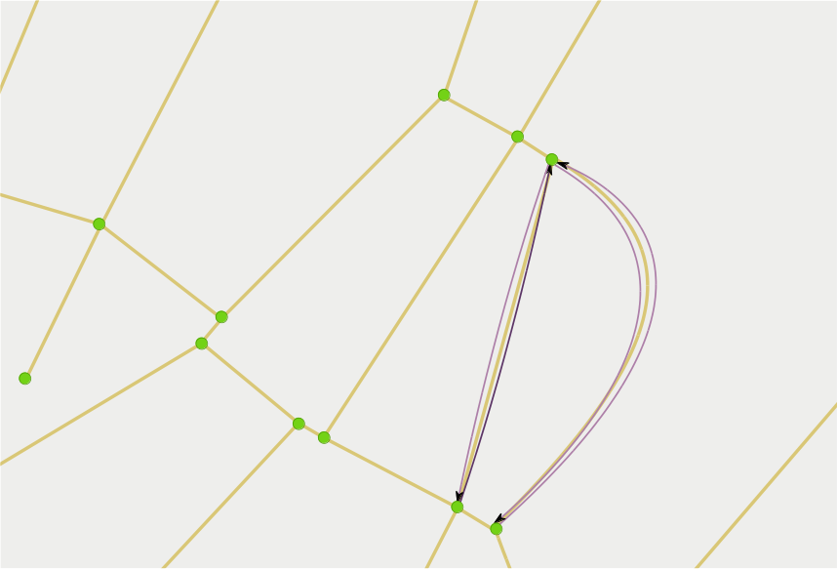
3. restrictions (directed graph)

Slide 32
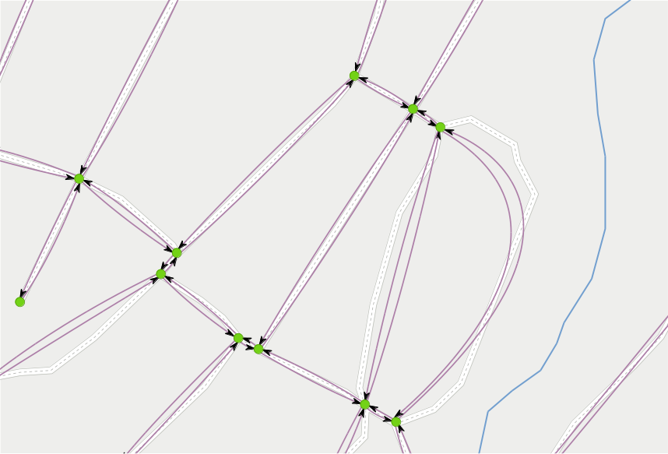
3. restrictions (directed graph)
Notes:
Now have DIRECTED graph
One edge per LANE
One-way = one edge

Slide 33

3. restrictions
Notes:
Back to restrictions:
Does not affect topology
Barrier stops travel via the road = no edge

Slide 34
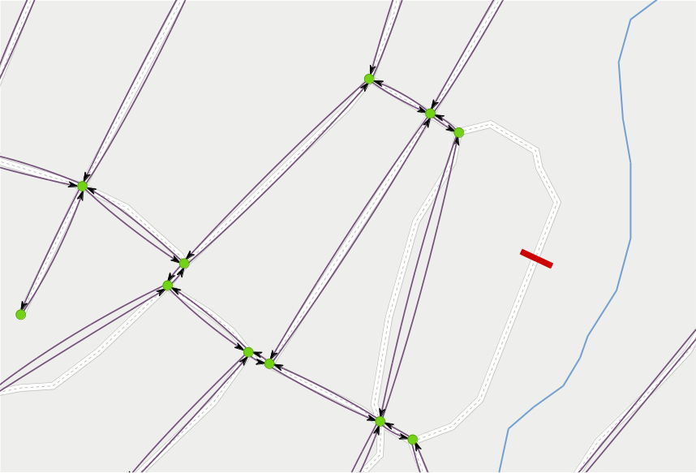
3. restrictions
Notes:
Barrier stops travel via the road = no edges
What if target of route is among those edges?
- This line graph routing needs to be supplemented with short distance routing.

Slide 35

3. restrictions
Notes:
Turn restriction is different:
- RELATION between edges, not applied to ONE edge.

Slide 36
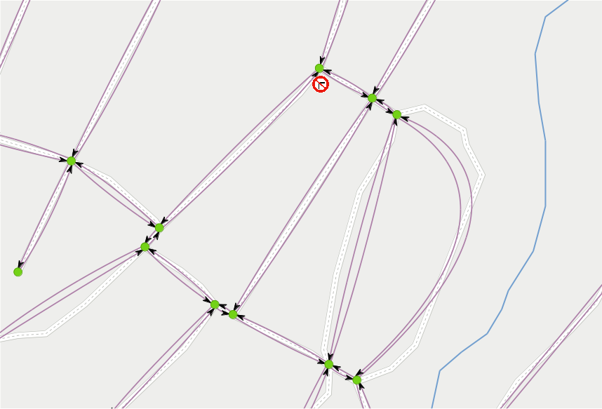
3. restrictions
Notes:
Turn restriction is different:
- RELATION between edges, not applied to ONE edge.
Means edges in graph does not disappear.

Slide 37
1
load map data
2
build topology
3
apply restrictions
4
build line graph
Notes:
Now we have a directed graph, with restrictions.
Time to build a line graph.
A line graph is a transformation of a graph.

Slide 38

4. line graph
Notes:
The transformation:
Each edge in the graph is made to a “node” in the line graph.

Slide 39

4. line graph
Notes:
The transformation:
Each edge in the graph is made to a “node” in the line graph.

Slide 40

4. line graph
Notes:
The transformation:
Each edge in the graph is made to a “node” in the line graph.

Slide 41

4. line graph
Notes:
The transformation:
Each edge in the graph is made to a “node” in the line graph.

Slide 42
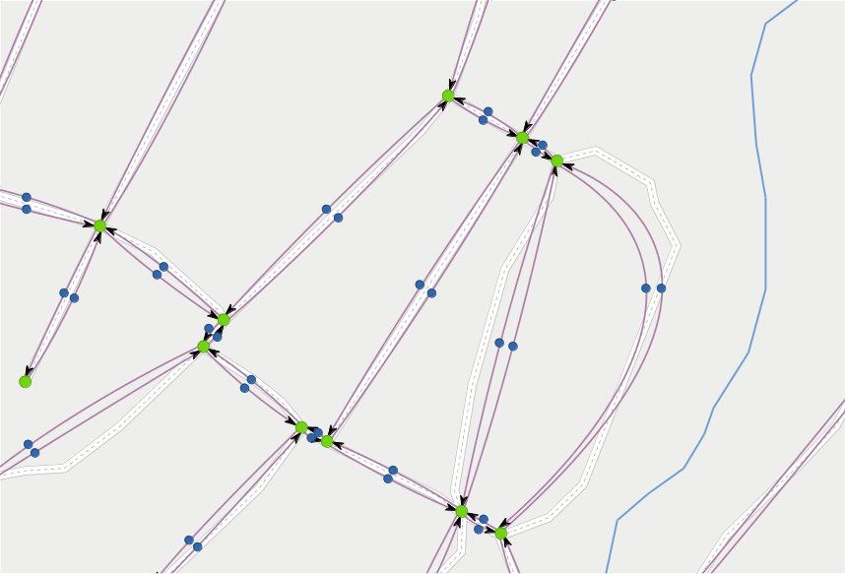
4. line graph
Notes:
The transformation:
Each edge in the graph is made to a “node” in the line graph.
Then the nodes are connected with directed lines where travel is possible.

Slide 43
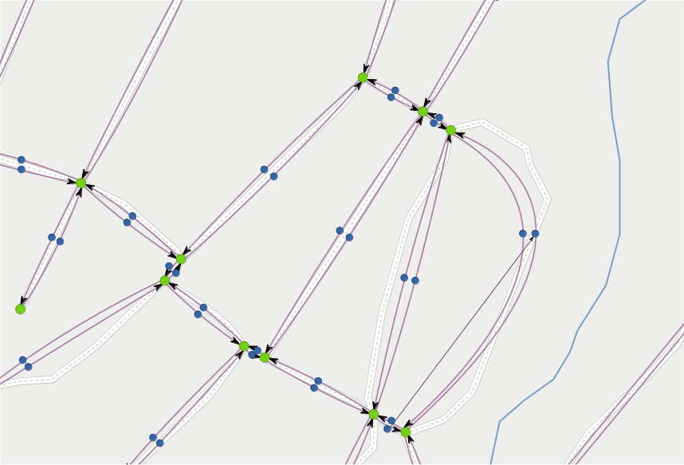
4. line graph
Notes:
The transformation:
Each edge in the graph is made to a “node” in the line graph.
Then the nodes are connected with directed lines where travel is possible.

Slide 44
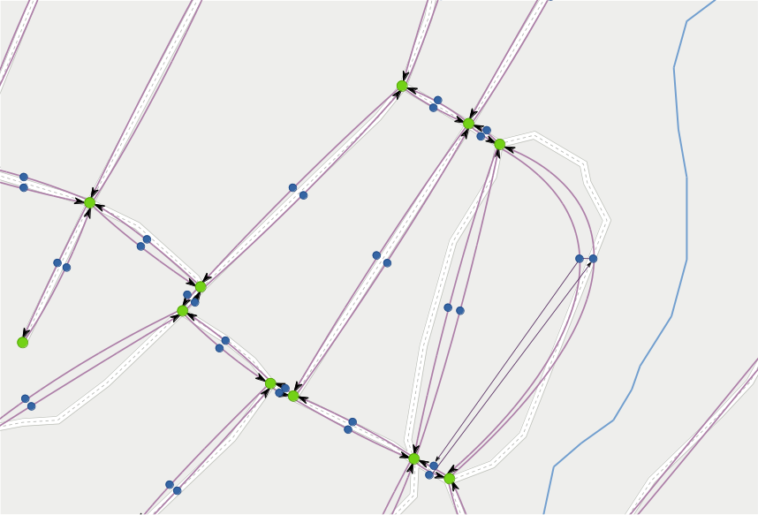
4. line graph
Notes:
The transformation:
Each edge in the graph is made to a “node” in the line graph.
Then the nodes are connected with directed lines where travel is possible.

Slide 45
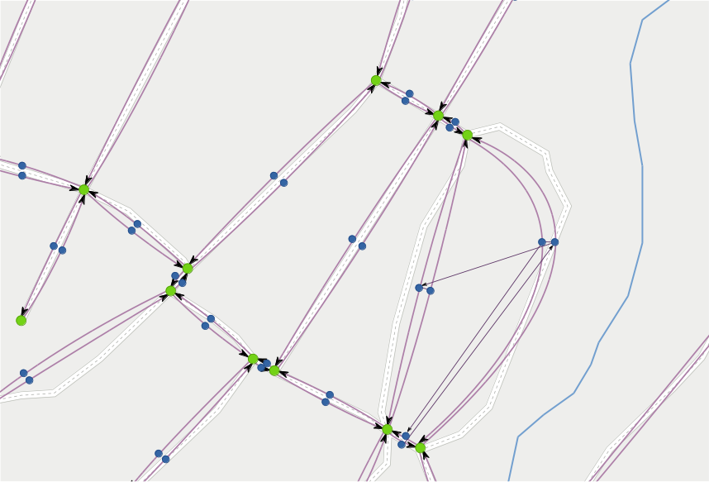
4. line graph
Notes:
The transformation:
Each edge in the graph is made to a “node” in the line graph.
Then the nodes are connected with directed lines where travel is possible.
Note: nodes are connected = U-turns are allowed

Slide 46
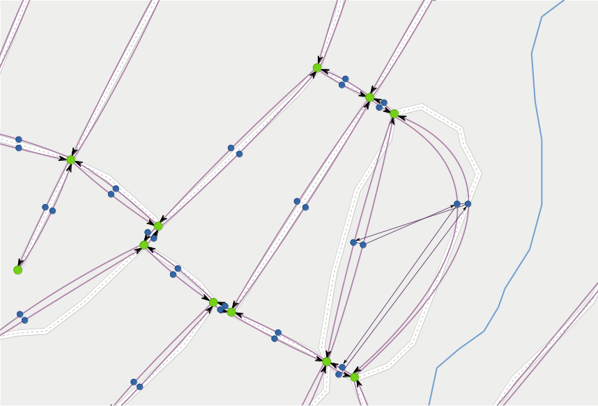
4. line graph
Notes:
The transformation:
Each edge in the graph is made to a “node” in the line graph.
Then the nodes are connected with directed lines where travel is possible.
Note: nodes are connected = U-turns are allowed

Slide 47

4. line graph
Notes:
See: a lot more lines than there were edges → increase in space needs.
Line graph is not the most efficient technology.

Slide 48
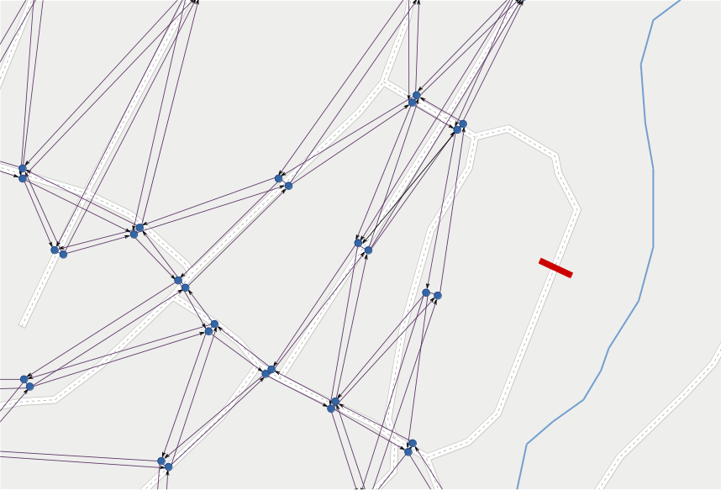
4. line graph
Notes:
When barrier: no edges → no nodes → no lines

Slide 49
4. line graph
Notes:
See: a lot more lines than there were edges → increase in space needs.
Line graph is not the most efficient technology.

Slide 50
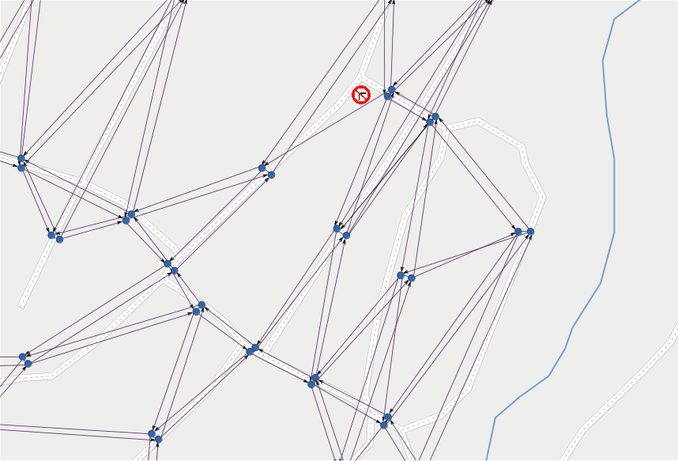
4. line graph
Notes:
When turn restriction: only affected line = turn disappears.

Slide 51
4. line graph
tool:
Boost graph library
typedef boost::adjacency_list
< boost::listS, boost::vecS, boost::directedS,
LineGraphNode, LineGraphLine >
LineGraphType;
Notes:
Module developed in c++
Requirement:
- Return line graph as a BOOST GRAPH data structure.
First time with boost.
- long template expressions,
- typedefs are necessary

Slide 52
remarks
Notes:
Solution:
Some remarks about solution

Slide 53
preliminary
Notes:
Solution:

Slide 54
preliminary
load map data
Notes:
Solution:

Slide 55
preliminary
load map data
build topology
Notes:
Each time a new map is introduced or new roads are built (permanent changes to topology).
Might take some seconds per city.

Slide 56
preliminary
load map data
build topology
on demand
Notes:
Solution:
On each request by calling application

Slide 57
preliminary
load map data
build topology
on demand
apply restrictions
Notes:
Solution:
Current state in database

Slide 58
preliminary
load map data
build topology
on demand
apply restrictions
build line graph
Notes:
Solution:
This takes a couple hundred milliseconds.
Configurable:
Topology CAN be built on demand (but is slow).

Slide 59
configurable
Notes:
Module should be configurable

Slide 60
configurable
json file
for settings
Notes:
Takes all settings from a json file

Slide 61
configurable
json file
for settings
database
Notes:
Takes all settings from a json file

Slide 62
configurable
json file
for settings
database, vehicle properties
Notes:
Takes all settings from a json file

Slide 63
configurable
json file
for settings
database, vehicle properties,
road speeds
Notes:
Takes all settings from a json file

Slide 64
configurable
json file
for settings
database, vehicle properties,
road speeds, surfaces
Notes:
Takes all settings from a json file

Slide 65
configurable
json file
for settings
database, vehicle properties,
road speeds, surfaces,
restrictions and costs, ...
Notes:
Takes all settings from a json file

Slide 66

mapping IDs
OSM
Notes:
Several layers of IDs.

Slide 67

mapping IDs
OSM +
topology
Notes:
Several layers of IDs.

Slide 68
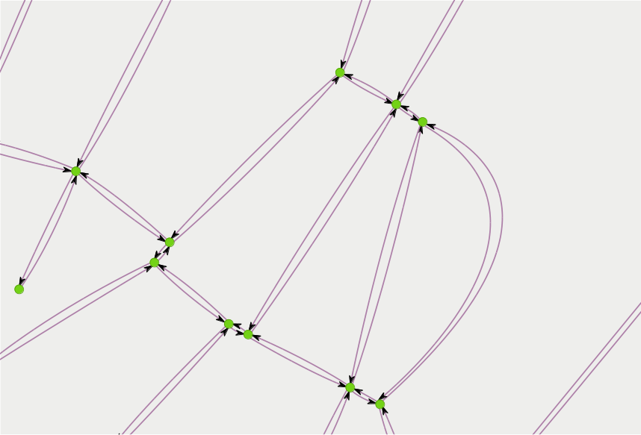
mapping IDs
OSM +
topology +
graph
Notes:
Several layers of IDs.

Slide 69
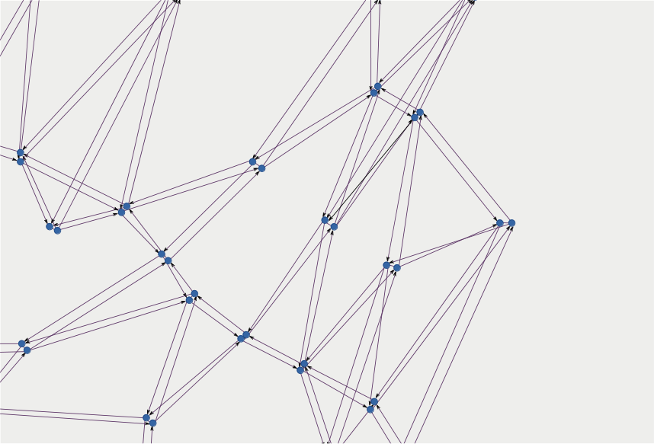
mapping IDs
OSM +
topology +
graph +
line graph
Notes:
Several layers of IDs.

Slide 70
restrictions
Values:
yes
Notes:
The hardest part in this project.
Not all implemented yet. Needs remodeling.

Slide 71
restrictions
Values:
yes,
no
Notes:
The hardest part in this project.
Not all implemented yet. Needs remodeling.

Slide 72
restrictions
Values:
yes, no,
permissive
Notes:
The hardest part in this project.
Not all implemented yet. Needs remodeling.

Slide 73
restrictions
Values:
yes, no, permissive,
designated
Notes:
The hardest part in this project.
Not all implemented yet. Needs remodeling.

Slide 74
restrictions
Values:
yes, no, permissive, designated,
private
Notes:
The hardest part in this project.
Not all implemented yet. Needs remodeling.

Slide 75
restrictions
Values:
yes, no, permissive, designated, private,
discouraged
Notes:
The hardest part in this project.
Not all implemented yet. Needs remodeling.

Slide 76
restrictions
Values:
yes, no, permissive, designated, private, discouraged,
delivery
Notes:
The hardest part in this project.
Not all implemented yet. Needs remodeling.

Slide 77
restrictions
Values:
yes, no, permissive, designated, private, discouraged, delivery,
customers ...
Notes:
The hardest part in this project.
Not all implemented yet. Needs remodeling.

Slide 78
restrictions
values:
yes, no, permissive, designated, private, discouraged, delivery, customers ...
routing:
one-way (explicit / implicit), lanes ...
Notes:
The hardest part in this project.
Not all implemented yet. Needs remodeling.

Slide 79
restrictions
values:
yes, no, permissive, designated, private, discouraged, delivery, customers ...
routing:
one-way (explicit / implicit), lanes ...
transportation mode:
all
Notes:
The hardest part in this project.
Not all implemented yet. Needs remodeling.

Slide 80
restrictions
values:
yes, no, permissive, designated, private, discouraged, delivery, customers ...
routing:
one-way (explicit / implicit), lanes ...
transportation mode:
all,
foot
Notes:
The hardest part in this project.
Not all implemented yet. Needs remodeling.

Slide 81
restrictions
values:
yes, no, permissive, designated, private, discouraged, delivery, customers ...
routing:
one-way (explicit / implicit), lanes ...
transportation mode:
all, foot,
vehicle
Notes:
The hardest part in this project.
Not all implemented yet. Needs remodeling.

Slide 82
restrictions
values:
yes, no, permissive, designated, private, discouraged, delivery, customers ...
routing:
one-way (explicit / implicit), lanes ...
transportation mode:
all, foot, vehicle,
bicycle
Notes:
The hardest part in this project.
Not all implemented yet. Needs remodeling.

Slide 83
restrictions
values:
yes, no, permissive, designated, private, discouraged, delivery, customers ...
routing:
one-way (explicit / implicit), lanes ...
transportation mode:
all, foot, vehicle, bicycle,
motor_vehicle
Notes:
The hardest part in this project.
Not all implemented yet. Needs remodeling.

Slide 84
restrictions
values:
yes, no, permissive, designated, private, discouraged, delivery, customers ...
routing:
one-way (explicit / implicit), lanes ...
transportation mode:
all, foot, vehicle, bicycle, motor_vehicle,
motorcycle
Notes:
The hardest part in this project.
Not all implemented yet. Needs remodeling.

Slide 85
restrictions
values:
yes, no, permissive, designated, private, discouraged, delivery, customers ...
routing:
one-way (explicit / implicit), lanes ...
transportation mode:
all, foot, vehicle, bicycle, motor_vehicle, motorcycle,
motorcar
Notes:
The hardest part in this project.
Not all implemented yet. Needs remodeling.

Slide 86
restrictions
values:
yes, no, permissive, designated, private, discouraged, delivery, customers ...
routing:
one-way (explicit / implicit), lanes ...
transportation mode:
all, foot, vehicle, bicycle, motor_vehicle, motorcycle, motorcar,
goods
Notes:
The hardest part in this project.
Not all implemented yet. Needs remodeling.

Slide 87
restrictions
values:
yes, no, permissive, designated, private, discouraged, delivery, customers ...
routing:
one-way (explicit / implicit), lanes ...
transportation mode:
all, foot, vehicle, bicycle, motor_vehicle, motorcycle, motorcar, goods,
hgv
Notes:
The hardest part in this project.
Not all implemented yet. Needs remodeling.
Hgv = heavy goods vehicle

Slide 88
restrictions
values:
yes, no, permissive, designated, private, discouraged, delivery, customers ...
routing:
one-way (explicit / implicit), lanes ...
transportation mode:
all, foot, vehicle, bicycle, motor_vehicle, motorcycle, motorcar, goods, hgv ...
by use:
psv
Notes:
The hardest part in this project.
Not all implemented yet. Needs remodeling.
PSV = public service vehicle
= bus, taxi

Slide 89
restrictions
values:
yes, no, permissive, designated, private, discouraged, delivery, customers ...
routing:
one-way (explicit / implicit), lanes ...
transportation mode:
all, foot, vehicle, bicycle, motor_vehicle, motorcycle, motorcar, goods, hgv ...
by use:
psv,
car_sharing
Notes:
The hardest part in this project.
Not all implemented yet. Needs remodeling.

Slide 90
restrictions
values:
yes, no, permissive, designated, private, discouraged, delivery, customers ...
routing:
one-way (explicit / implicit), lanes ...
transportation mode:
all, foot, vehicle, bicycle, motor_vehicle, motorcycle, motorcar, goods, hgv ...
by use:
psv, car_sharing,
emergency
Notes:
The hardest part in this project.
Not all implemented yet. Needs remodeling.

Slide 91
restrictions
values:
yes, no, permissive, designated, private, discouraged, delivery, customers ...
routing:
one-way (explicit / implicit), lanes ...
transportation mode:
all, foot, vehicle, bicycle, motor_vehicle, motorcycle, motorcar, goods, hgv ...
by use:
psv, car_sharing, emergency,
hazmat
Notes:
The hardest part in this project.
Not all implemented yet. Needs remodeling.

Slide 92
restrictions
values:
yes, no, permissive, designated, private, discouraged, delivery, customers ...
routing:
one-way (explicit / implicit), lanes ...
transportation mode:
all, foot, vehicle, bicycle, motor_vehicle, motorcycle, motorcar, goods, hgv ...
by use:
psv, car_sharing, emergency, hazmat,
disabled
Notes:
The hardest part in this project.
Not all implemented yet. Needs remodeling.

Slide 93
restrictions
values:
yes, no, permissive, designated, private, discouraged, delivery, customers ...
routing:
one-way (explicit / implicit), lanes ...
transportation mode:
all, foot, vehicle, bicycle, motor_vehicle, motorcycle, motorcar, goods, hgv ...
by use:
psv, car_sharing, emergency, hazmat, disabled ...
Notes:
The hardest part in this project.
Not all implemented yet. Needs remodeling.

Slide 94
restrictions
values:
yes, no, permissive, designated, private, discouraged, delivery, customers ...
routing:
one-way (explicit / implicit), lanes ...
transportation mode:
all, foot, vehicle, bicycle, motor_vehicle, motorcycle, motorcar, goods, hgv ...
by use:
psv, car_sharing, emergency, hazmat, disabled ...
dimensions:
max height, weight, width ...
Notes:
The hardest part in this project.
Not all implemented yet. Needs remodeling.

Slide 95
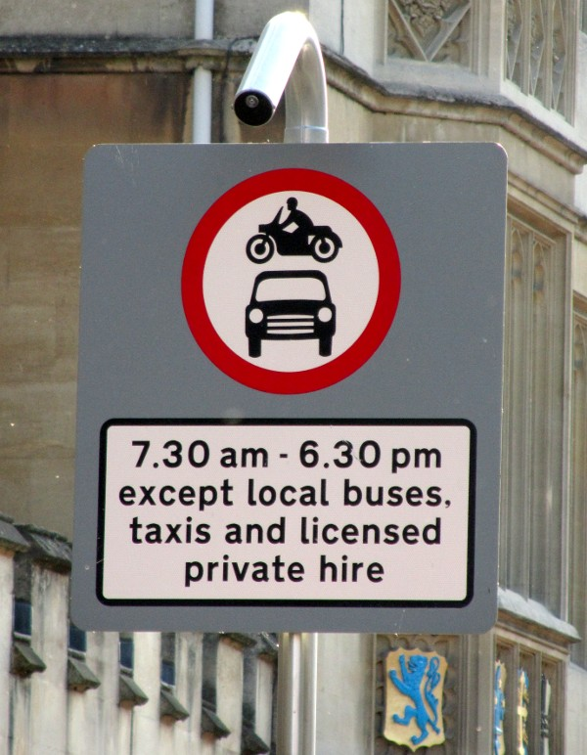
conditional
restrictions
Photo (cropped): Achadwick. ©CC-SA 2.0
http://wiki.openstreetmap.org/wiki/File:UK_motor_restriction_sign_with_exceptions.jpg
Notes:
Not implemented at all yet.

Slide 96
conditional
restrictions
Photo (cropped): Achadwick. ©CC-SA 2.0
http://wiki.openstreetmap.org/wiki/File:UK_motor_restriction_sign_with_exceptions.jpg
motor_vehicle=no
motor_vehicle:conditional=yes @ (18:30-07:30)
psv=yes
Notes:
Not implemented at all yet.

Slide 97
conditional
restrictions
maxspeed=none
maxspeed:conditional=
120 @ (06:00-20:00);
100 @ (22:00-06:00)
Notes:
Not implemented at all yet.
German highway.

Slide 98
turning
restrictions
Relation:
Notes:
Turning restrictions are RELATIONS,
Handled differently.
Problem for me as the imprter tool
Osm2pgsql did not handle relations well.
Needs some parsing.

Slide 99
turning
restrictions
Relation:
from
Notes:
FROM edge

Slide 100
turning
restrictions
Relation:
from → via
Notes:
VIA vertex OR edge(s).
Difficult to handle edge case since the LGU does not know enough about the route.

Slide 101
turning
restrictions
Relation:
from → via → to
Notes:
TO edge.

Slide 102
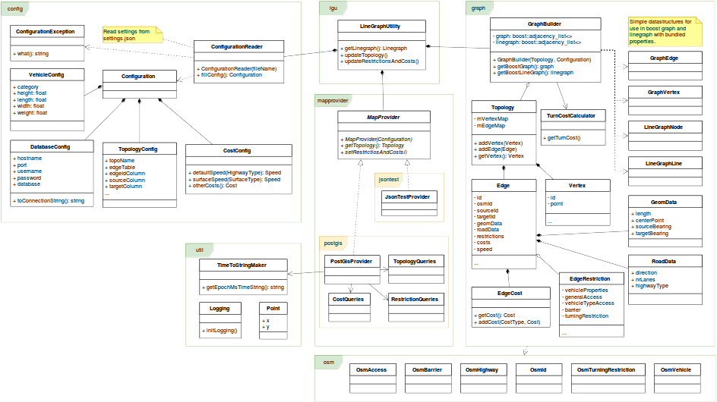
solution
class diagram
Notes:
Small look at the class diagram to give a view of the solution.
Packages:
- config
- graph
- lgu
- mapprovider
- osm
- util

Slide 103
LineGraph
Utility
Jonas Bergman, jobe0900@student.miun.se
Notes:
Have given overview of project:
Requirements, background and remarks about the solution.
Conclusion
OSM is messy = real traffic is messy?
Restrictions are hard. Need to rework them in the LineGraphUtility.

