Slide 1
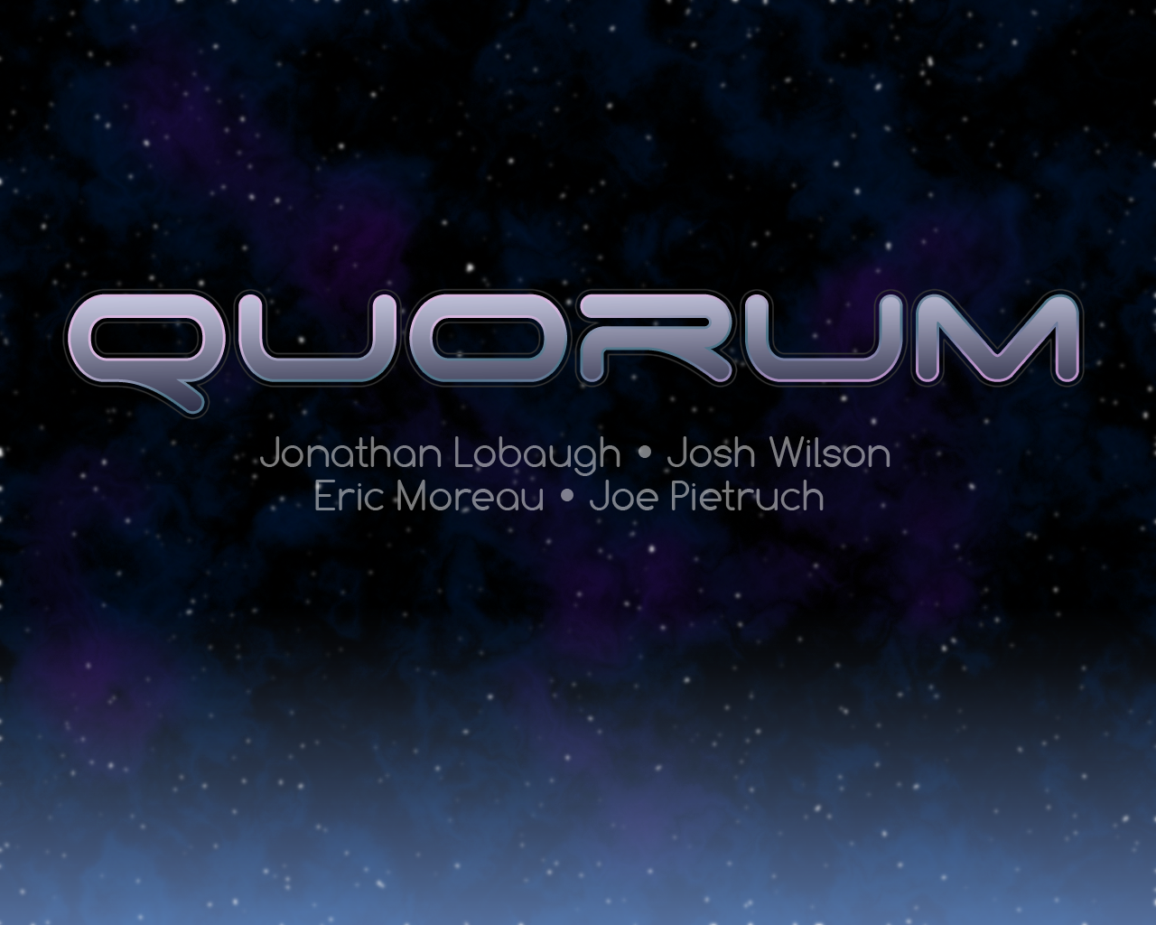
A co-operative top-down space exploration and shooter game

Slide 2
Quo∙rum [kwawr-uhm, kwohr-]
the number of members of a group or organization required to be present to transact business legally, usually a majority - OR -
the minimum number of people needed to get stuff done

Slide 3
Basic Game Concept
Command an under-staffed starship with a skeleton crew
Complete missions to repair/upgrade ship
Reap vengeance upon the “Vickarians”

Slide 4
Game Description
Back Story
Characters
World
Ship Design

Slide 5
A long time ago in a galaxy far, far away. . . .
Quadrant created
Sun ended
Quadrant thrown into quantum chaos
“Dev” wars start
Bad guys move in
People fight back
A lot of death and destruction
Enter you the player!

Slide 6
Character Reference
Bad guys: “Vick-arians”
Good guys
Captain Dale Houston
Optional First Mate Fuzzy Bottom Knocker
There are also some random pirate people
And a bunch of random shop people
And people people
And Space Hermits…IN SPAAAACE!

Slide 7
World 1-1
INFINITE…you will never find the end (muhahahaha)
Quadrant of space known as “Atarii”
Collapsed sun, Pirates, “Vick-arians”, black holes, asteroids…all around bad place.
the princess is a lie … but the pie is real

Slide 8
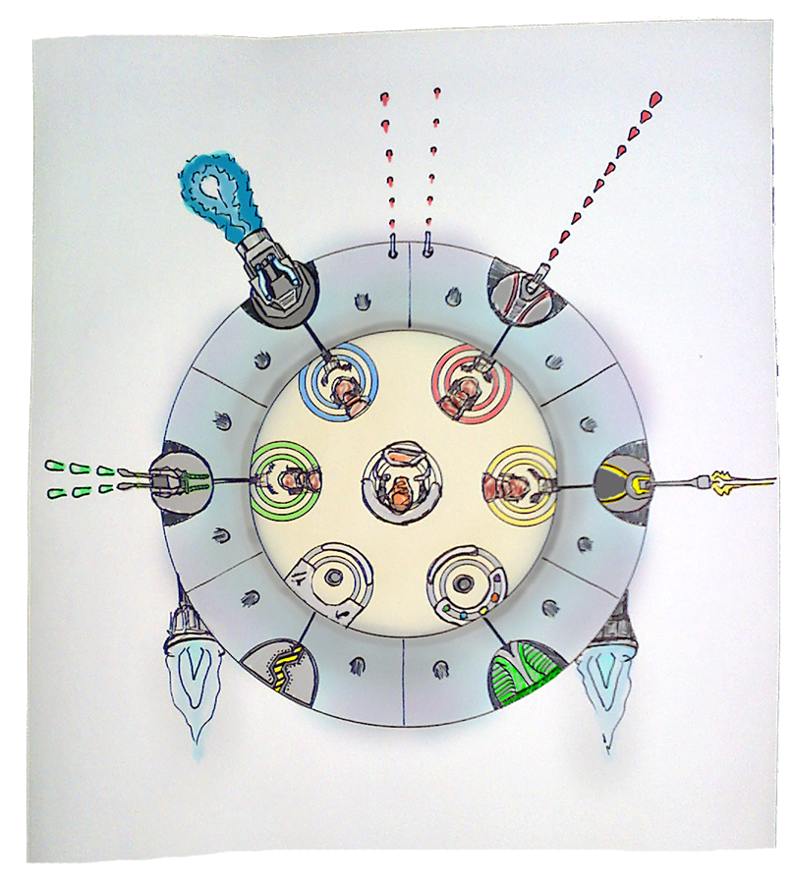
Preliminary Design

Slide 9
User Interface
Top-down view
Station status
Player status
Radar
Map View w/ beacon
Store front
Game menus
Lobby (Networking?)

Slide 10
Controls
Xbox360 Controller
Quick switching between stations
Control stations
Turrets
Shields
Piloting
Repairing

Slide 11
Graphics & Audio
2D with 3D highlights
Space sci-fi graphics
AWESOME audio tracks

Slide 12
System Requirements
Windows XP/Vista
2+ XBox360 Wired controllers
DirectX 10 enabled graphics card
1 GB of Memory
100 MB of Hard Drive space

Slide 13
Risk Management
C++ Memory Leaks
Networking
Development time on the engine
Work (the kind you make money at)
Its spring time…Come on! (aka Spring fever)
Xbox360 (we are game students!)
Other classes
Laziness

Slide 14
Questions?

