Slide 1

CB23F35 · LOW-CODE APPLICATION DEVELOPMENT USING ZOHO CREATOR
Solar Panel Performance & Maintenance Tracker
A monitoring and maintenance management application built on Zoho Creator
Jobeson J
Reg. No. 240701217 · B.E. Computer Science Engineering
Course Faculty: Bhuvaneshwaran B · HOD: Dr. J. Manoranjani
Notes:
Introduce the project: a Zoho Creator application that tracks solar panel performance and maintenance. Presented for the End Semester Examination, November 2026.

Slide 2





THE PROBLEM
Weak panels lose energy until noticed
Performance readings, panel details and maintenance history sit in different places, so losses go unseen and maintenance is arranged late.
Compare output
Classify panels
Track maintenance
Add weather context
Ask in plain language
Actual vs expected energy for every reading, repeatably
Find poor performers without manual calculation
Inspection, repair and next due date against the panel
Temperature, humidity, cloud cover, solar radiation
Analysis and maintenance advice from an AI agent
Notes:
Five needs drawn from Section 1.2 of the report.

Slide 3
THE SOLUTION
One application for the whole workflow
What it does
4
3
1
Stores solar panel records and expected vs actual energy
Calculates Performance = Actual ÷ Expected × 100
Classifies health and alerts below 70%
Keeps maintenance records and reminders
Fetches weather from Open-Meteo through a Custom API
Shows everything on a Tracker Dashboard
forms
named reports
dashboard page
4
1
1
form workflows
Custom API
AI agent
Forms: Solar Panels · Energy Readigs · Maintenance Records · Self Service Form. Zoho Analytics workspace created for further analysis.

Slide 4
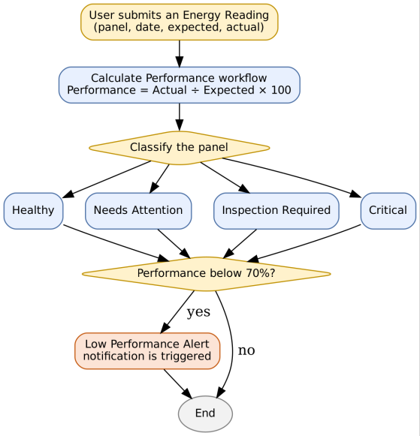
HOW IT WORKS
Each reading is scored and classified
Class | Performance
Healthy | 80% or above
Needs Attention | 70% to below 80%
Inspection Required | 50% to below 70%
Critical | Below 50%
Low Performance Alert
Raised when performance falls below 70%. Class thresholds are design values adopted in the report; the values configured in the workflow were not supplied.

Slide 5
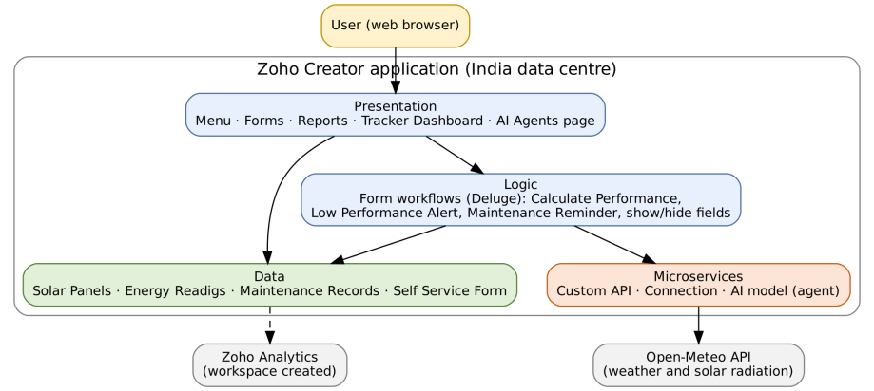
SYSTEM DESIGN
Four layers on one low-code platform
Presentation
Menu, forms, reports, Tracker Dashboard, AI Agents page
Logic
Deluge form workflows: calculate, alert, reminder
Data
Solar Panels, Energy Readigs, Maintenance Records, Self Service Form
Microservices
Custom API, connection, AI model (agent)

Slide 6
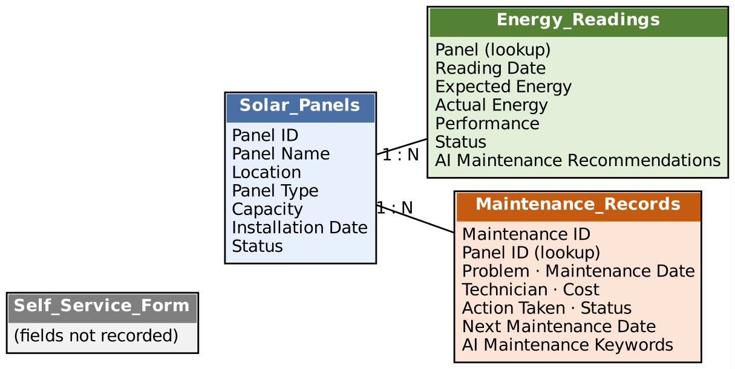
DATA MODEL
Three linked forms hold the data
How the forms connect
Solar Panels is the parent record: ID, name, location, type, capacity, installation date, status
Energy Readigs looks up a panel and stores expected energy, actual energy and performance
Maintenance Records looks up a panel and stores problem, dates, technician, cost, action and status
One panel has many readings and many maintenance records (1 : N)

Slide 7
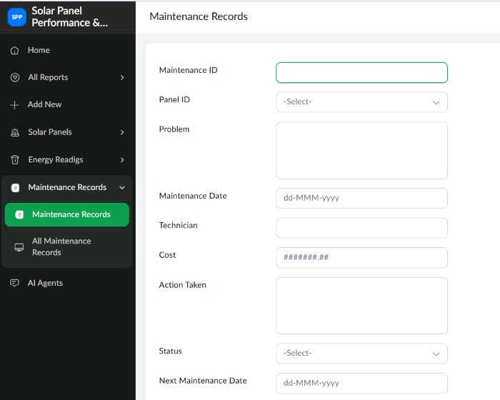
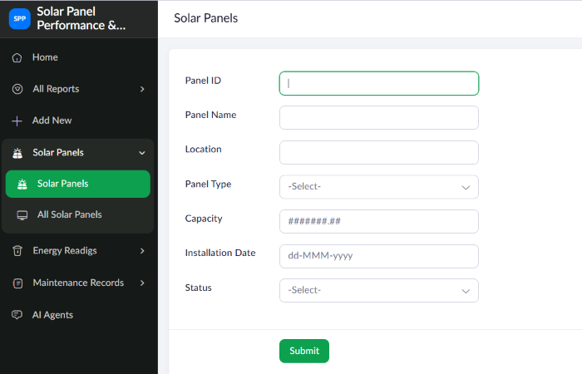
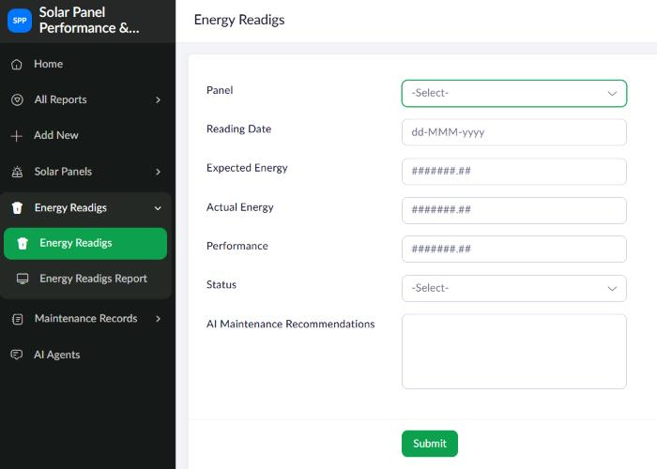
IMPLEMENTATION
Forms in live mode
Solar Panels
Energy Readigs
Maintenance Records
Form and menu name “Energy Readigs” carries a spelling slip, logged as defect D-04.

Slide 8
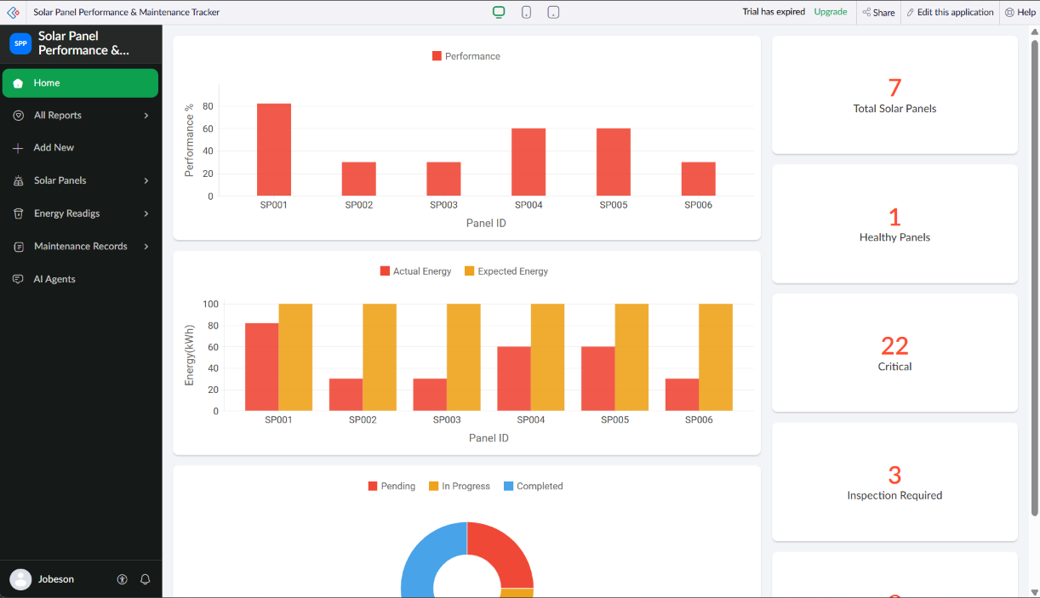
IMPLEMENTATION
The dashboard shows panel health at a glance
7
Total Solar Panels
1
Healthy Panels
3
Inspection Required
22
Critical (see open items)
Left column: performance %, actual vs expected energy, maintenance-status donut. Right: count tiles.

Slide 9
AUTOMATION
Short Deluge workflows carry the business rules
1
Calculate Performance
2
Low Performance Alert
3
Maintenance Reminder
Energy Readigs · on submit
Energy Readigs · on submit
Maintenance Records
Performance = Actual ÷ Expected × 100, then classify the panel
Notifies when performance is below 70% (channel not recorded)
Supports follow-up on due maintenance
Reference logic (Code 5.1)
performance = (actual / expected) * 100;
if (performance < 70) { /* Low Performance Alert */ }

Slide 10

INTEGRATIONS
Weather, AI agent and analytics
Fetch Solar Weather Data
Solar Performance Analyst
Zoho Analytics
Custom API calling Open-Meteo for temperature, humidity, cloud cover and solar radiation. Call reported successful.
AI agent defined as a microservice for analysis and maintenance recommendations. Chat assistant disabled in the account.
Workspace and “Solar Analytics Connection” created; import screen shown. No imported tables or reports.
Reported
Defined; chat disabled
Set up only

Slide 11
RESULTS
Only one panel clears the 70% line
What the values show
SP001 is near 82%, the only panel above 70%
SP004 and SP005 sit near 60%
SP002, SP003 and SP006 are near 30%
Expected energy is 100 for each panel, so the energy chart carries the same information

Slide 12
OBJECTIVES VS EVIDENCE
What is achieved, and what the evidence shows
Objective | Implemented through | Status
Store panel information | Solar Panels form | Achieved
Record energy, calculate performance | Energy Readigs; Calculate Performance | Achieved
Maintenance records | Maintenance Records; Reminder | Achieved
Dashboard | Tracker Dashboard | Achieved
Classify panels | Calculate Performance | Partly evidenced
Low-performance notification | Low Performance Alert | Built, not shown
Weather data | Fetch Solar Weather Data | Achieved (reported)
AI assistance | AI agent; chat assistant | Agent defined; chat off
The report states what it cannot show: Deluge sources, configured thresholds, alert channel, AI output and weather responses were not supplied.

Slide 13
TESTING AND DEBUGGING
Open items found during review
D-01
Chat agent disabled for the organisation (Zia setting)
Enable under Operations → Zia
D-02
Critical tile shows 22, more than the 7 panels
Check the tile criteria
D-03
Two Custom API entries named Fetch Solar Weather Data (one Draft)
Delete or publish the draft
D-04
Form and menu spelled “Energy Readigs”
Rename to Energy Readings
D-05
Application trial expired
Upgrade or re-create the application
All five are Open. Test cases TC-08 to TC-12 are planned and have not been executed.

Slide 14
FUTURE ENHANCEMENTS
Roadmap: fix, verify, then extend
Correct open items
D-01 to D-05
Add roles and profiles
Operators, technicians, viewers
1
5
Record thresholds and scripts
Author's own records
Complete Zoho Analytics
Imported tables, reports
2
6
Run planned tests
Record results
Weather + history in AI advice
Chat agent enabled
3
7
Store weather per reading
Working Custom API
Each step fits the existing data model, apart from one new field for weather values.
4

Slide 15
Conclusion
Panel records, energy readings and maintenance history now live in one Zoho Creator application
Performance is calculated, panels are classified and a dashboard shows the position
Weather API and AI agent are in place; chat assistant and analytics need finishing
The report records plainly what is shown and what is still open
Thank you
Jobeson J · 240701217 · Department of CSE

