Slide 1
FOUNDATIONS OF ARTIFICIAL INTELLIGENCE · PROJECT REVIEW
Smart Rummy
Q
♦
K
♥
J
♣
A
♠
10
♠
An Explainable AI Agent for 13-Card Indian Rummy using Search and Heuristic Decision-Making
♦
♥
♣
♠
♠
Jobeson Julius
240701217
Pragadesh S
240701388
Department of Computer Science and Engineering
Rajalakshmi Engineering College, Chennai · October 2026
Notes:
Introduce the team and the project: Smart Rummy, a web game where computer players are AI agents built from classical techniques, and a coach explains every move to the player.

Slide 2
Abstract
♠
123
♥
Indian Rummy is a game of skill played by millions, yet digital versions never explain why a move is good, and their bots are black boxes.
Smart Rummy is a full-stack web game where every computer player is a utility-based AI agent built only from classical AI: backtracking search, memoised bitmask dynamic programming, heuristic simulation and exact probability.
The same reasoning powers a coach that explains every move, lists helpful cards (outs) and reads what opponents are collecting.
automated tests passing
22.6 ms
♦
to evaluate a 13-card hand
65–66%
♣
rounds won by smart agents vs reflex agent
Notes:
Summarise: problem, approach (classical AI only, no machine learning), and the three headline numbers.

Slide 3






Problem Statement and Objectives
♠
Objectives
The problem
Model each bot as a rational agent (PEAS)
Rummy apps are built for real-money play, not learning
No explanation of why a move is good or bad
Computer opponents are opaque black boxes
Finding the best arrangement of 13 cards is combinatorially hard; naive search is exponential
Verify declarations by backtracking search
Evaluate hands fast with bitmask DP
Explain every move with an AI coach
Verify with tests and simulated games
Notes:
Explain the gap: no rummy app teaches. Then list the five objectives.

Slide 4
Literature Survey (1/2)
Paper (authors, year, venue) | Methodology | Merit | Drawback
Kotnik & Kalita (2003) TD-Rummy vs EVO-Rummy, ICML | Self-play training of Gin Rummy agents with temporal-difference learning and evolution | Strategy emerges with no expert knowledge | Opaque neural evaluator; Gin Rummy only, no jokers
Cowling, Powley & Whitehouse (2012) Information Set MCTS, IEEE TCIAIG | Monte Carlo tree search over information sets for hidden-card games | General, strong for imperfect information | Thousands of simulations per move; hard to explain
den Hertog & Hulshof (2006) Solving Rummikub by ILP, Computer Journal | Integer linear programming for optimal meld placement | Provably optimal meld formation | Needs a solver; Rummikub tiles, no wild joker
Notes:
Earlier rummy and card-game AI: learning agents, Monte Carlo search, and exact meld solvers. None explain their moves.

Slide 5
Literature Survey (2/2)
Paper (authors, year, venue) | Methodology | Merit | Drawback
Truong & Neller (2021) Data-driven Gin Rummy hand evaluation, AAAI | CNN “offensive” score plus Bayesian “defensive” discard risk | Combines hand value with opponent risk | 55.4% vs a simple baseline; black-box model
Saha et al. (2026) Rule-based strategy in Indian Rummy, arXiv | MinScore by bitmask DP, MinDist, opponent-aware strategy | First metric study of Indian Rummy; >60% wins | Static metrics; simulation only, no explanation
Mohan (2026) IRumAI: RL for Indian Rummy, arXiv | PPO agent with behaviour-cloning warm start | 53.9% vs strongest search baseline; 0.33 ms/move | Needs demonstration data; decisions not explainable
Notes:
Recent work, including two 2026 papers on Indian Rummy itself. Our system adds explanations and a live coach.

Slide 6



Research Gap
♥
♦
♣
Mostly Gin Rummy
Solvers without players
No explanations
Indian Rummy, with its round-specific wild joker and mandatory pure sequence, is barely studied
Exact meld optimisation has not been combined with a playing agent and an interactive game
No reviewed system explains its decisions to a human learner
Smart Rummy: exact DP hand evaluation + utility-based agents + plain-language explanations, in one playable web app
Notes:
Three gaps, and how our project fills all three.

Slide 7
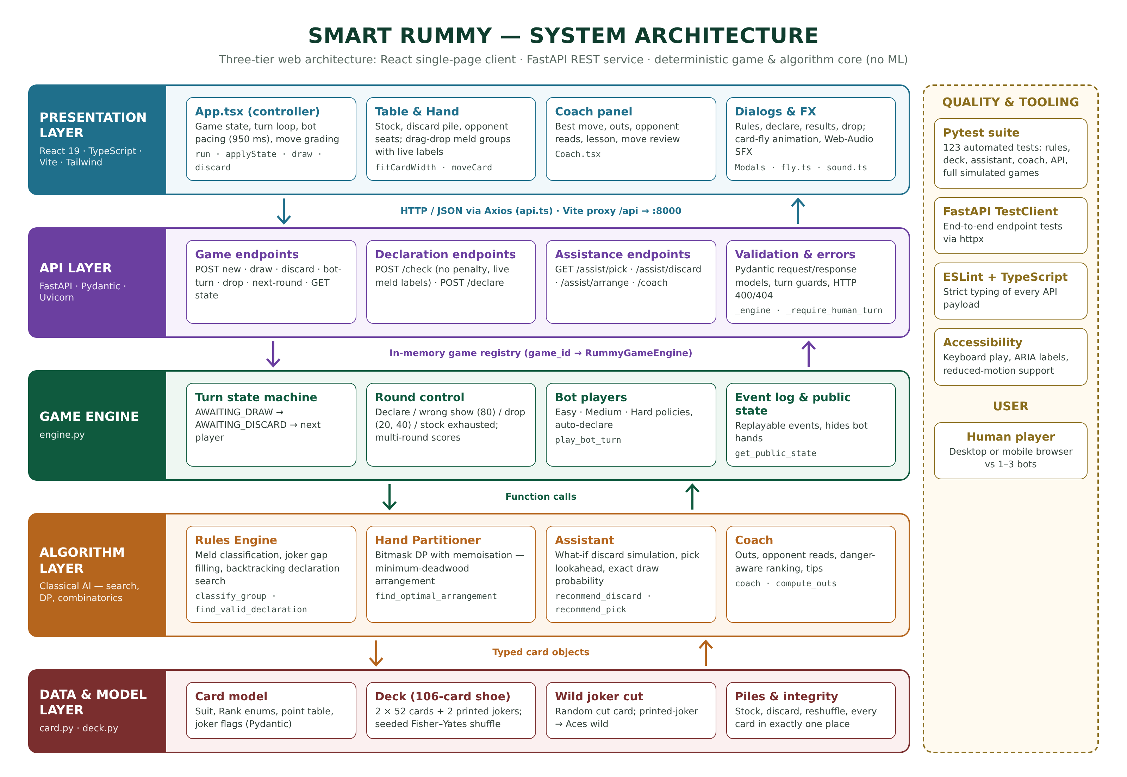
System Architecture
Presentation
React + TypeScript UI, coach panel
API
FastAPI, 13 REST endpoints
Game engine
Turns, scoring, agents
AI core
Search, DP, heuristics
Data
Cards, 106-card shoe
Notes:
Walk top to bottom: the React client talks to FastAPI over REST; the engine runs turns and agents; the AI core holds the algorithms; the data layer models cards and the deck.

Slide 8
The Bot as an Intelligent Agent
Performance
Declare first; otherwise minimise deadwood and total score
Environment properties
P
Partially observable hidden stock and hands
E
Environment
106-card shoe, stock, discard pile, wild joker, 2–4 players
Stochastic random next card
Multi-agent competitive opponents
A
Actuators
Draw from stock or discard pile, discard, declare
Sequential each discard shapes the future
S
Sensors
Own hand, open card, discard history, opponents’ pickups
Static & discrete finite cards and actions
Notes:
Describe the task environment with PEAS, then why rummy is hard for AI: hidden cards, chance, other players.

Slide 9






Implementation
♠
♥
♦
React 19 + TypeScript
Python + FastAPI
Classical AI core
Single-page client, Vite, Tailwind
13 REST endpoints, Pydantic models
Backtracking, bitmask DP, simulation
♣
♠
♥
Pytest
Responsive UI
Live game loop
123 automated tests, simulated games
Desktop and mobile, keyboard play
Bots paced 950 ms apart, animated
Notes:
Tech stack and how the pieces fit: React front end, FastAPI back end, Python AI core, Pytest.

Slide 10
Module 1: Game Environment and Rules Engine
Seeded Fisher–Yates shuffle
Uniform, reproducible 106-card shoe
Declaration = constraint satisfaction
search(remaining, groups):
if remaining empty:
return groups if ≥2 seq, ≥1 pure
if remaining in dead: FAIL
f ← first remaining card
for each valid group g ∋ f:
r ← search(remaining − g)
if r ≠ FAIL: return r
dead.add(remaining)
return FAIL
Wild-joker cut
Random cut; printed joker makes Aces wild
Meld classification
Pure / impure sequence, set; Ace low or high, no K-A-2
Joker gap filling
_run_feasible checks if jokers can fill a run
Turn engine
Draw → discard / declare; drop 20/40, wrong show 80
Backtracking with failure memoisation
Notes:
Module 1 builds the environment: shuffle, joker cut, strict meld rules, and the turn engine. Declarations are verified by backtracking search that memoises dead ends.

Slide 11
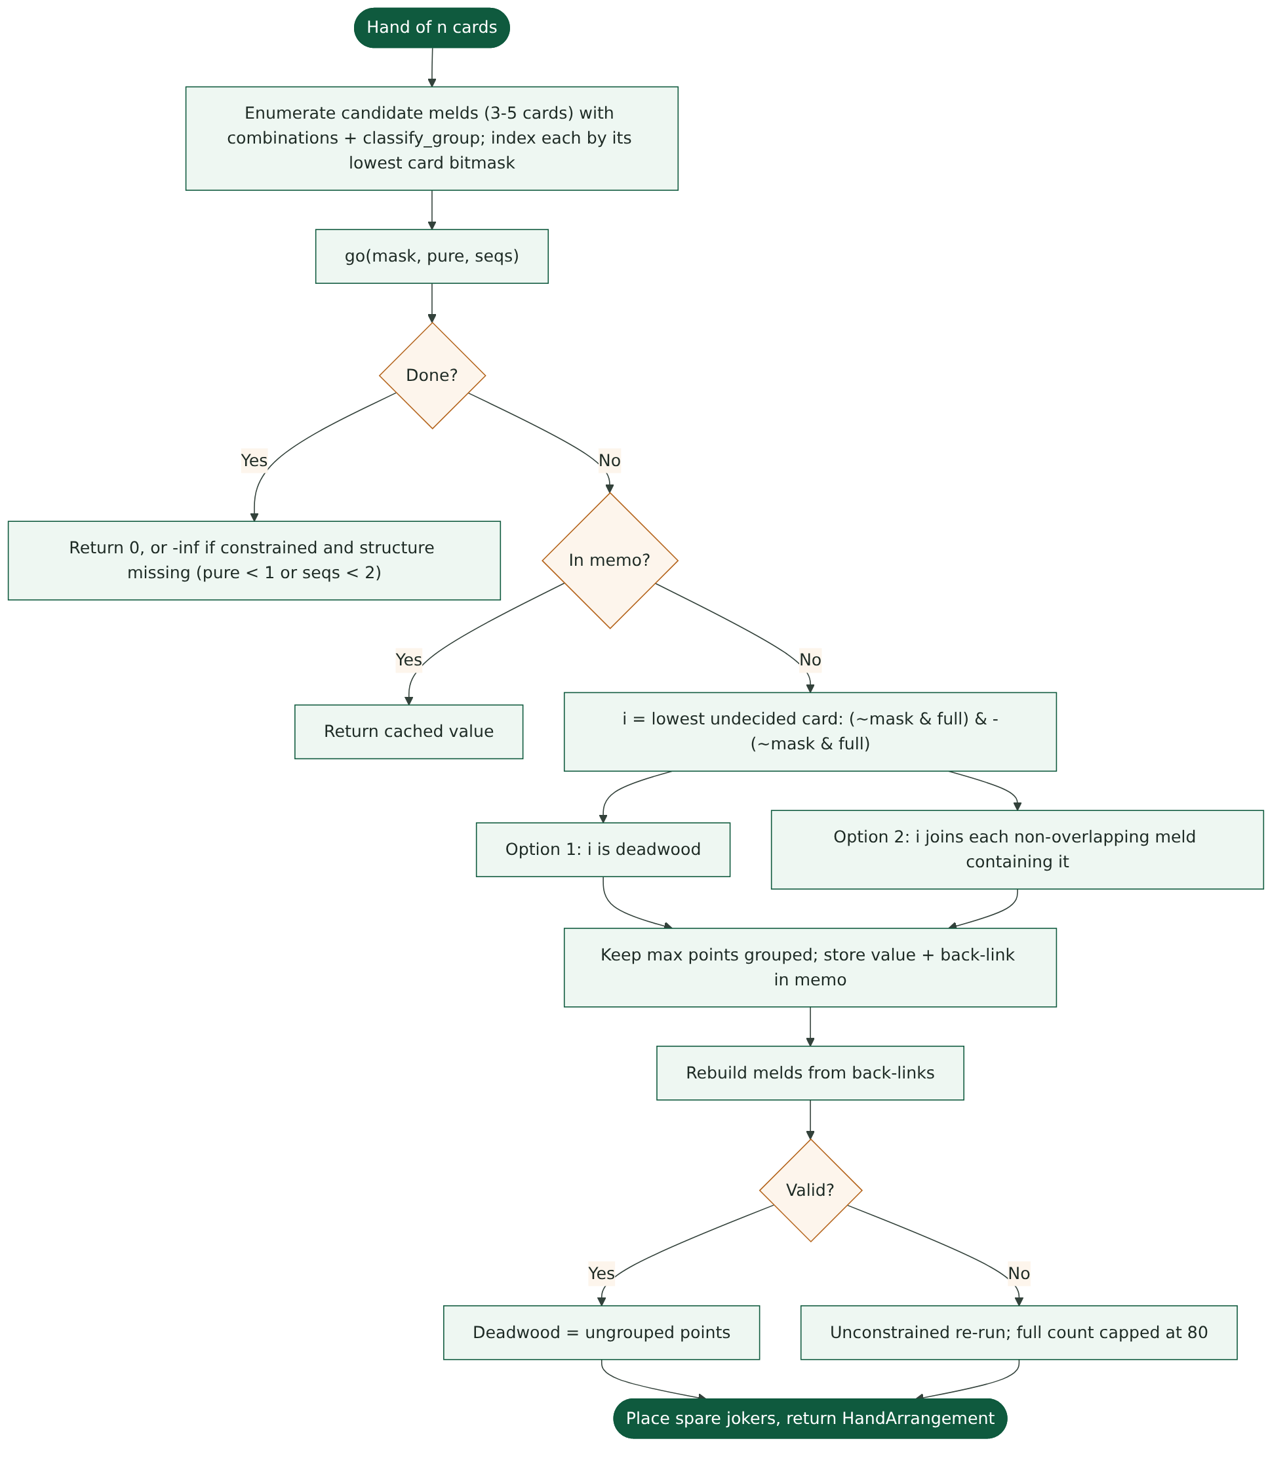
Module 2: Hand Evaluation with Bitmask DP
Weighted set packing
Choose disjoint melds covering the most points
Lowest-undecided-card branching
Each card decided once: deadwood, or joins a meld
Memoised state (mask, pure, seqs)
Back-links rebuild the optimal melds
Two passes
Constrained (≥1 pure, ≥2 seq), else unconstrained, capped at 80
Progress cost (utility)
C(H) = loose points + 30·[no pure] + 15·[< 2 seq]
Notes:
Module 2 is the core algorithm. Explain the lowest-card trick: each card is decided once, so permutations of the same choice are never explored, and memoisation keeps it at about 23 ms.

Slide 12


Module 3: Decision Making, Agents and Coach
♦
♣
Three agent designs
Easy
Simple reflex
Takes jokers only; throws highest loose card
♦
Discard simulation
Pick lookahead
Try all 14 discards; rank by (cost, connectivity, −points)
Take the open card only if the hand strictly improves
Medium
Utility-based
Lookahead pick + discard simulation
♣
♠
♥
Exact probability
Coach
Hard
Model-based utility
Medium + memory of dead cards
♠
P(useful) = useful unseen copies ÷ unseen cards
Best move + reason, outs, opponent reads, move grading
Notes:
Module 3 turns evaluation into decisions, gives three difficulty levels as three agent types, and reuses the same computations in the coach.

Slide 13
Results: Playing Strength
65%
♥
Medium beats Easy
p = 0.0035
66%
♦
Hard beats Easy
p = 0.0018
50%
♣
Hard vs Medium
tie: memory rarely changes a move
Notes:
300 bot-vs-bot rounds, alternating who goes first. Both utility agents clearly beat the reflex agent; Medium and Hard tie because dead-card memory only breaks ties.

Slide 14
Results: Speed and Correctness
♠
123 / 123
tests pass: rules, deck, AI, API, full games
♥
< 0.3 s
every bot decision, far under the 950 ms pause
♦
27
candidate melds per hand on average
Notes:
Every operation runs far faster than the pause between bot moves. All 123 tests pass.

Slide 15
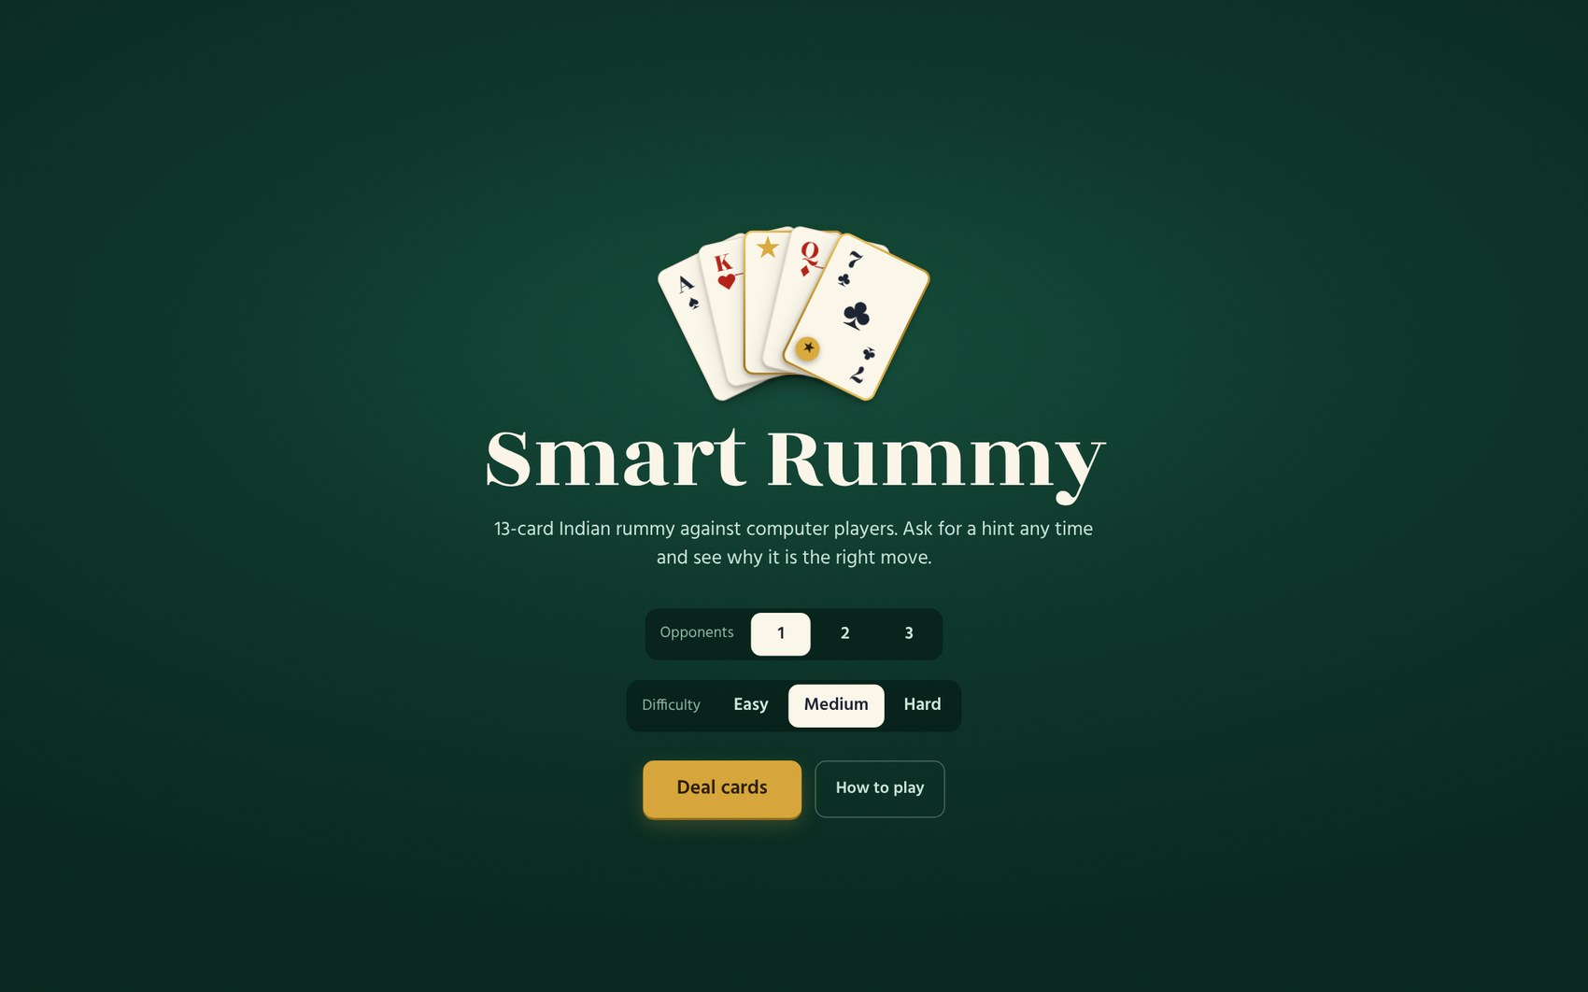
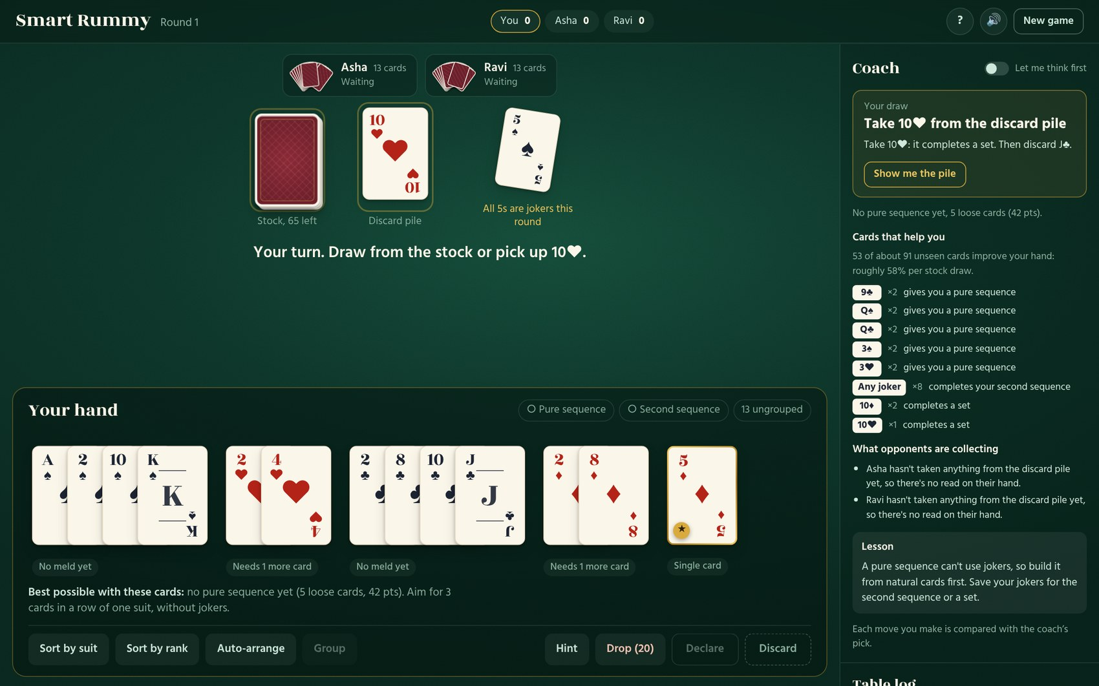
Output Screenshots (1/3)
Start screen: choose opponents and difficulty
Game table with the coach and helpful cards
Notes:
Real screenshots captured while playing the app.

Slide 16
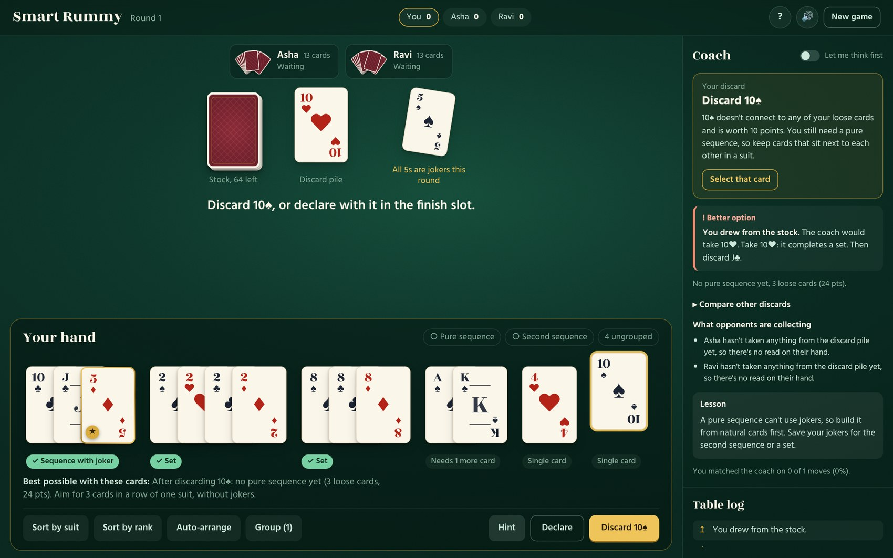
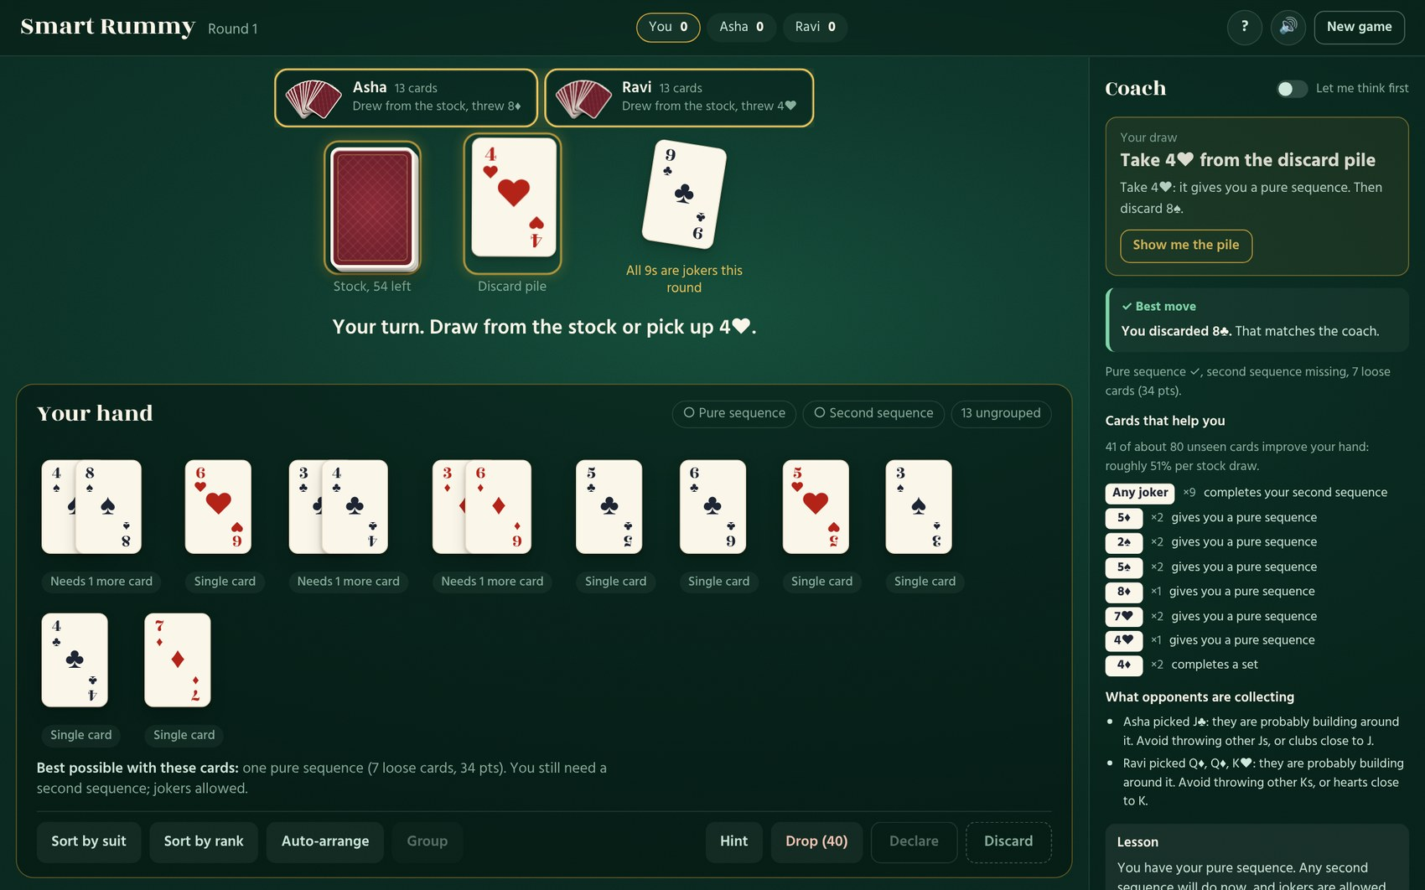
Output Screenshots (2/3)
Discard advice with reasoning and move review
Opponent reads and each bot’s last move
Notes:
Real screenshots captured while playing the app.

Slide 17
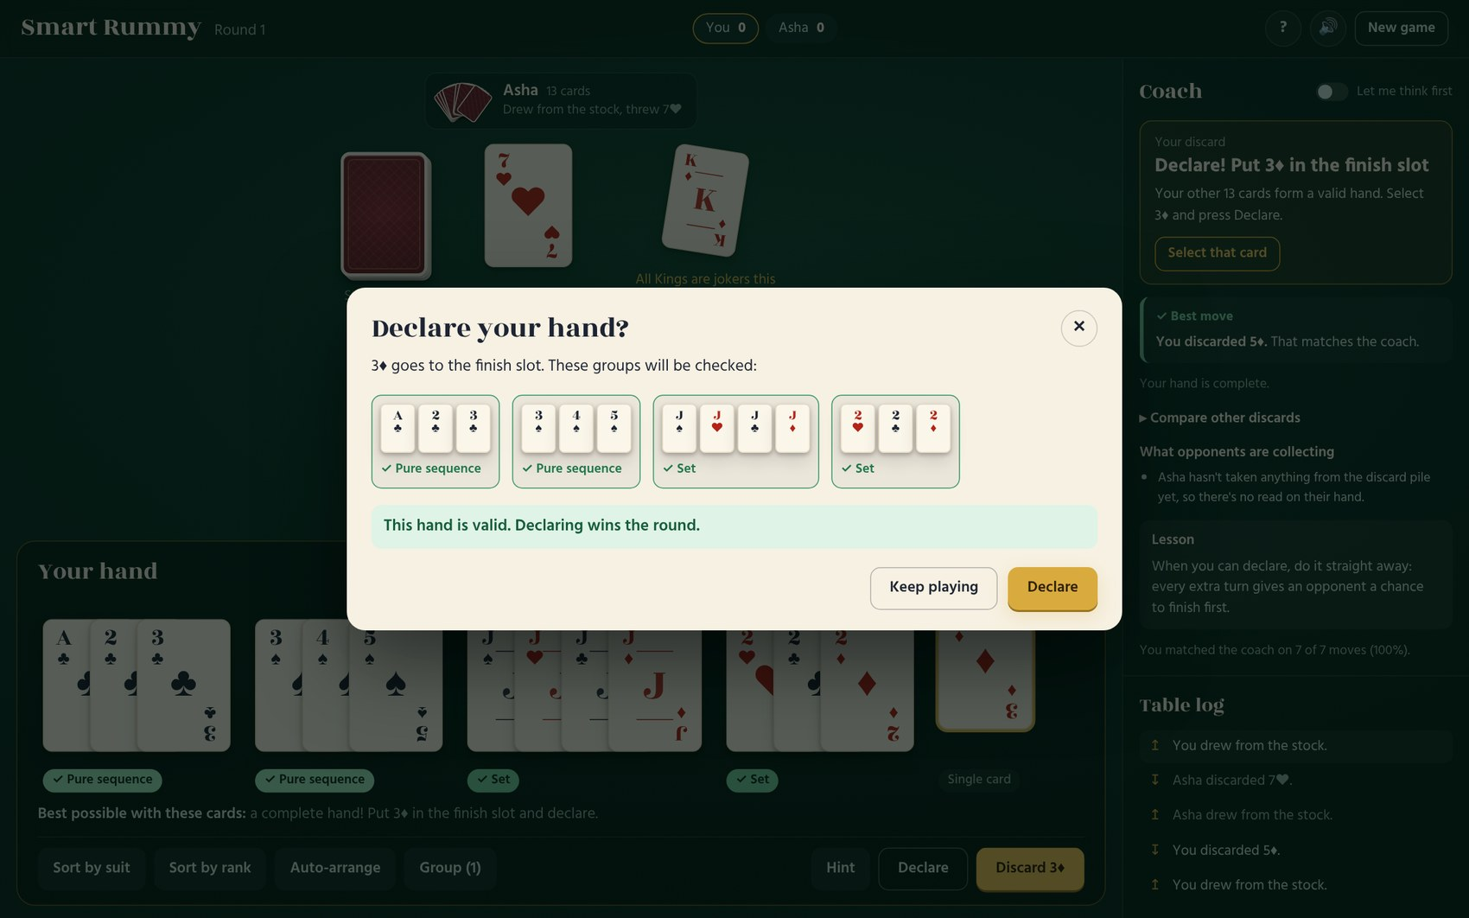
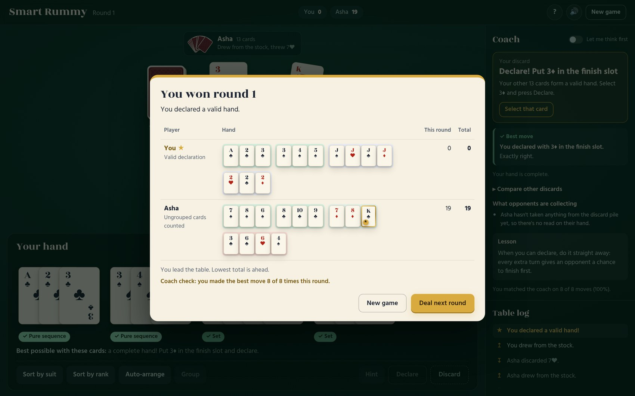
Output Screenshots (3/3)
Declare dialog validates every group
Round result after a valid declaration
Notes:
Real screenshots captured while playing the app.

Slide 18




Conclusion and Future Enhancement
Classical AI is enough for fast, testable, explainable rummy agents
Utility agents beat the reflex agent in about two-thirds of rounds
Every decision takes well under a second and comes with a reason
123 automated tests confirm the rules and the algorithms
Expert agent with Monte Carlo search (ISMCTS)
Online multiplayer over WebSockets
Learned opponent model from picks and discards
User study: does the coach improve play?
Notes:
Conclusion and four directions for future work.

Slide 19

Thank You
♠
♥
Questions?
♦
♣
Source code on GitHub
https://github.com/jobeson-j/Rummy-project.git
Jobeson Julius (240701217) · Pragadesh S (240701388)
Notes:
Thank the panel, share the GitHub link, invite questions.

