Slide 1

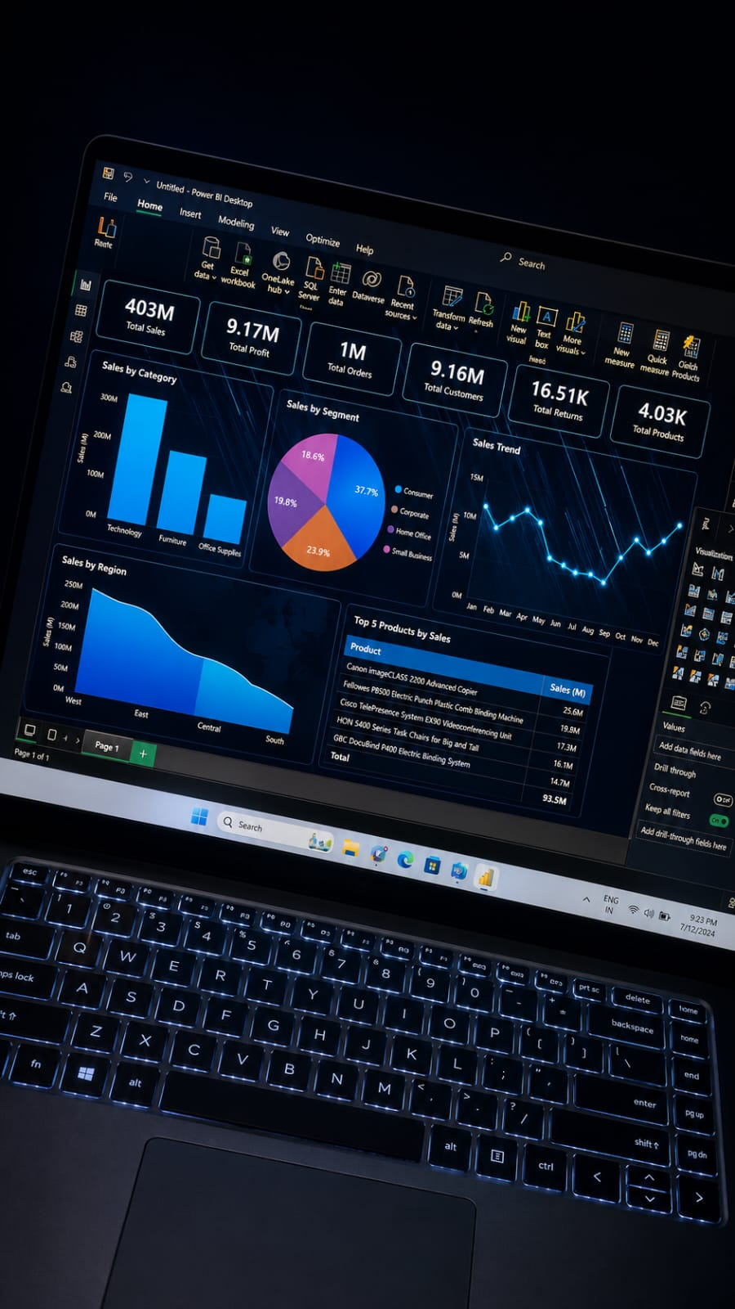
Sales Data Cleaning, Analysis & Visualization
This project demonstrates the complete data analytics process using a retail sales dataset.
The work starts with raw, unclean data and ends with business insights
and an interactive dashboard.
The project was completed using Python, Pandas, Matplotlib, Excel, and Power BI.
The objective was to transform unreliable data into meaningful information
that supports business decisions.

Slide 2
Business Problem
The company collects sales data every day, but the dataset contains missing values,
duplicate records, incorrect data types, inconsistent text, and other quality issues.
These problems make reporting unreliable.
Management cannot confidently identify the best products, profitable regions,
customer trends, or monthly sales performance without first cleaning the data.

Slide 3
Project Objectives
• Improve data quality. • Clean and standardize the dataset. • Perform exploratory data analysis. • Build charts and a Power BI dashboard. • Provide business recommendations based on the analysis.

Slide 4
Dataset Overview
The dataset contains customer, product, sales, profit, quantity, city, region, payment method,
rating, and order information.
After cleaning, the dataset becomes consistent and ready for reporting and visualization.

Slide 5
Data Quality Issues
During exploration, several issues were identified: missing values, duplicate rows,
extra spaces, inconsistent text formatting, incorrect data types, and outliers.
Each issue was resolved before analysis to ensure accurate results.

Slide 6
Data Cleaning Process
The dataset was imported into Pandas and examined using head(), info(), describe(),
and isnull(). Missing values were handled, duplicate rows removed, text columns cleaned,
data types corrected, outliers treated, and the cleaned dataset exported.
These steps improved the quality and reliability of the data.

Slide 7
Challenges & Solutions
One challenge was handling missing values without affecting the overall analysis.
Another was identifying duplicate records and correcting inconsistent values
such as gender or city names.
Each challenge was solved using suitable Pandas functions like fillna(), drop_duplicates(),
astype(), str.strip(), and IQR-based outlier detection.

Slide 8
EDA
Exploratory Data Analysis was performed to understand the dataset.
Summary statistics, value counts, group by analysis, and correlation helped
identify important patterns.
This stage answered business questions before creating visualizations.

Slide 9
Visualizations
Charts such as Sales by City, Sales by Product Category, Payment Method Distribution,
Monthly Sales Trend, and Profit by Region were created.
These visualizations make complex data easier to understand and
support quick decision-making.

Slide 10
Power BI Dashboard
The cleaned dataset was imported into Power BI to create an interactive dashboard.
KPI cards, bar charts, line charts, donut charts, and slicers were added.
Managers can filter the dashboard and monitor sales performance in real time.

Slide 11
Key Findings
The analysis identified the highest-performing cities, product categories,
and regions. Customer payment preferences and monthly sales trends were also discovered.
These findings help management focus on profitable areas and improve weaker segments.

Slide 12
Business Impact
The project helps management make data-driven decisions. It supports inventory planning,
marketing strategies, regional performance analysis, and customer satisfaction improvement.
Clean and accurate data increases confidence in business reports.

Slide 13
Conclusion
This project demonstrates the complete workflow of a Data Analyst—from raw data to actionable business insights. Data cleaning was the foundation for reliable analysis.
The final dashboard and reports provide valuable information for decision-makers.

Slide 14
Lessons Learned
I improved my skills in Pandas, data cleaning, EDA, visualization, Power BI,
and business storytelling. I also learned how important data quality is before performing analysis.

Slide 15
Future Improvements
Future enhancements include connecting the project to SQL Server,
automating data refresh, adding forecasting, and building machine learning models
for sales prediction.

Slide 16
Thank You
Thank you for reviewing this project.
Prepared by:
Aditya Sandip Deshmukh Data analyst portfolio project

