Slide 1
Splitting Schemes as Preconditioners
A numerical study of splitting schemes and implicit solution methods for Biot's equation
SIAM GS13 — Recent advances in inexact solvers
J. B. Haga ▪ Kalkulo AS
J. M. Nordbotten ▪ Dept. of Mathematics, University of Bergen
K. A. Mardal ▪ Center for Biomedical Computations, Simula Research Lab.

Slide 2
Outline
Motivation
— What is Biot's equation; what is it good for; and why is it hard to solve
Splitting Methods and Preconditioners
— Outline of common splitting methods; and how may be formulated as block preconditioners
Experiments and results
— Test cases; convergence results
Summary

Slide 3
What is Biot's equation
Motivation
Splittings+Prec
Experiments
Summary
Couples solid deformation and fluid pressure in a fluid-filled porous material
(Linear case:)
  Linear elasticity for the solid matrix (A)
  Poisson's equation for the fluid pressure (C)
  Coupled by Darcy's law and the concept of effective stress (B)
Block structured saddle point problem:
  A is positive
  C is negative (or zero)

Slide 4
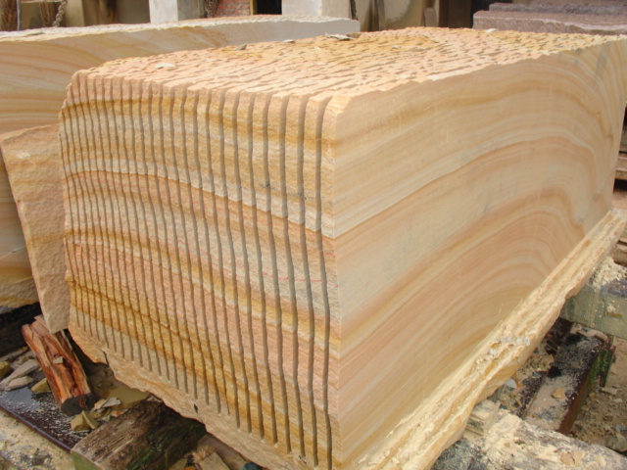
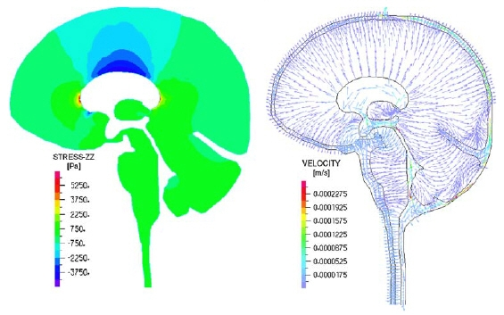
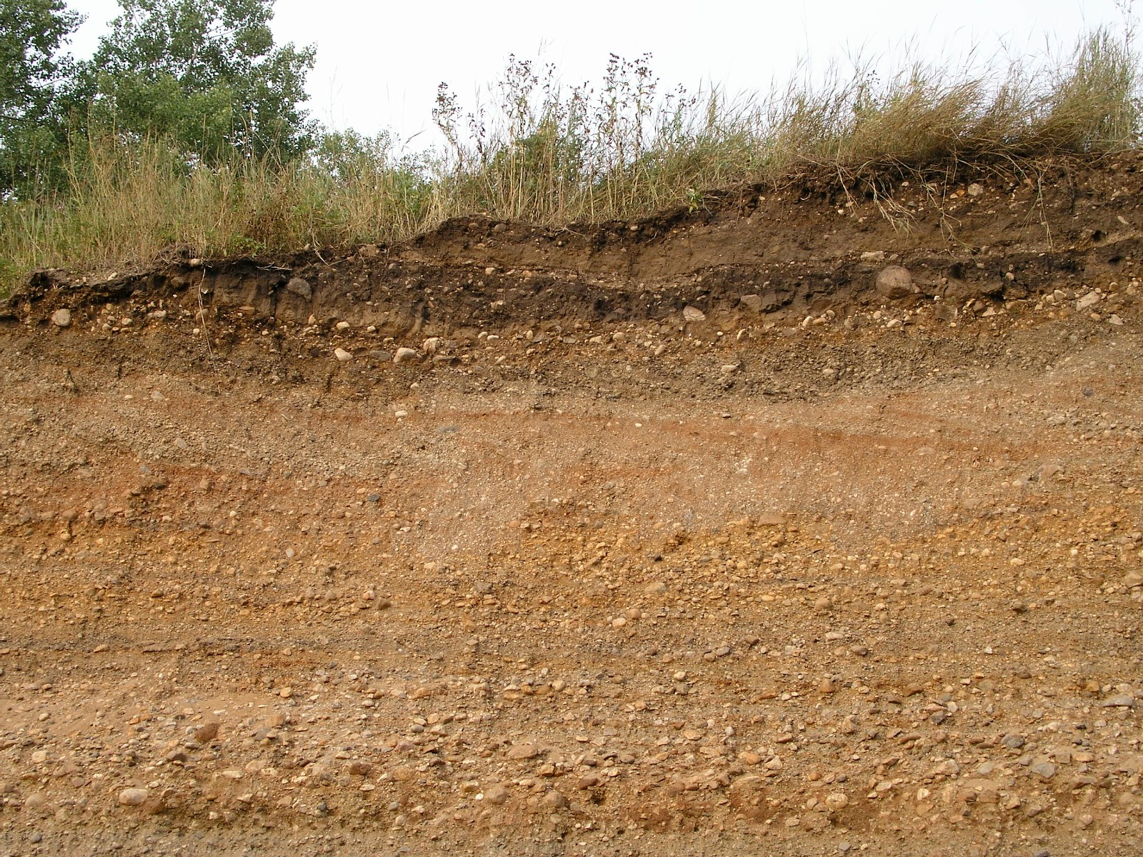
Why is Biot's equation hard to solve?
Very large range of material parameters, and large parameter contrasts
[image: ablemax.co.kr]
[image: materialproject.org]
[image: K. Van Rees]

Slide 5
Splitting methods and Preconditioners

Slide 6
Solution methods for the coupled system
Explicit coupling (or loose coupling)
  Solve pressure at every time step
  Update mechanics only occasionally
Iterative coupling
  Solve pressure and mechanics (separately) at every time step
  Uses a splitting scheme
Implicit coupling (or full coupling)
  “Full iterations“ (of which iterative coupling is a special case)
  OR other iterations at each time step (preconditioned Krylov, ...)
  OR direct solver

Slide 7
Solution methods for the coupled system
Explicit coupling (or loose coupling)
  Solve pressure at every time step
  Update mechanics only occasionally
Iterative coupling
  Solve pressure and mechanics (separately) at every time step
  Uses a splitting scheme
Implicit coupling (or full coupling)
  “Full iterations“ (of which iterative coupling is a special case)
  OR other iterations at each time step (preconditioned Krylov, ...)
  OR direct solver
`

Slide 8
Notation

Slide 9
Splitting schemes
The split-variable (d*, p*) is constrained in different ways in the split-step.
Pressure split
(Drained, Undrained split)
Displacement split
(Fixed strain, stress)

Slide 10
Drained split
1. The displacement is solved with constant pressure,
2. The pressure is then solved with fixed displacement:
The drained split can be written as
with

Slide 11
Drained split
1. The displacement is solved with constant pressure,
2. The pressure is then solved with fixed displacement:
Preconditioned
Richardson iteration
The drained split can be written as
with

Slide 12
Drained split
1. The displacement is solved with constant pressure,
2. The pressure is then solved with fixed displacement:
The drained split can be written as
with

Slide 13
Drained split
1. The displacement is solved with constant pressure,
2. The pressure is then solved with fixed displacement:
Block triangular
preconditioner
The drained split can be written as
with

Slide 14
Drained split

Slide 15
Relationship between iterative coupling and full iterations
Iterative coupling is a single iteration of full iterations
at each time step
is then the time step, rather than the iteration number
It follows that for constant , iterative coupling (in time)
is the same as full iterations (within a time step).

Slide 16
Common splitting schemes
Conditionally
stable
Drained split
Undrained split
Fixed strain
Fixed stress
Stable
approximate
displacement Schur complement
approximate
pressure Schur complement

Slide 17
Splitting schemes as general preconditioners
The preconditioners derived from splitting schemes can be used with other, more efficient iterative methods (i.e., preconditioned Krylov methods).
Two questions then arise:
  Is the block triangular structure advantageous?
  Are the Schur complement approximations advantageous?

Slide 18
Experiments and results

Slide 19
Implementation overview
For the main experiments
  Finite Element discretisation using FENiCS
  Linear algebra and algebraic preconditioners/solvers from Trilinos
  (and the MUMPS sparse direct solver, via Trilinos)
  Blockwise formulation and iterative solvers from cbc.block
  Random initial iterate (to remove influence of load vector / Neumann BC)
For supplementary experiments
  Control Volume discretisation

Slide 20
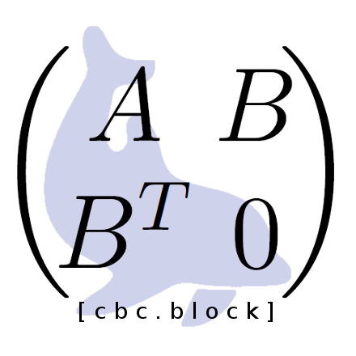
cbc.block
def pressure_schur(A, B, C):
Ainv = MumpsSolver(A)
Spre = MumpsSolver(collapse(C – B.T*InvDiag(A)*B))
Sinv = BiCGStab(C – B.T*Ainv*B, precond=Spre)
P1 = block_mat([[1, 0 ],
[0, Sinv]])
P2 = block_mat([[ 1, 0],
[-B.T, 1]])
P2 = block_mat([[Ainv, 0],
[ 0, 1]])
return P1*P2*P3

Slide 21
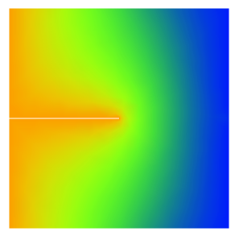
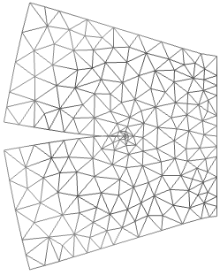
Test case 1: Hydraulic fracturing
Problem statement
Domain: Unit square
Dirichlet boundary:
Parameters:
Everything set to unity (in Lamé formulation)
Young's
modulus
Poisson's
ratio
Fluid
mobility
Fluid storage
coefficient
Coupling
strength
E | ν | Λ | b | τ
2.5 | 0.25 | 1 | 1 | 0.5

Slide 22
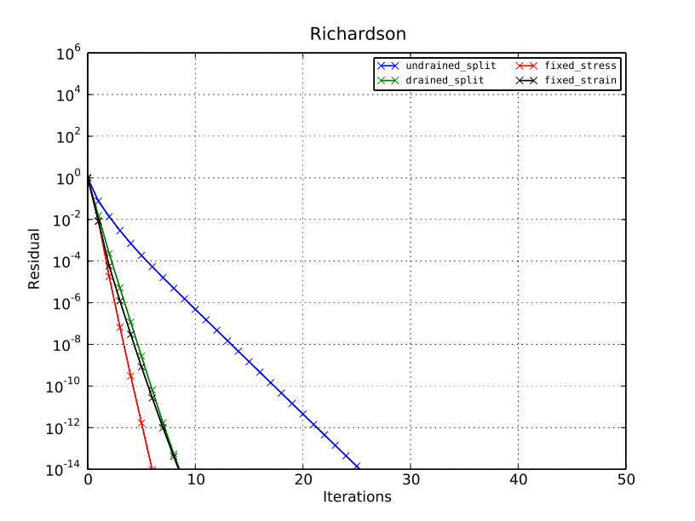
Test case 1: Hydraulic fracturing
Full iterations converges fast
Exact Richardson iterations
h ~ 0.1

Slide 23
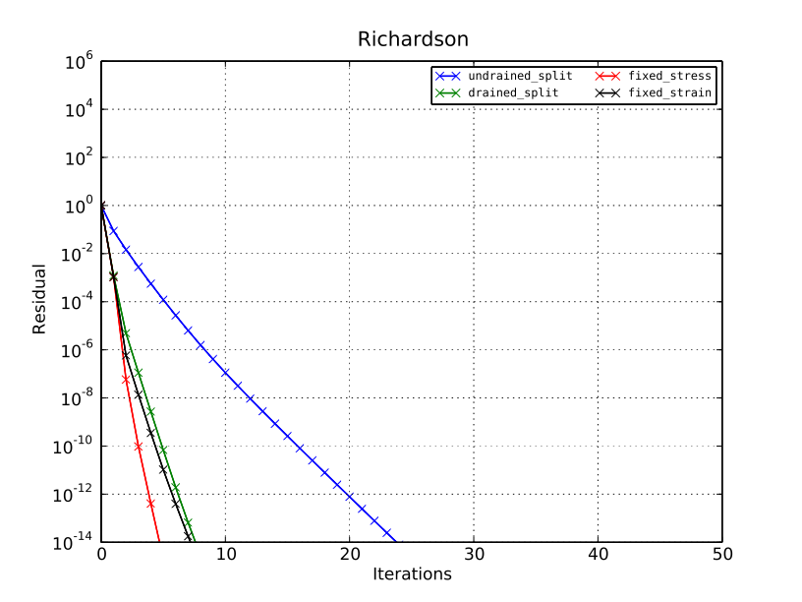
Test case 1: Hydraulic fracturing
Convergence is independent of grid resolution
Exact Richardson iterations
h ~ 0.01
–no grid dependence!

Slide 24
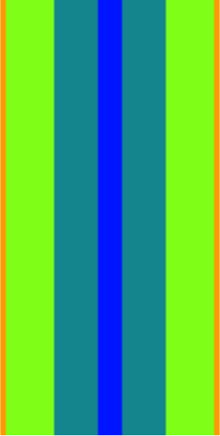
Test case 2: Two-dimensional spinal cord
Problem statement
central
canal
grey
matter
Dirichlet boundary:
pia
mater
(pia madre)
Parameters:
Young's
modulus
Poisson's
ratio
Fluid
mobility
Fluid storage
coefficient
Coupling
strength
 | E | ν | Λ | b | τ
Pia mater | 2·10⁴ | 0.35 | 4·10⁻⁶ | 1·10⁻⁵ | 4.5
White matter | 5·10¹ | 0.35 | 2·10⁻⁵ | 1·10⁻² | 1.8
Grey matter | 5·10¹ | 0.35 | 2·10⁻⁶ | 1·10⁻² | 1.8
Central canal | 5·10¹ | 0.35 | 1·10⁻³ | 1·10⁻² | 1.8
white
matter

Slide 25
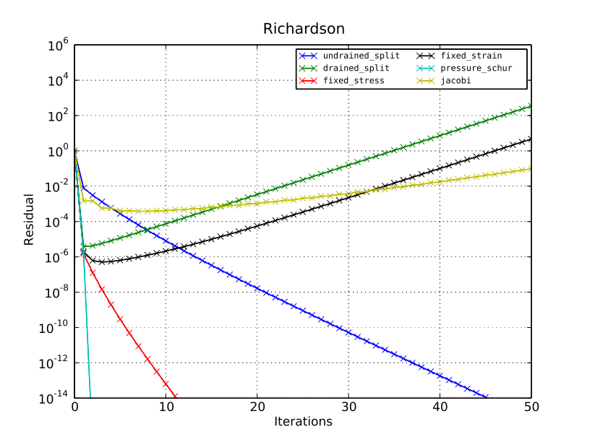
Test case 2: Two-dimensional spinal cord
Exact Richardson iterations
The two unstable splittings
diverge – as expected.
Two new preconditioners
are introduced as benchmark:
  – Block Jacobi
  – Block triangular press. Schur

Slide 26

Test case 2: Two-dimensional spinal cord
Exact Richardson iterations
The two unstable splittings
diverge – as expected.
Two new preconditioners
are introduced as benchmark:
  – Block Jacobi
  – Block triangular press. Schur
  But a digression:

Slide 27
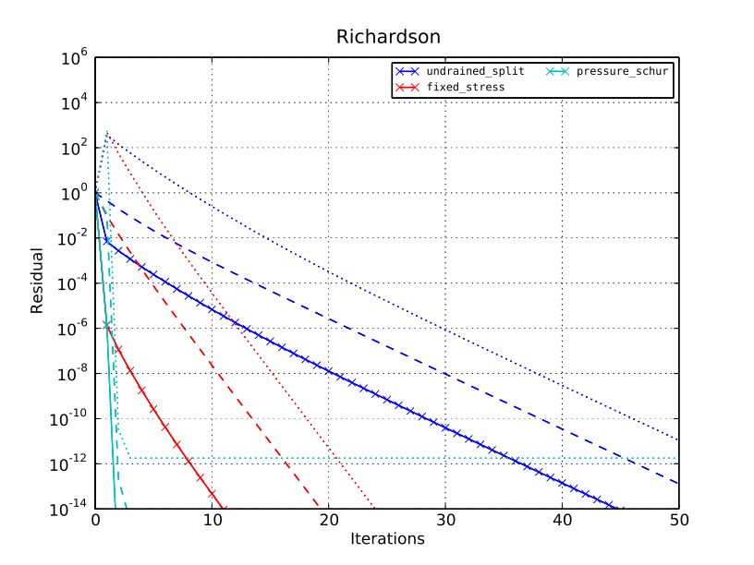
Test case 2: Two-dimensional spinal cord
Real error may be much larger than the residual! (digression)
Exact Richardson iterations – error by component
Relative reduction of error
in p is up to 9 orders of
magnitude smaller than
reduction of residual!
The size of this effect is
due to the random initial
iterate, but something to
be aware of.
Error in p
Error in u
Residual

Slide 28
Test case 2: Two-dimensional spinal cord
A few words about preconditioned Krylov-space solvers
is indefinite symmetric,
is non-symmetric.
Options include general methods like BiCGStab or GMRES,
or symmetric methods like MinRes or even PCG in a non-standard norm.
The latter usually places conditions on the initial iterate as well as the RHS.
The results presented here are with BiCGStab, but GMRES
behaves similarly.

Slide 29
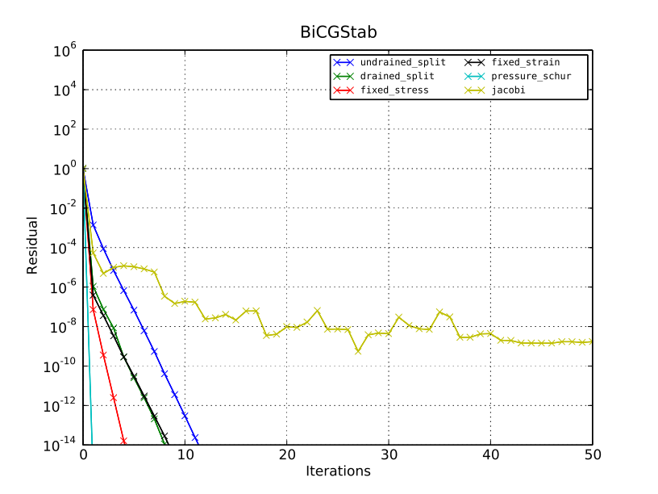
Test case 2: Two-dimensional spinal cord
Exact BICGStab iterations
Exact Richardson iterations
Notice:
Unstable splittings work well,
Jacobi not so much.

Slide 30
Approximate inverses
ML (from Trilinos)
ILUT (from Trilinos/IFPACK)
The benchmark pressure Schur is:

Slide 31
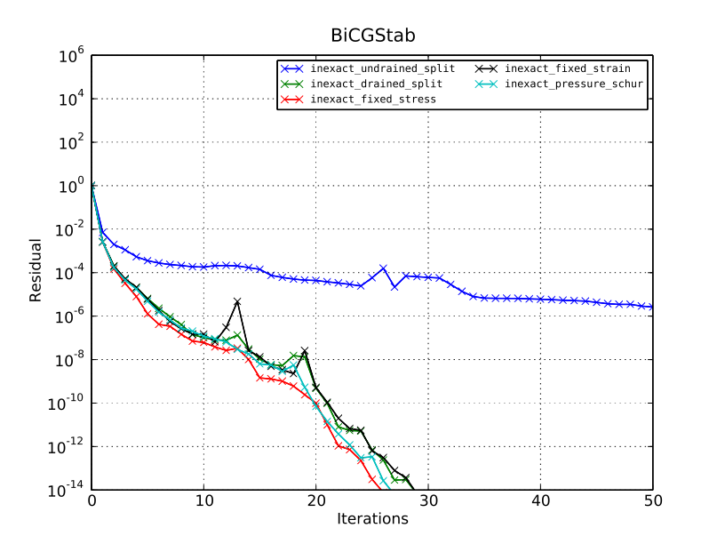
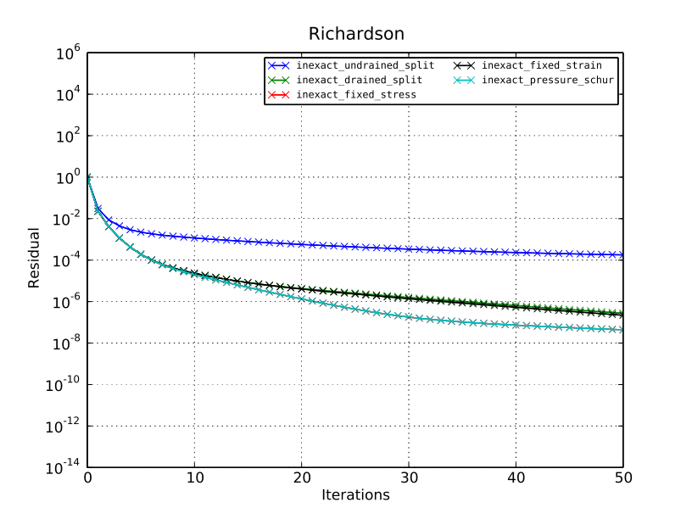
Test case 2: Two-dimensional spinal cord
Inexact BICGStab iterations
Inexact Richardson iterations

Slide 32
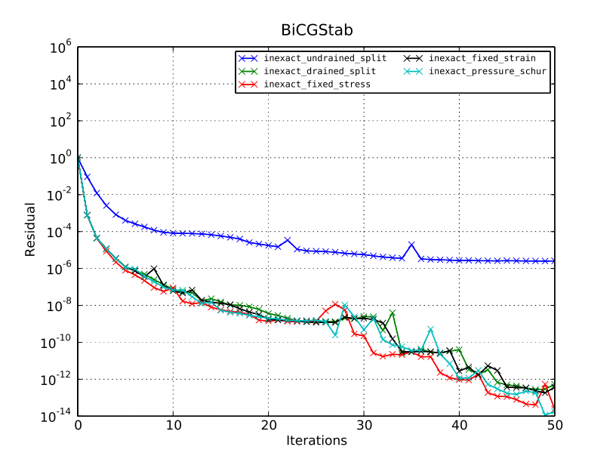

Test case 2: Two-dimensional spinal cord
Inexact BICGStab iterations (4x)
Inexact BICGStab iterations (reference)
We have lost grid independence!
iterations ~ h^{-1/2}

Slide 33
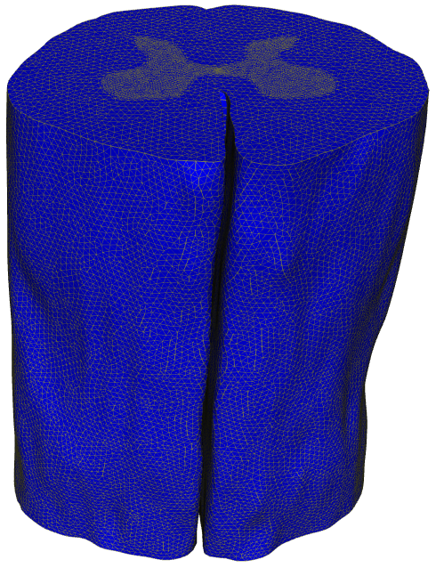
Test case 3: Three dimensional spinal cord
Problem statement
Dirichlet boundary:
Parameters (same as 2D):
Young's
modulus
Poisson's
ratio
Fluid
mobility
Fluid storage
coefficient
Coupling
strength
 | E | ν | Λ | b | τ
Pia mater | 2·10⁴ | 0.35 | 4·10⁻⁶ | 1·10⁻⁵ | 4.5
White matter | 5·10¹ | 0.35 | 2·10⁻⁵ | 1·10⁻² | 1.8
Grey matter | 5·10¹ | 0.35 | 2·10⁻⁶ | 1·10⁻² | 1.8
Central canal | 5·10¹ | 0.35 | 1·10⁻³ | 1·10⁻² | 1.8
0.5M unknowns

Slide 34
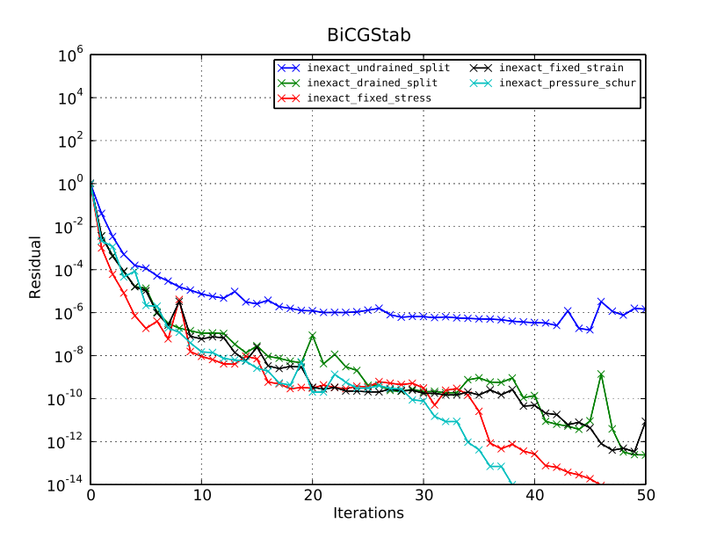
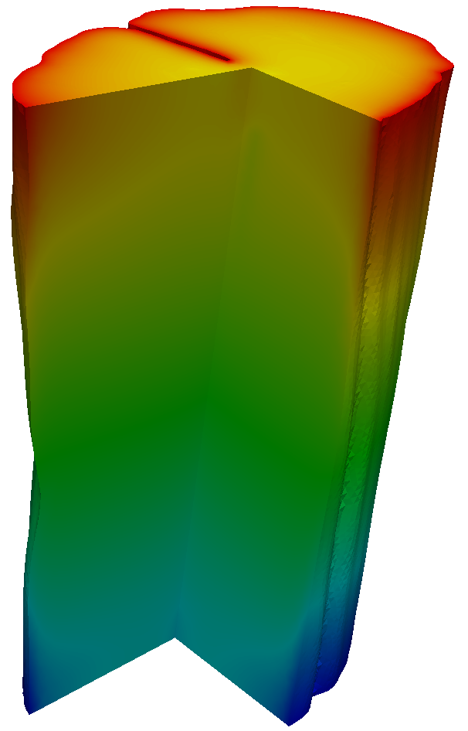
Test case 3: Three dimensional spinal cord
Inexact BICGStab iterations
All work fairly
well, except
undrained split.
But another
digression...

Slide 35
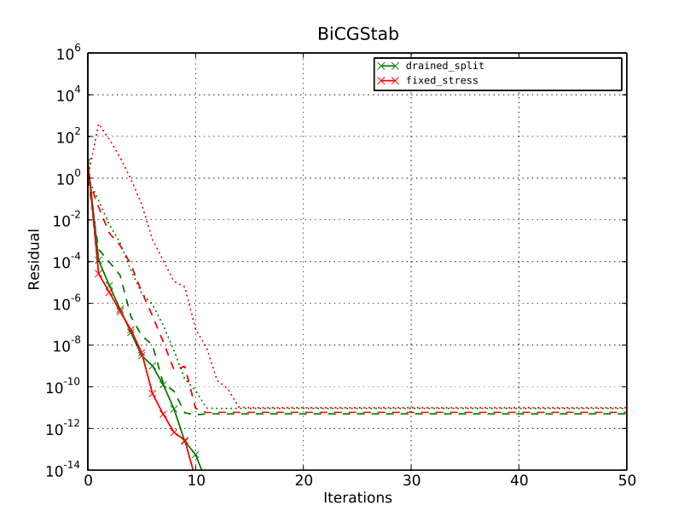
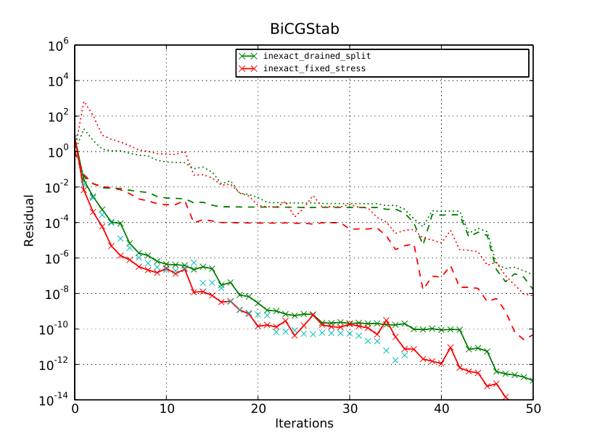


Test case 3: Three dimensional spinal cord
A final digression...
Exact BICGStab iterations
Inexact BICGStab iterations
The error is significantly larger for FSe with exact solvers,
but the difference disappears with inexact solvers.

Slide 36
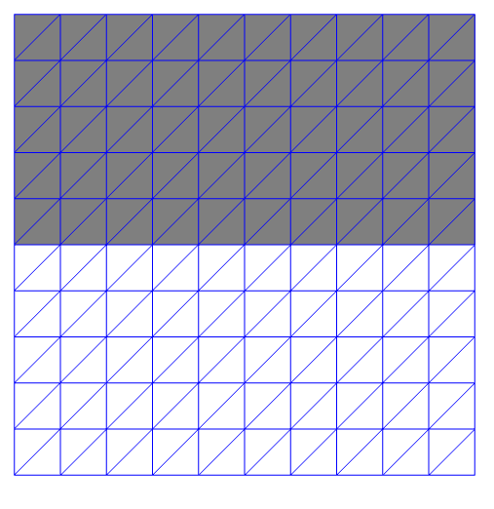
Test case 4: Pore seal
Problem statement
Dirichlet boundary:
Parameters:
Young's
modulus
Poisson's
ratio
Fluid
mobility
Fluid storage
coefficient
Coupling
strength
 | E | ν | Λ | b | τ
Top half | 3·10³ | 0.45 | 1·10^{-8`} | 1·10⁻⁶ | 91
Bottom half | 3·10³ | 0.45 | 1 | 1·10⁻⁶ | 91
Designed to be hard!

Slide 37
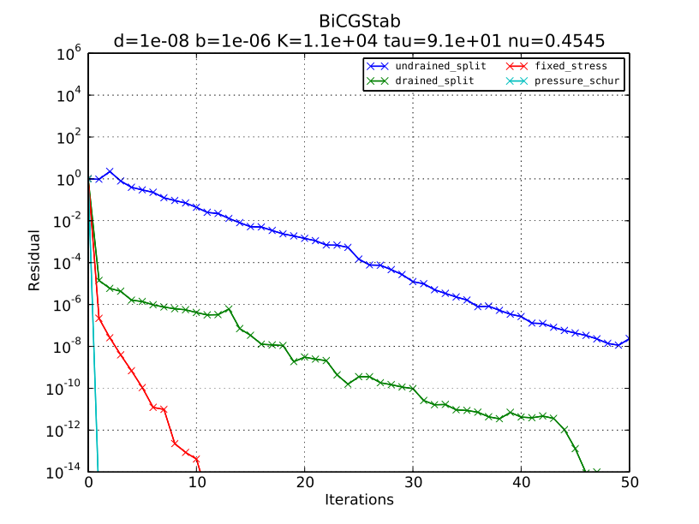
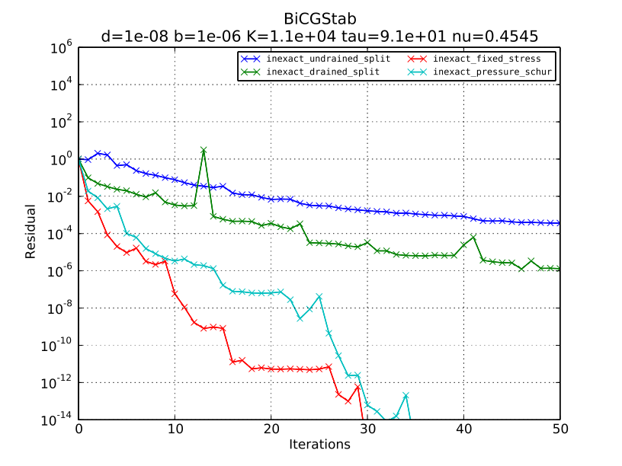
Test case 4: Pore seal
Exact BICGStab iterations
Inexact BICGStab iterations

Slide 38
Summary
All the splitting methods can be rewritten as block triangular preconditioners.
These work well for the preconditioned BiCGStab method (and for GMRES, results not shown), and will have significantly faster convergence than full iterations in „hard“ cases.
The block triangular structure is advantageous; i.e., superior to the block Jacobi benchmark (as well as Schur-Jacobi, results not shown).
The pressure Schur approximation of the Fixed Stress method seems to have comparable performance to the benchmark approximation when used with inexact solvers. The Schur formulation becomes important with really tough parameters.
But be aware of the error!

Slide 39
Some references
Splitting methods, and their stability
  Mikelić and Wheeler. Convergence of iterative coupling for coupled flow and geomechanics. Computational Geosciences, 2012.
  Kim, Tchelepi and Juanes. Stability and convergence of sequential methods for coupled flow and geomechanics (x2). Computer Methods in Applied Mechanics and Engineering, 2011.
Block triangular preconditioners, and Krylov methods in non-standard norms
  Benzi, Golub and Liesen. Numerical solution of saddle-point problems. Acta Numerica, 2005.
  Pestana and Wathen. Combination preconditioning of saddle point systems for positive definiteness. Report 11/13, Oxford University Mathematical Institute, 2011.
FEniCS, cbc.block
  http://bitbucket.org/fenics-apps/cbc.block
  http://fenics.org

