Slide 1



Slide 2
Most Common Mistakes and the Cost of Mistakes
Everyone Should Be Aware
JOBIN AUGUSTINE
PostgreSQL Escalation Specialist

Slide 3


Notes:
Broken Chair Geneva -

Slide 4
Copying “Oracle” or “XYZ” way
Best Practices for XYZ or ABC software may not be relevant for PostgreSQL

Slide 5
Infrastructure Mistakes

Slide 6
Non-Standard binaries
Generally triggered by the non-standard locations
Source installation is easy. doen’t mean that you need to be doing that always.
PostgreSQL is a database Kernel with thousands of extensions and tools around
Later Problems
Extensions and tools fails
Difficult to troubleshoot, longer outages
Too many edge cases.

Slide 7
Recommendations
Avoid source builds for Production use
Use community / standard binaries for Production use
Importance of testing every pieces together

Slide 8
“postgres” user account
Users ignores the Importance of OS user account
It is possible to run Postgres in OS account. However, Special attention should be there starting from the file permissions, peer/ident authentication, default super user, Service management

Slide 9
Misunderstanding of security
Changing the Port number or Installation location won’t add any security
“Downloading” packages and installing is a frequent cause of security related incidents.
Obstructions and deviations from standards and best practices often causes more vulnerabilities.
Recommendation
Involve security experts to assess if doubt exists
Report CVE
Avoid deviations from well tested, proven paths
Use standard repository for installing packages
Make the recommended path a “Happy Path”

Slide 10
Selection of Hosting Infrastructure
Database on Cloud
Database on Kubernetes
No Silver Bullets.
Virtual Machines and Bare metals
Notes:
Protect yourself against hypes

Slide 11
Big tables - No data retention policies
Big indexes
Autovacuum has lot more work to do
requirement for higher maintenance_work_mem.

Slide 12
Frequent Configuration Mistakes

Slide 13
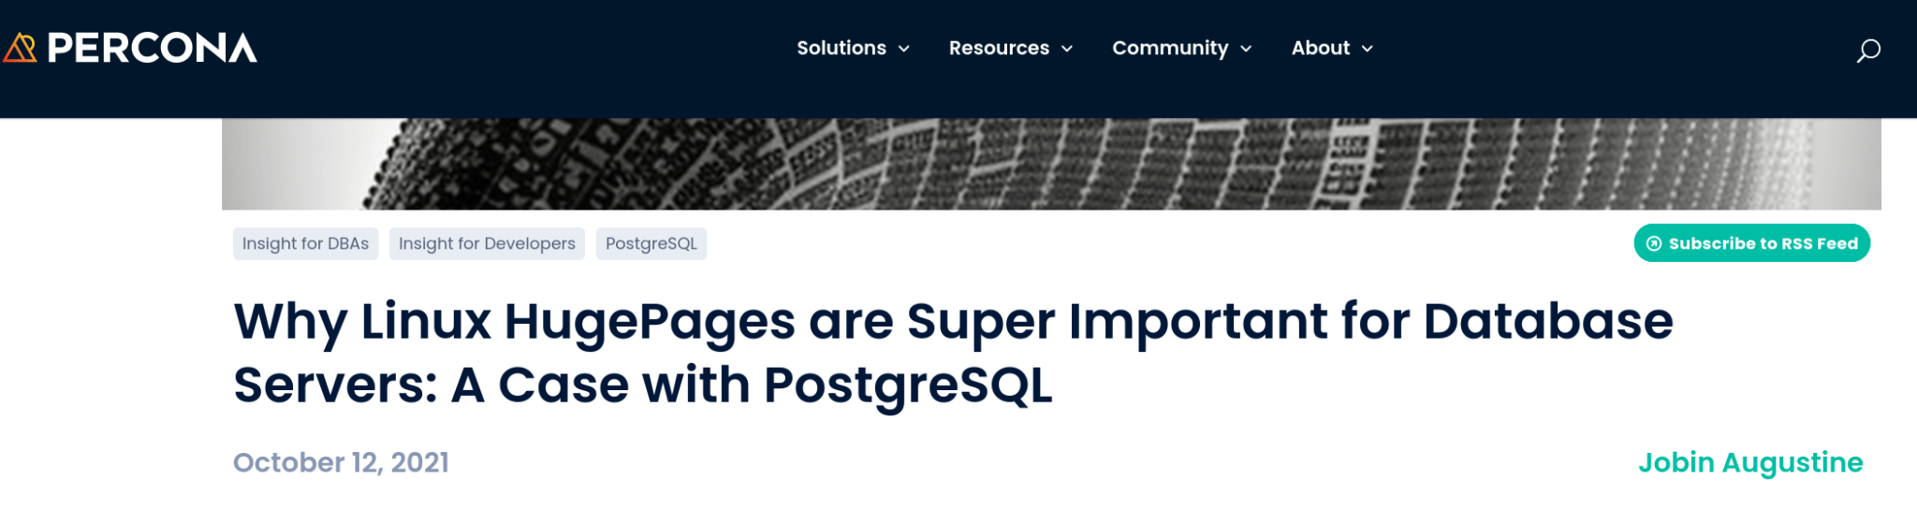

Memory and HugePages

Slide 14
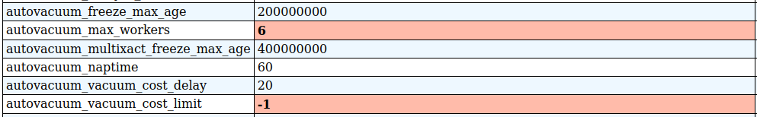
autovacuum_max_workers
Workers need to share autovacuum_vacuum_cost_limit
Higher the number of workers, each worker runs slower
  Slow running workers defeats its own purpose.

Slide 15

max_connections
https://richyen.com/postgres/2021/09/03/less-is-more-max-connections.html
https://www.citusdata.com/blog/2020/10/08/analyzing-connection-scalability/
https://blog.anarazel.de/2020/10/07/measuring-the-memory-overhead-of-a-postgres-connection/
https://aws.amazon.com/blogs/database/resources-consumed-by-idle-postgresql-connections/
https://elephas.io/connection-scaling/
Avoid exceeding 10x of CPU count

Slide 16
Expectations

Slide 17
vacuum tuning ≠ parameter tuning
Expecting a vacuum tuning achieving by parameter
Scheduled vacuum jobs are unavoidable.

Slide 18
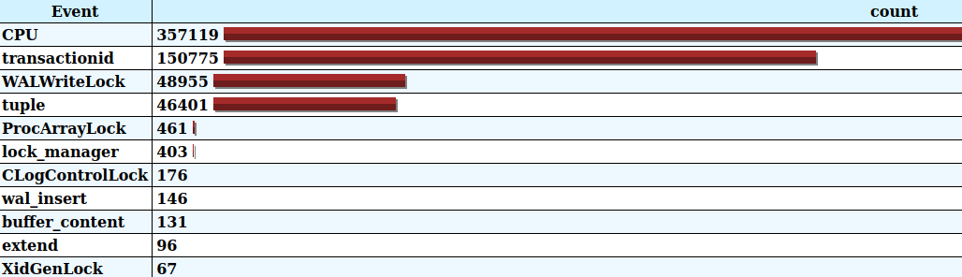
Concurrency by design - Blocking/Contention

Slide 19
Concurrency by design - Blocking/Contention
SELECT … FOR UPDATE
Myths of throughput.
  More sessions doen’t mean that faster response the the application or better throughput.

Slide 20
Datatypes - Common mistakes
Excessive use of NUMERIC
Excessive use JSON
Less use of ENUM

Slide 21
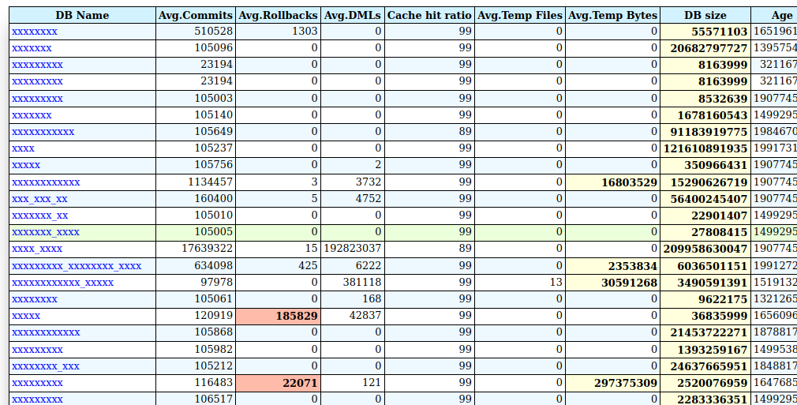
Multi-Tenancy
Hosting multiple databases / schema in single Instance has very less advantage, But has many disadvantages.

Slide 22
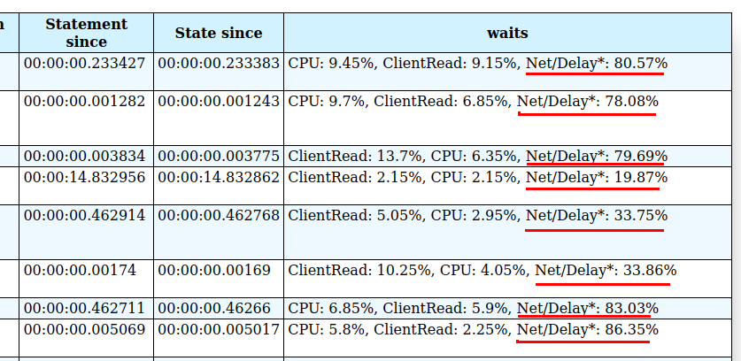

Network latency - A common performance killer
https://www.percona.com/blog/how-to-measure-the-network-impact-on-postgresql-performance/

Slide 23
Good&Bad Practices

Slide 24
Session / Connection termination
Often done by DBAs
Scripting for handling “idle” sessions
Parameter settings like “idle_session_timeout”

Slide 25
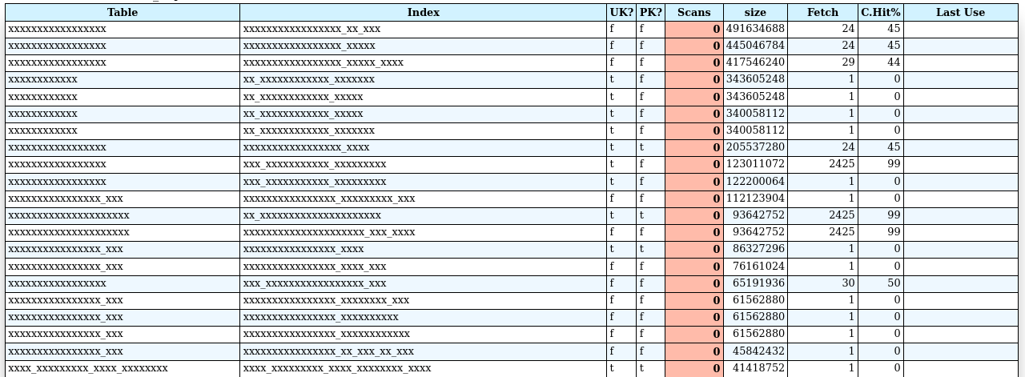

Overuse of Indexes
Indexes are very very very costly
https://www.percona.com/blog/postgresql-indexes-can-hurt-you-negative-effects-and-the-costs-involved/
Notes:
Slows down transactions

Slide 26
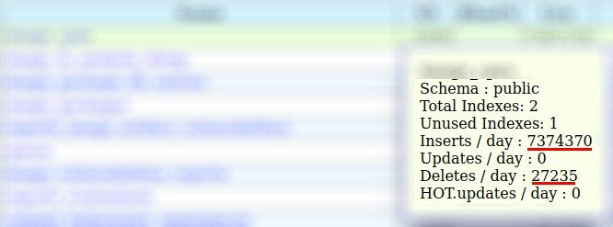
Data retention policy implementation
Keep an eye on rapidly growing tables.

Slide 27
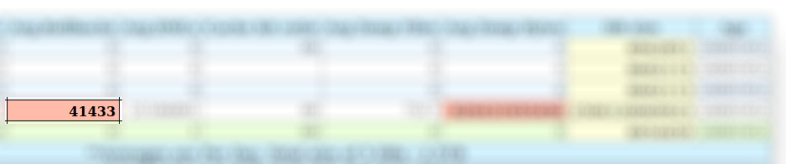
Aborts / Rollbacks
Inspect PostgreSQL logs
DBAs/Ops responsibility to report it back and get it fixed

Slide 28

Temp file generation
Causes Disk I/O
Cloud vendors may charges hefty

Slide 29
Over Engineering = Overkill + Shooting on leg
More the complexity, more the problems, unavailability and security vulnerabilities.
Security incidents because server dont have access to PostgreSQL repository
Certificate authentication need to be used with care, Expiry can lead to outage, its a ticking bomb.
Custom developed scripts for HA causing problems.
Notes:
Security incidents because server don’t have access to PostgreSQL repository
Custom developed scripts for HA causing problems
Overkills for security. Certificate authentication need to be used with care, Expiry can lead to outage, its a ticking bomb

Slide 30

External Poolers everywhere
External connection poolers like pgBouncers are over used
External connection poolers are required if there is no connection pooler on the application side.
Problems
Scalability issues
Extra network hop and Latencies
Additional point of failure
Pooler on the top of pooler
Timeouts, if there is another pooler which is not releasing the connection.

Slide 31

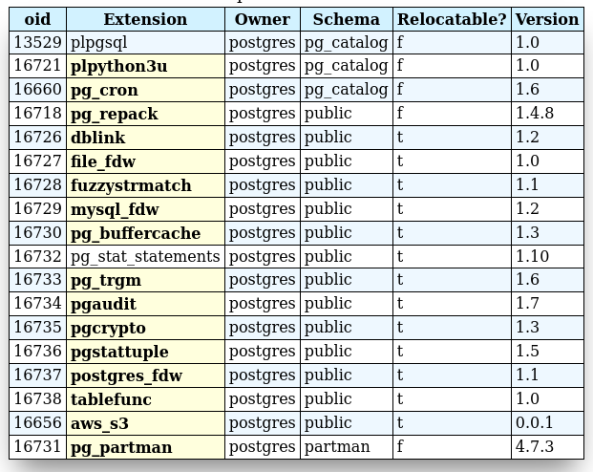
Extensions are not cheap
Extensions uses hooks
Performance overhead.
The most frequent cause of crash.
Notes:
PostgreSQL has hundreds or thousands of generic extensions.
Use them only when it is required.

Slide 32
Myths of High Availability
High Availability must be measured
MTBF - Mean Time Between Failures
MTTR (mean time to recovery, repair, or resolve)
Availability 9s. - Big claims
Multi-Master myths.
Notes:
MTTA: Mean time to acknowledge
MTTF: Mean time to failure
repmgr incidents, split brain, standby

Slide 34
DR (Disaster Recovery) ≠ HA (High Availablity)
High Availability : A substitute with same configuration on same location without affecting the the application
Disaster Recovery : Moving the Operations to a far away location.
Vise-versa Another node on same region is not DR as well
Notes:
Application should be connecting to local database
The impact of network is heavily underestimated

Slide 35
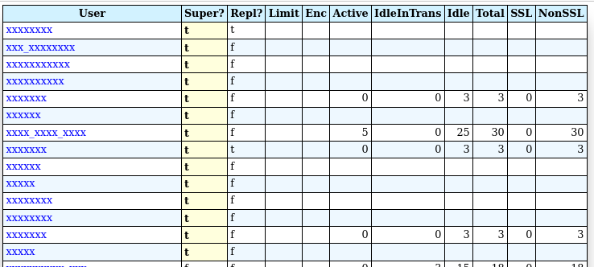
Security
Notes:
Something currently working doen’t mean that it is good

Slide 36
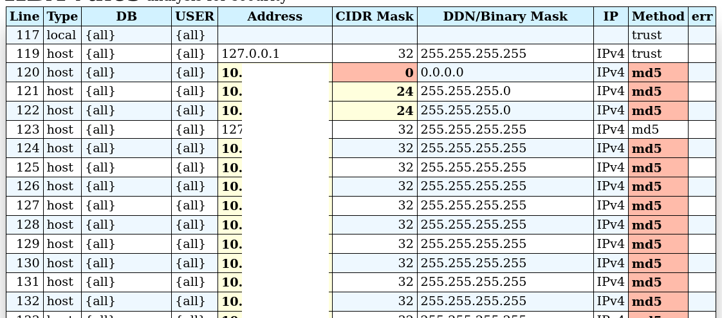
Security

Slide 37
Checkpoint tuning
Default checkpointing in every 5 minutes
Causes too many full page writes
In an HA cluster, Standby will be promoted if primary is lost. So instance recovery time is not affecting anything.

Slide 38
Beware of overkill
Always ask, What are the proven methods and recommendations for production use.
Develop “Ops” mindset.
Assess the value for business. Avoid experimenting with production systems

Slide 39
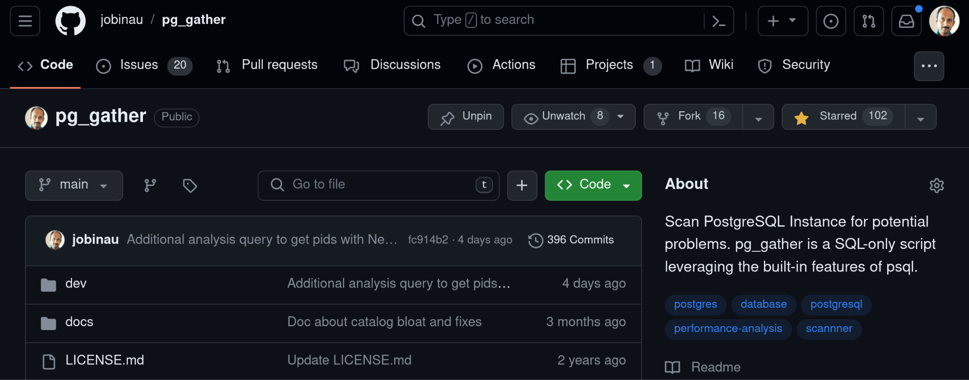
Tool for help

Slide 40


Encryption
https://github.com/Percona-Lab/pg_tde

