Slide 1
Analysis Of An IoT Based Water Quality Monitoring System For Fish Farms
Master thesis work
Jobin Kachappally Mathai
211AEG004
Supervisor – : Dr.sc.ing Andis Supe
Consultant – Mg.sc.ing. Ruslans Sudņiks
2024

Slide 2
Overview about the thesis
Fish farming is a growing industry that holds potential, for economic growth particularly in developing countries.
Improper management of the water quality of the fish farm will hurt the growth and health of the fish leading to many health risks.
The existing monitoring system, where people collect water from the pond, take it to the laboratories regularly.
These laboratories are stationary, and the farmers need to take the samples to specific locations.
It is a tiresome process and also each tests are expensive and are time consuming too. And People need to routinely check on the water level of the ponds.
The essential goal of this project is to propose a system to monitor the quality of fishpond water to control water pollution and various other factors with the assistance of IoT.

Slide 3
Selected Water Quality Parameters In Fish Farm
Temperature
Potential of hydrogen(pH)
Total Dissolved Solids (TDS)
Turbidity

Slide 4
Proposed system
To overcome the drawbacks of existing system, new system is proposed with the following features.
Consist of Temperature sensor, TDS sensor, Turbidity sensor, Water level sensor.
Monitor the values in mobile and desktop.
Water inflow and outflow pump based on water level.

Slide 5
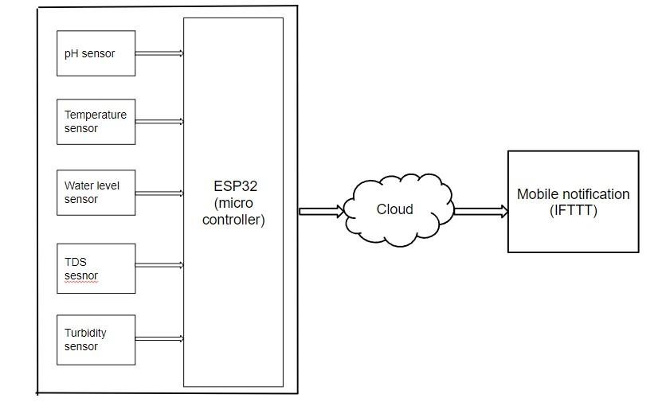
Block diagram of proposed system
TDS
sensor

Slide 6
Results
Test results of various experiment that we done.
It is important to analyze the results for the better understanding of the efficiency and reliability of the system.
The tables shows the threshold value
This will make us to know which water is suitable for fish farming.
PARAMETER | THRESHOLD
Temperature | 22-30 °C
pH | 6.5 - 8
Turbidity | 30 NTU
TDS | 1000 ppm

Slide 7
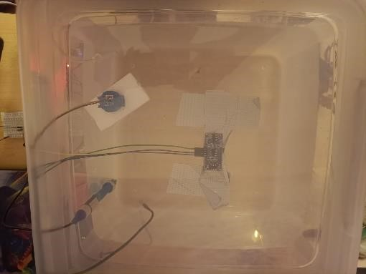
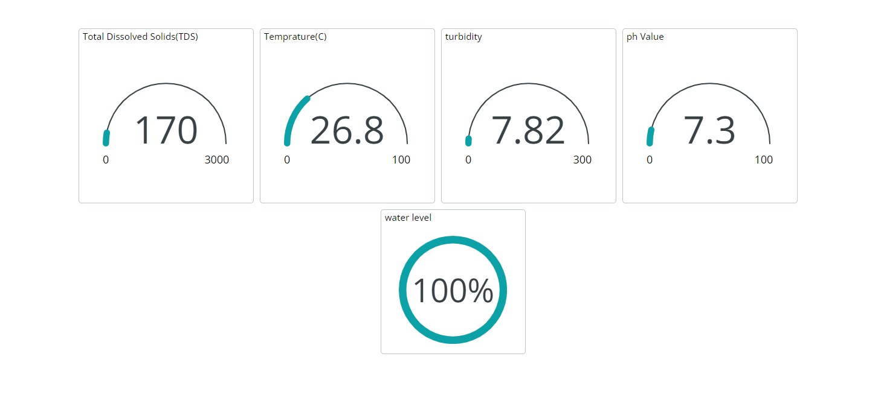
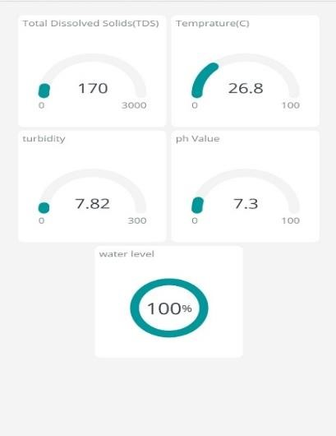
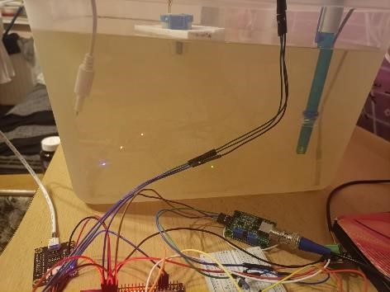
Results
Clear water
Monitoring in PC
Monitoring in phone
Prototype testing

Slide 8
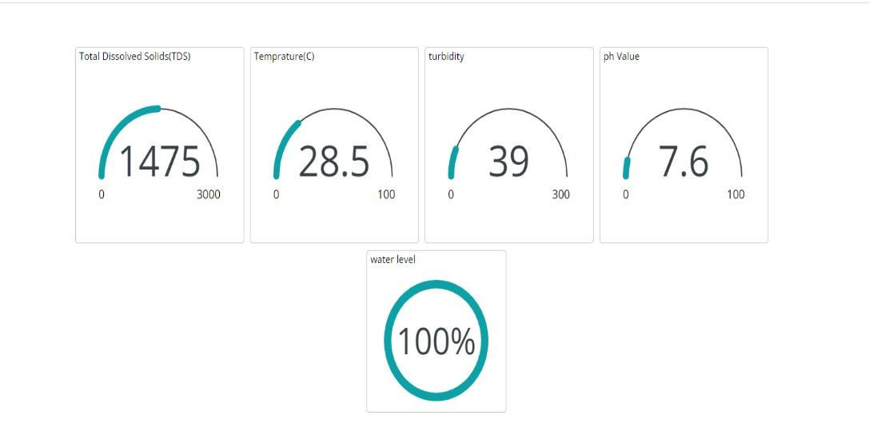
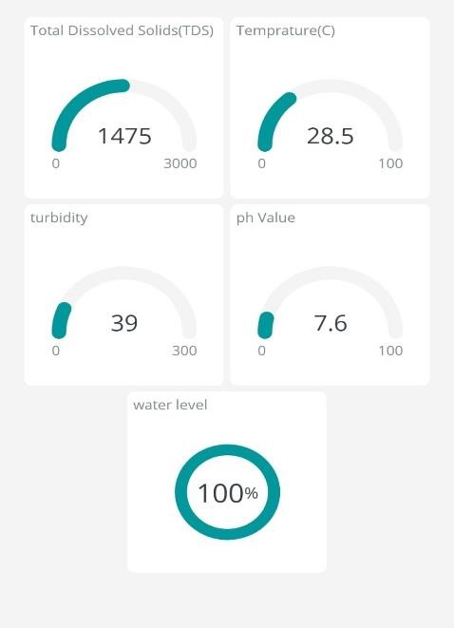
Results
Dirty Water

Slide 9
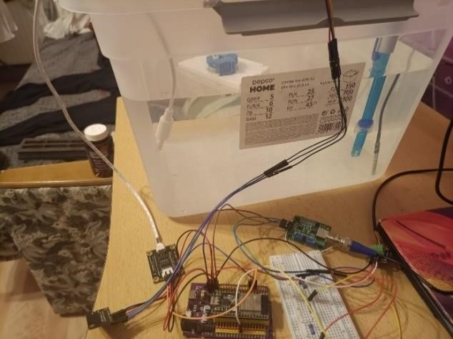
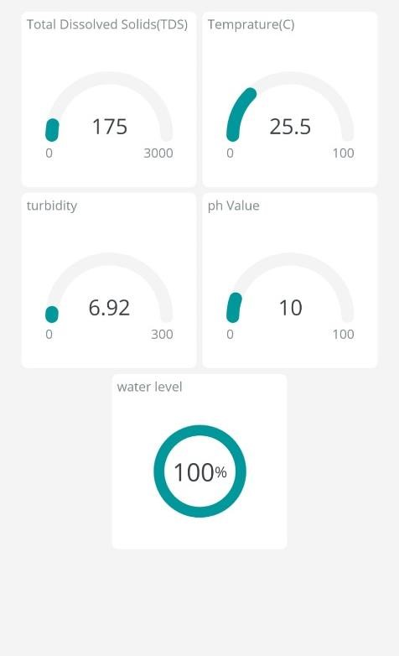
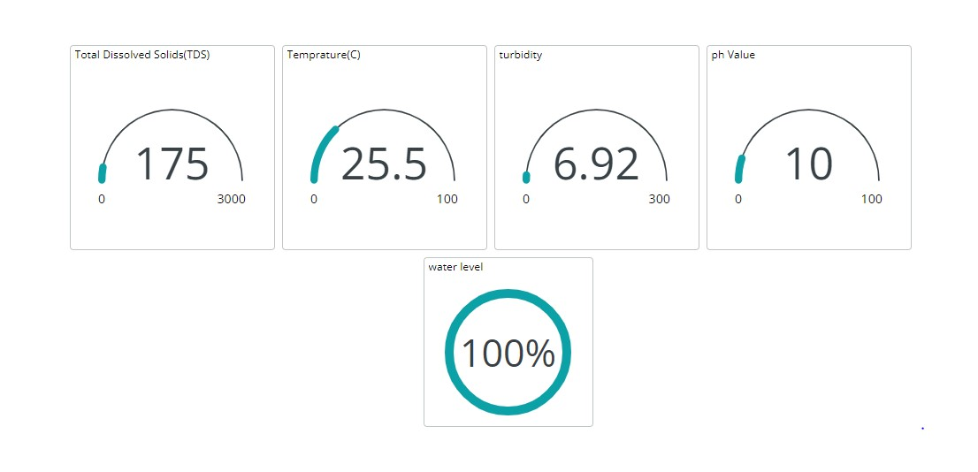
Results
Alkaline Water

Slide 10
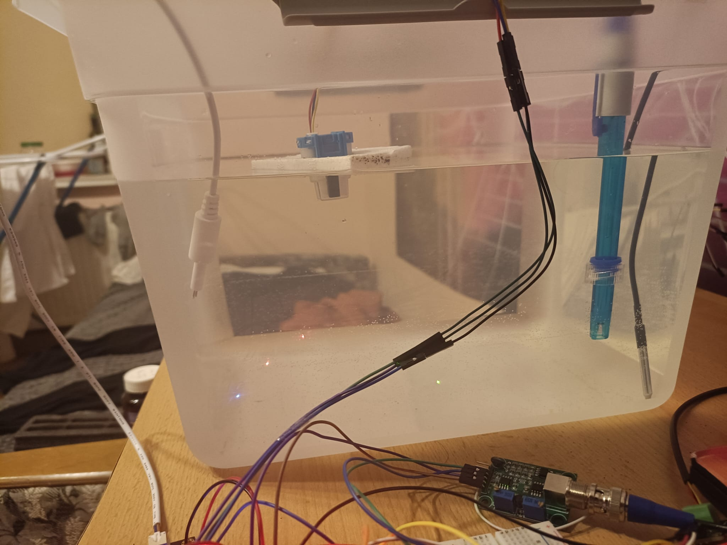
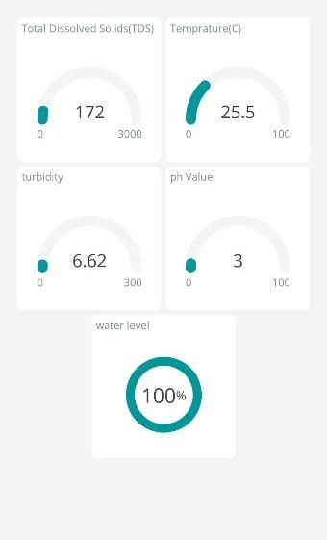
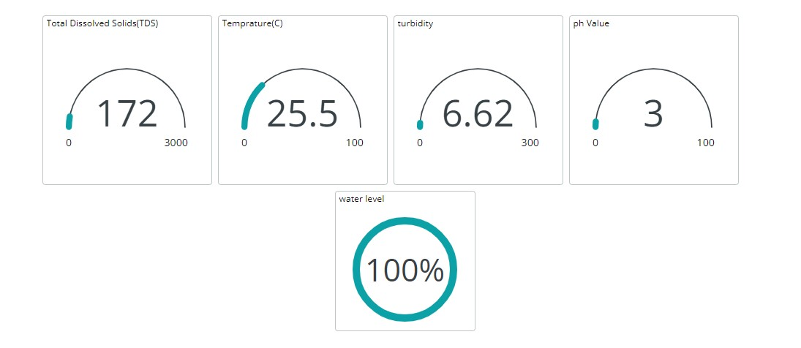
Results
Acidic Water

Slide 11
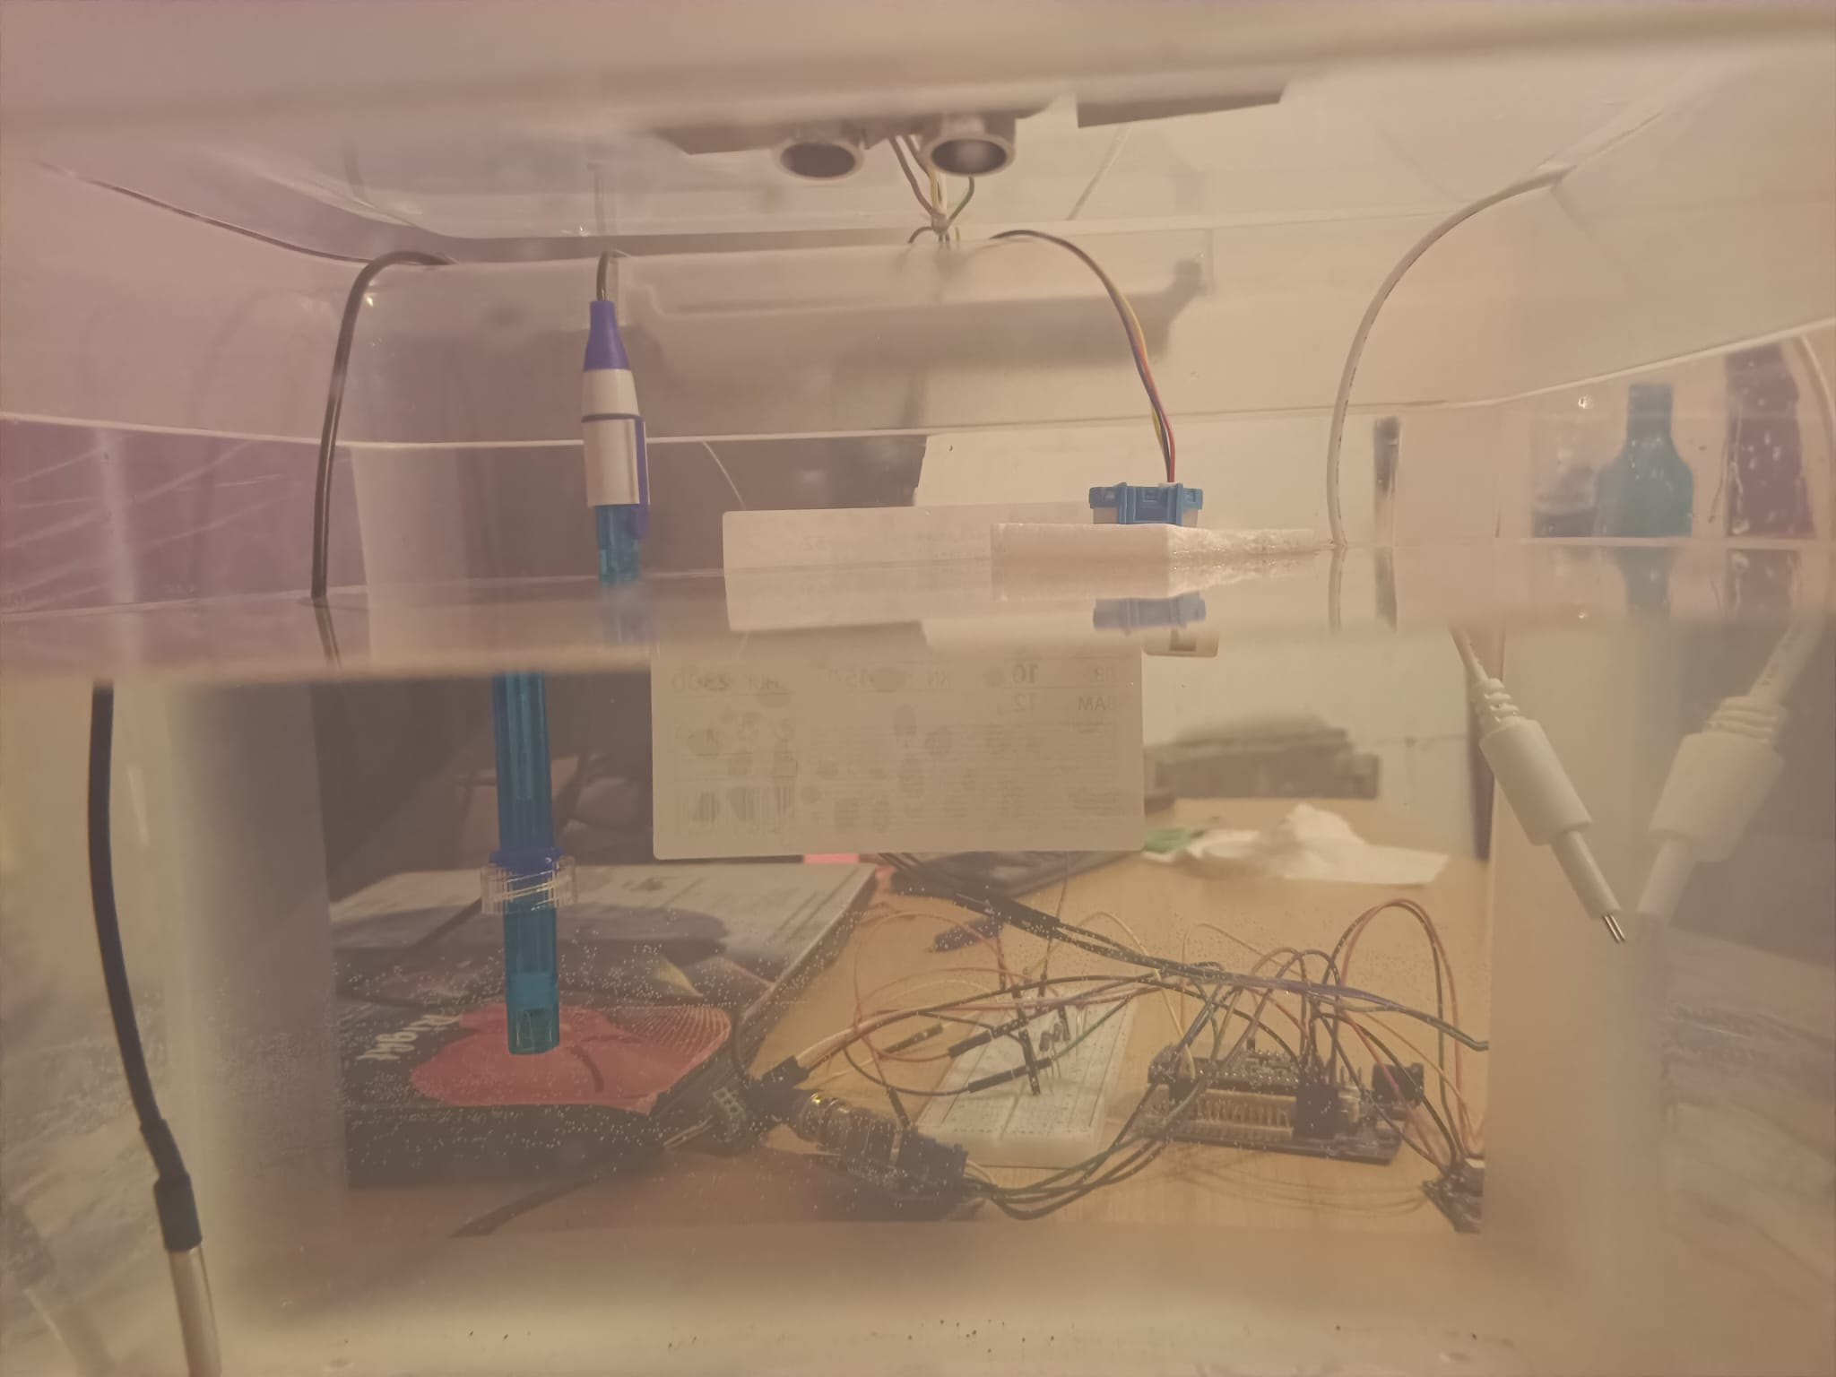
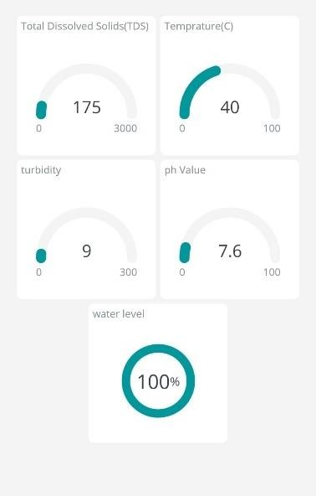
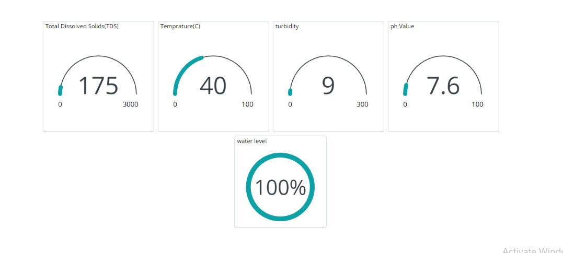
Results
High Temperature Water

Slide 12
Conclusion
The proposed system overcome the disadvantages of the existing system.
The farmer no need to visit the farm daily all the parameters are in the fingertip of the farmer
The system has its application not only in fish farming but also in various areas, including households and municipal water authorities. It can be easily integrated into existing fish ponds with minimal setup costs.

Slide 13
Questions
What is the physical operation of the temperature sensor?
What all does involve in regular maintains and what is the expected lifetime of the sensors?
It is suitable for measuring around 500 ft pond, how this obtained?

Slide 14

Thank you

