Slide 1
Provincial Public Health of Chumphon
Resource

Slide 2
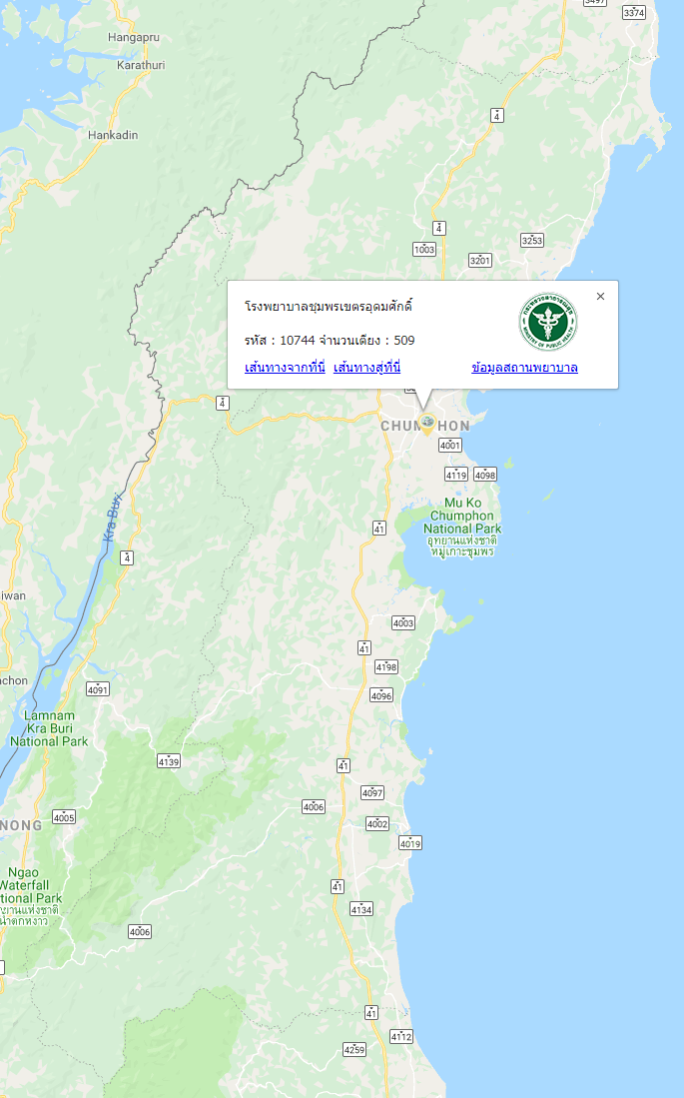
Chumphon Hospital
List | Count of bed
Number of bed | 509
I.C.U surgery | 10
I.C.U medical | 9
I.C.U compound | 8
Specialist | Number
Physician | 9
Surgeon, Obstetrician | 21
Pediatrician, E.N.T | 13
Pathologist, Radiologist | 3
General Practitioner | 5
Dentist | 1

Slide 3
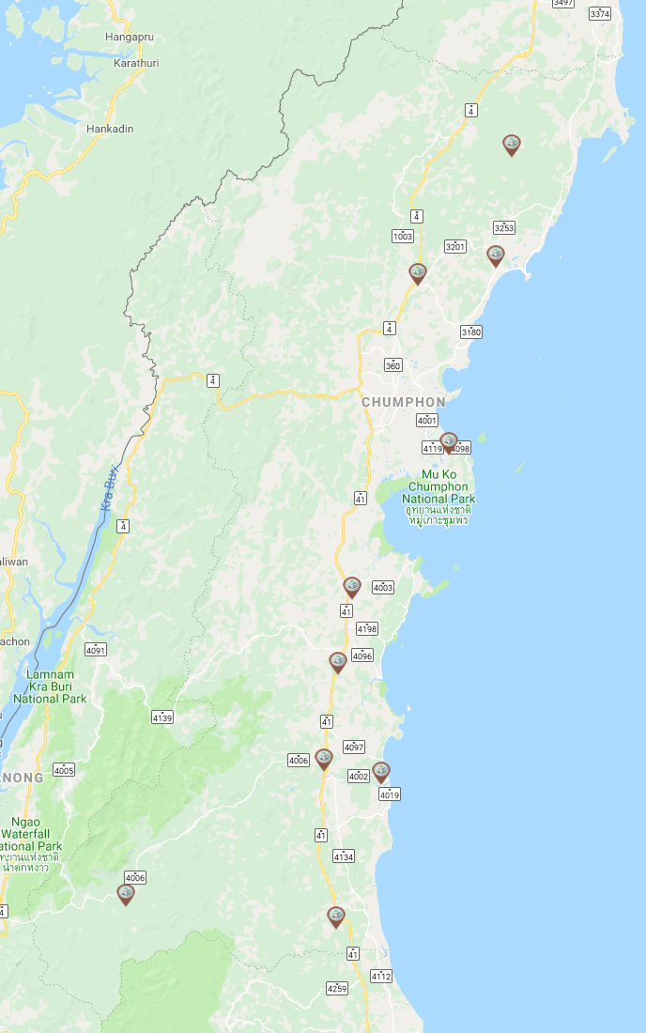
Comunity Hospital
List | Count of bed
Marbammarit Hospital | 30
Pathu Hospital | 60
Thasae Hospital | 60
Paknamchumphon Hospital | 10
Sawee Hospital | 67
Thungthago Hospital | 30
Langsuan Hospital | 120
Paknamlangsuan Hospital | 22
Lamae Hospital | 30
Patho Hospital | 30

Slide 4
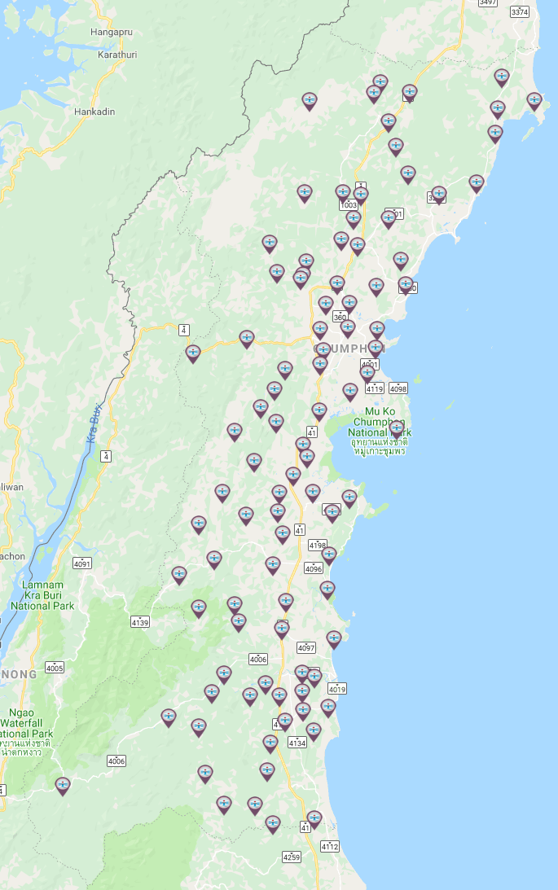
Public health Hospital
List | Count of bed
Public health Hospital | 90
Primary care unit | 4

Slide 5
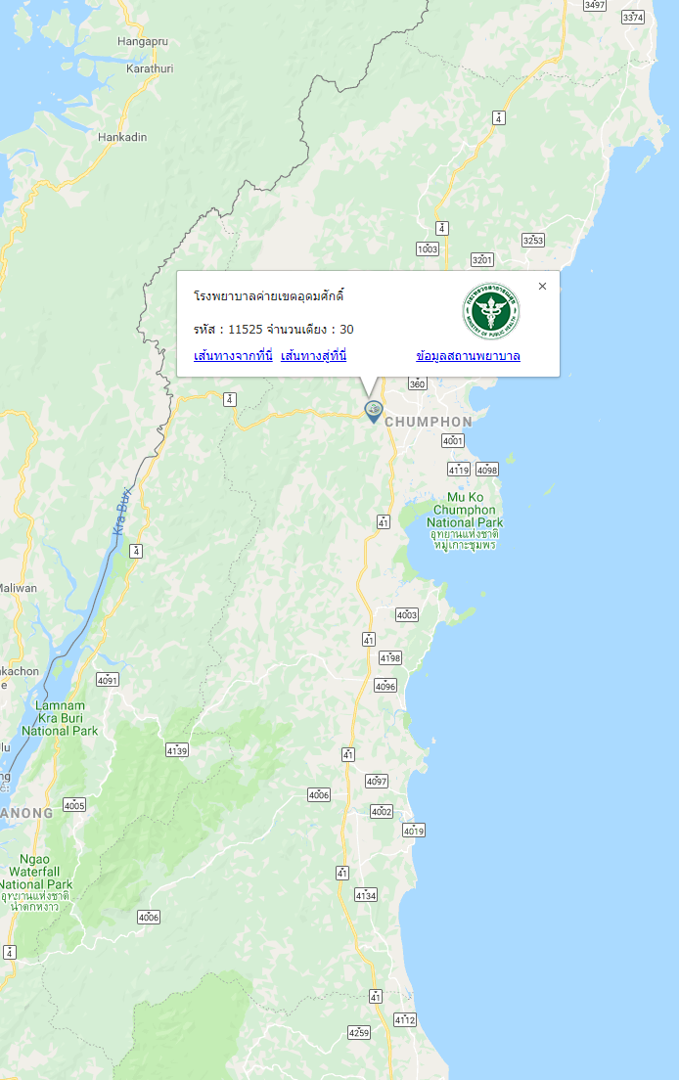
Military Hospital
List | Count of bed
Number of bed | 30
Physician | 1
Radiologist | 1

Slide 6
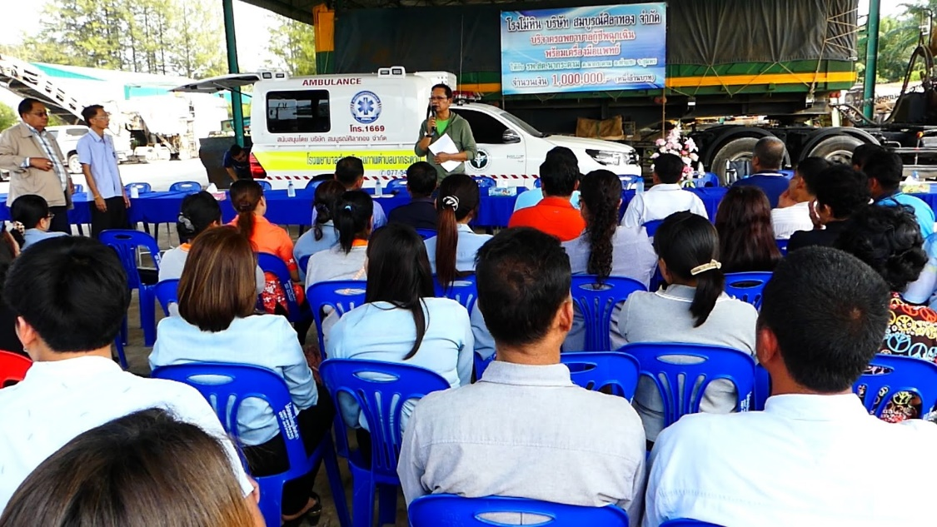
Private Rescue Organization
List | Number
Organization | 14
Volunteer Rescuers | 1,294
Ambulance | 9

Slide 7
HOT LINE 1669
EMS 1669
Emergency medical services 24 hours
Source http://gishealth.moph.go.th

