Slide 1
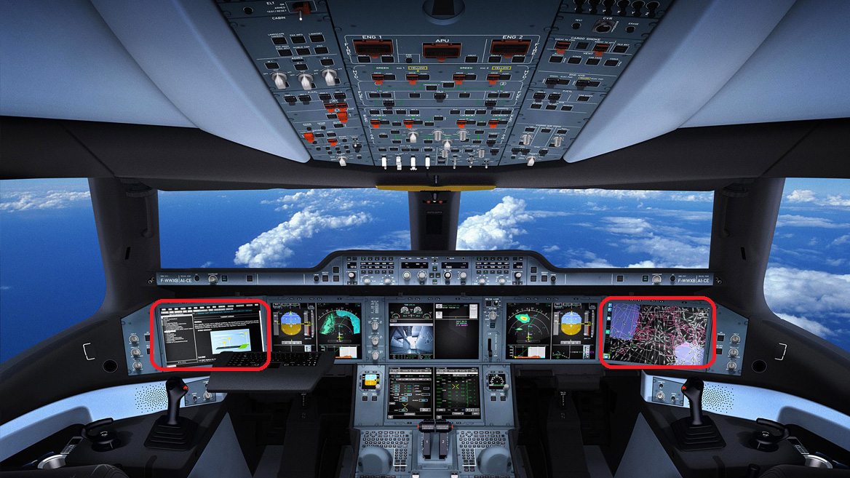
Cockpit 11

Slide 2


Cockpit 11
Chumphon Private Cloud
HDC

