Slide 1
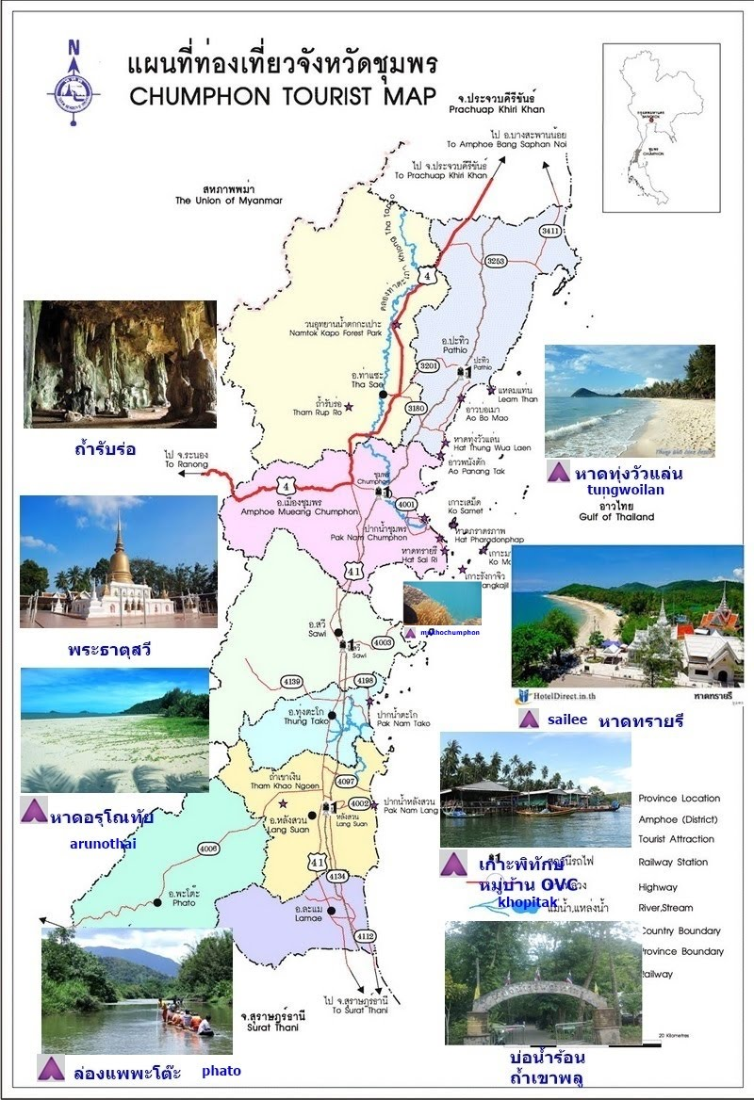
Contact

Slide 2
Provincial Public Health of Chumphon
Resource

Slide 3




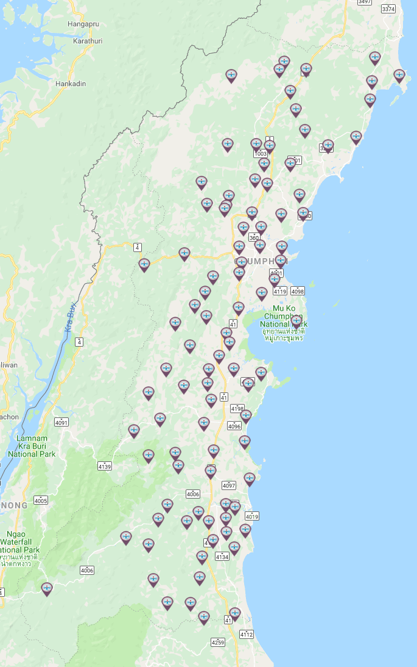





Chumphon Hospital
District Hospital
Sub-district health
promoting Hospital
List | Size (bed)
Number of bed | 509
I.C.U surgery | 10
I.C.U medical | 9
I.C.U | 8
List | Number
Sub-district health promoting Hospital | 94
Primary care unit | 5
Mab-am-marit
Thasae
Pathu
Specialist | Number
Physician | 9
Surgeon, Obstetrician | 21
Pediatrician, E.N.T | 8
Pathologist, Radiologist | 3
General Practitioner | 3
Dentist | 10
Military
Chumphon
Paknam Chumphon
Sawee
Thungthago
Langsuan
Paknam Langsuan
Phato
Lamae

Slide 4
Emergency Operating Center ( E.O.C )
Hospital | ALS Ambulance
Chumphon Hospital | 6
Thasae Hospital | 5
Marbammarit Hospital | 3
Pathu Hospital | 2
Paknamchumphon Hospital | 3
Sawee Hospital | 3
Thungthago Hospital | 3
Langsuan Hospital | 3
Paknamlangsuan Hospital | 3
Lamae Hospital | 5
Patho Hospital | 3

Slide 5
Private Rescue Organization
District | BLS | FR
Chumphon | 7 | 7
Thasae | 1 | 6
Pathu Hospital | 1 | 9
Sawee Hospital | 1 | 2
Thungthago Hospital | 0 | 3
Langsuan Hospital | 1 | 2
Lamae Hospital | 0 | 2
Patho Hospital | 0 | 1

Slide 6
Emergency Operation Response Team
List | TEAM
MERT | 1
MINI-MERT | 11
SERT | 9
MCATT | 9

Slide 7
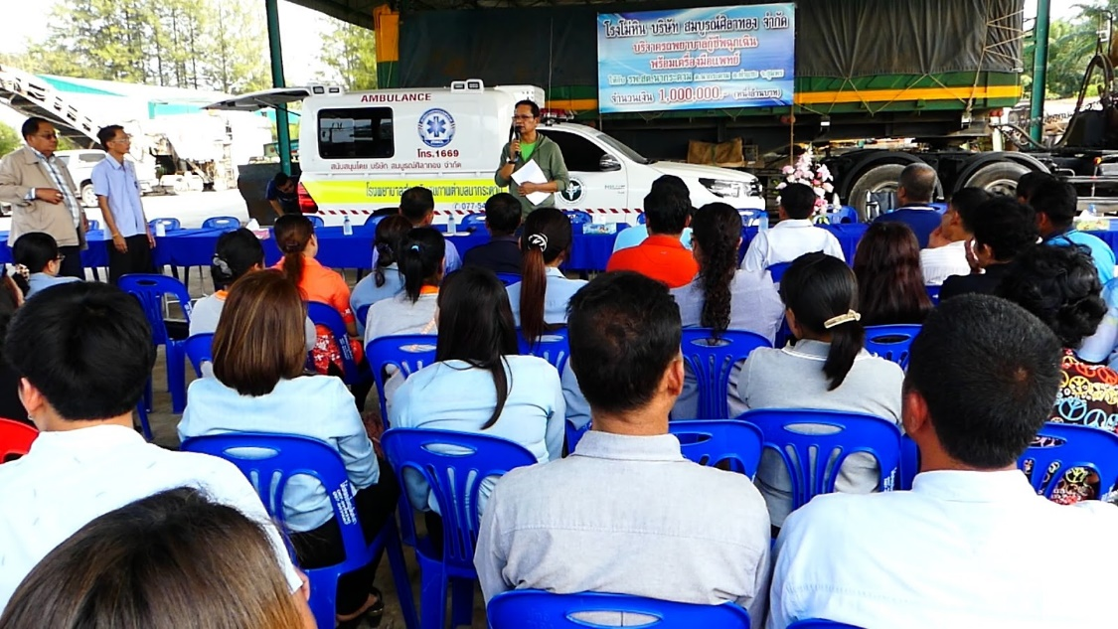
Private Rescue Organization
List | Number
Organization | 37
Volunteer Rescuers | 1,294
Ambulance | 14

Slide 8
Marine Health
District | TEAM
Chumphon | 4
Pathu Hospital | 3
Langsuan Hospital | 1

Slide 9
HOT LINE 1669
EMS 1669
Emergency medical services 24 hours
Source http://gishealth.moph.go.th

