Slide 1
Provincial Public Health of Chumphon
Resource

Slide 2
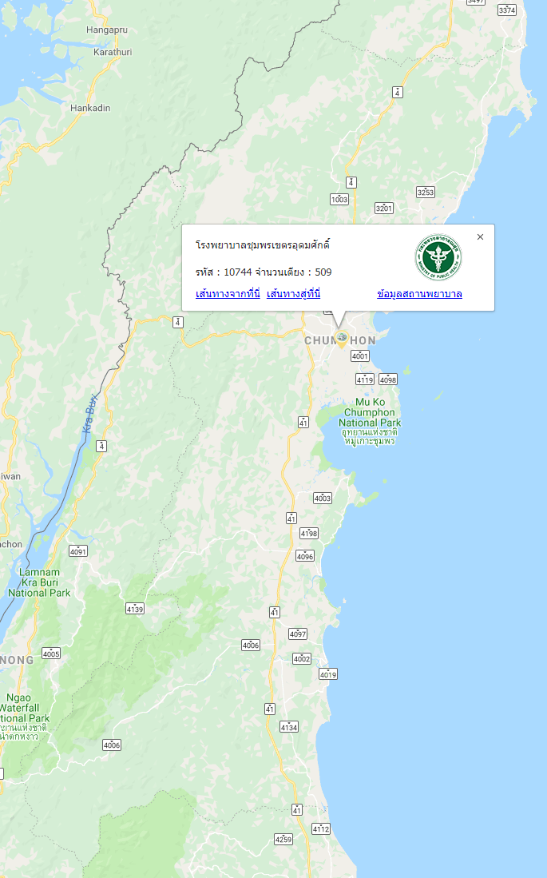
Chumphon Hospital
List | Size (bed)
Number of bed | 509
I.C.U surgery | 10
I.C.U medical | 9
I.C.U compound | 8
Specialist | Number
Physician | 9
Surgeon, Obstetrician | 21
Pediatrician, E.N.T | 13
Pathologist, Radiologist | 3
General Practitioner | 5
Dentist | 1

Slide 3
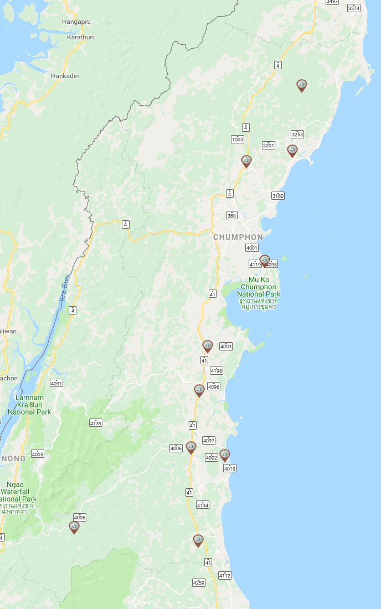
District Hospital
List | Size (bed)
Marbammarit Hospital | 30
Pathu Hospital | 60
Thasae Hospital | 60
Paknamchumphon Hospital | 10
Sawee Hospital | 67
Thungthago Hospital | 30
Langsuan Hospital | 120
Paknamlangsuan Hospital | 22
Lamae Hospital | 30
Patho Hospital | 30

Slide 4
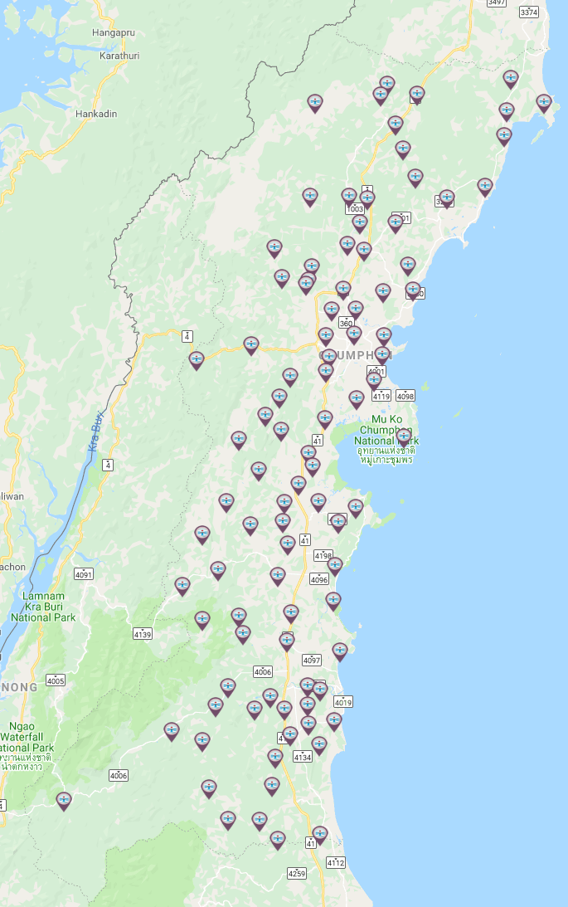
Sub-district health promoting Hospital
List | Number
Sub-district health promoting Hospital | 94
Primary care unit | 4

Slide 5
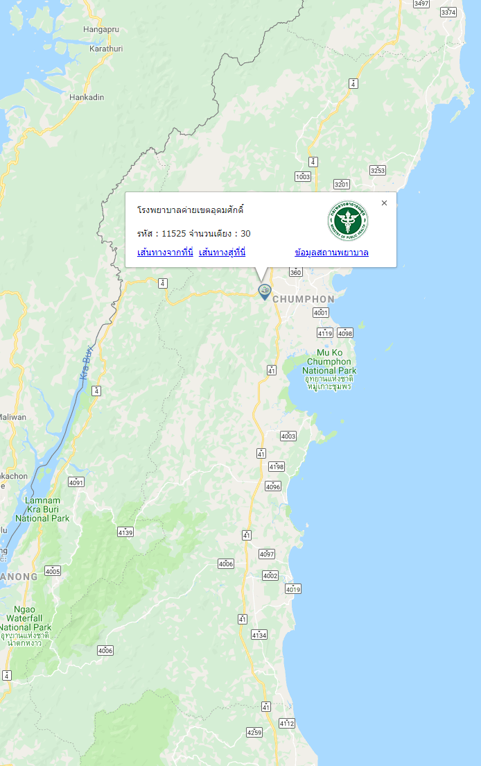
Military Hospital
List | Size (bed)
Number of bed | 30

Slide 6
Emergency Operating Center ( E.O.C )
Hospital | ALS Ambulance
Chumphon Hospital | 6
Thasae Hospital | 5
Marbammarit Hospital | 3
Pathu Hospital | 2
Paknamchumphon Hospital | 3
Sawee Hospital | 3
Thungthago Hospital | 3
Langsuan Hospital | 3
Paknamlangsuan Hospital | 3
Lamae Hospital | 5
Patho Hospital | 3

Slide 7
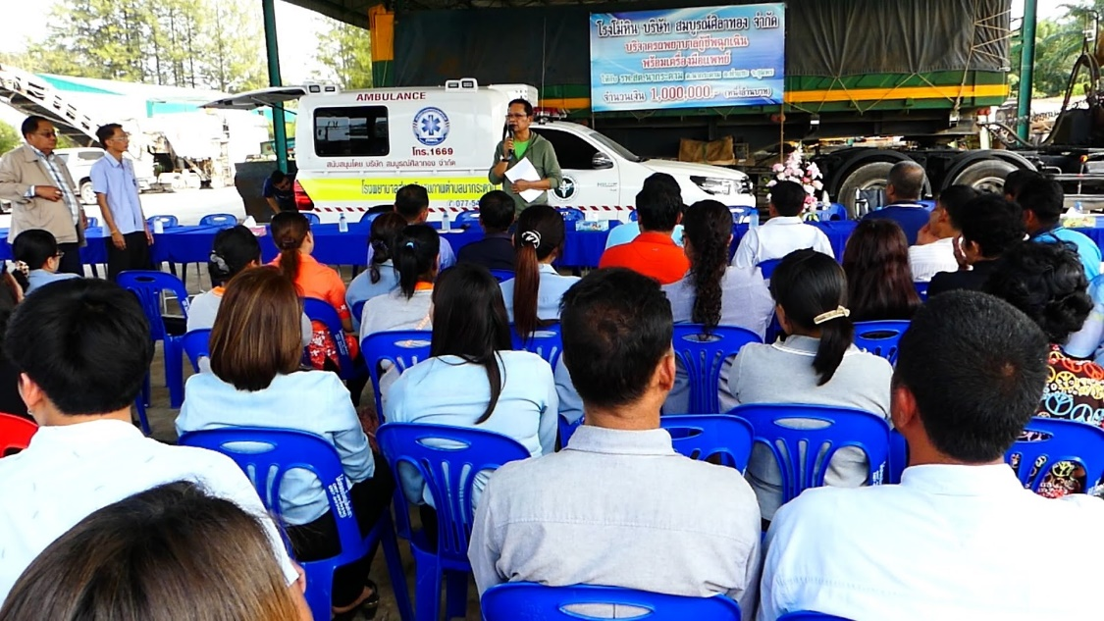
Private Rescue Organization
List | Number
Organization | 37
Volunteer Rescuers | 1,294
Ambulance | 14

Slide 8
HOT LINE 1669
EMS 1669
Emergency medical services 24 hours
Source http://gishealth.moph.go.th

