Slide 1
Project 2 Group 10
Industry employment data for 50 US states
Members: Patricia Mobolade, David Martinez, Roberto De La Torre, Josh Bond

Slide 2
WHY DO WE CARE?
With the current push to support small businesses in the United States today. It begs the question, how much do small businesses contribute to the US economy in comparison to the "Amazons", "Googles" of the world? How has it varied over time? What sectors do small & large business tend to gravitate to? On average, do employees in larger enterprises earn more per capita than small businesses? How to earnings vary across the states and industries?
DATA SOURCE: Census.gov
North American Industry Classification System (NAICS) Stats 2008 -2017 (10 CSV Datasets)
2017 NAICS Structure Summary
US States Code

Slide 3
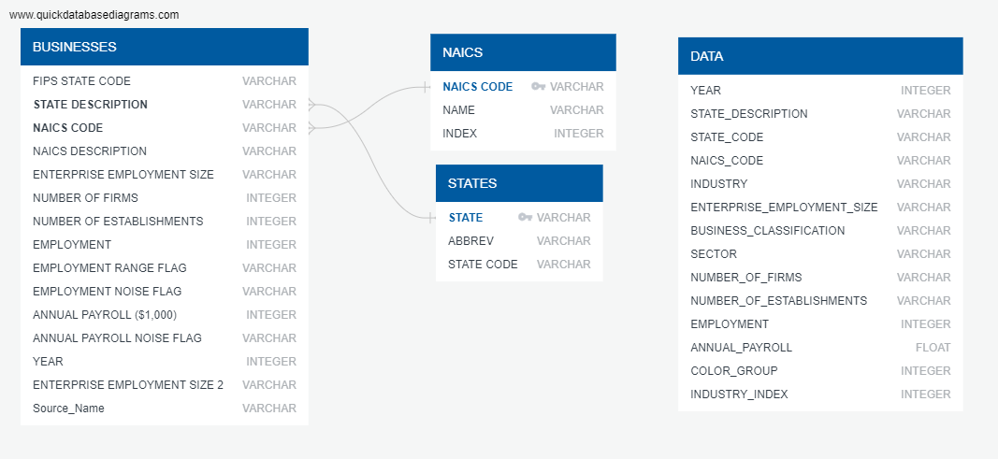
METADATA

Slide 4
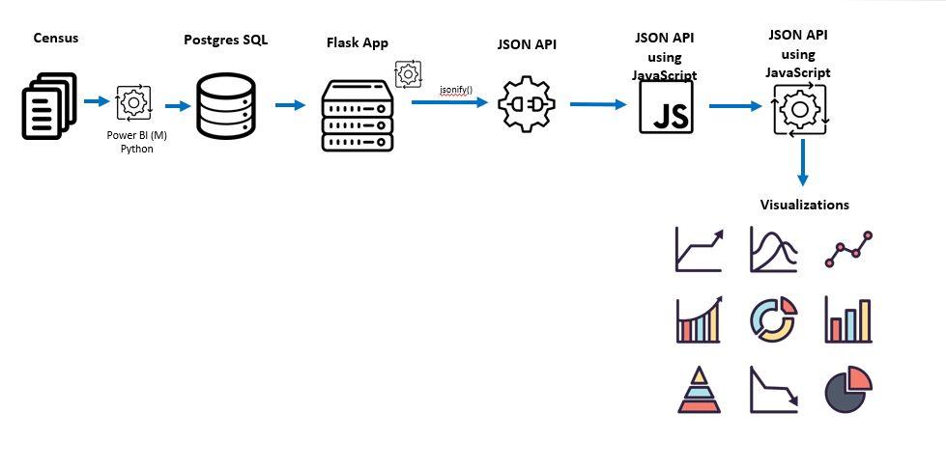
DATA ARCHITECTURE

Slide 5
Dashboard Overview
Barchart showing Industry vs Revenue
Scatterplot with Employment vs Payroll, distinguishes points by total revenue
To make good analysis, need to define parameters (year, industry, etc)
The closest differential in Small and Large is within the Finance & Insurance industry, this suggests a low capital, mid margin, mid skill industry, compare this to Health Care (high capital), Hospitality (low skill), Construction (high margin)

Slide 6
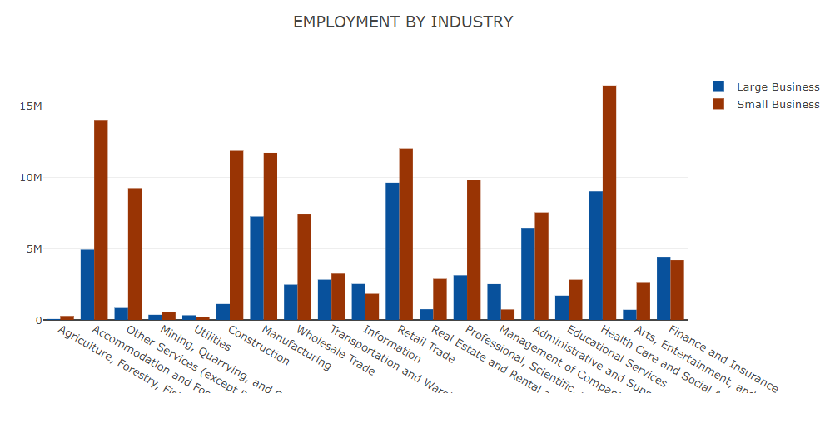
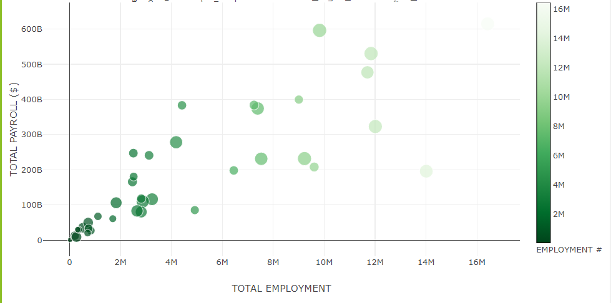
Lets Add a photo of the Dashboard not individual graphs

Slide 7
Lets Add a photo of the Dashboard not individual graphs

Slide 8
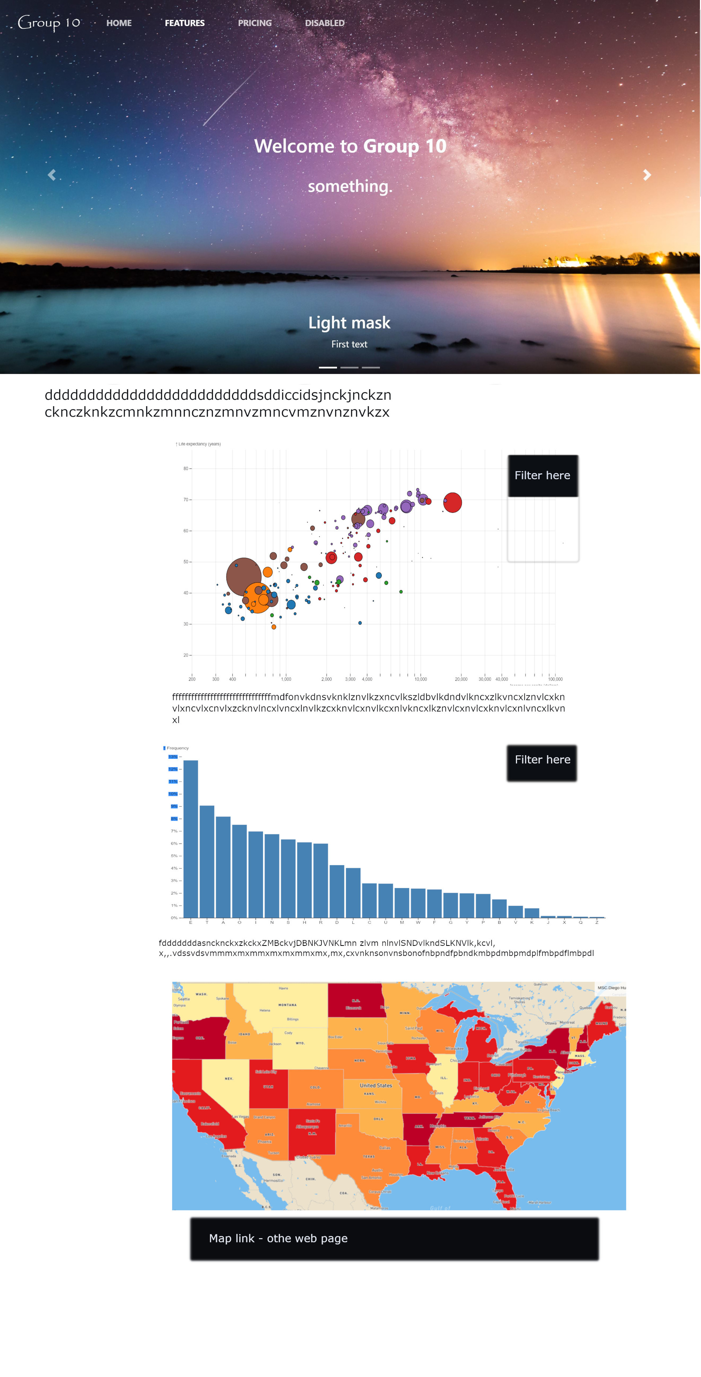
Like This

Slide 9
The Bubble trends
Industries are side by side comparisons of Big and Small Businesses
Revenue by industry (this shows a 1st world *service* economy)
Management, Utilities, Finance & Insurance, Resource Exploitation
(3rd world has the last one as #1 industry every time)
Information is a rapidly growing piece of the pie (@10k per pop) ;)
Large Businesses dominate the US economies Total Payroll
Time permitting the “by industry” Average Salary differentials would be an interesting deep dive comparison

Slide 10
Color map
Shows the US economy grew by roughly 15% from 2008 to 2017 within these Industries (David- can compute the annual GDP growth from that? (reverse compound interest)
Big business grew from 08 to 10 then dropped until 14 then jumped 1M in 15, then dropping the next 2 years, look into something between 13 and 14 causing massive big biz windfall in 15.
Small Businesses dropped every year from 08 to 15, jumping significantly in 16. Falls in line with historical political trends as to small businesses support.

Slide 11
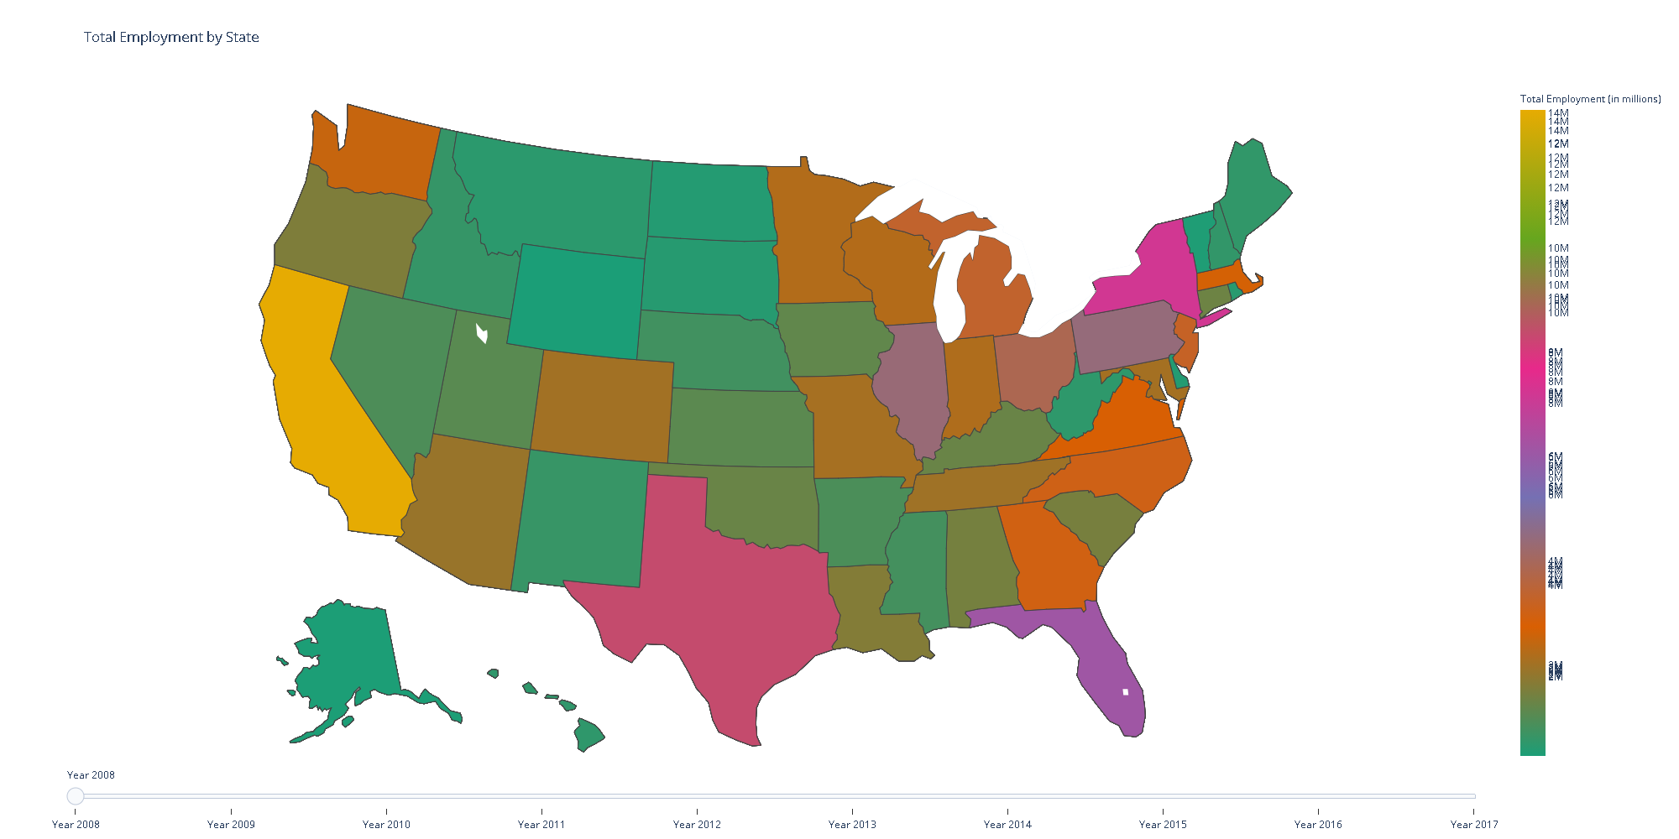
Small Business Map

Slide 12
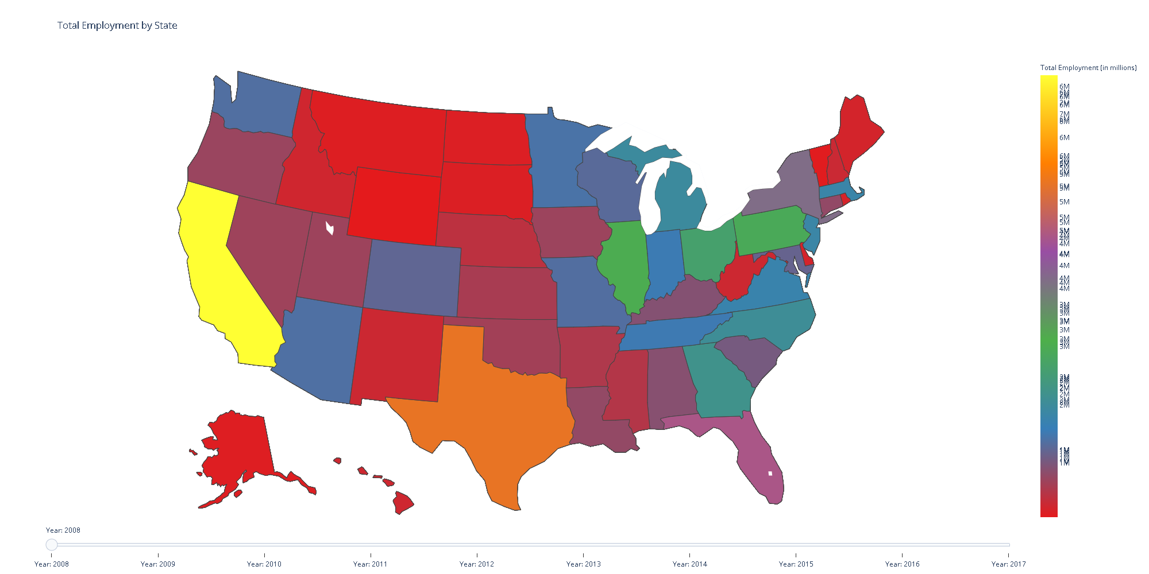
Large Business Map
We actually need side by side comparisons by year

Slide 13
Bubble chart
Missing or Illegible Tags on Equipment
Damage to Synthetic Slings
Stretched or Bent Links on Alloy Chain Slings
Broken Wires, Corrosion, and Deformation to Wire Rope
Broken or Damaged Rigging Hardware
Homemade or unmarked below the hook devices

Slide 14
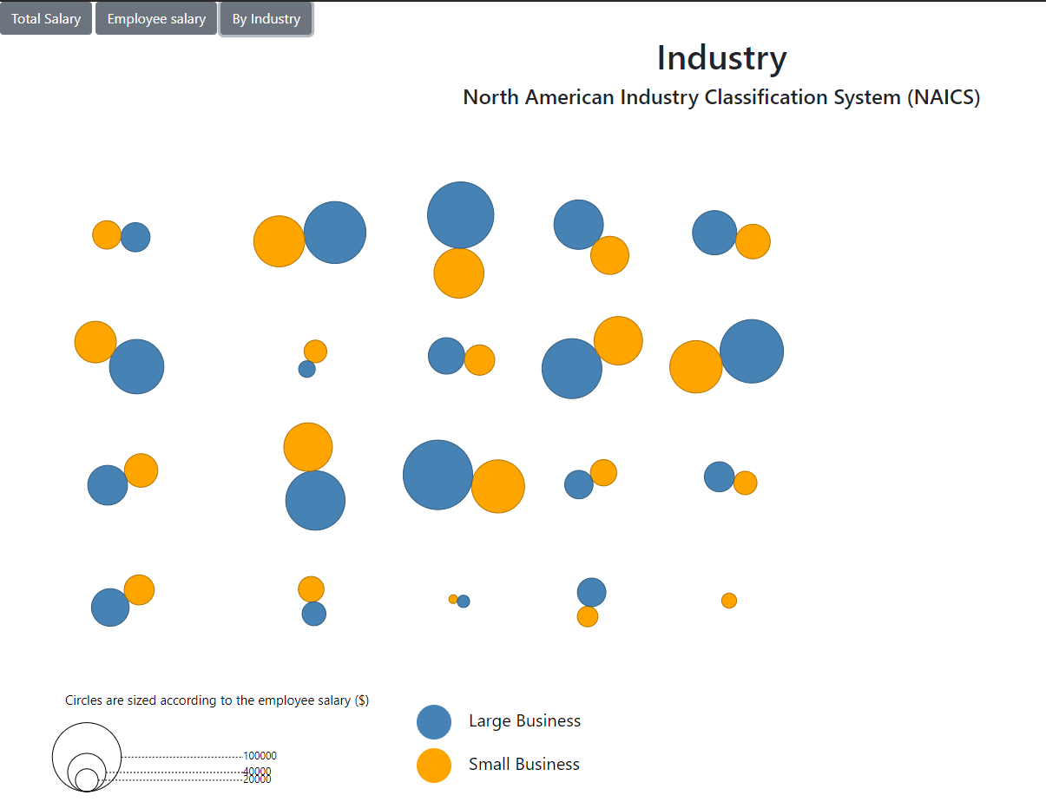

Slide 15
Analysis summary
Big Picture
Cool things
What to explore

Slide 16
Picture Here?

Slide 17
Knowledge is key
How to take advantage
Insights

Slide 18
conclusion
Questions, comments, or concerns

