Slide 1
Project 2 Group 10
Industry employment data for 50 US states
Members: Patricia Mobolade, David Martinez, Roberto De La Torre, Josh Bond

Slide 2
WHY DO WE CARE?
With the current push to support small businesses in the United States today. It begs the question, how much do small businesses contribute to the US economy in comparison to the "Amazons", "Googles" of the world? How has it varied over time? What sectors do small & large business tend to gravitate to? On average, do employees in larger enterprises earn more per capita than small businesses? How to earnings vary across the states and industries?
DATA SOURCE: Census.gov
North American Industry Classification System (NAICS) Stats 2008 -2017 (10 CSV Datasets)
2017 NAICS Structure Summary
US States Code

Slide 3
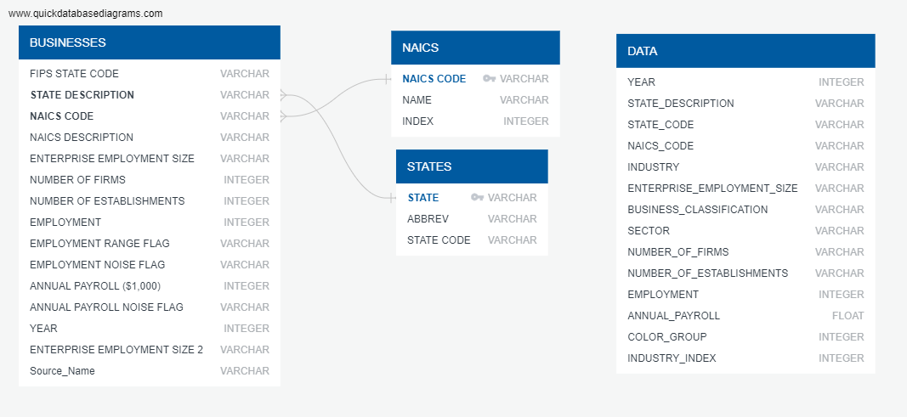
METADATA

Slide 4
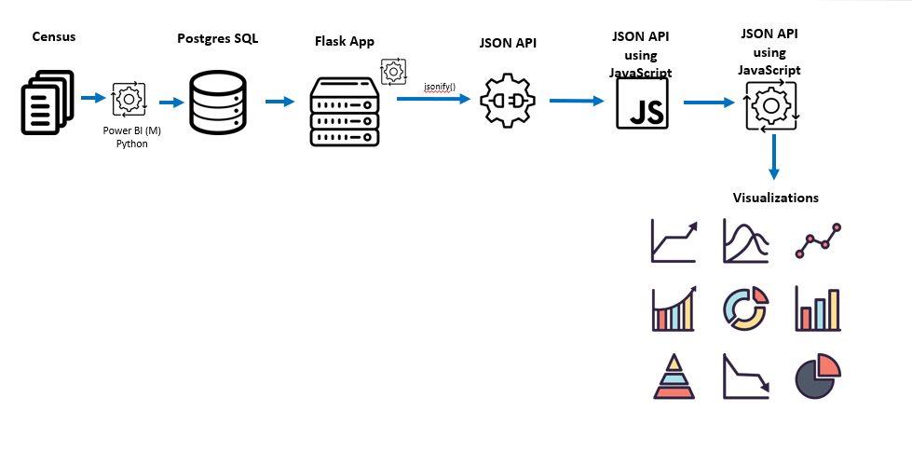
DATA ARCHITECTURE

Slide 5
Dashboard Overview
Bar chart showing Industry vs Revenue
Scatterplot with Employment vs Payroll, distinguishes points by total revenue
To make a good analysis, we needed to define parameters (year, industry, etc)
The closest differential in Small and Large is within the Finance & Insurance industry, this suggests a low capital, mid margin, mid skill industry, compare this to Health Care (high capital), Hospitality (low skill), Construction (high margin)

Slide 6
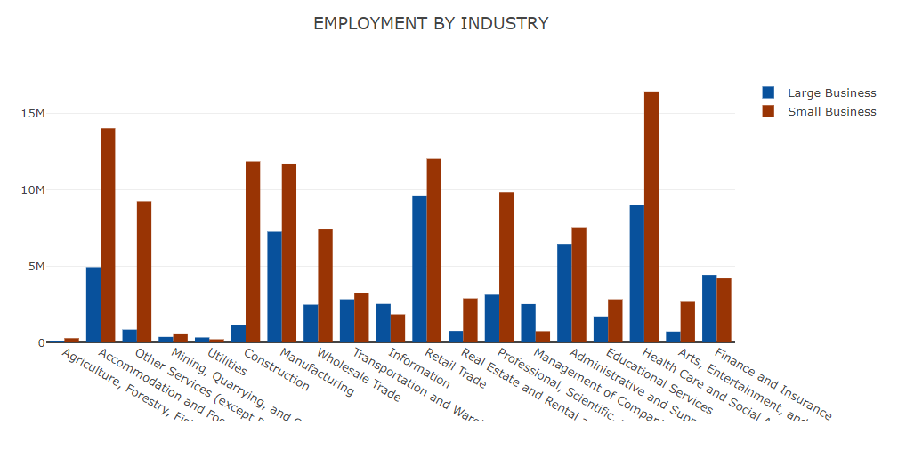

Slide 7
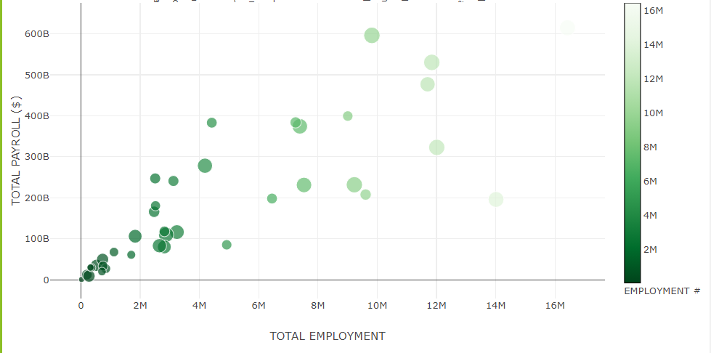

Slide 8
Color map
Shows the US economy grew by roughly 15% from 2008 to 2017 within these Industries (David- can compute the annual GDP growth from that? (reverse compound interest)
Big business grew from 08 to 10 then dropped until 14 then jumped 1M in 15, then dropping the next 2 years, look into something between 13 and 14 causing massive big biz windfall in 15.
Small Businesses dropped every year from 08 to 15, jumping significantly in 16. Falls in line with historical political trends as to small businesses support.

Slide 9
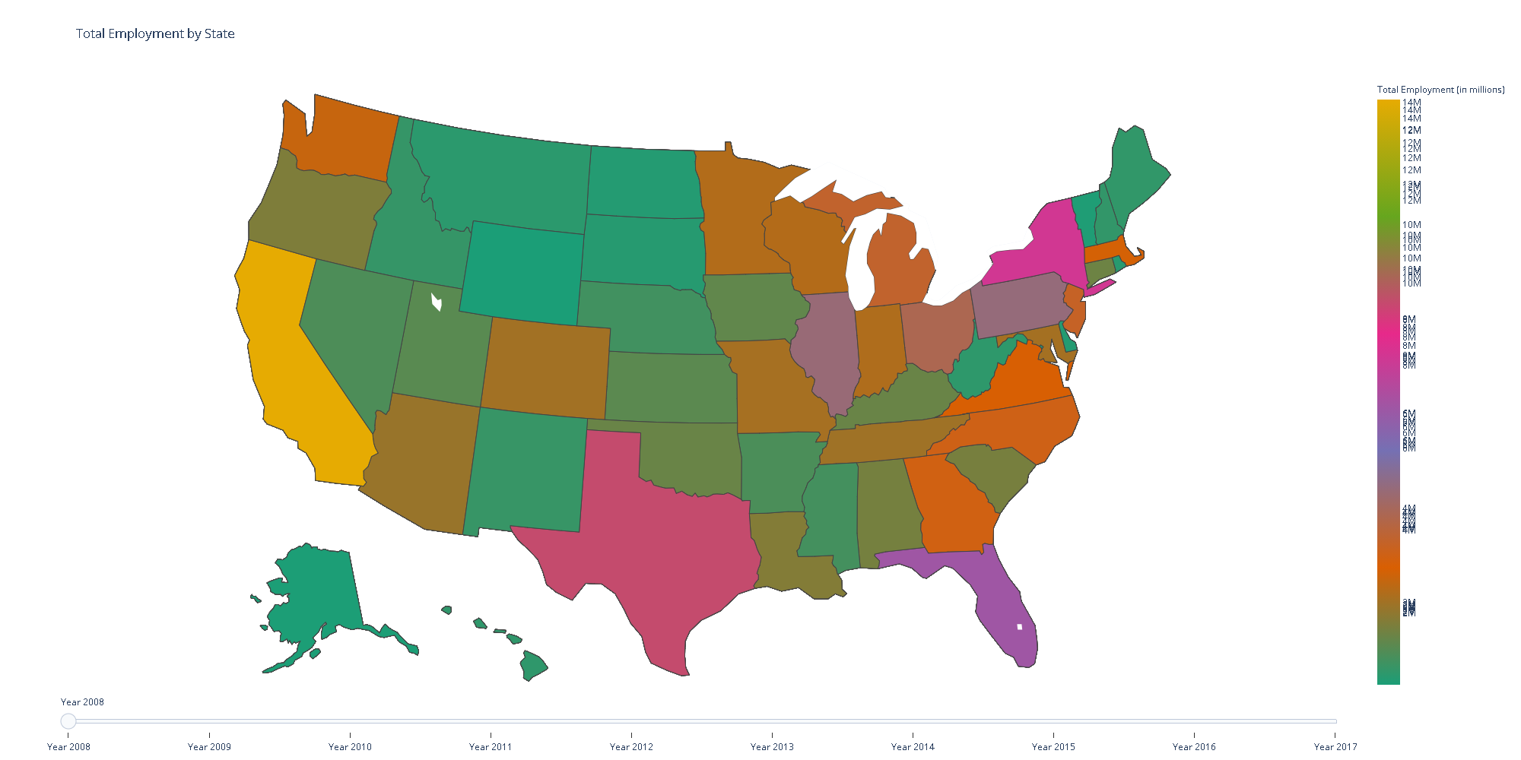
Small Business Map

Slide 10
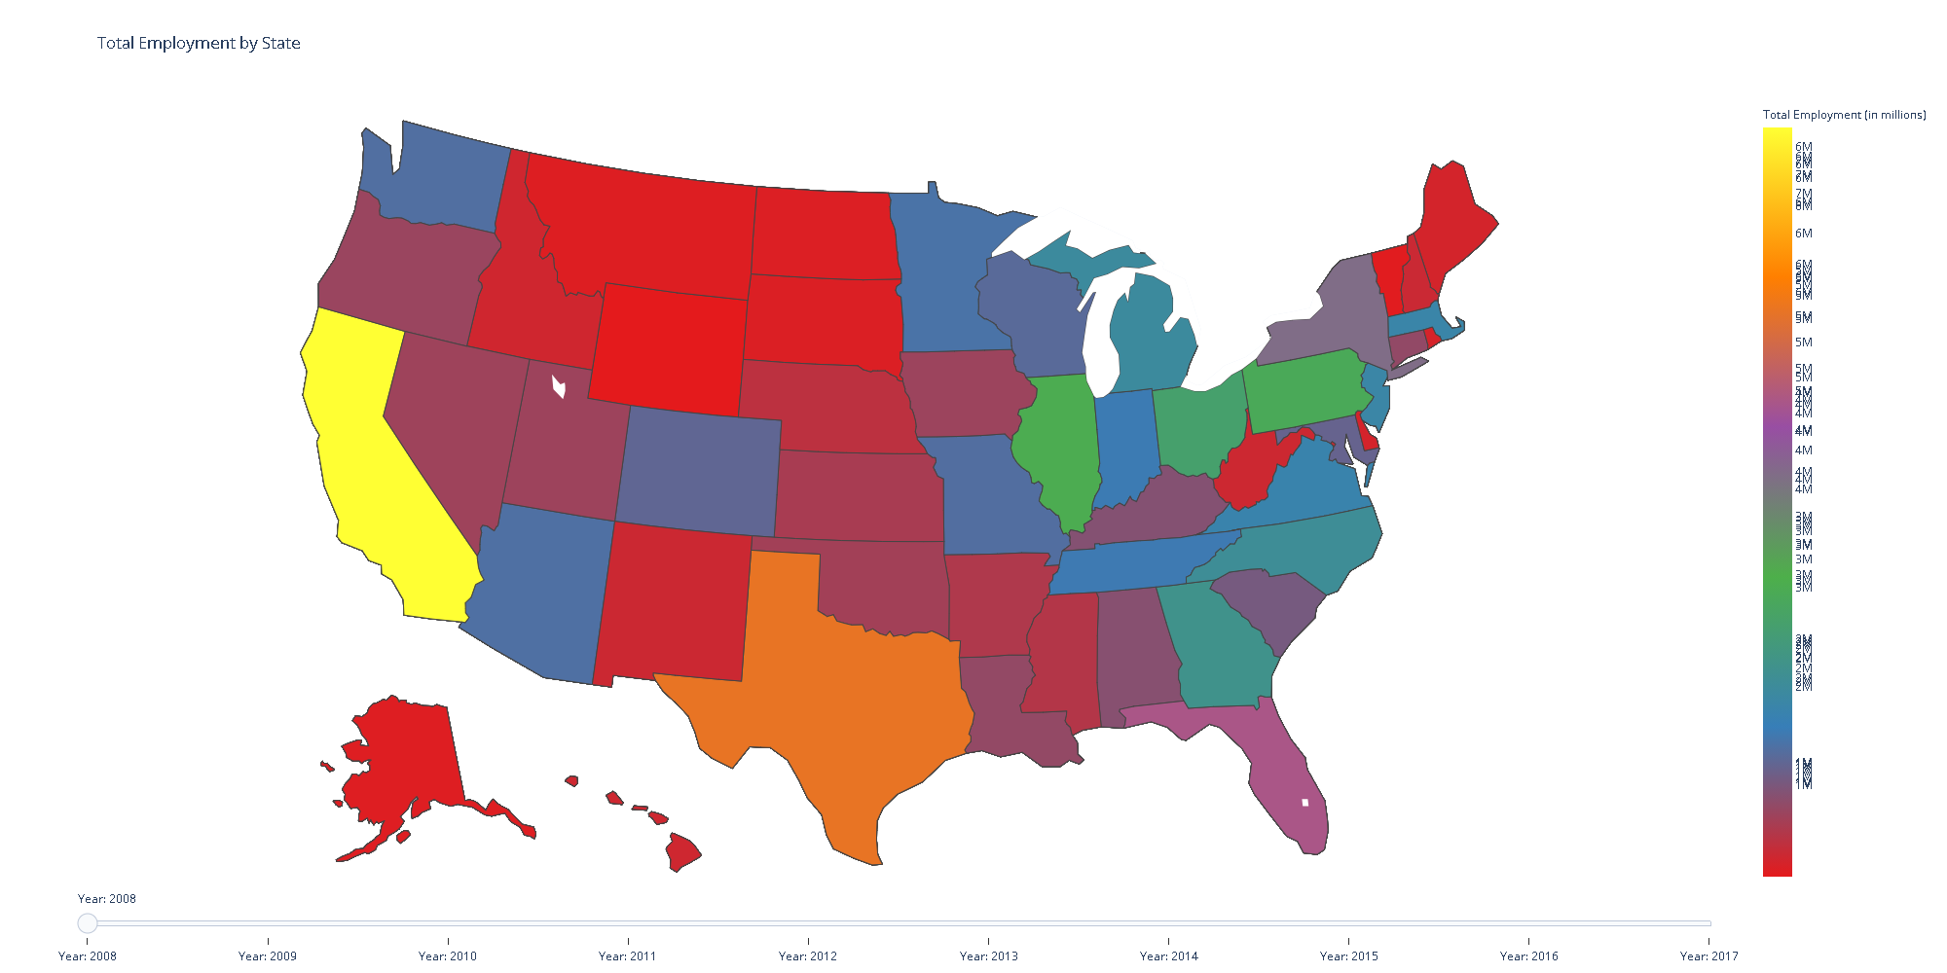
Large Business Map
We actually need side by side comparisons by year

Slide 11
Color map
Shows the US economy grew by roughly 15% from 2008 to 2017 within these Industries
Big business grew from 2008 to 2010 then dropped until 2014 then jumped 1M in 2015, then dropped.
Small Businesses dropped every year from 2008 to 2015, jumping significantly in 2016.

Slide 12
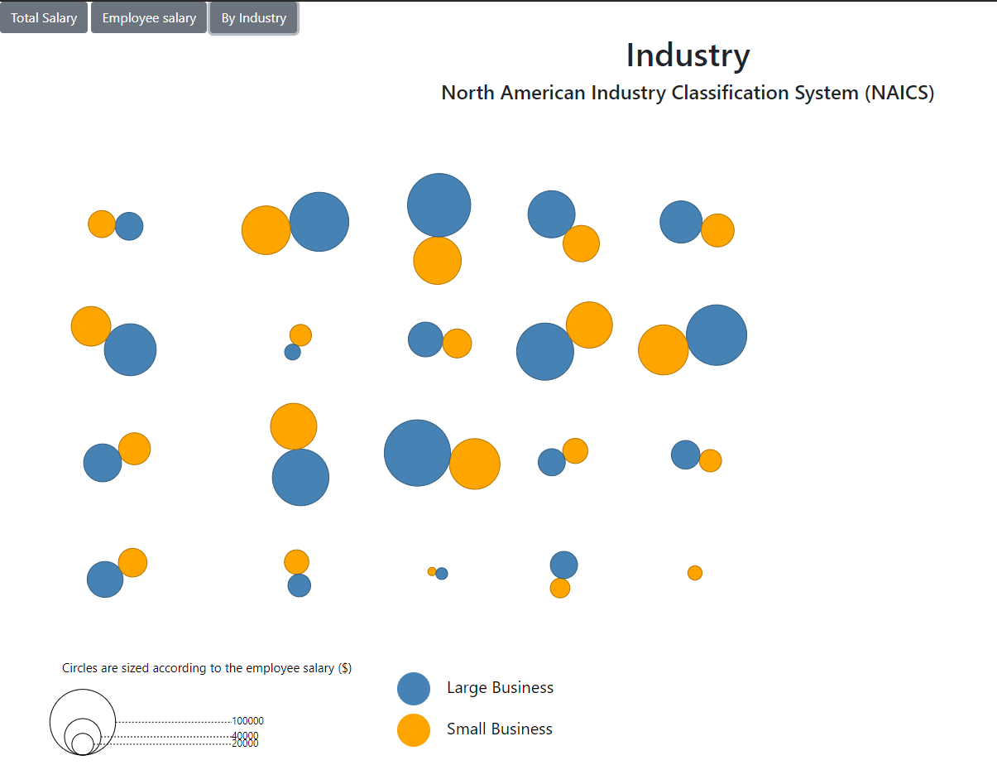

Slide 13
The Bubble trends
Industries are side by side comparisons of Big and Small Businesses
Revenue by industry (this shows a 1st world *service* economy)
Management, Utilities, Finance & Insurance, Resource Exploitation
Information is a rapidly growing piece of the pie
Large Businesses dominate the US economies Total Payroll

Slide 14
Analysis summary
Look into something between 2013 and 2014 causing massive big business windfall in 2015.
Falls in line with historical political trends as to small businesses historically.
Time permitting the “by industry” Average Salary differentials would be an interesting deep dive comparison

Slide 15
conclusion
Questions, comments, or concerns

