Slide 1
Project 2 Group 10
Industry employment data for 50 US states

Slide 2
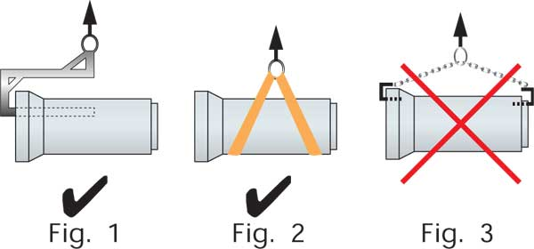

Slide 3
Project overview
Inspections
Testing
Maintenance
Forms
Program Site and Coursework

Slide 5
Data
Inspections
Testing
Maintenance
Forms
Program Site and Coursework

Slide 7
Dashboard
Overload of Lifting Equipment
Improper Installations

Slide 8
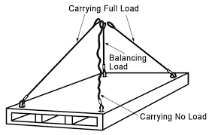
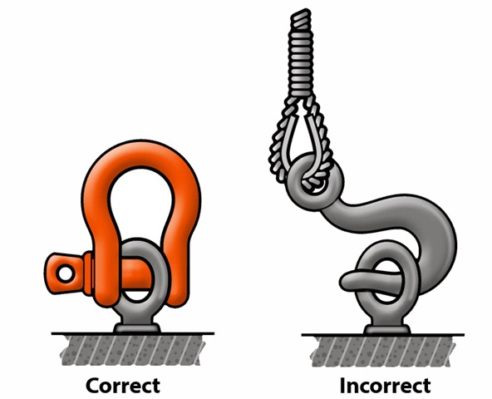

Slide 9
Color map
Inspections must be performed by a “qualified person”
Pre-Lift Plan
Working knowledge of all work to be performed
Weights, envelope dimensions
Reduce planning down to manageable rigging and lift work to be performed

Slide 10
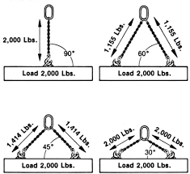
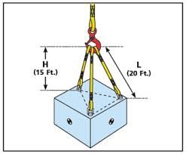

Slide 11
Bubble chart
Missing or Illegible Tags on Equipment
Damage to Synthetic Slings
Stretched or Bent Links on Alloy Chain Slings
Broken Wires, Corrosion, and Deformation to Wire Rope
Broken or Damaged Rigging Hardware
Homemade or unmarked below the hook devices

Slide 12
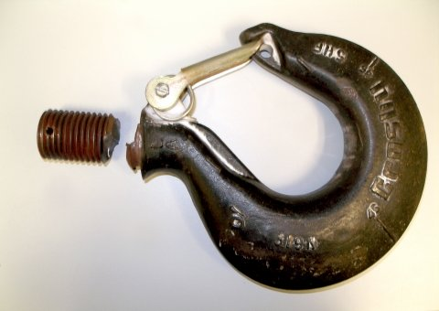

Slide 13
Analysis summary
What is difference between lifting and rigging?
Proper Rigging Techniques
Degrees of Freedom and Maintaining Control

Slide 14
Knowledge is key
Knowing Equipment to be Lifted
Knowing the Equipment used in Lifting

Slide 15
Questions
Questions, comments, or concerns

