Slide 1
Emergency Room Patient Volume as a Predictor of Treatment Time
Bellevue University – DSC530
Jolene Branch
February 29, 2020

Slide 2
Initial question: “Do facilities (with ERs) with larger volume of patients tend to get fibrinolytic (clot busting) therapy administered within 30 minutes of ER/ED arrival better than smaller facilities?”
Interview of an experienced ER RN and quality improvement professional determined that answering this question within the boundaries of this dataset would provide a misleading conclusion. (A. Ducklow, personal communication, February 21, 2020)
Revised question: “If you are having chest pain, should you go to a bustling/high volume ER/ED or a quiet one?”
Hypothesis: Low volume ERs perform initial diagnostic testing quicker than high volume ERs.

Slide 3
Variables used from https://data.medicare.gov/data/hospital-compare > Timely and Effective Care - Hospital
OP_2 is the % of outpatients with chest pain or possible heart attack who got drugs to break up blood clots within 30 minutes of arrival
OP_18b is the median time patients spent in the ED before leaving from the visit
OP_23 is the % of patients who came to ED with stroke symptoms who received brain scan results within 45 minutes of arrival
OP_3b is the median number of minutes before outpatients with chest pain or possible heart attack who needed specialized care were transferred to another hospital
OP_5 is the median number of minutes before outpatients with chest pain or possible heart attack got an ECG
EDV is the ED volume (non-numeric)

Slide 4
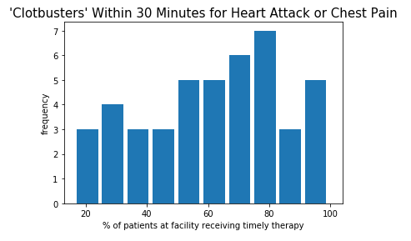
Mean is 69.0. Mode is 82.0. Standard deviation is 20.3.
The tail extends farther to the left than right. Results are not normally distributed. There appears to be a cluster of facilities that administer the medication timely around 55% of the time, and another cluster of facilities that administer it timely around 80% of the time. The cluster around 55% is not enough to call this a bimodal distribution.

Slide 5
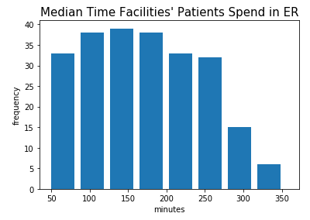
Mean is 143.0. Mode is 122.0. Standard deviation is 41.7. The tail extends farther to the right than left, with a sudden drop at about the 250-minute mark. This might reflect a practice of ERs to move patients through in under 4 hours.

Slide 6
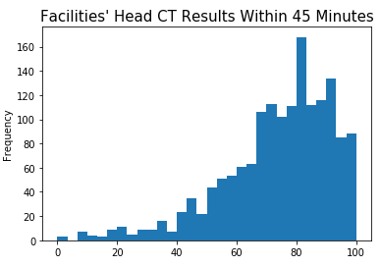
Mean is 73.8. Mode is 100.0. Standard deviation is 18.6. The tail extends farther to the left. There is a concentration to the right of the mean. It appears that the processes of many facilities are designed to accomplish this task on time between 65 and 90% of the time. One thing to note about this evidence-based practice (EBP) measure; It is all or nothing. If results were available in 46 minutes, the instance counts as a zero. Perhaps facilities unable to perform the scan timely should not be attempting to do so. If the track record is poor, they should immediately send the patient to a higher-level acuity facility (as long as that facility does better at this measure).

Slide 7
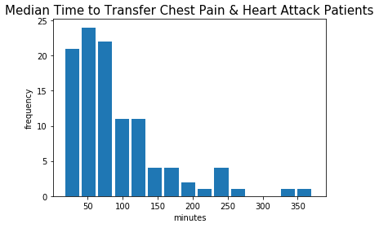
Mean is 63.2. Mode is 52.0. Standard deviation is 39.3. The tail extends farther to the right than left, with a sudden drop at about the 85- to 90- minute mark. This suggests a practice or goal of getting patients out in under 90 minutes. The y axis ‘frequency is the count of facilities whose average time was in that particular x axis bin.

Slide 8
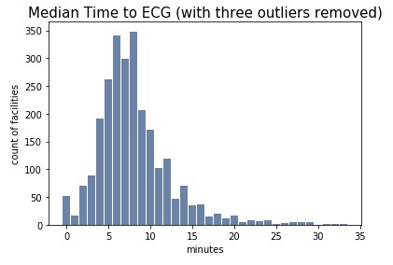
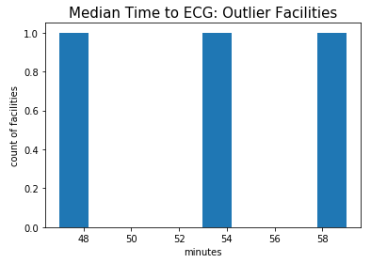
Mean is 8.08. Mode is 8.0. Standard deviation is 4.6. The mean and mode are nearly the same. The data is approximately normally distributed. The tail does extend farther to the right, with three (way) outliers, which would benefit from facility-level drill down or root cause analysis. Remember that the data for each facility is the median number of minutes for that facility. I removed the three outlier facilities and replotted the data, but kept them in the data frame for analysis, as the mean, median, and standard deviation of the OP_5 series remained nearly identical before and after removing the outliers (which had resulted in unexpected removal of additional rows).

Slide 9
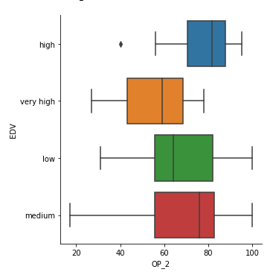
Looking at ways to compare the effect of ER volume on timeliness of expected best practices, an interesting result of subsetting the ‘clot busters within 30 minutes’ (or OP_2) variable is seen. Note that the y axis is NOT ordered by volume, but notice that very high volume ERs do the best on this measure, and high volume ERs do the worst, with the low and medium volume facilities falling somewhere between the two. This suggests that I am not going to have a straight-forward "yes/no" answer to my hypothesis. I need to look at the other variables.

Slide 10
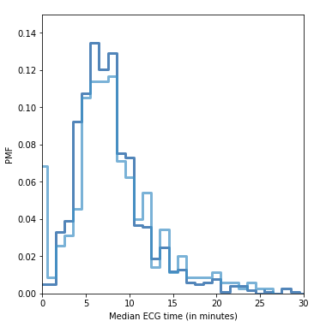

An ECG can be had in under a minute at a number of very high-volume ERs, but after that the low volume ERs edge ahead by about a minute. The probability of it taking greater than 10 minutes, which is industry standard, is worse at a very high-volume ER.

Slide 11
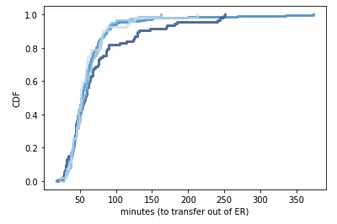
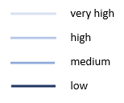
If a patient is not transferred out of an ER within the first 60 minutes, the transfer is going to be even more delayed if at a low volume ER.

Slide 12
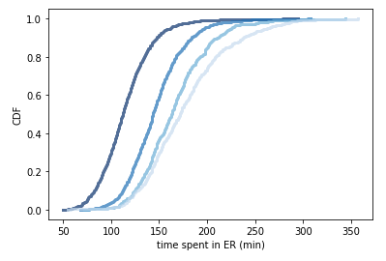
Patients spend less time in a low volume ER. Is this due to their efficiency or their need to transfer more people out due to lack of specialty care resources? BUT, the CDFs on the previous slide show that if you don't get transferred out of the low volume ER within the first 60 minutes, you are going to be sitting there longer. Interview of ER RN revealed that low volume ERs are more likely to be connected to smaller hospitals (without all treatment modalities available at larger hospitals) and are therefore more likely to require transfer out. Low volume ERs are also more likely to be in rural areas, so inability to safely provide timely emergency transport is more likely to occur due to things like weather conditions and reliance on emergency transport of the receiving facility.

Slide 13
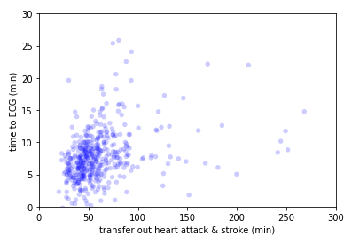
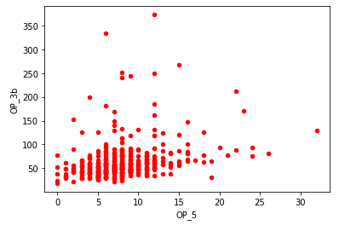
The scatter plot on the left was created using the methods in the Downey text, including jittering and transparency. The chart on the right is the same two variables, plotted on opposite axes. The chart on the right was easier to create, but makes the outliers appear more important than they are. The dots ‘lining up’ vertically makes it difficult to gauge volume.
Covariance is 48.6 and correlation is 0.3. The correlation is positive. Then time to ECG is high, time to transfer out tends to be high.

Slide 14
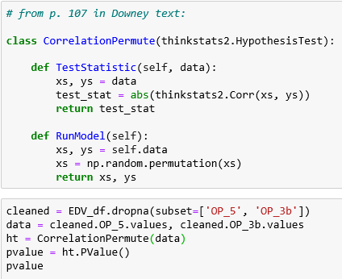
Hypothesis Testing Using Pearson’s Correlation
This produces a p value of 0.0, which is statistically significant and unlikely to occur by chance. The concern is that the effect might not be important or significant in practice.

Slide 15
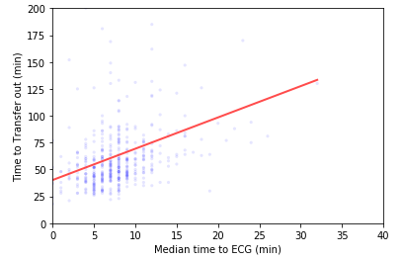
Linear least squares was used to estimate the slope and produce a “linear fit” line for this model. This chart plots time to ECG and time to transfer out, along with a fitted line. This relationship appears to be linear and seems like a good model for the relationship. However, unless the ‘time to ECG’ is subtracted out of each facility’s individual record of ‘time to transfer out’ prior to calculating the median times, there is certainly some measure of overfitting of this model.
Size/volume of the ER is not a good predictor of treatment time. While my initial hypothesis is correct, interdependence of the variables makes the significance of the results questionable. Just the same, do not drive by a small ER with an empty parking lot if you are having chest pain – unless the weather is bad.

