Slide 1
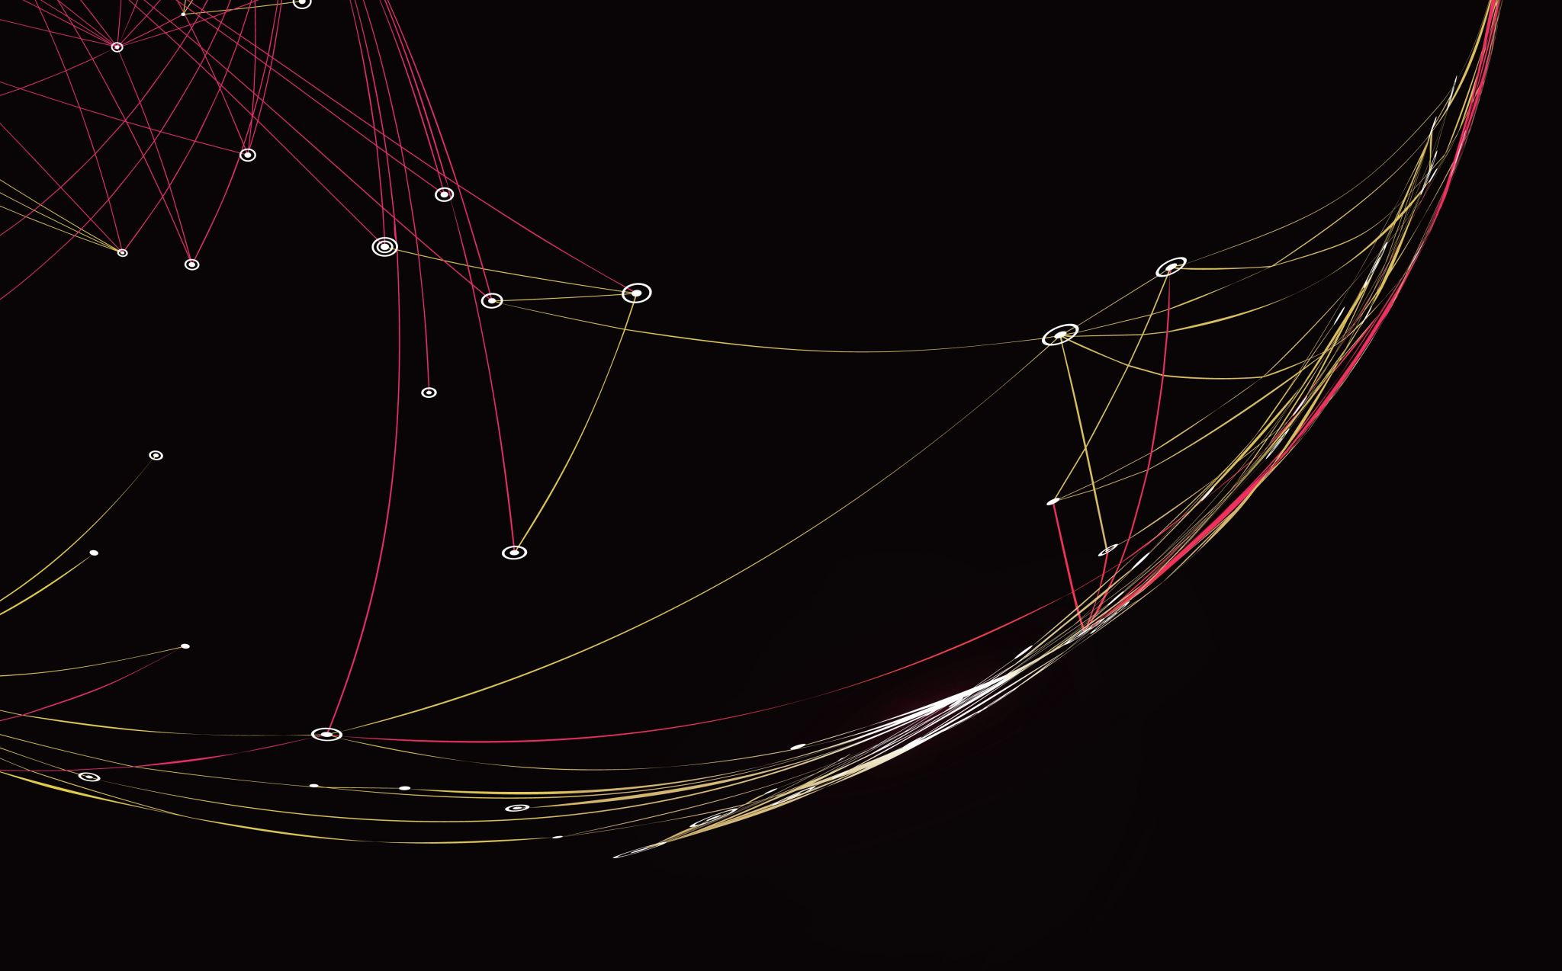
Attempting FaceMask Screening Automation using Image Recognition
Jolene Branch
DSC680: Applied Data Science
Bellevue University
August 12, 2021
Notes:
Recording of audio/visual presentation available at https://screenrec.com/share/ejxqYw7rUR

Slide 2
Table of Contents
Questions to Answer
Data Source
Methods
Analysis and Findings
Conclusion
References
Notes:
Wow. Nice automatically generated icons from ‘Design Ideas,’ on the ‘Designer’ tab in the PowerPoint ribbon.

Slide 3

Questions to Answer
Can I create an image recognition model that performs better than any of the Kaggle competition entries (that received at least one upvote)?
Does the widespread wearing of face masks cause known, established image detection programs, such as the Viola Jones Algorithm, to fail?
What level of accuracy can I achieve?
Is there any literature on human visual accuracy (such as at screening checkpoints) for comparison?
Once I unzip the contents of the downloaded folder, can I save them and delete the original zipped folder?

Slide 4
(Continued) Questions to Answer
Will a ‘run-of-the-mill’ personal laptop be sufficient for processing a convolutional neural net problem?
Can interesting graphics be generated from a simple unbalanced binary classification problem?
When lifting bits and pieces of code from multiple sources, is there any guidance on how many characters/lines need to be the same in order to necessitate reference citation?
If the Delta variant of COVID-19 can be spread among fully vaccinated individuals, AND masks are proven to prevent transmission, why weren’t President Obama and the guests to his 60th birthday party extravaganza wearing masks?
Is there a correlation between education level and individual compliance with CDC recommendations?

Slide 5
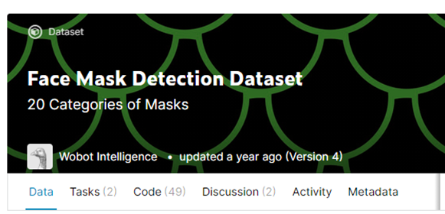
Data Source
https://www.kaggle.com/wobotintelligence/face-mask-detection-dataset
Notes:
Numerous datasets for image recognition of face mask wearers are available. The Kaggle competition dataset (https://www.kaggle.com/wobotintelligence/face-mask-detection-dataset) was used for this project due to the availability of comparative success rates. Images within the dataset were in the form of .png, .jpg, and .jpeg files, which were easily downloaded as a .csv file (although it took 20 minutes)! The dataset contained six variables, including one outcome variable, ‘classname. The original ‘train’ file contained 6 columns and 15413 rows. There were no missing values within the dataset.

Slide 6
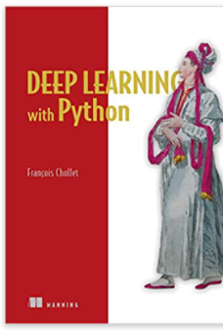
Methods -
Convnet
Three strategies
Train from scratch
Feature extraction using pretrained model
Fine-tuning
“…deep learning models are by nature highly repurposable…reuse it on a significantly different problem with only minor changes…” (Chollet, 2018)
Notes:
The plan is to train an image classification model using a convolutional neural network designed from scratch.
The ‘dogs versus cats’ example in the text was also a balanced binary classification problem.
This almost seemed like a ‘no brainer.’ Could I possibly do a ‘plug and play’ using the code from the text? The author himself says how repurposable these models are!
I might even do better than the Kaggle competition entrants!

Slide 7
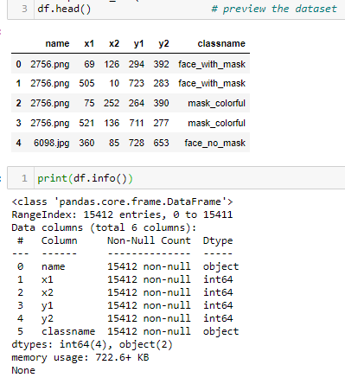
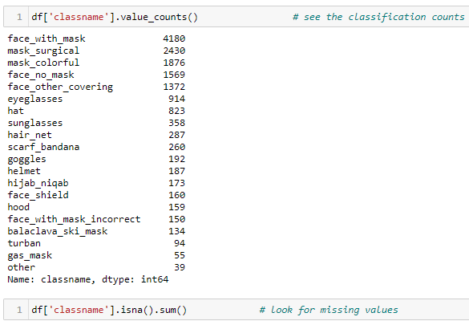
Things were looking good to start with.

Slide 8
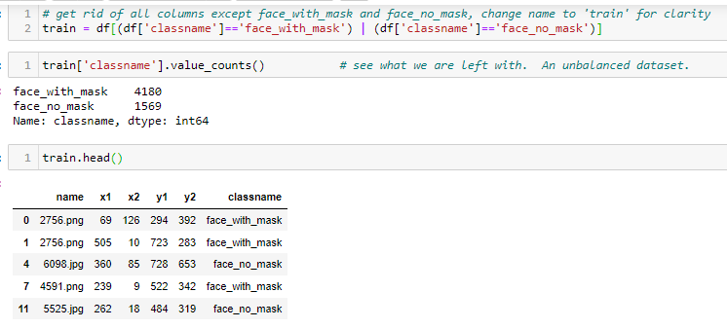
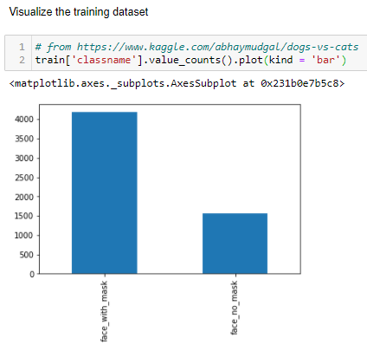
By this point, I thought this was going to be a ‘piece of cake!’

Slide 9
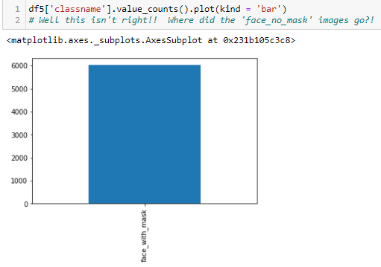
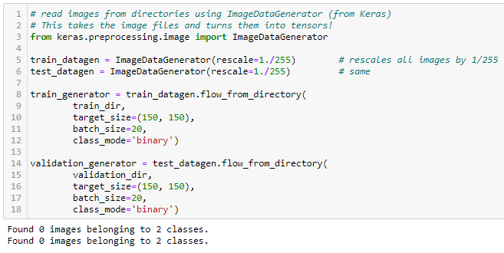
Then THIS happened…
…resulting in THIS!
Notes:
At this point, I had not yet panicked. I moved on with instantiating a small convnet. I had a binary classification model, so I needed to end up with the probability that an image was either one class or the other. That meant I would have a Dense layer of size 1.
Binary crossentropy would be the loss function to use when ending the network with this single sigmoid unit. (from the Chollet text).
I moved on with creating the layers and ImageDataGenerator, thinking I could find the solution to this problem within the code of some of the Kaggle entrants.
Unfortunately, I was never able to.

Slide 10
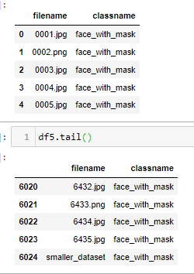
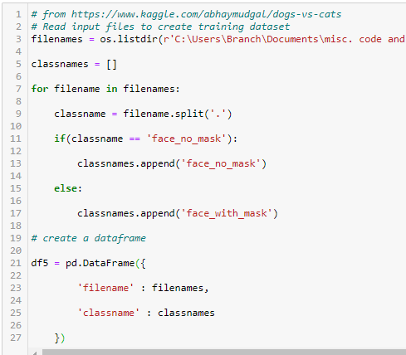
…the suspected culprit – poor logic in the For loop
Notes:
Note the lack of any ‘face_no_mask’ files!

Slide 11

Question 1
Can I create an image recognition model that performs better than any of the Kaggle competition entries (that received at least one upvote)?
Notes:
This is going to be tough, as the Kaggle competition entrants are also aware of the potential for 95% accuracy training a convnet from scratch.

Slide 12
Question 2
Does the widespread wearing of face masks cause known, established image detection programs, such as the Viola Jones Algorithm, to fail?
Notes:
Not in this case. This project did not reach that point of model comparison.

Slide 13
Question 3
What level of accuracy can I achieve?
Notes:
!!

Slide 14
Question 4
Is there any literature on human visual accuracy (such as at screening checkpoints) for comparison?
Notes:
There is all KINDS of literature on this, especially related to the aviation industry, as they were the leaders in principles of high reliability organizations. When I was patient safety manager, I learned about Navy tests of staff watching radar, and the ‘drop-off’ in accuracy after two hours. So at the VERY LEAST, after two hours of continuous screening, a successful convnet image recognition model is going to outperform a human. Unless you can guarantee a ‘new’ human doing visual screening at about the 90 minute mark, then, it would be prudent to explore this automated process further.

Slide 15
Question 5
Once I unzip the contents of the downloaded folder, can I save them and delete the original zipped folder?
Notes:
Yes, I believe so. Although I did try importing the files directly from the .zip file, as I saw someone else do. So that is possible.

Slide 16
Question 6
Will a ‘run-of-the-mill’ personal laptop be sufficient for processing a convolutional neural net problem?
Notes:
For the purposes of this project, the capacity of the laptop did not appear to be a barrier, and this is not even a ‘gaming’ laptop!

Slide 17
Question 7
Can interesting graphics be generated from a simple unbalanced binary classification problem?
Notes:
Well, yes, but they are essentially meaningless. I am fond of the visual generated by treemapping. Solid colors. No white space. It is a nice contrast to most other visuals that we generate.

Slide 18
Question 8
When lifting bits and pieces of code from multiple sources, is there any guidance on how many characters/lines need to be the same in order to necessitate reference citation?
Notes:
Not that I have found. There is APA guidance, however, on line limits for in-line quotes versus indented sections. I doubt that anyone outside of academia is troubled by pushing the limits of those guidelines and keeping the entire quote in-line, though.

Slide 19
Question 9
If the Delta variant of COVID-19 can be spread among fully vaccinated individuals, AND masks are proven to prevent transmission, why weren’t President Obama and the guests to his 60th birthday party extravaganza wearing masks?
Notes:
Oops! How did a rhetorical question sneak its way into this project?!

Slide 20
Question 10
Is there a correlation between education level and individual compliance with CDC recommendations?
Notes:
Right. I’d like to see where the ‘elbow(s)’ on that curve is/are!

Slide 21
Analysis and Findings
The code did not run from end to end due to ‘borrowing’ lines from too many different coders without a strong conceptual framework of what the finished product needed to accomplish.
Notes:
Challenges associated with properly separating and reading the image types into the test/train/validation folders created an insurmountable obstacle in analysis of the utility of the model. Referencing of numerous peoples’ attempts at creating this model is thought to be contributory, akin to the problems revealed in the Johnny Cash classic song ‘One Piece At a Time.’ “The narrator recognizes that he’ll never be able to afford one of his own, so he and a co-worker decide to steal one by taking small parts from work in a comically large lunchbox…” (Dunn, 2021). But alas, the parts do not fit together correctly, as they are from different years. This is what happened when using bits and pieces of code from various authors and books, without a strong framework to begin.

Slide 22
Conclusion
The success of other Kaggle competition entrants is the best predictor of the success at face mask compliance image recognition modeling.
This project did not add to the pool of knowledge.
Applications in high reliability organizations as a mitigating factor to human perceptual limitations over extended periods.
Notes:
Initial hypotheses (in the form of questions) proved to be as likely to be correct as incorrect. This is due to inability to validate hypotheses based on malfunctioning code.
Due to the unsuccessful attempts to wrangle this image recognition dataset into train/test/validation folders, the success of other Kaggle competition entrants is the best predictor of the success at face mask compliance image recognition modeling. This project did not add to the pool of knowledge. At best, it acknowledges the fact that sometimes projects fail, and that being up-front about the reason for failure is itself a positive trait in a student or employee!
Remember earlier comments about testing of human perceptual abilities over time within the military and aviation industries (in the name of high reliability)? This might be part of the solution! https://www.faa.gov/about/initiatives/maintenance_hf/library/documents/media/human_factors_maintenance/good_practices_in_visual_inspection_-_drury.doc
Disclaimer: It likely already is and I just don’t know about it!

Slide 23
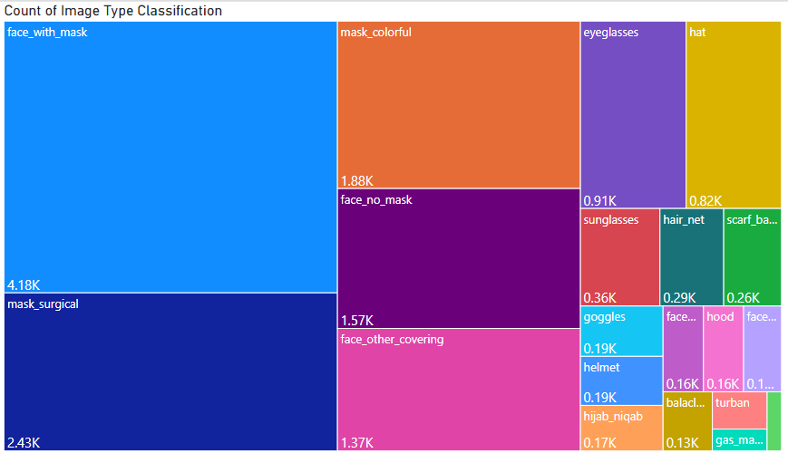

Slide 24
References
Asrani, P., Hasan, G. M., Sohal, S. S., & Hassan, M. D. I. (2020, November 24). Molecular Basis of Pathogenesis of Coronaviruses: A Comparative Genomics Approach to Planetary Health to Prevent Zoonotic Outbreaks in the 21st Century. Omics : a journal of integrative biology. https://pubmed.ncbi.nlm.nih.gov/32940573/
Bernstein, B. (2021, April 17). COVID-19 Death Toll Surpasses 3 Million Worldwide. National Review. https://www.nationalreview.com/news/covid-19-death-toll-surpasses-3-million-worldwide/
Chollet, F. (2018). Deep learning for computer vision. In Deep learning with python (pp. 130–158). essay, Manning.
D'Agostino, A., Demartini, B., Cavallotti, S., & Gambini, O. (2020, May). Mental health services in Italy during the COVID-19 outbreak. The Lancet: Psychiatry. https://doi.org/10.1016/S2215-0366(20)30133-4
Dong, E., Du, H., & Gardner, L. (2020, February 19). An interactive web-based dashboard to track COVID-19 in real time. Redirecting. https://doi.org/10.1016/S1473-3099(20)30120-1
Dunn, A. (2021, April 17). Johnny cash's 'One piece at a TIME': Story behind the hilarious song. Outsider. https://outsider.com/news/country-music/johnny-cashs-one-piece-at-a-time-story-behind-the-hilarious-song/
Elrashdy, F., Redwan, E. M., & Uversky, V. N. (2020, September 11). Why COVID-19 Transmission Is More Efficient and Aggressive Than Viral Transmission in Previous Coronavirus Epidemics? Biomolecules. https://pubmed.ncbi.nlm.nih.gov/32933047/

Slide 25
References
El-Sayed, A., Abdel-Daim, M. M., & Kamel, M. (2021, May 5). Causes of respiratory failure in COVID-19 patients. Environmental science and pollution research international. https://pubmed.ncbi.nlm.nih.gov/33954917/
Liu, Z., Xiao, X., Wei, X., Li, J., Tan, H., Zhu, J., Zhang, Q., Wu, J., & Liu, L. (2020, March 11). Composition and divergence of coronavirus spike proteins and host ACE2 receptors predict potential intermediate hosts of SARS-CoV-2. Journal of medical virology. https://pubmed.ncbi.nlm.nih.gov/32100877/
Mujtaba, H. (2020, November 30). How to detect face recognition Using Viola Jones Algorithm. GreatLearning Blog: Free Resources what Matters to shape your Career! https://www.mygreatlearning.com/blog/viola-jones-algorithm
Petrosillo, N., Viceconte, G., Ergonul, O., Ippolito, G., & Petersen, E. (2020, March 28). COVID-19, SARS and MERS: are they closely related? Clinical microbiology and infection : the official publication of the European Society of Clinical Microbiology and Infectious Diseases. https://pubmed.ncbi.nlm.nih.gov/32234451/
Singh, R., Kang, A., Luo, X., Jeyanathan, M., Gillgrass, A., Afkhami, S., & Xing, Z. (2021, March). COVID-19: Current knowledge in clinical features, immunological responses, and vaccine development. FASEB journal : official publication of the Federation of American Societies for Experimental Biology. https://pubmed.ncbi.nlm.nih.gov/33577115/
Yang, Y., Rao, X., & Shang, W. (2020, June). Facing the COVID-19 outbreak: What should we know and what could we do? Journal of medical virology. https://pubmed.ncbi.nlm.nih.gov/32091134/

