Slide 1
AITEX Classification
By Chris Oriente

Slide 2
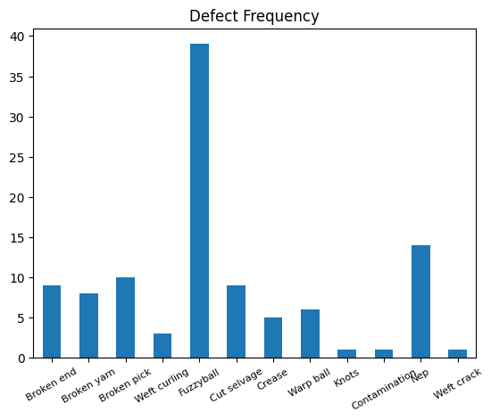
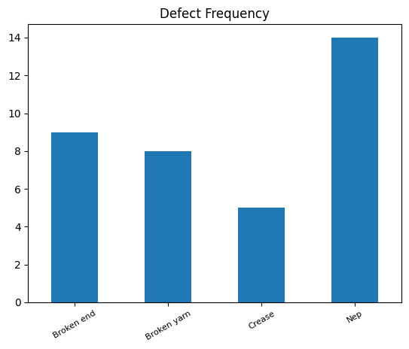
Data Exploration
Imbalanced data set of grey images 256x4096
Defects found: 106
No Defects found: 141
Disregard defects with less than 5 examples
Augment defect files to balance minority class
Chose 4 defects to train this model
Defect
No defect

Slide 3
Preprocessing & Train Time Augmentation
Load by decoding png
Augments
Defect images to balance their minority class. 8 were created images of random vertical flips, brightness, and contrast change.
Augments that reduced accuracy that were tested were random cropping and horizontal flips
Normalized by reducing the mean
Turn defect code into one hot encoding
Resize image to [224,224]

Slide 4
Supervised Learning Model
Resnet152
Pros
Deep 152 layers
Strong performance on computer vision tasks
Residual learning
Cons
Expensive, 8 GB model training
Training takes ~40 min on a CPU

Slide 5
Model Evaluation & Conclusion
K fold cross validation to assess accuracy and F1 score on 5 random shuffles of the data.
Avg model accuracy: 0.896
Average F_1:
Total Confusion Matrix:
No defect | Broken End | Broken Yarn | Crease | Nep
0.955 | 0.334 | 0.8600 | 0.600 | 0.398
Predicted Label
211 | 0 | 0 | 0 | 0
2 | 3 | 0 | 0 | 2
1 | 0 | 7 | 0 | 2
2 | 0 | 0 | 4 | 0
15 | 3 | 0 | 0 | 8

Slide 6
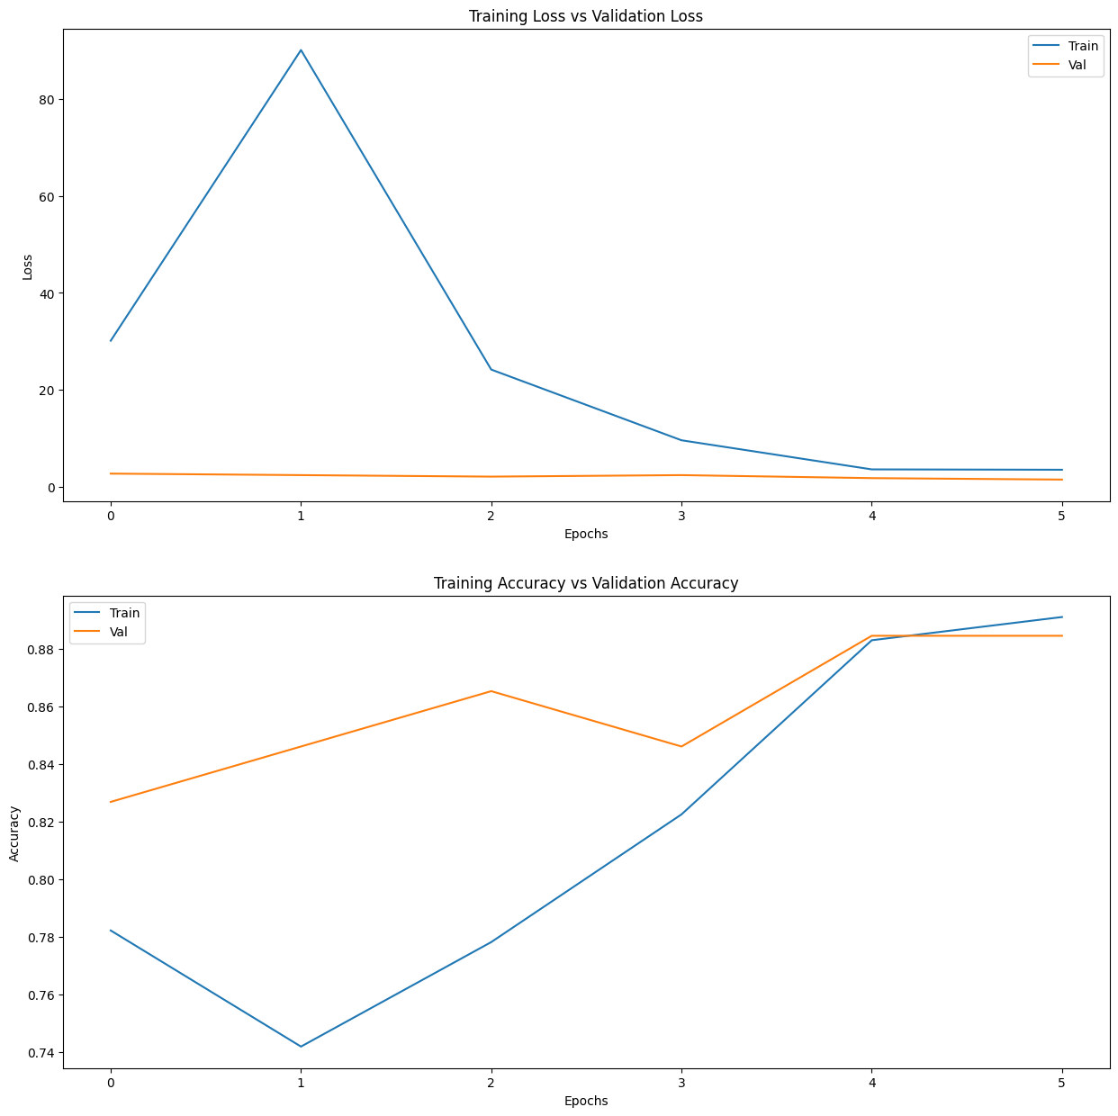
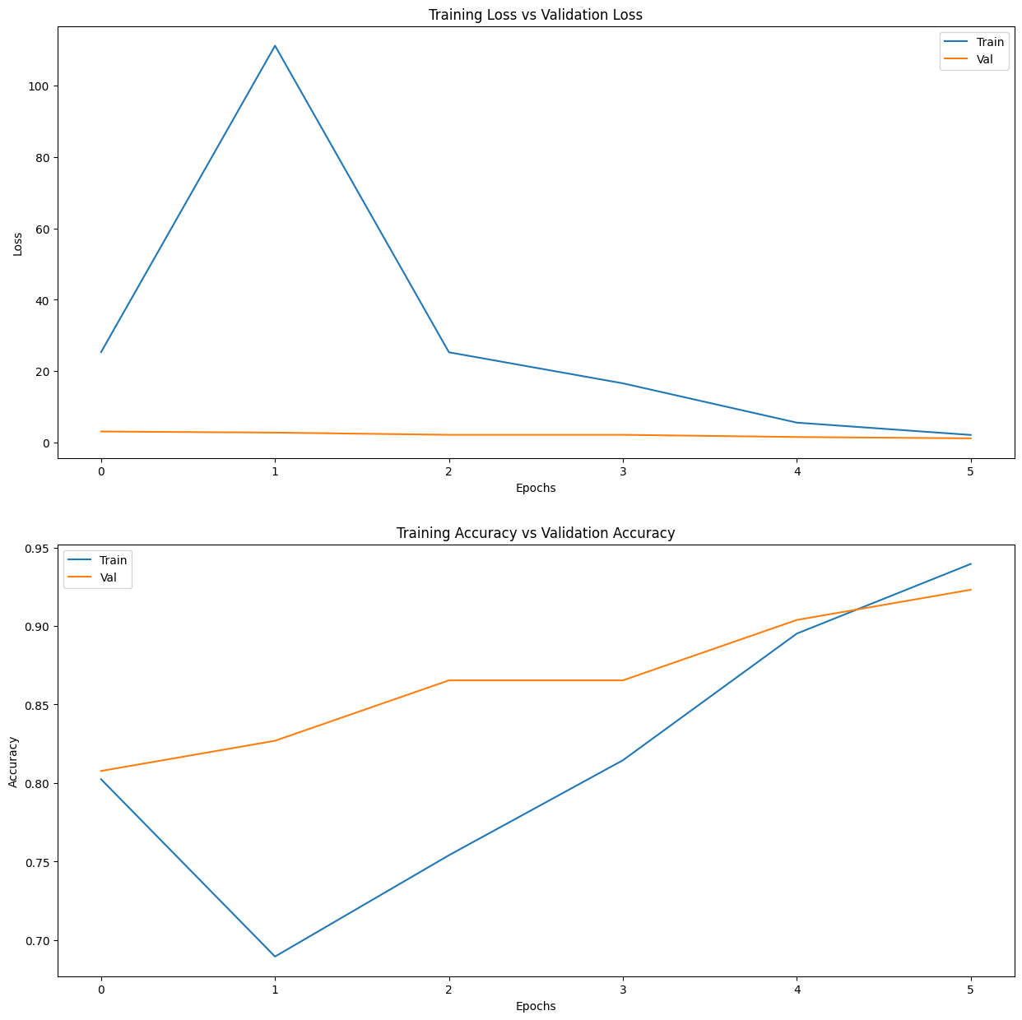
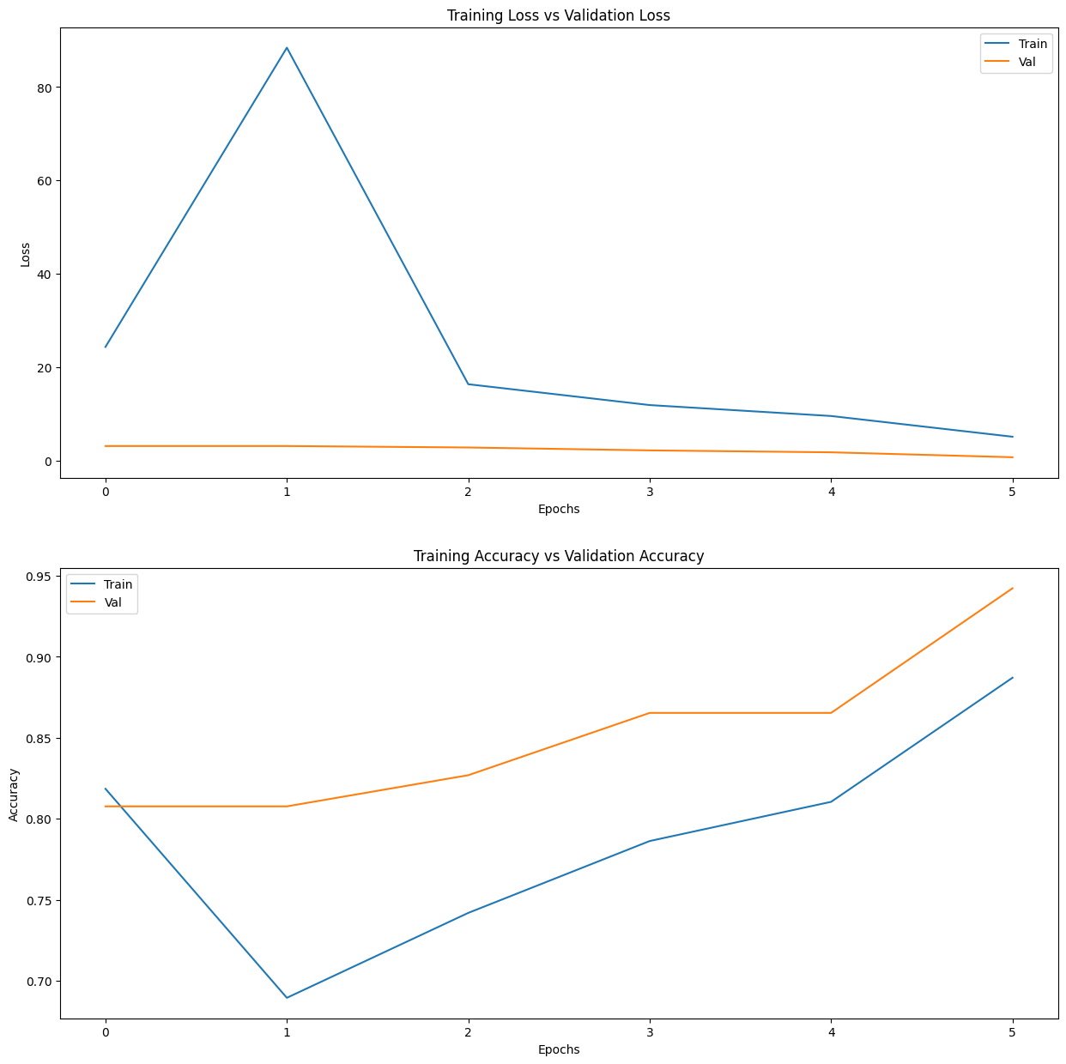
K Fold Training curves for Overfitting

Slide 7
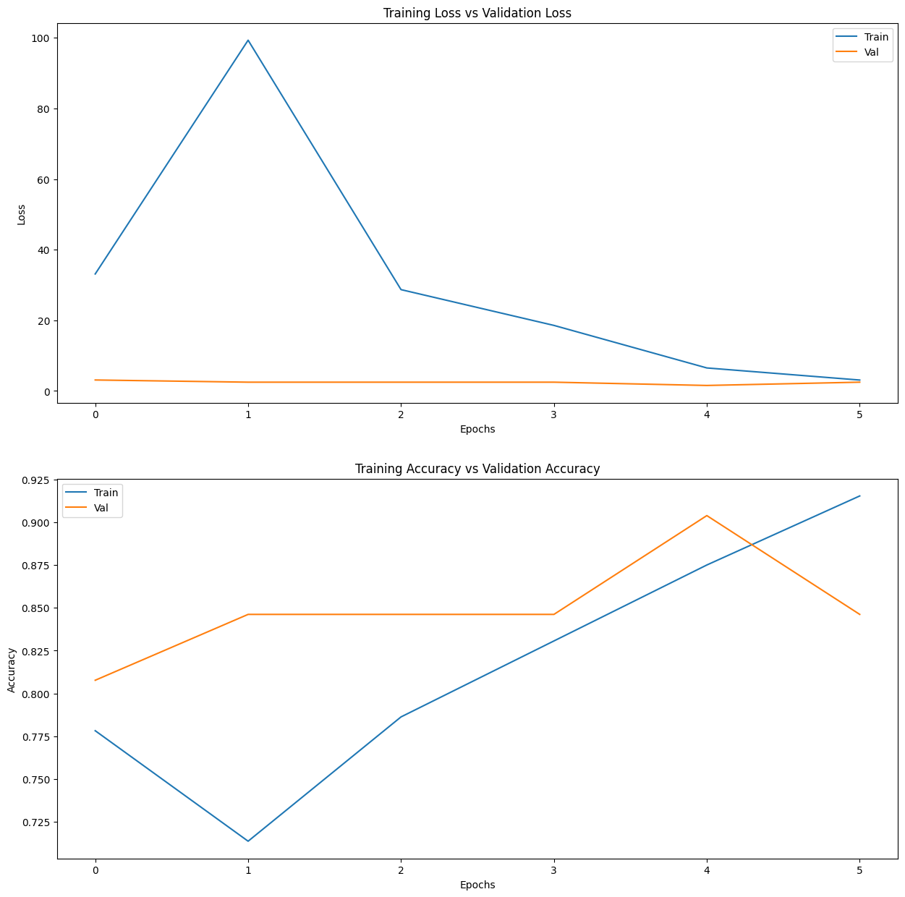
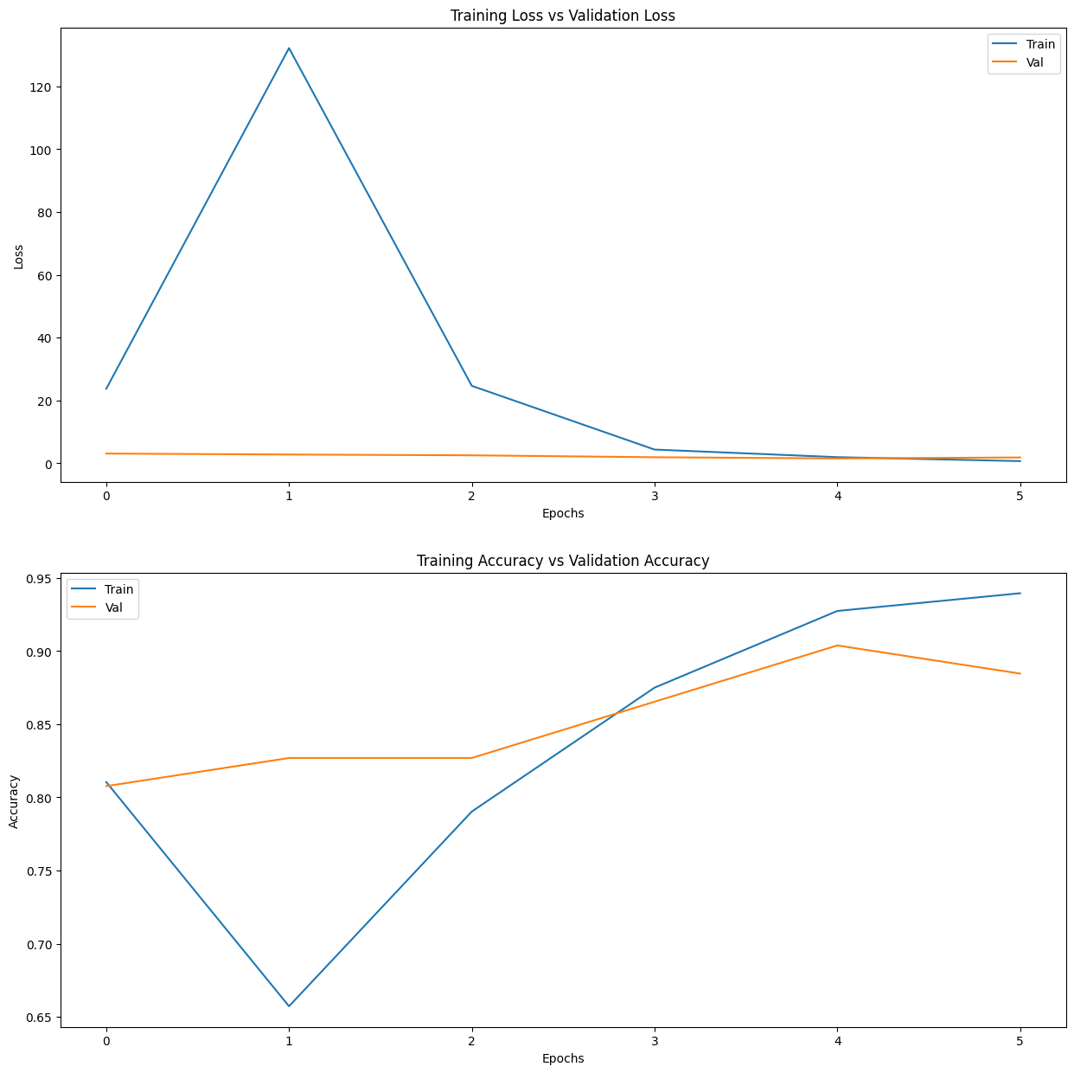
K Fold Training curves for Overfitting

Slide 8
Future Work
Few and One shot learning can help capture defects that have one example
Test different models to find the one that performs the best
A fully convolutional network does not require an input size. This will reduce the loss from resizing a rectangular image to a square.

