Slide 1

11.05.2026
Retrieval-Augmented Detection and Explanation of Dark Patterns in E-Commerce Product Texts
Jobin Roy (250752)
Akshita Sakshi (256271)
Shifin Mohammed (250715)
Group 7
GROUP 7
Jobin Roy
jobin.roy@st.ovgu.de
28/01/26
HCNLP 2026, Otto von Guericke University Magdeburg

Slide 2
11.05.2026
Agenda
Motivation & problem
Dataset & augmentation
Pipeline architecture
Retrieval strategies
Main results
Cross-dataset & cross-lingual
Human evaluation
Limitations & conclusion
Demo
8/01/26
Jobin Roy · Akshita Sakshi · Shifin Mohammed
HCNLP 2026
Slide 3
GROUP 7

Slide 3
11.05.2026
What is a dark pattern?
Deceptive interface and text strategies that manipulate consumers into unintended actions
"Only 2 hours left at this price!"
Why now?
Urgency
Mathur et al. (2019) found them on 11% of 11,000 shopping sites
"Just 3 left in stock"
Scarcity
EU Digital Services Act (2022) mandates auditing & removal
"Cancel only by certified mail"
Forced Action
Need: automated, explainable detection regulators can audit and operators can act on
"Free trial — auto-renews at $49.99/mo"
Sneaking
GROUP 7
Jobin Roy · Akshita Sakshi · Shifin Mohammed
HCNLP 2026

Slide 4
11.05.2026
Existing approaches
Fine-tuned classifiers
Zero-shot LLM (Just Prompting)
What we want instead
(Yada et al. 2022 BERT)
No explanation
Macro F1 only 0.488
Regulators: which lever, which harm?
No evidence span
Misdirection F1 = 0.000
Operators: how to fix the snippet?
No rewrite
F1 collapses on rare classes
An output that can be audited
Gap: Neither option produces an output a regulator can audit or an operator can act on directly.
GROUP 7
Jobin Roy · Akshita Sakshi · Shifin Mohammed
HCNLP 2026

Slide 5
11.05.2026
Source corpus: EC-DarkPattern (Yada et al., 2022)
The benchmark for dark-pattern detection in e-commerce listings
The 8-category taxonomy
What's in the corpus
Category | Example signal phrase
Not Dark Pattern | —
Scarcity | "only 3 left"
Social Proof | "61 people just bought"
Urgency | "2 hours remaining"
Misdirection | "no thanks, I despise..."
Obstruction | "cancel only by mail"
Sneaking | free trial w/ auto-renewal
Forced Action | "agree to all to continue"
• 2,361 product-description snippets
• Source: Amazon product listings
• Annotated by trained crowdworkers
• Inter-annotator agreement κ > 0.7
• 8-category taxonomy (right)
Yada et al. show fine-tuned BERT beats rule-based methods, but classification is all you get. No explanation.
What we changed: re-stratified to 70/15/15 v2 splits + added 145 synthetic rare-class examples → working corpus 2,501.
GROUP 7
Jobin Roy · Akshita Sakshi · Shifin Mohammed
HCNLP 2026

Slide 6
11.05.2026
Synthetic augmentation: the rare-class problem
Three categories were too rare to learn or evaluate reliably
The problem
The method
• Original test set had zero Forced Action examples
• Composite prompting (Kochanek et al. 2024)
• Sneaking: 8 total; Obstruction: 27 total
• Real exemplar + structured mechanism + harm
• Both BERT and zero-shot LLM hit F1 = 0 here
• LLM generates paraphrases of the seed
• Bigram-Jaccard filter > 0.4 to discard duplicates
• Zero-shot rarely sees them in context either
• 145 examples added: 103 train, 42 val/test (stratified)
Ablation: BERT classifier macro F1 across augmentation proportions
Augmentation | Macro F1 | Forced Action F1 | Sneaking F1 | Obstruction F1
0% (no augmentation) | 0.785 | 0.000 | 0.545 | 0.923
33% | 0.952 | 1.000 | 0.769 | 0.960
67% | 0.964 | 1.000 | 0.933 | 0.923
100% (full augmentation) | 0.968 | 1.000 | 0.941 | 0.960
GROUP 7
Jobin Roy · Akshita Sakshi · Shifin Mohammed
HCNLP 2026

Slide 7
11.05.2026
How we generated synthetic examples
Hybrid similarity-plus-composite prompting (Kochanek et al., 2024)
Kochanek et al. (2024) — Improving Training Dataset Balance with ChatGPT Prompt Engineering.
Paper compares three prompting strategies for class-imbalance rebalancing: basic, composite, and similarity. We implement the similarity+composite hybrid the paper proposes as future work.
1. Similarity seeding
2. Composite descriptors
3. Format & temperature
(from paper) Each call seeds the LLM with a real example from the target rare class. Keeps generated text domain-grounded rather than template fill-in.
Probabilistic slots assembled into the prompt:
• manipulation mechanism
• harm dimension
• product type (rotation)
JSON output to Python list (parse reliability).
Temperature 0.8 (paper).
We use Qwen3 8B locally instead of GPT-3.5-turbo.
Prompt template (simplified)
"Generate a {product_type} listing exhibiting {category} via {mechanism}. Reference example: '{seed}'. Output one JSON snippet."
GROUP 7
Jobin Roy · Akshita Sakshi · Shifin Mohammed
HCNLP 2026

Slide 8
11.05.2026
Did synthetic data introduce hidden issues?
1. Bigram-Jaccard filter
2. Distinct bigram ratios: 0.95 – 0.99
3. Pairwise overlap
Synthetic examples sharing > 0.4 bigram
overlap with any existing training example were discarded post-generation.
Prevents near-duplicate regeneration.
Between real and synthetic text.
Synthetic outputs have distinct bigram inventories, so they do not collapse to a single template.
Real ↔ real bigram overlap < 0.015.
Real ↔ synthetic cross-overlap < 0.40.
Synthetic examples are not paraphrases of specific real examples.
Honest disclosure
19 of 376 test examples are synthetic (5%).
A fine-tuned classifier can implicitly memorize the synthetic generator's style.
RAG cannot, since there are no gradient updates. Real-only re-evaluation is left for future work.
GROUP 7
Jobin Roy · Akshita Sakshi · Shifin Mohammed
HCNLP 2026

Slide 9
11.05.2026
German dark-pattern test set
102
76
71
6 – 12
candidates scraped
unique (dedup)
final test set
per class (balanced)
Sources & scope
Annotation guidelines
• 4 e-commerce sites: Otto, Zalando, Shein, MediaMarkt
Same 8-category EC-DarkPattern taxonomy, augmented with German signal phrases:
• Listing pages, subscription flows, checkout screens
"Nur noch X Stück" → Scarcity
• 3 annotators (paper authors), independent labels
"automatische Verlängerung" → Sneaking
• Resolved by majority vote; 5 cases without majority dropped
"Kündigung nur per Einschreiben" → Obstruction
GROUP 7
Jobin Roy · Akshita Sakshi · Shifin Mohammed
HCNLP 2026

Slide 10
11.05.2026
System architecture: Two-Phase Pipeline
PHASE 1: Offline (done once)
PHASE 2: Online (every new text)
PHASE 1: Offline
Build the searchable library
Retrieve, prompt, generate
①
Take 1,750 labelled training texts
①
New suspicious text arrives
②
Tokenize each text → token IDs
②
Encode with same SBERT encoder
→
③
③
Search FAISS → top-k similar examples
Forward pass-through encoder
④
Mean-pool → single 768-dim vector
④
Build prompt: k examples + new text
⑤
L2-normalise the vector (length = 1)
⑤
Qwen3 8B generates structured JSON
⑥
Store in FAISS flat index
⑥
Return 7-field output to user
⑥
A
GROUP 7
Jobin Roy · Akshita Sakshi · Shifin Mohammed
HCNLP 2026

Slide 11
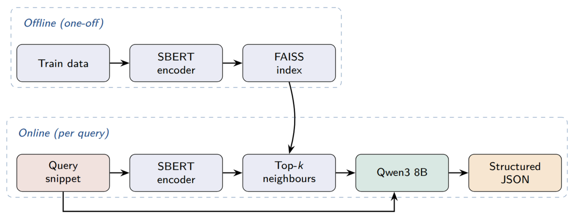
11.05.2026
System architecture: Two-Phase Pipeline
A
GROUP 7
Jobin Roy · Akshita Sakshi · Shifin Mohammed
HCNLP 2026

Slide 12
11.05.2026
Encoders tested in Phase 1
Encoder
Pooling
Dim
Params
F1
Used for
Why it matters
SBERT
768
110M
0.923
English
NLI fine-tuned
mean-pool gives rich semantic vectors. Best for similarity.
MEAN
BERT
768
110M
0.765
English
Same size as SBERT, but CLS pooling was trained for Masked Language Models, not similarity.
CLS
RoBERTa-Large
1024
355M
0.773
English
3× larger than BERT but still CLS pooling
CLS
GROUP 7
Jobin Roy · Akshita Sakshi · Shifin Mohammed
12
HCNLP 2026
Otto-von-Guericke-Universität Magdeburg · DarkExplain · Jobin Roy, Akshita Sakshi, Shifin Mohammed

Slide 13
11.05.2026
Retrieval strategies compared
KNN: K-nearest neighbours
Picks the k most similar training vectors using cosine similarity
It works best because dark patterns carry strong surface signals, i.e., the nearest example almost always shares the correct label.
Prototype
Scores each candidate by its similarity to both the query AND the center (prototype) of its class
More representative picks, but adds noise for clear-signal categories.
MMR / Diversity
Maximal Marginal Relevance iteratively picks examples that are relevant to the query but diverse from already selected ones.
Prevents identical-class slots, but dark patterns don't need diversity.
HyDE: Hypothetical document embeddings
LLM first imagines an ideal dark-pattern snippet (temp=0.7), encodes that hypothetical text, then retrieves neighbours using it
Adds noise when original queries are already short and clear.
GROUP 7
Jobin Roy · Akshita Sakshi · Shifin Mohammed
13
HCNLP 2026

Slide 14
11.05.2026
Structured output schema: 7 fields per prediction
label
The dark pattern category is one of 8 types (e.g., urgency, scarcity, forced action).
confidence
Model's self-rated certainty (0–1)
Low-confidence cases can be flagged for human review by regulators.
psychological_mechanism
The cognitive bias being exploited (e.g., loss aversion, social conformity, status quo bias)
evidence_span
Verbatim substring from the input text that is manipulative
Lets regulators point to the exact phrase.
harm_dimension
The consumer harm (e.g., financial loss, privacy violation, autonomy deprivation)
rationale
1–3 sentence explanation connecting the evidence span → mechanism → harm
Human-readable.
rewrite
A non-manipulative alternative that keeps product info but removes the deceptive element
Actionable for platforms.
GROUP 7
Jobin Roy · Akshita Sakshi · Shifin Mohammed
14
HCNLP 2026

Slide 15
11.05.2026
Experimental setup & comparison design
Controlled local inference, fixed prompt/schema, and targeted ablations
MODEL
GENERATION
RETRIEVAL
HARDWARE
Qwen3 8B
Temperature = 0.0
FAISS flat
RTX 5060
Frozen, locally served via Ollama
JSON output with fallback parser
Exact inner-product search
8 GB VRAM, 32 GB RAM
Tier
Question tested
Configurations
No retrieval
What happens without grounding examples?
Zero-shot; random few-shot k=3; random few-shot k=5
RAG with SBERT
Which retrieval strategy works best?
KNN k=5; KNN k=2; Diversity/MMR; Prototype; HyDE
Alternative encoders
Does representation quality matter?
BERT KNN k=5; RoBERTa KNN k=5; RoBERTa KNN k=2
GROUP 7
Jobin Roy · Akshita Sakshi · Shifin Mohammed
15
HCNLP 2026

Slide 16
11.05.2026
Baselines and evaluation metrics
How configurations are compared and what is measured
Supervised baseline: Fine-tuned BERT
Classification
Macro-averaged F1, precision, recall · Per-class F1 across all 8 dark-pattern categories · Cohen's κ (chance-corrected agreement with gold labels)
bert-base-uncased · fine-tuned for classification only
Training
5 epochs, lr = 2e-5, batch 16, AdamW
Span grounding
Exact-match rate of predicted evidence_span · Case-insensitive exact match rate · Mean span length in characters
Train data
1,647 real examples
Output
Label only, no explanation, no rewrite
Confidence calibration
Calibration gap = |mean confidence − accuracy| · Smaller gap = model knows when it is uncertain · Compared across all 11 configurations
Purpose
Baseline performance for our RAG pipeline
Cross-lingual gap
Result
Macro F1 = 0.785
Absolute F1 drop from English to German test set · Per-class transfer behavior inspected · English-only vs multilingual encoder compared
GROUP 7
Jobin Roy · Akshita Sakshi · Shifin Mohammed
16
HCNLP 2026

Slide 17
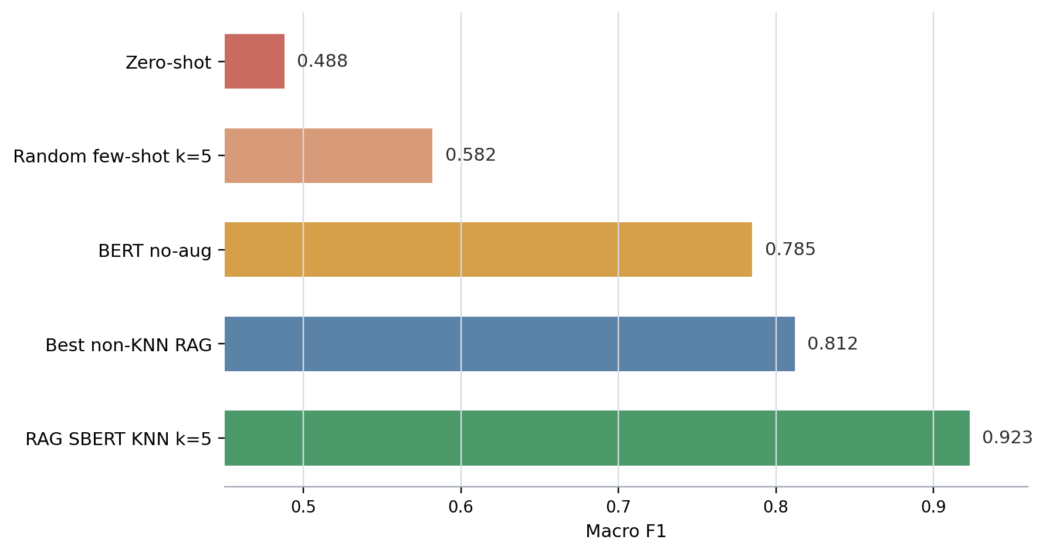
11.05.2026
Main result: retrieval relevance drives performance
The gain comes from picking relevant demonstrations, not from adding more examples
+0.435
vs zero-shot
+0.341
vs random few-shot k=5
(Prototype)
+0.138
vs BERT no-augmentation
Same context budget, very different results. What matters is which labelled examples you retrieve, not how many.
GROUP 7
Jobin Roy · Akshita Sakshi · Shifin Mohammed
HCNLP 2026

Slide 18
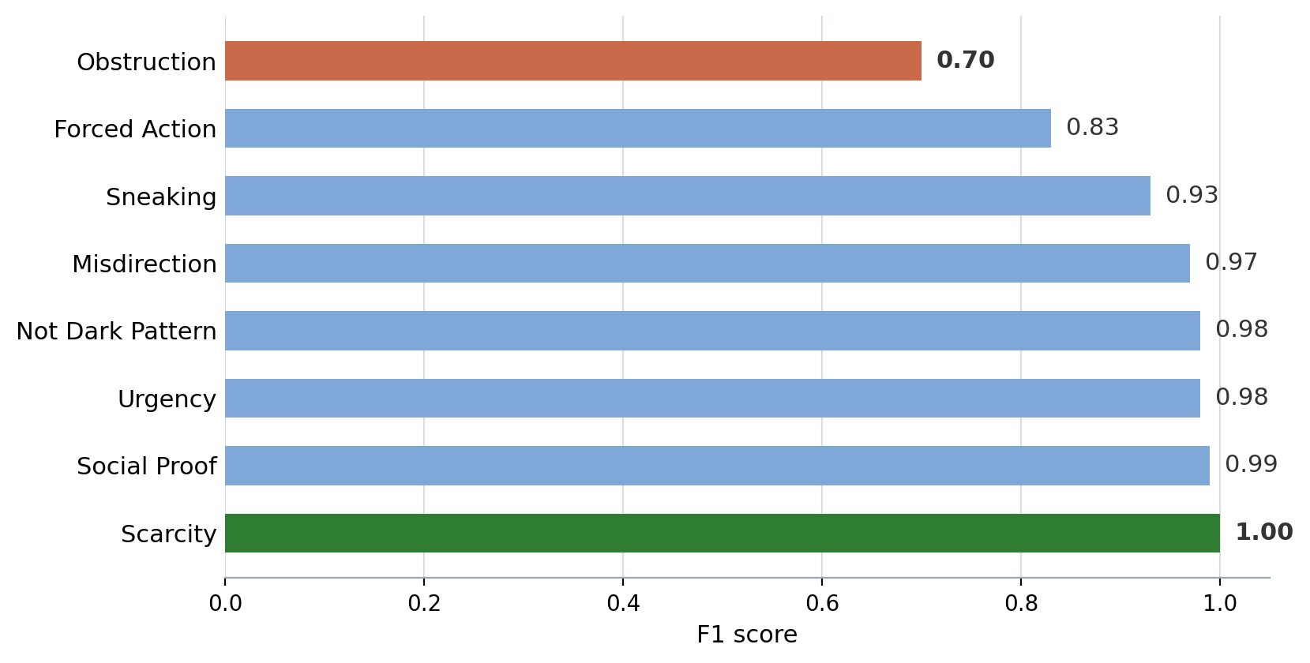
11.05.2026
Per-class F1 on EC-DarkPattern v2
Deployed English configuration: RAG SBERT KNN k=5
0.923
macro F1 on EC-DarkPattern
Weakest class: Obstruction (0.70). Signal-rich classes such as Scarcity and Urgency are near-perfect.
Overall pattern: Most classes are well above 0.9. The remaining difficulty is concentrated in the structural categories like Obstruction.
GROUP 7
Jobin Roy · Akshita Sakshi · Shifin Mohammed
HCNLP 2026

Slide 19
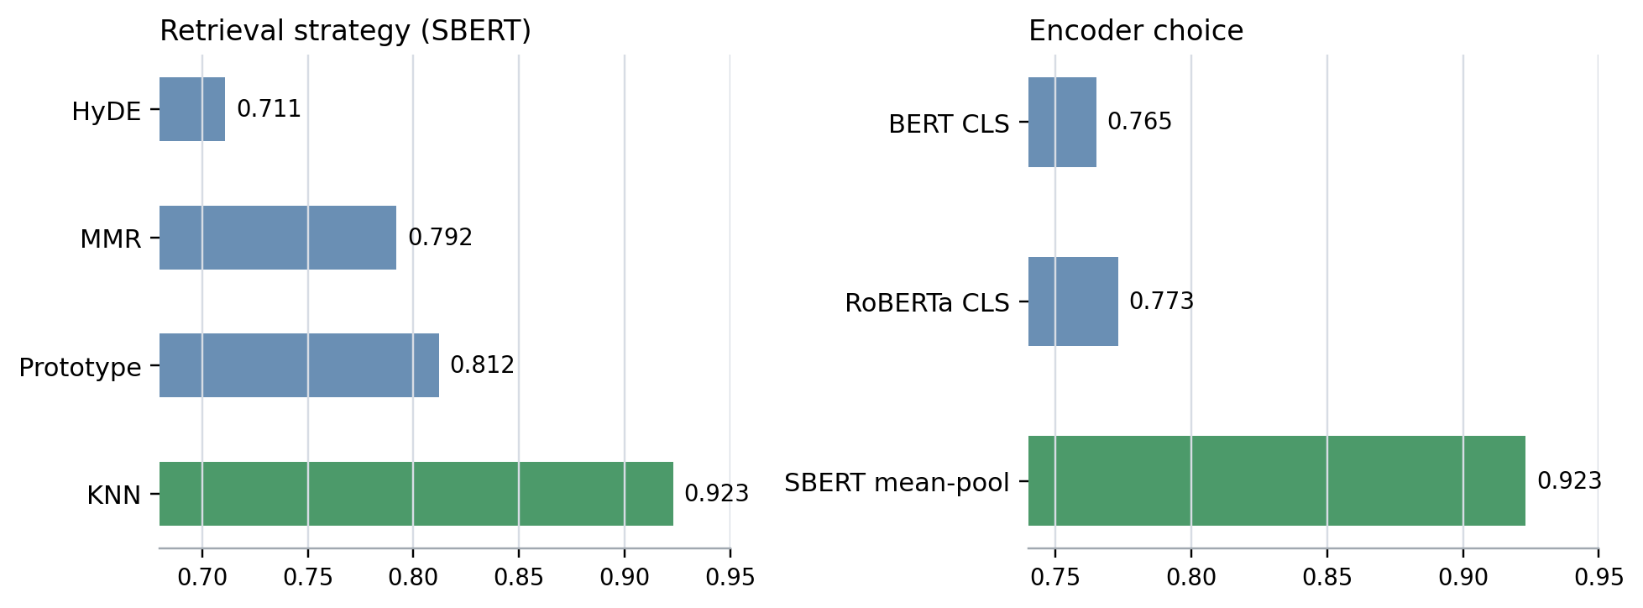
11.05.2026
Why RAG works
Nearest labelled examples anchor the category; SBERT gives the best retrieval representation
Finding 1
KNN beats Diversity/MMR, Prototype, and HyDE because dark-pattern snippets often contain direct surface cues.
Finding 2
SBERT mean-pooling beats larger CLS-pooled encoders. Representation quality matters more than raw model size for retrieval.
Takeaway: for this task, the right inductive bias is nearest examples plus sentence-level embeddings.
We choose RAG over BERT and fine-tuning as RAG is more flexible and meets the requirements such as to provide rationale and rewrites reliably. ​
GROUP 7
Jobin Roy · Akshita Sakshi · Shifin Mohammed
HCNLP 2026

Slide 20
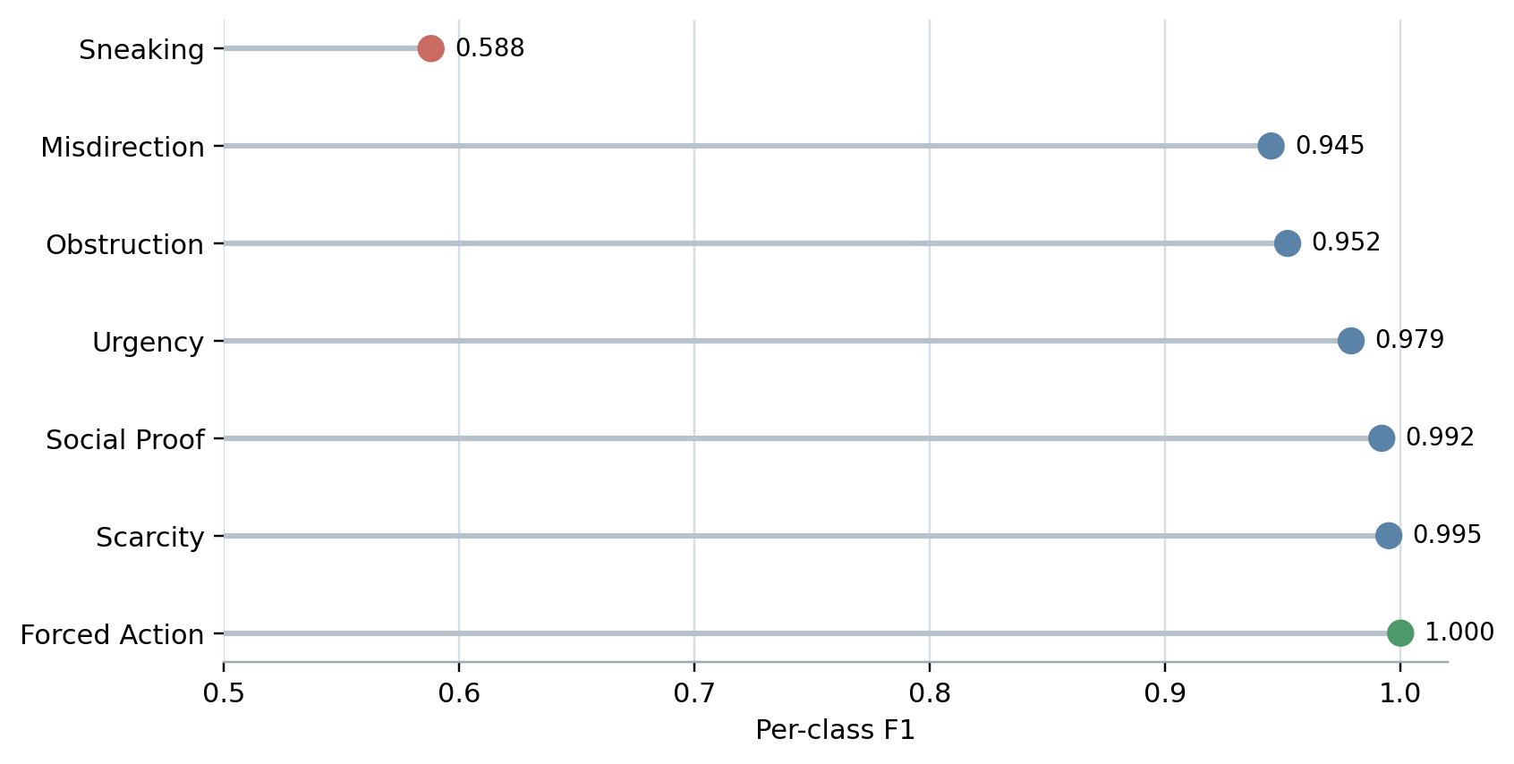
11.05.2026
Cross-dataset transfer: Mathur et al. (2019)
The deployed index transfers to a related English corpus without retraining or index updates
0.922
macro F1 on Mathur
6 of 7 shared categories are at or above 0.94. Sneaking is the weak point because annotation conventions differ.
Within-domain transfer: both corpora are English e-commerce text.
GROUP 7
Jobin Roy · Akshita Sakshi · Shifin Mohammed
HCNLP 2026

Slide 21
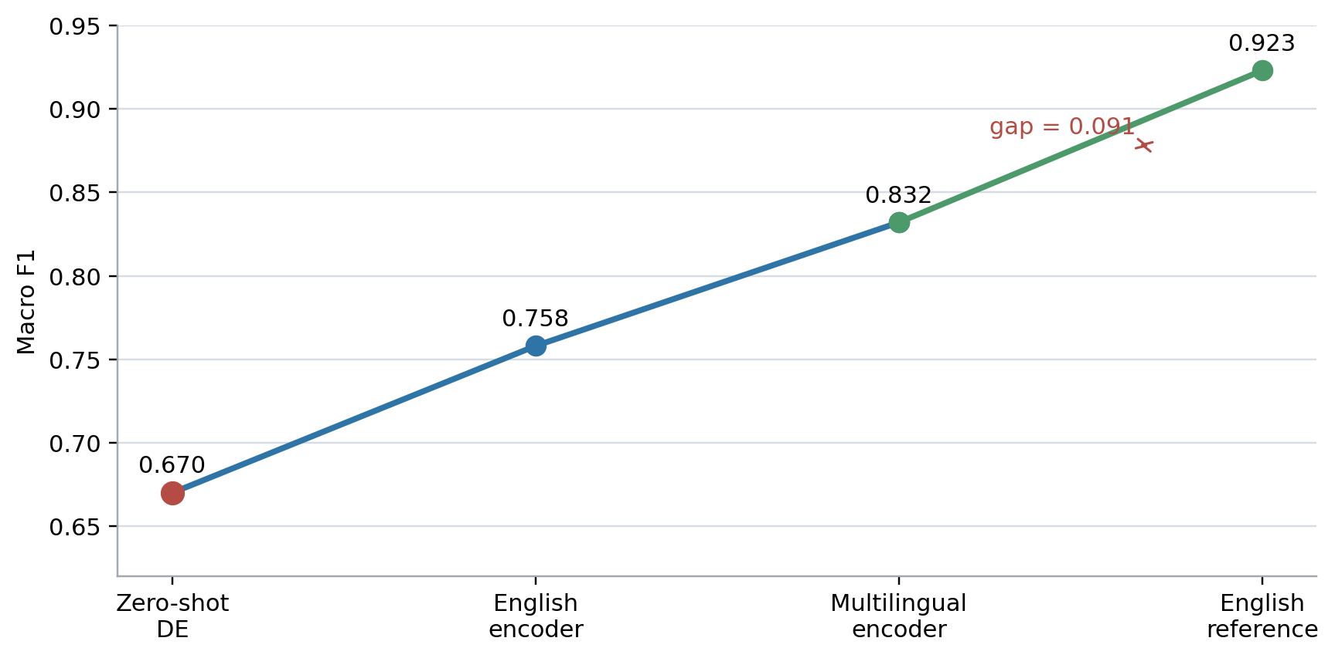
11.05.2026
Cross-lingual evaluation: English training, German testing
We compare zero-shot German, English-encoder retrieval, and multilingual retrieval on 71 majority-labelled examples
Zero-shot German
No retrieved examples. German signal phrases in the prompt only.
English-encoder retrieval
German queries retrieve from the English FAISS index, but language mismatch remains.
Multilingual retrieval
German queries and English examples are mapped into a shared multilingual space.
GROUP 7
Jobin Roy · Akshita Sakshi · Shifin Mohammed
HCNLP 2026

Slide 22
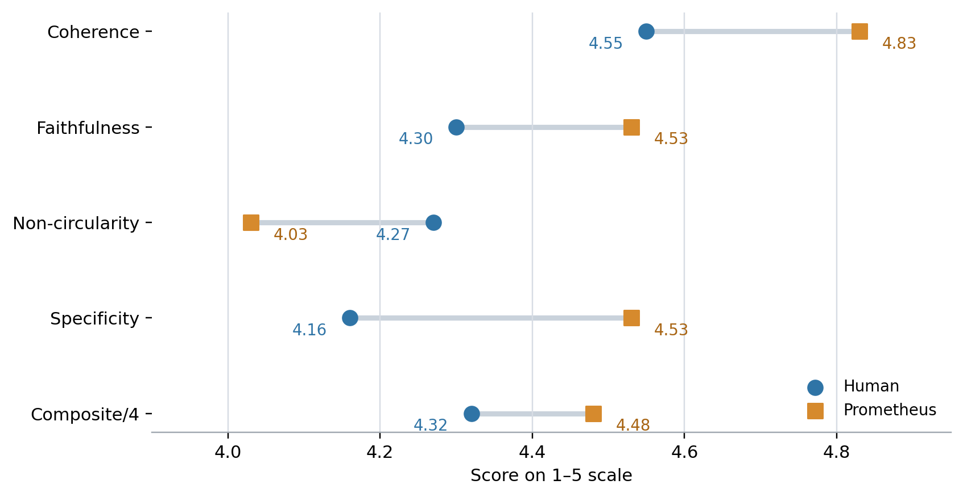
11.05.2026
Evaluation: explanations are strong, but agreement is weak
High mean scores support usefulness, but weak agreement limits how strongly we can validate explanation quality
17.29
human composite / 20
17.93
Prometheus / 20
Within-one agreement stays relatively high at 70.0–85.8%, but chance-corrected agreement is weak. Frame as a feasibility signal, not gold-standard validation.
GROUP 7
Jobin Roy · Akshita Sakshi · Shifin Mohammed
HCNLP 2026

Slide 23
11.05.2026
Limitations
The claims are scaled to the evidence, not stretched beyond it
Limitation
What it affects
Synthetic examples in test set
Rare-class F1 may be inflated
German artifact completeness
Cross-lingual reproducibility is weaker than English
Confounded multilingual condition
Cannot isolate encoder, threshold, and MMR effects
Human evaluation scope
Small sample and weak agreement
Detecting dark pattern scripts
Dark patterns implemented in JavaScript
Single-label assumption
Multi-pattern snippets are not handled
GROUP 7
Jobin Roy · Akshita Sakshi · Shifin Mohammed
HCNLP 2026

Slide 24
11.05.2026
Demo: from snippet to regulator-facing output
Text snippet or URL
→
RAG SBERT KNN k=5
→
7-field JSON + retrieved demos
→
Streamlit UI
streamlit run demo/streamlit_app.py
The UI highlights the evidence span, colour-codes the label, and shows a consumer-safe rewrite for review.
GROUP 7
Jobin Roy · Akshita Sakshi · Shifin Mohammed
HCNLP 2026

Slide 25
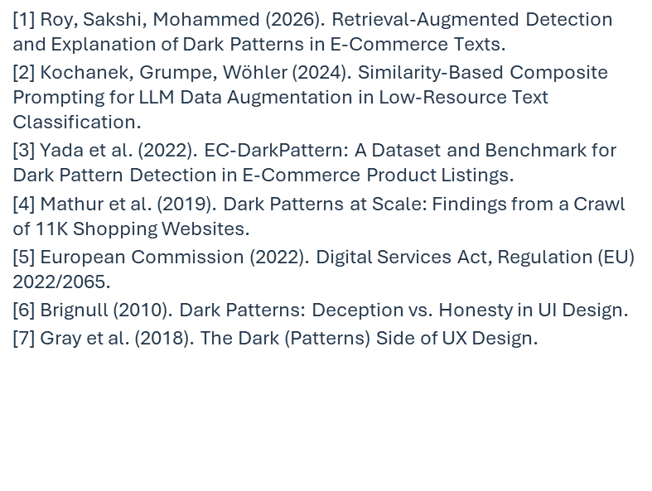
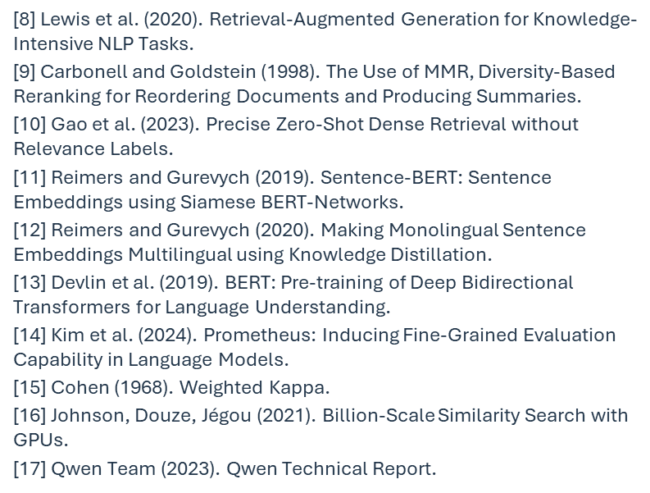
11.05.2026
References
GROUP 7
Jobin Roy · Akshita Sakshi · Shifin Mohammed
HCNLP 2026

Slide 26
11.05.2026
Takeaways
No task-specific fine-tuning
Explainable output
Strong transfer
Label, confidence, evidence span, mechanism, harm, rationale, rewrite
0.923 on EC-DarkPattern dataset
0.922 on Cross dataset
0.832 on German test data
Frozen Qwen3 8B plus dense retrieval gives a practical local system
GROUP 7
Jobin Roy · Akshita Sakshi · Shifin Mohammed
HCNLP 2026

Slide 27
11.05.2026
Thank you
Questions?
Group 7: Jobin Roy · Akshita Sakshi · Shifin Mohammed
HCNLP 2026, Otto von Guericke University Magdeburg
GROUP 7
Jobin Roy · Akshita Sakshi · Shifin Mohammed
HCNLP 2026

