Slide 1
T5.4 Use case#3: HealthCare Assistant (HCA)
Review meeting – Online – July 10, 2024

Slide 2
T5.4 in brief
Task leader: WLI
Timing: M10-M36
Task | WLI | TSI | CNR | TSG | UBI | SAG | TID | EUT | TUM | IFAG | AEGIS | CAM | TOTAL
T5.4 | 14 | 4 | 3 | 3 |  |  | 10 |  | 5 |  |  |  | 39

Slide 3
T5.4 objectives
Develop a Personal assistant with activity identification and anomaly detection capabilities
Using IoT devices (several sensors and a gateway) located in the homes of the elderly people
Identify the activities and detect anomalies based on the data collected by multiple sensors of different types located in the house
Send the activities and anomalies to a component responsible for managing this information and allowing access to caregivers and family members: Senior Care app
Target hardware:
Gateway: Raspberry Pi 5
Sensors (simulated for the pilot)

Slide 4
Status of the Use Case
Defined the EDGELESS workflow for the UC
Initial implementation of the workflow
First Rust Functions for the EDGELESS workflow implemented
Data parsing and formatting
ML preprocessing
Senior person simulator implemented (light version)
Integration of the simulator with EDGELESS workflow
Sensors’ data analysed by TID and WLI
Initial approach for the TID testbed integration
Testing the system in a Raspberry Pi 5

Slide 5
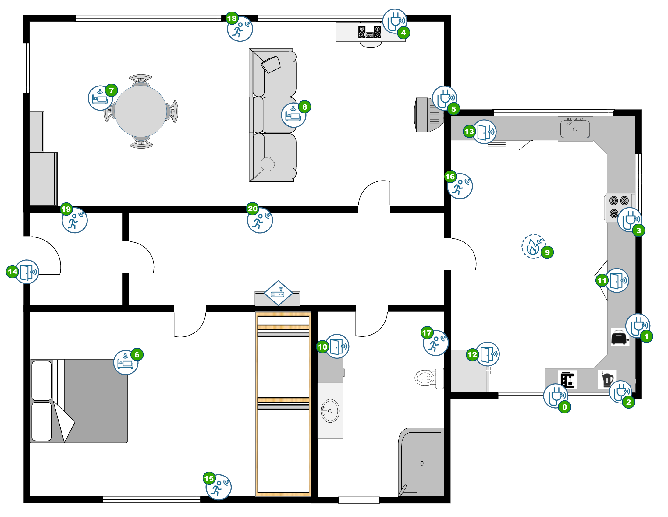
Senior person simulator sensors
Device sensor | Index | Room | Place
Smart Plug | 0 | KITCHEN | COFFEE_MAKER
 | 1 | KITCHEN | TOASTER
 | 2 | KITCHEN | ELECTRIC_KETTLE
 | 3 | KITCHEN | CERAMIC_STOVE
 | 4 | LIVING_ROOM | MUSIC_SYSTEM
 | 5 | LIVING_ROOM | TELEVISION
Mattress | 6 | BEDROOM | BED
 | 7 | LIVING_ROOM | CHAIR
 | 8 | LIVING_ROOM | COUCH
Smoke | 9 | KITCHEN | CEILING
Window-Door | 10 | BATHROOM | DRAWER
 | 11 | KITCHEN | CABINET
 | 12 | KITCHEN | FRIDGE
 | 13 | KITCHEN | DRAWER
 | 14 | ENTRANCE_HALL | DOOR
Motion | 15 | BEDROOM | WALL
 | 16 | KITCHEN | WALL
 | 17 | BATHROOM | WALL
 | 18 | LIVING_ROOM | WALL
 | 19 | ENTRANCE_HALL | WALL
 | 20 | CORRIDOR | WALL

Slide 6





Sensor devices
Device |  | Details
 | Mattress Device | Type: Pressure sensor. Event Trigger: The sensor is activated upon each change of state, detecting when pressure is applied or removed. Item Attachment: Can be attached to beds, couches, chairs, and similar furniture items. This device generates data only when a change of state happens.
 | Motion Device | Type: Motion sensor. Event Trigger: Sends an alert with each detection of movement or cessation of movement within a room. Item Attachment: Installed on room walls or ceilings for optimal coverage. This device generates data only when a change of state happens.
 | Smart Plug Device | Type: Electric power sensor. Event Trigger: Reports electric consumption data every minute. Item Attachment: Connected to electrical appliances such as TVs, coffee makers, music systems, and lamps. This device generates data every minute.
 | Window-Door Device | Type: Contact sensor. Event Trigger: Activates when the contact between two device components is broken or re-established. Item Attachment: Suitable for doors, windows, boxes, and drawers to monitor access and closure. This device generates data only when a change of state happens.
 | Smoke Device | Type: Smoke presence sensor. Event Trigger: Triggers only when smoke is detected to alert for potential fire hazards. Item Attachment: Fixed to ceilings, the device ensures timely smoke detection. This device generates data only when a change of state happens.

Slide 7
EDGELESS Workflow integration

Slide 8
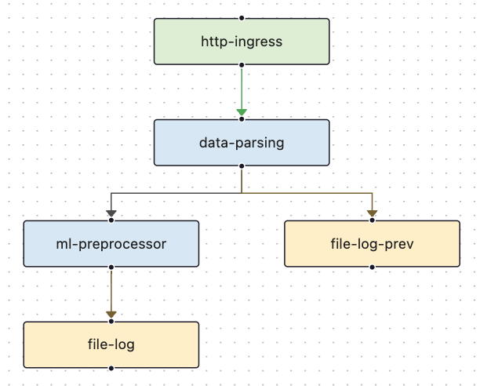

Demo
https://www.youtube.com/watch?v=29Z9WvIZnBo
Senior person simulator (light version)
Triggering EDGELESS workflow composed by the first 2 functions and resources
Functions implemented: data-parsing, ml-preprocessor
Resources used: http-ingress, file-log
1 single node to execute EDGELESS (Raspberry Pi 5)
EDGELESS workflow
New event (sensor data)
Senior person simulator

Slide 9
Results from the initial experiments
Senior person simulator integrated with EDGELESS (light version, the simulator needs to be improved).
Definition of a basic EDGELESS workflow for the initial experiments.
First Rust functions of the UC up and running, the EDGELESS system working properly.
Resources (http-ingress and file-log) tested.
Integrated system working for hours and without any problems or interruptions.

Slide 10
Description of the pilot infrastructure (M36) Overview
1 or more homes (senior person simulator instances). Devices: Raspberry Pi 5
Testbed provided by Telefónica
EDGELESS deployed (next slides diagrams)
Senior person simulator generating sensors’ data (sensors explained in previous slides)
Senior Care system (AWS)
Senior Care front end app to visualize results (mobile phones, laptops, etc.)

Slide 11
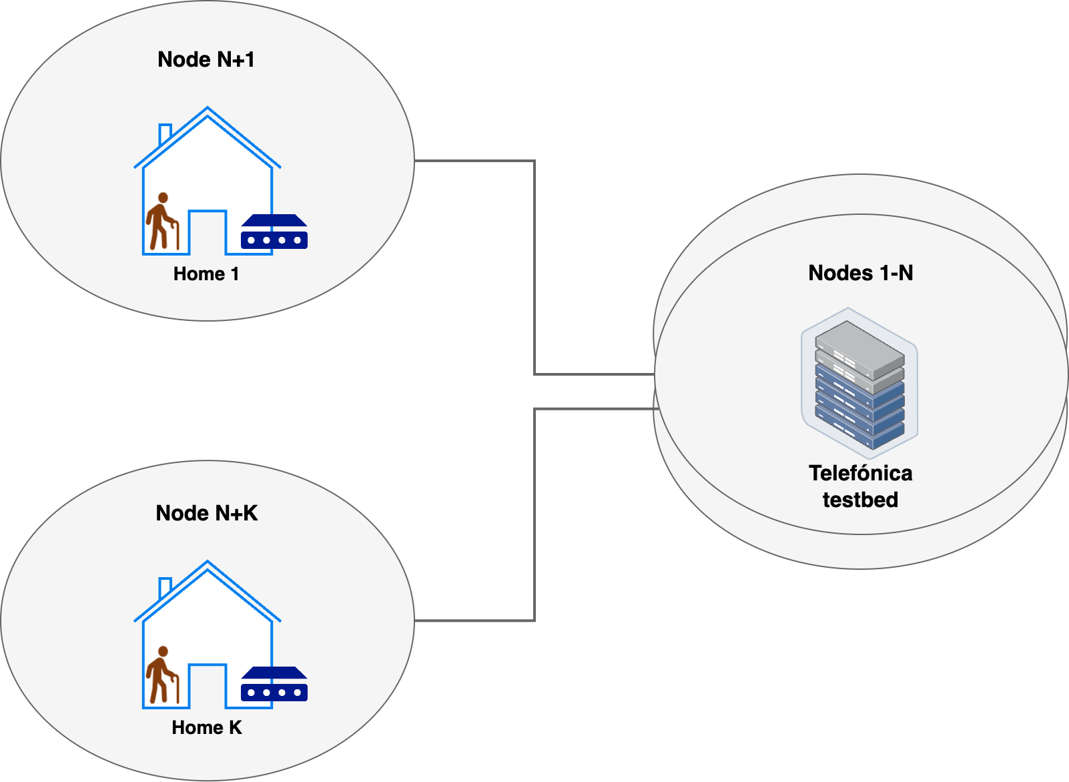
Description of the pilot infrastructure (M36) EDGELESS orchestration domain diagram

Slide 12
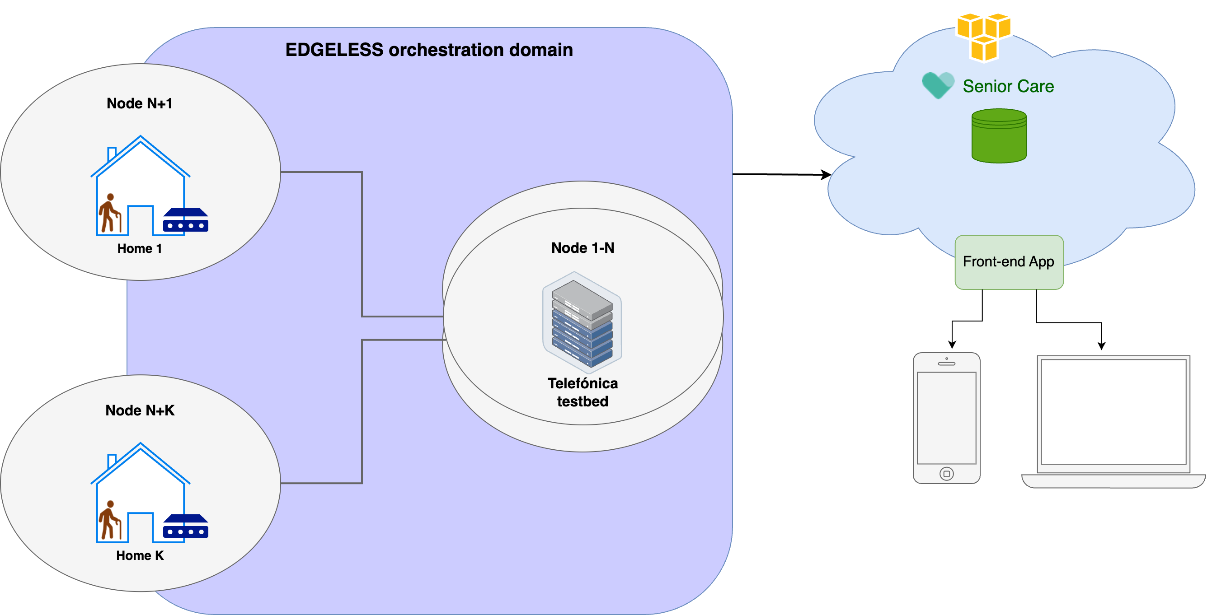
Description of the pilot infrastructure (M36) EDGELESS orchestration domain

Slide 13
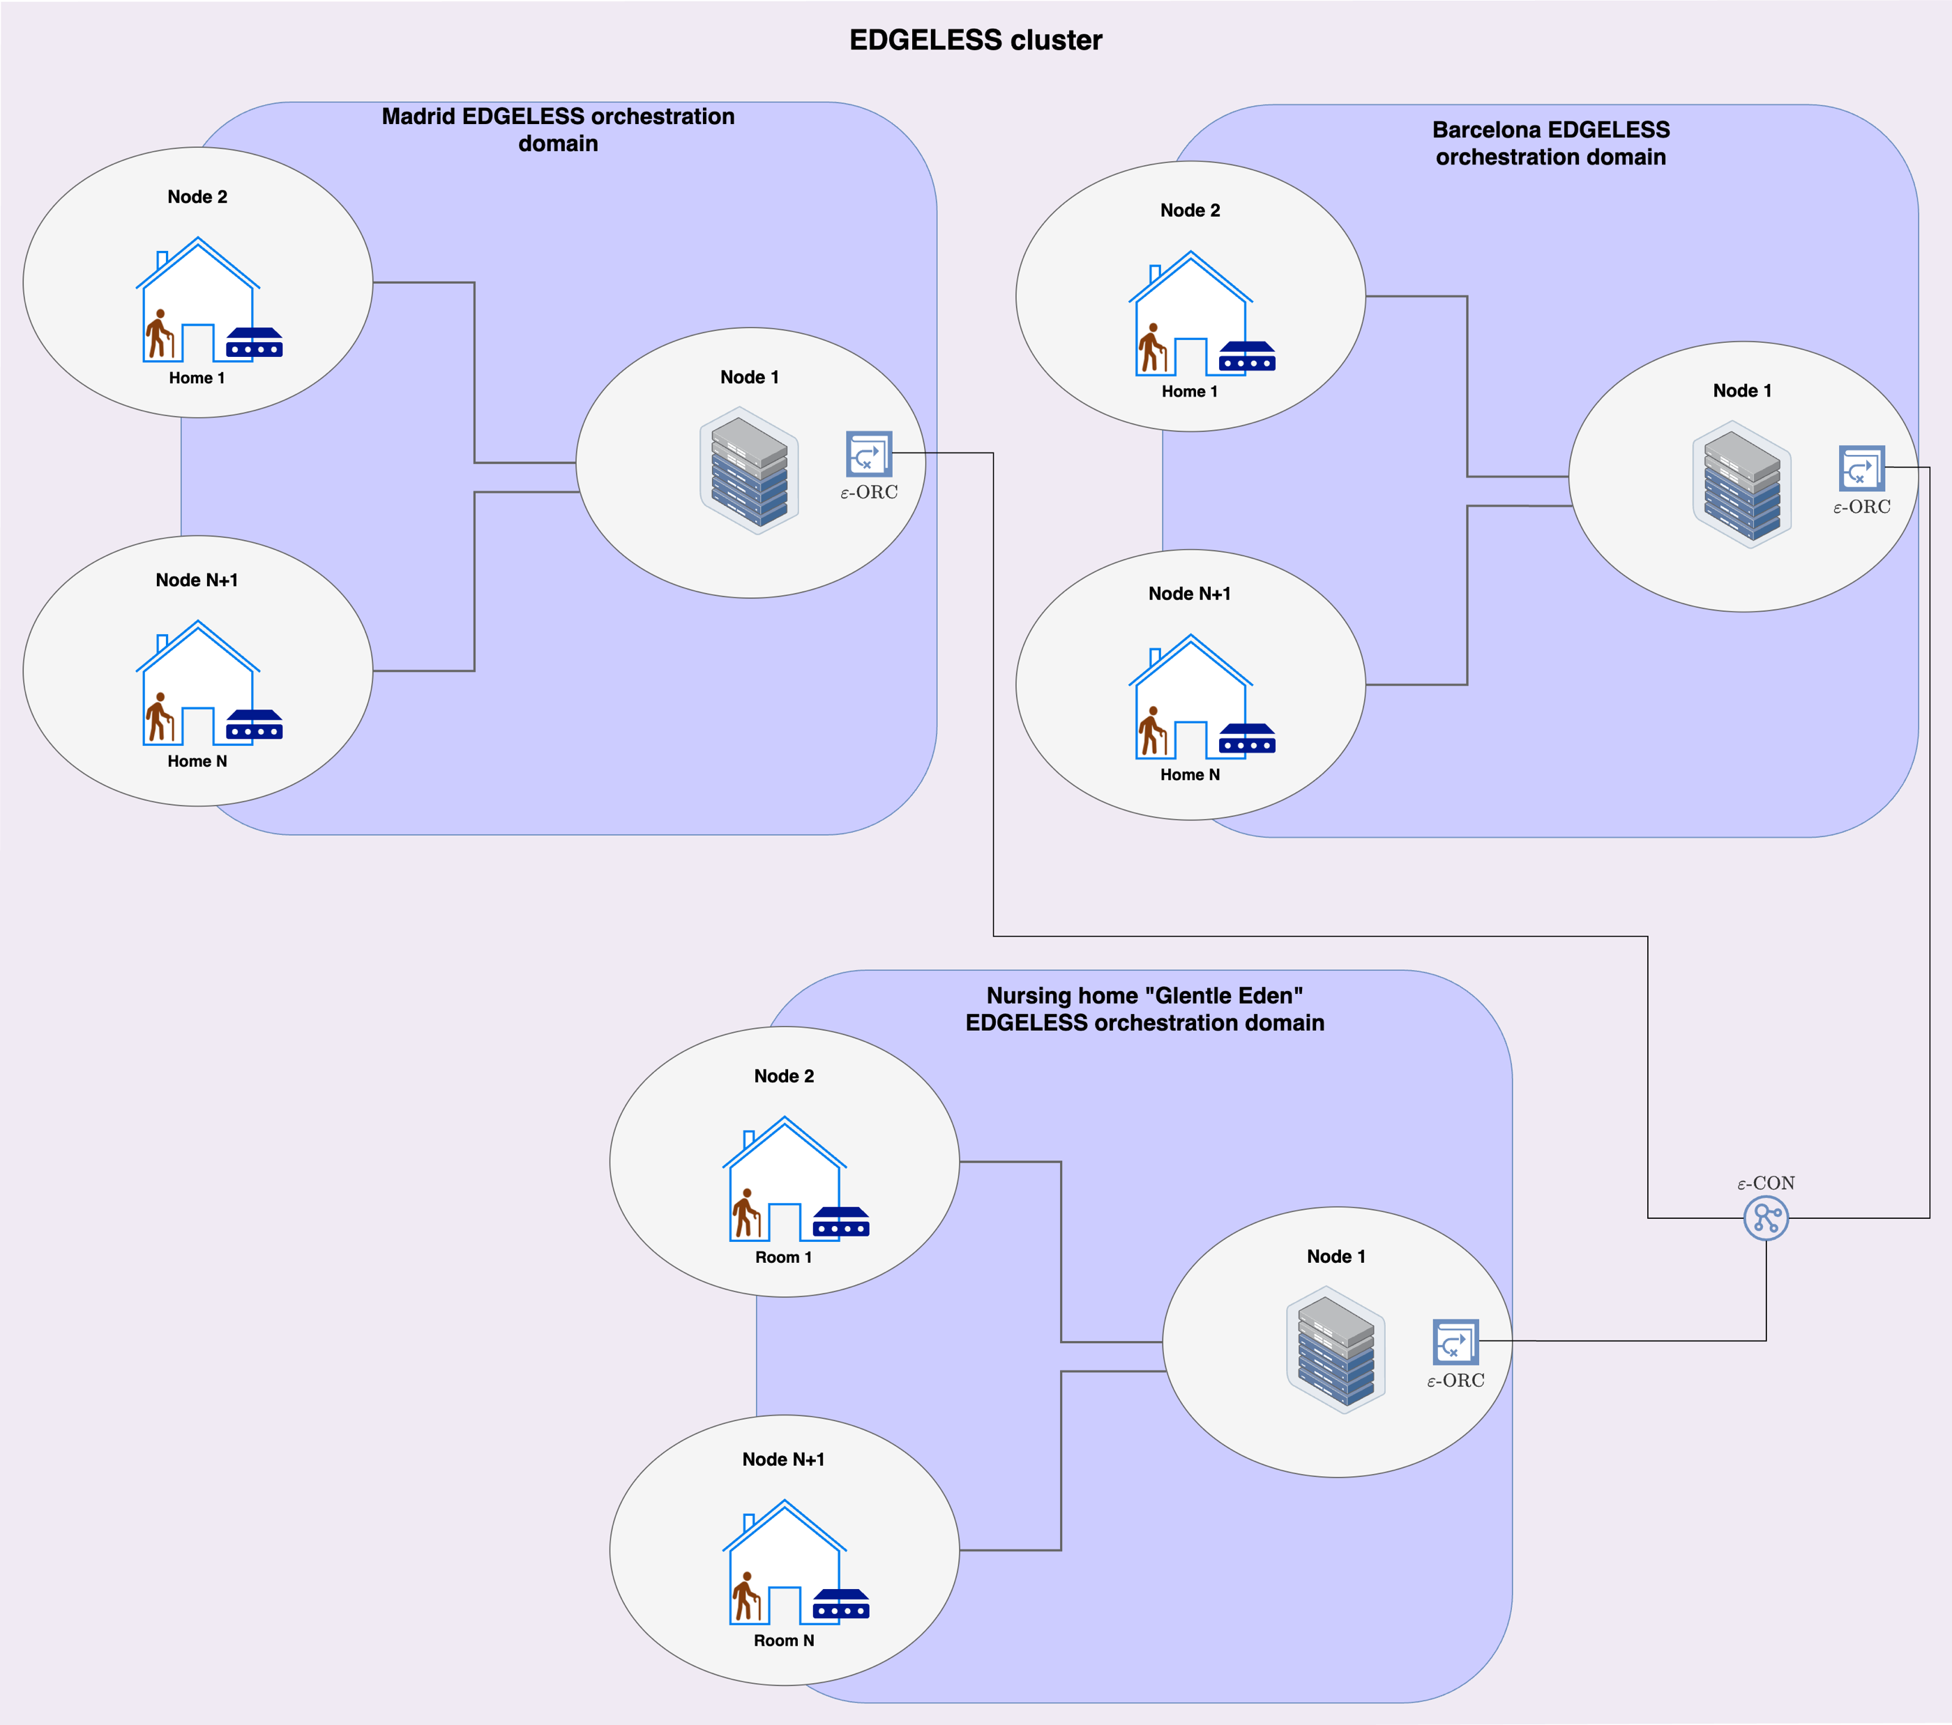
Cluster implementation proposal (Future roadmap)

Slide 14
T5.4 next steps
Improve the Senior person simulator
Continue working on the Rust functions for the Workflow
Develop and train ML model for activity detection
Develop and train ML model for anomaly detection
Integrate ML models within the EDGELESS workflow
Integration with testbed provided by Telefónica
Integration with current Senior Care app
Tests and validations

