Slide 1

Django – The-Batteries-and-Kitchen-Sink-included Python Framework
By Shelby Elzinga and John Cassidy

Slide 2
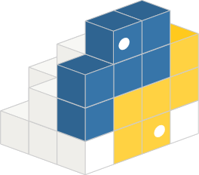
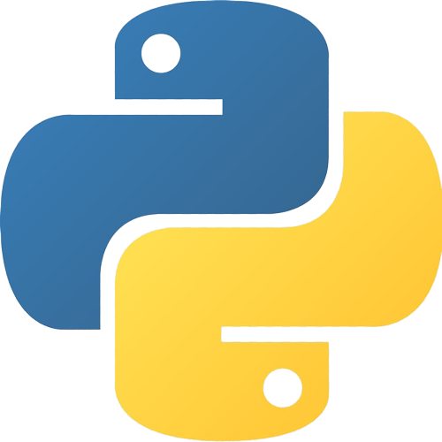
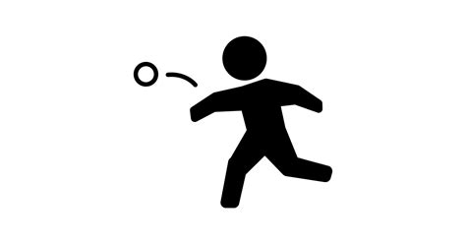
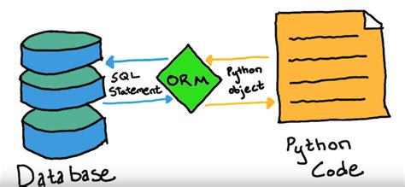
Why does Python have web frameworks?
Allows end-to-end app development in python
Can use the vast array of libraries
Finally! there is an ORM that doesn’t make you want to defenestrate your computer.

Slide 3
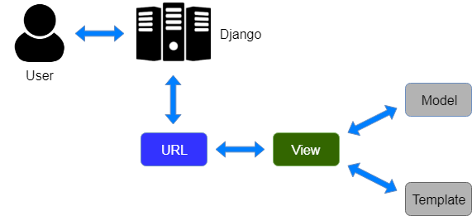
What is this MVT all about?
It’s basically MVC but instead it is model-view-template
Django Views server as the Controller
Stolen from javatpoint.com/django-mvt

Slide 4
Sounds cool, how do I start using it?
download Python (ofc - you can figure that out)
python -m pip install Django
django-admin startproject {project name}
django-admin startapp {app name}
If you want to do a virtual environment, the quickest way here is to do python –m venv venv in the root of the project some point after here
Yes, I know there are like 3 other virtual env tools and poetry is objectively superior or whatever– spare me.
Why do we need both startproject and startapp?:
The project is the overarching container for separate apps – e.g a backend and frontend

Slide 5


Why not use Flask? ?
You may often hear people say that Django is too heavy – for many cases that is true.
Django and Flask are very similar to the paradigm of Angular and React in JavaScript
Django is opinionated and assumes a lot, but will just work, like a car
Flask is much smaller and more maneuverable, but easier to crash, like a motorcycle

