Slide 1

Cinema : is it slowing down?
A data analysis from 1980 to 2020 in French cinemas

Slide 2

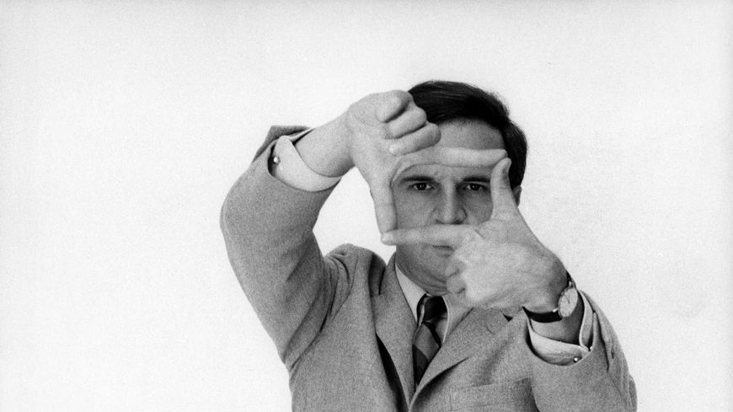
Introduction
"Cinema is a matter of what's in the frame and what's out.“
Martin Scorcese
“Le cinéma c'est de l'art de faire faire de jolies choses à de jolies femmes.”
François Truffaut
A data analysis from 1980 to 2020 in French cinemas

Slide 3
Introduction
Perimeter :
KPI: admissions
Source : CNC
Geography : France
Years : 1989 to 2020
Customer oriented analysis
A data analysis from 1980 to 2020 in French cinemas

Slide 4
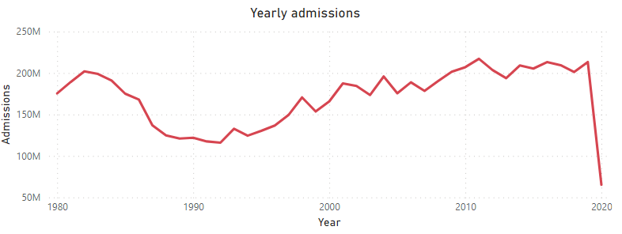
1. Audience
Annual audience
Conclusion : since 2010, audience was back at its 1982 peak ( ≈ 200 M adm/y) before Covid crisis

Slide 5
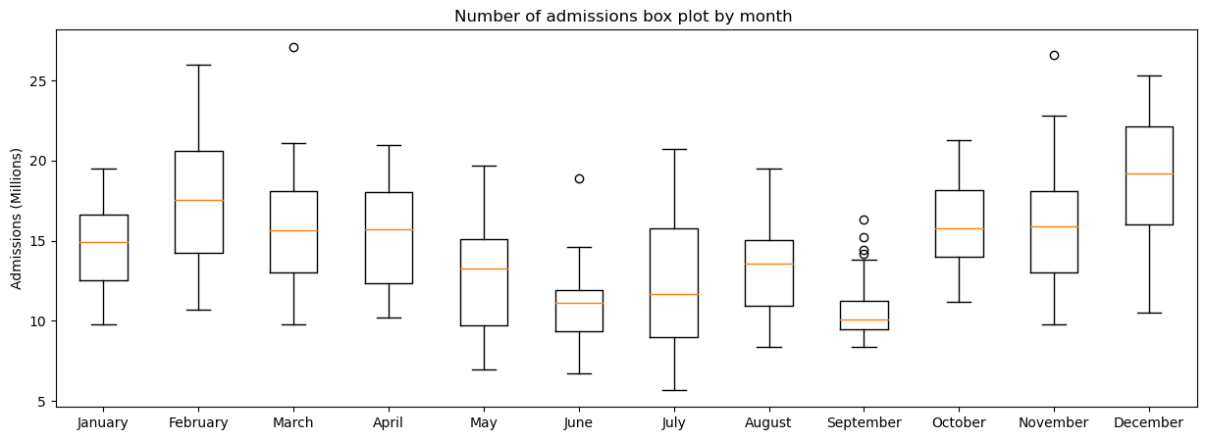
2. Behaviour
Monthly audience (1980-2019)
Conclusion : February, March, April, October, November, December seem to be the top months

Slide 6
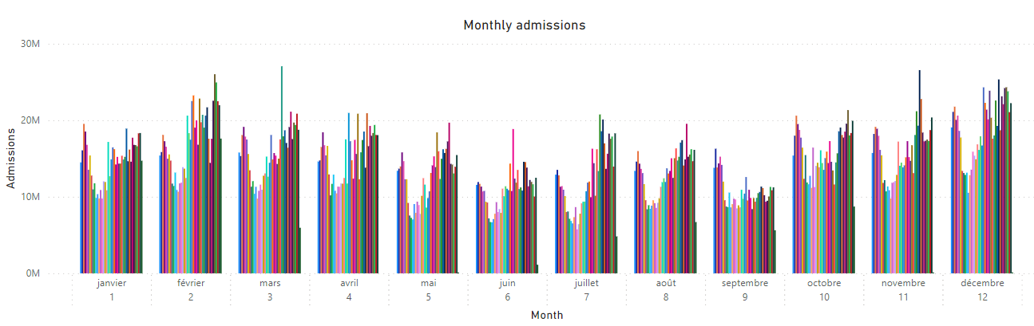
2. Behaviour
Monthly audience
Conclusion : 1. February, March, April, October, November, December seem to be the top months
2. Power BI has its limits

Slide 7
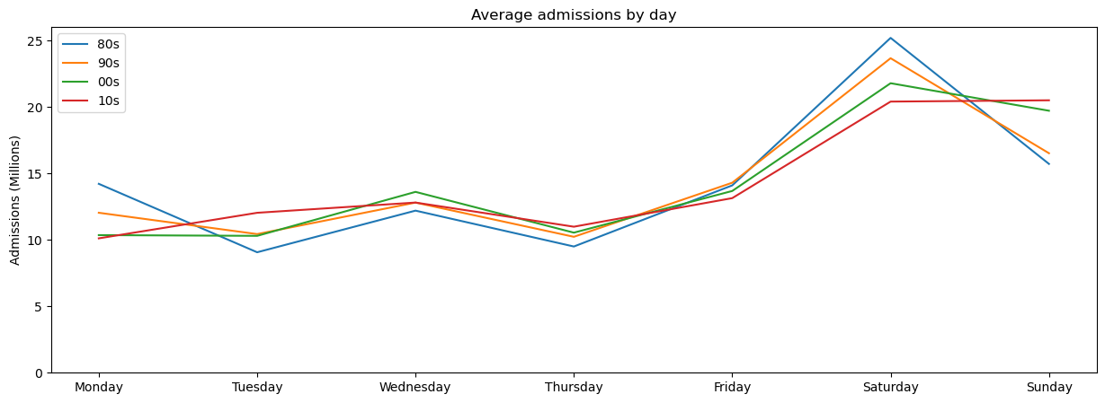
2. Behaviour
Daily audience (1980-2019)
Conclusion : no big changes observed, but curves tend to be flattened

Slide 8
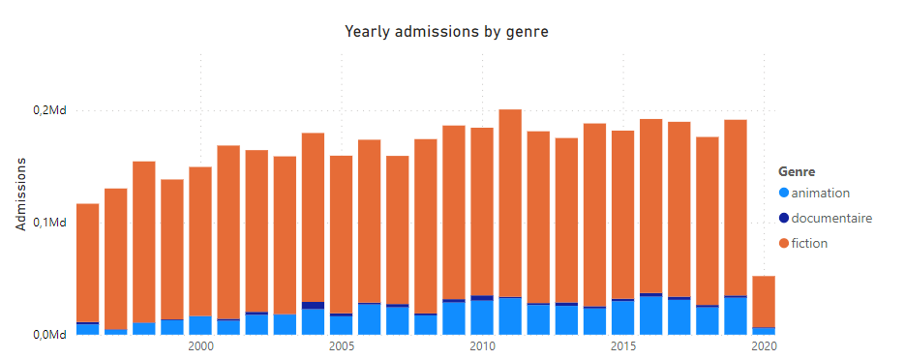
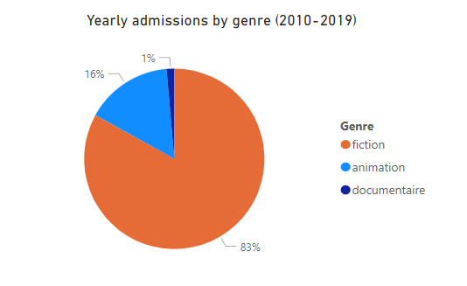
2. Behaviour
Admissions by genre (1996 – 2020)
Conclusion : 1. Fiction is the preferred genre of the audience
2. Animation genre has grown to reach a ceiling of 15% since 2010

Slide 9
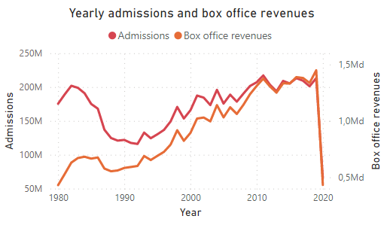

3. Business review : 80s vs 10s
Revenue vs admissions
inflation
Admissions : from 190M/y to 210M/y
Revenues : from 0,7Md€/y to 1,4 Md/y
Inflation: +122% between 1983 and 2019
0,7 Md€ ≈ today’s 1,5 Md€ with this rate

Slide 10
Conclusion
Overall audience : has not slowed down before Covid
Overall revenue: has not slowed down before Covid
revenue correlates with inflation
Audience behaviour : has slightly changed:
More animation movies
More traffic on Wednesday
More audience in February and April
Less audience in September
A data analysis from 1980 to 2020 in French cinemas
More kids?

Slide 11
Conclusion
Overall audience : has not slowed down before Covid
Overall revenue: has not slowed down before Covid
revenue correlates with inflation
Audience behaviour : has slightly changed:
More animation movies
More traffic on Wednesday
More audience in February and April
Less audience in September
A data analysis from 1980 to 2020 in French cinemas
More kids?

Slide 12

Thanks !

