Slide 1
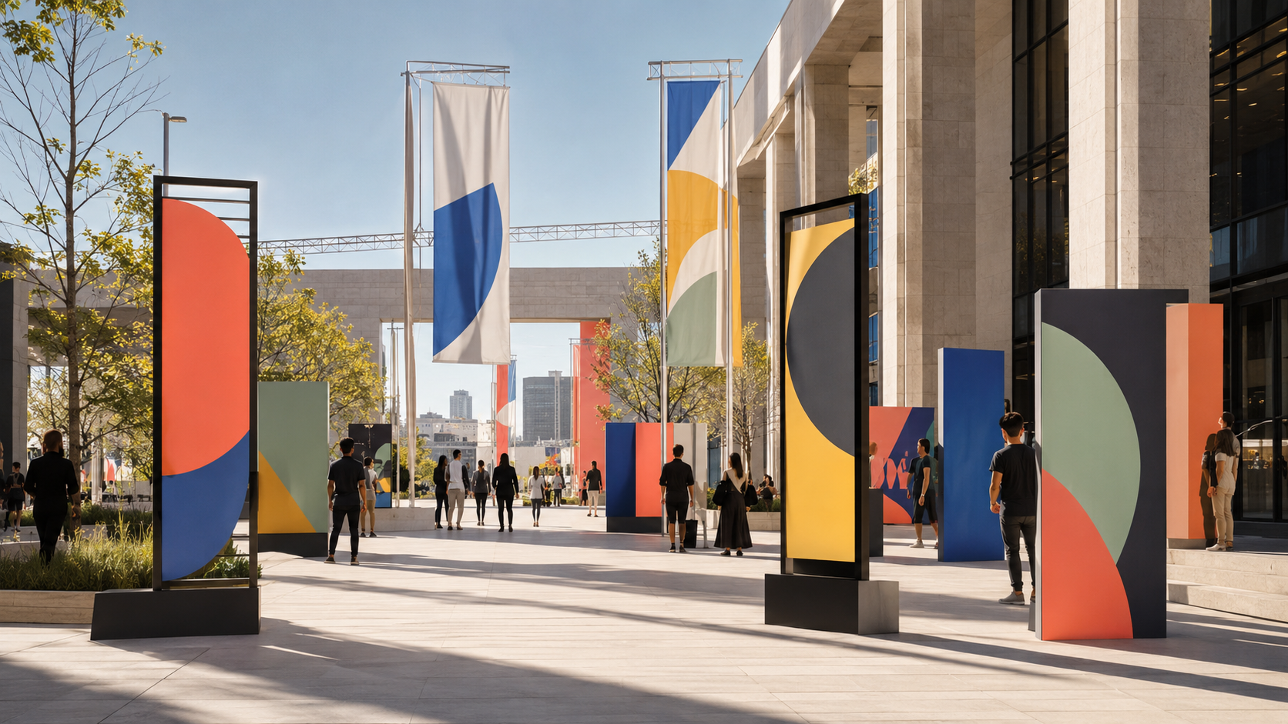
SELF-DIRECTED CONCEPT / BRAND, PRESENTATION, SOCIAL, PRINT, WAYFINDING
Civic
Bloom
A public-program communication system for a fictional design festival: client-ready deck, social campaign, print pack, large-format wayfinding, review workflow, and final QA.
Presentation system
Social assets
Print-ready
CIVIC BLOOM — VISUAL COMMUNICATION SYSTEM
01

Slide 2
01 / PROJECT BRIEF
A civic event identity that needs to work everywhere.
COMMUNICATION JOBS
01
Persuade
Introduce the festival concept and value to partners.
The fictional program turns public plazas into a weekend of installations, workshops, talks, and guided walks. The design challenge was to create a system that feels joyful and public-facing while remaining practical for deck review, production, campaign rollout, and on-site navigation.
02
Promote
Adapt the identity into social posts, stories, and event assets.
03
Orient
Help visitors move between venues, schedules, and program types.
04
Deliver
Create print-ready files and clean handoffs that survive revision.
CIVIC BLOOM — VISUAL COMMUNICATION SYSTEM
02

Slide 3
02 / AUDIENCE & STAKEHOLDER MAP
Different readers, one system.
The system has to speak to leadership during review, production teams during handoff, and the public during the event. The visual language stays consistent, but the hierarchy shifts by use case.
Leadership review
Production team
Visitors
Needs the idea, budget logic, program value, and visual confidence.
Needs clean specs, naming, export status, and editable source logic.
Need a quick read: what is happening, where to go, and what comes next.
CIVIC BLOOM — VISUAL COMMUNICATION SYSTEM
03

Slide 4
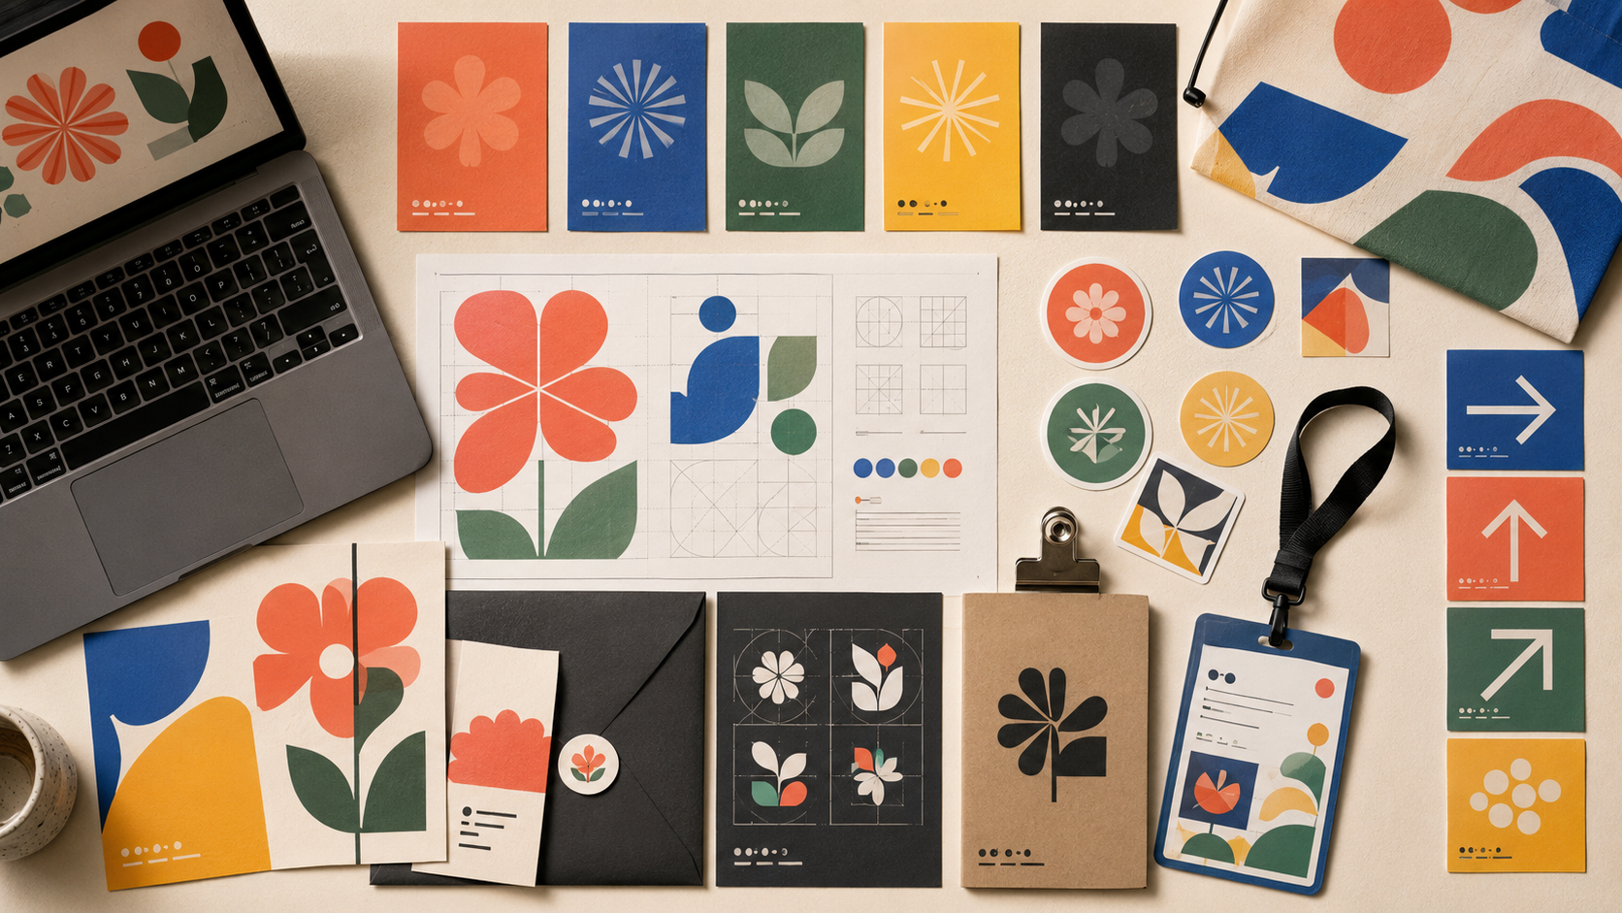
03 / BRAND SYSTEM
A modular language of civic shapes.
The identity uses public-space geometry - arches, circles, leaves, directional arrows, and civic blocks - to create a flexible system for presentation, social, print, and wayfinding.
Color role
Coral for attention, blue for civic structure, yellow for energy, sage for public space, charcoal for grounding.
Typography role
High-impact headings paired with a functional sans serif for schedules, labels, and production specs.
Image role
Bright public-space photography and clean cutouts create an optimistic civic tone.
CIVIC BLOOM — VISUAL COMMUNICATION SYSTEM
04

Slide 5
04 / PRESENTATION SYSTEM
Decks as tools for decision-making.
The presentation design is modular: cover, section divider, visual concept, schedule/timeline, stakeholder review, and production checklist. Each format uses consistent positioning so updates are fast and accurate.
COVER
TIMELINE
CHECKLIST
Presentation rule: each slide should have one dominant message, one supporting visual system, and no more than three secondary points.
CIVIC BLOOM — VISUAL COMMUNICATION SYSTEM
05

Slide 6
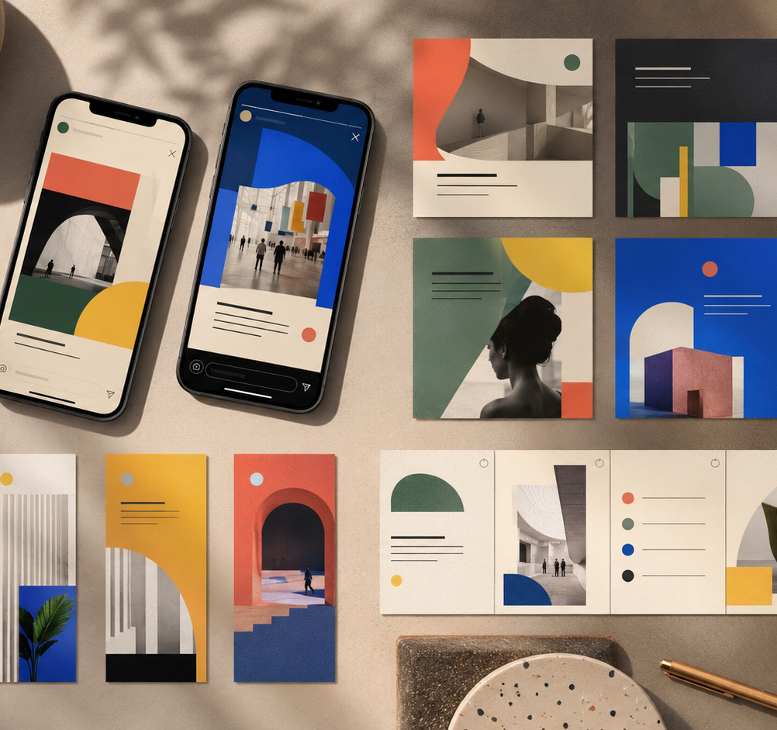
05 / SOCIAL MEDIA & DIGITAL PRODUCTION
Fast variations, protected hierarchy.
A social system should give the designer room to produce quickly without letting brand consistency fall apart. Civic Bloom includes modular crops, safe zones, post families, and campaign-specific cutdowns.
IG Feed · 1080 × 1080
Story/Reel · 1080 × 1920
LinkedIn · 1600 × 900
Carousel · 5–8 cards
CIVIC BLOOM — VISUAL COMMUNICATION SYSTEM
06

Slide 7
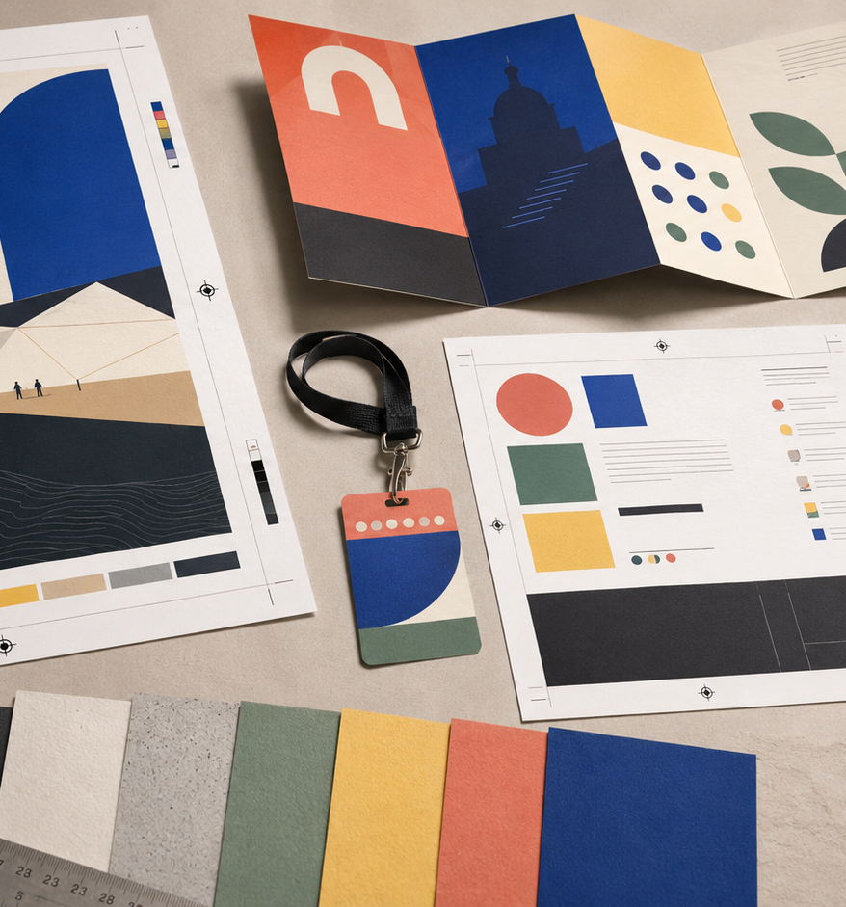
06 / PRINT ASSETS & SUBMISSION SUPPORT
Print-ready thinking from the first layout.
The system includes posters, one-pagers, leave-behinds, badges, and signage-style pieces. Production notes are not treated as an afterthought; bleeds, trims, resolution, and final export settings are built into the workflow.
Bleed
0.125 in for standard print pieces
Resolution
300 DPI effective image check
Color
CMYK / printer profile before final export
Packaging
Linked assets, fonts, exports, and archive copy
CIVIC BLOOM — VISUAL COMMUNICATION SYSTEM
07

Slide 8
07 / ENVIRONMENTAL GRAPHICS
A system for distance, speed, and place.
Large-format graphics rely on simplified geometry, high contrast, and directional cues. The goal is not only decoration; it is orientation, recognition, and movement across a public route.
Banners
Long-distance identity and event recognition.
Directional signs
Arrow-first hierarchy for movement.
Zone markers
Color-coded program areas and venue entrances.
CIVIC BLOOM — VISUAL COMMUNICATION SYSTEM
08

Slide 9
08 / COLLABORATION & REVIEW
Designed for feedback without losing momentum.
A junior designer often owns production detail while collaborating with leadership, strategy, and project teams. Civic Bloom includes review checkpoints, open questions, and version rules so feedback can move quickly.
1
2
3
4
5
Intake
Draft
Review
Revise
Deliver
Clarify audience, format, deadline, and owner.
Create first pass with notes on open decisions.
Capture comments by page, format, and priority.
Resolve comments, update exports, and mark changes.
Run final QA and archive source files.
CIVIC BLOOM — VISUAL COMMUNICATION SYSTEM
09

Slide 10
09 / POWERPOINT MOTION STORYBOARD
Animation should clarify the idea, not decorate it.
MOTION BUILD EXAMPLE
Show the path in pieces.
The presentation motion system is built as native PowerPoint animation: section reveals, diagram builds, staggered list entrances, and restrained page transitions. Every animated slide also exports cleanly as a static PDF.
01
02
03
Route appears
Program zones enter
CTA resolves
Animations are timed to match the presenter’s speaking order: one message, one reveal, one decision.
CIVIC BLOOM — VISUAL COMMUNICATION SYSTEM
10

Slide 11
10 / QA, FILE HYGIENE, AND HANDOFF
The last 10% is a design skill.
Names, dates, captions, URLs, grammar, and numbering.
Proofing
Production-forward design succeeds when the final files are easy to open, trust, revise, export, and archive. The checklist covers language, layout, accessibility, and technical delivery.
Layout QA
Alignment, spacing, type sizes, crops, and contrast.
Export QA
Bleed, trims, linked assets, format, filenames, and final version.
CIVIC BLOOM — VISUAL COMMUNICATION SYSTEM
11

Slide 12
11 / REFLECTION
A system is strongest when it makes future work easier.
Civic Bloom demonstrates how presentation design, social production, print assets, wayfinding, motion instincts, and file hygiene can operate as one connected design system. The next iteration would test the system with a timed production exercise and full-scale signage readability checks.
Next: build master templates in PowerPoint, recreate print pieces in InDesign, finalize vector icon families in Illustrator, and prepare a Webflow-ready landing-page style guide.
CIVIC BLOOM — VISUAL COMMUNICATION SYSTEM
12

