Slide 1

THRESHOLDS / VISUAL SYSTEM
Thresholds
A cross-format visual communication system for a fictional cultural exhibition — spanning presentation, social, print, and environmental applications.
Prepared by Jocelyn Martinez
UX/UI + Visual Designer
Presentation · social · print · space

Slide 2
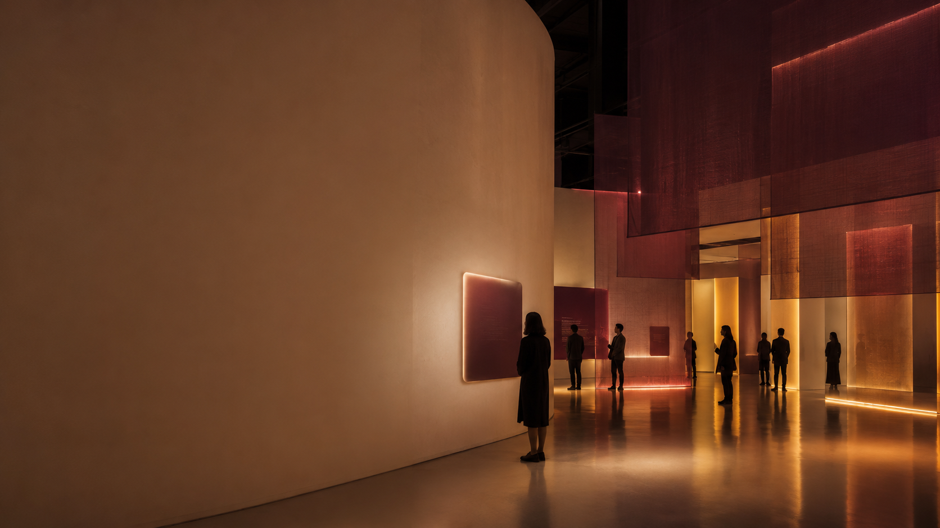
02
ONE IDEA, BUILT TO TRAVEL
A flexible identity across audience-facing formats.
01
02
Presentation craft
Multi-format production
Hierarchy, pacing, templates, animated-build thinking
LinkedIn, Instagram, one-pagers, signage-style layouts
Thresholds explores how one exhibition idea can retain its hierarchy, atmosphere, and recognizability across a narrative deck, campaign assets, printed collateral, and the physical environment.
03
04
Detail orientation
Experience-design interest
Proofing, export, alignment, file hygiene, final QA
Narrative, wayfinding, spatial storytelling, visitor flow
A design system for stories that move from deck → social → print → space.
JOCELYN MARTINEZ / THRESHOLDS / VISUAL SYSTEM
SYSTEM OVERVIEW

Slide 3
03
CREATIVE BRIEF
Turn invisible memory into a walkable story.
OBJECTIVE
Build emotional clarity without visual clutter.
Thresholds is a fictional immersive exhibition concept about ordinary objects, personal memory, and the traces people leave behind. The deck demonstrates how I would shape a client-facing design direction with clear pacing and visual discipline.
AUDIENCE
Museum visitors, cultural partners, educators, donors
TONE
Warm, reflective, elevated, intimate
DELIVERABLES
Client deck, social templates, one-pager, signage cues
SUCCESS
The idea is understood quickly and remembered visually
Material mood: translucent acrylic, warm linen, oxidized brass, archival paper.
JOCELYN MARTINEZ / THRESHOLDS / VISUAL SYSTEM
BRIEF

Slide 4
04
PRESENTATION PACING
A deck should guide attention like a visitor path.
Designer signal
Not just pretty slides — structured story, clear pacing, and reusable logic.
This slide shows how the idea is paced for a client audience: establish the emotional hook, then move into concept, visitor experience, system assets, and production detail.
01
02
03
04
05
Hook
Concept
Experience
System
Delivery
Why this story matters
The organizing design idea
How visitors move through it
Deck, social, print, signage
QA, exports, file handoff
JOCELYN MARTINEZ / THRESHOLDS / VISUAL SYSTEM
STORYTELLING

Slide 5
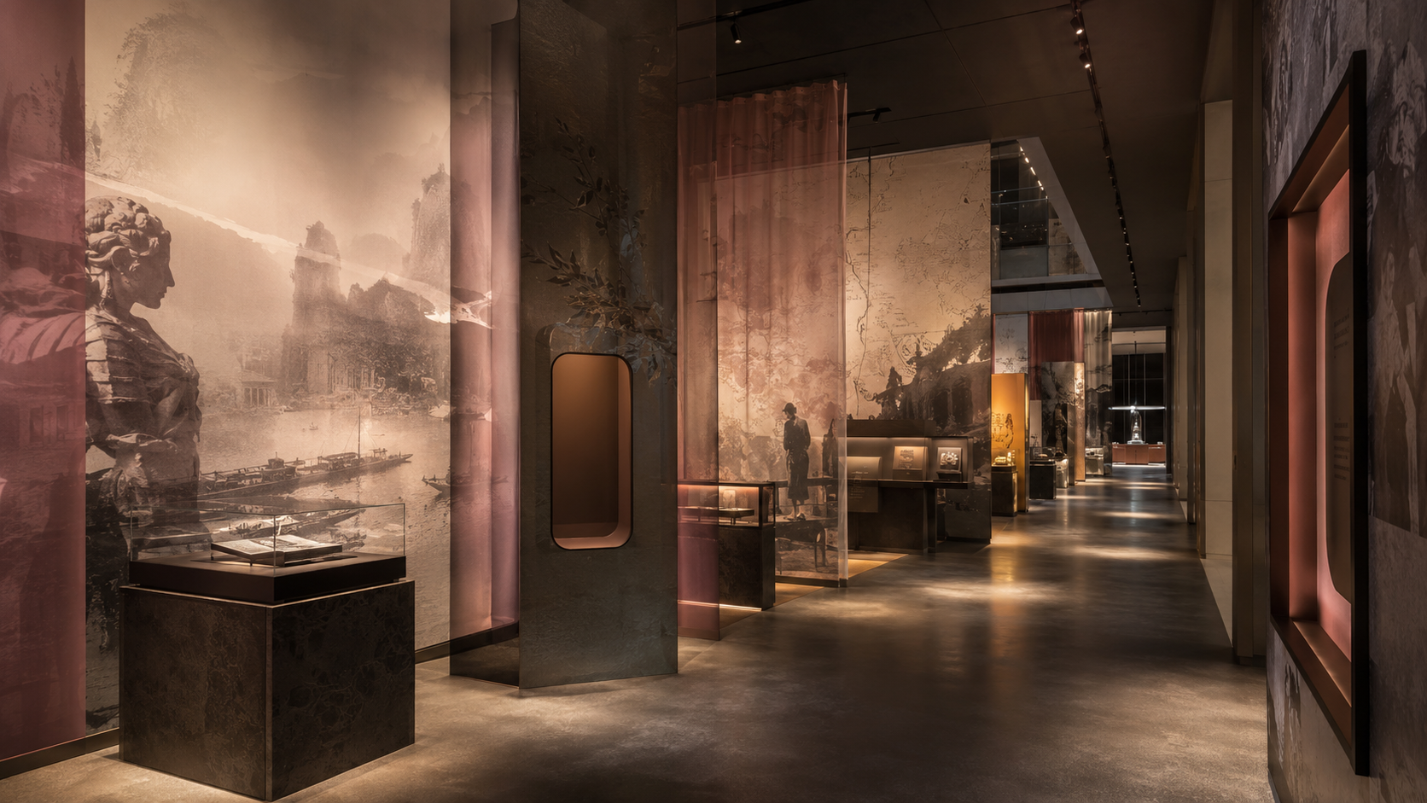
05
ENVIRONMENTAL GRAPHICS DIRECTION
A spatial language built from thresholds, fragments, and glow.
The concept uses translucent layers, warm directional light, and quiet moments of scale to make the exhibition feel immersive without becoming visually crowded.
Orientation
Memory rooms
Exit reflection
A calm entry moment that tells visitors how to read the space.
Four thematic zones: object, voice, place, and trace.
A final prompt that turns viewing into participation.

Slide 6
06
BRAND SYSTEM / DECK KIT
One system, many applications.
TYPE HIERARCHY
Thresholds
SECTION TITLES / GEORGIA
The system is intentionally production-friendly: a small palette, repeatable type hierarchy, strong crop logic, and clear usage rules for fast deck and social variations.
Client-facing decks need a clear typographic ladder: big idea, context, evidence, label, and production note.
ARCHIVE BURGUNDY
WARM PAPER
CHARCOAL
AGED ROSE
BRASS
Deck body / Aptos 11–14 pt
Labels / uppercase / tracking +1.6
Captions / concise production notes
JOCELYN MARTINEZ / THRESHOLDS / VISUAL SYSTEM
VISUAL SYSTEM

Slide 7
07
PRESENTATION SYSTEM
Reusable slide layouts for speed and consistency.
This is the kind of system I would build and maintain for a studio team: clear modules, consistent spacing, and simple rules that survive revisions.
TITLE / IDEA
COMPARISON
DELIVERY
large image + statement
two-column decision logic
checklist + assets
Consistent grid · label system · client-ready export area
Consistent grid · label system · client-ready export area
Consistent grid · label system · client-ready export area
PowerPoint animation note: use short fade / wipe builds to reveal sequences, not decorative motion that distracts from the idea.
JOCELYN MARTINEZ / THRESHOLDS / VISUAL SYSTEM
TEMPLATES

Slide 8
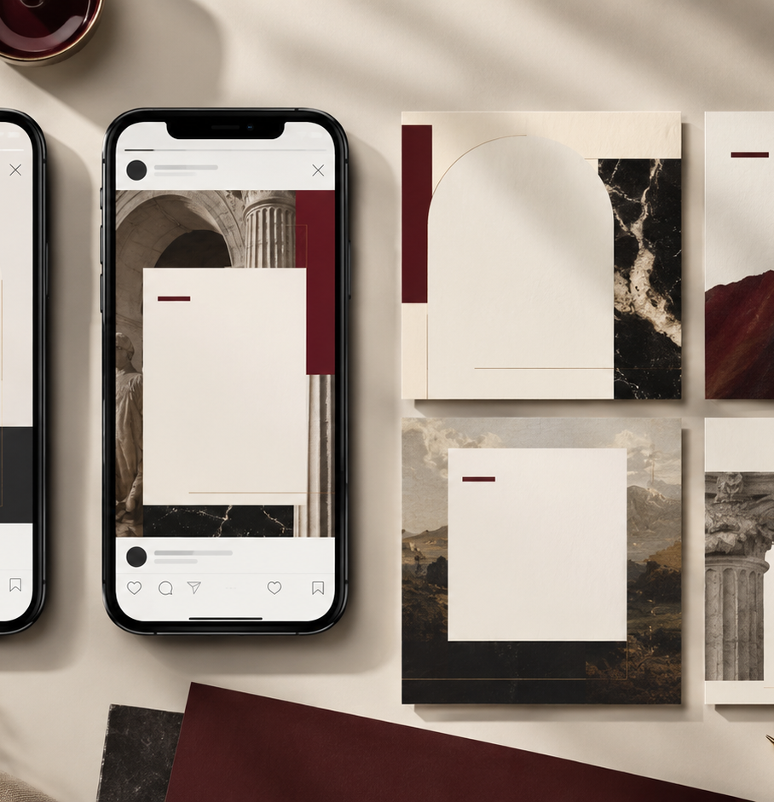
08
SOCIAL MEDIA PRODUCTION
Cutdowns that keep the idea intact.
Cross-format production requires fast, accurate variations without weakening the core idea. This system uses a flexible crop grid, consistent caption space, and restrained motion cues for carousels and cover frames.
LinkedIn carousel
1600 × 900 / idea sequence
Instagram feed
1080 × 1080 / visual hook
Story / reel cover
1080 × 1920 / vertical crop
Event graphic
date + location + CTA
03
JOCELYN MARTINEZ / THRESHOLDS / VISUAL SYSTEM
SOCIAL

Slide 9
09
PRINT / SUBMISSION SUPPORT
A one-page leave-behind with print-ready discipline.
This slide demonstrates print thinking: bleed-safe composition, clear hierarchy, cropping rules, caption systems, and production checks before export.
LEAVE-BEHIND
✓
Bleeds and trims set
Thresholds
✓
Links packaged and named
✓
Images 300 DPI+
An immersive cultural experience about memory, material traces, and the spaces between stories.
✓
Exported PDF and editable file
✓
Final proofread pass
BLEED 0.125" · CMYK READY · 300 DPI IMAGERY
JOCELYN MARTINEZ / THRESHOLDS / VISUAL SYSTEM
PRINT + SUBMISSIONS

Slide 10
10
THE LAST 10%
The work is not finished until it is clean enough to hand off.
For this role, quality control is a hiring signal. I would bring a production checklist mindset to decks, submissions, exports, and social variations.
Proofing
Design QA
Export QA
names, dates, captions, grammar, labels
alignment, spacing, type hierarchy, image crops
PPTX, PDF, links, package, resolution, file names
FILE HYGIENE EXAMPLE: 00_ADMIN / 01_SOURCE / 02_LINKED_ASSETS / 03_EXPORTS / 04_FINAL_DELIVERY
JOCELYN MARTINEZ / THRESHOLDS / VISUAL SYSTEM
QUALITY CONTROL

Slide 11
A SYSTEM DESIGNED TO TRAVEL
Consistency is not repetition.
PROJECT REFLECTION
•
Strongest contribution: a reusable presentation and campaign system
Add this as a short “Presentation + Visual System Sample” project. The title can be: “Thresholds — Presentation, Social, and Print System.” In the case-study caption, explain that it is a self-directed design exercise created to demonstrate deck storytelling, production accuracy, and multi-format adaptation.
•
Production focus: decks, social variations, print, and environmental applications
•
Next iteration: test motion pacing, proof printed colors, and refine wayfinding at scale
•
Project type: self-directed visual communication concept

