Slide 1
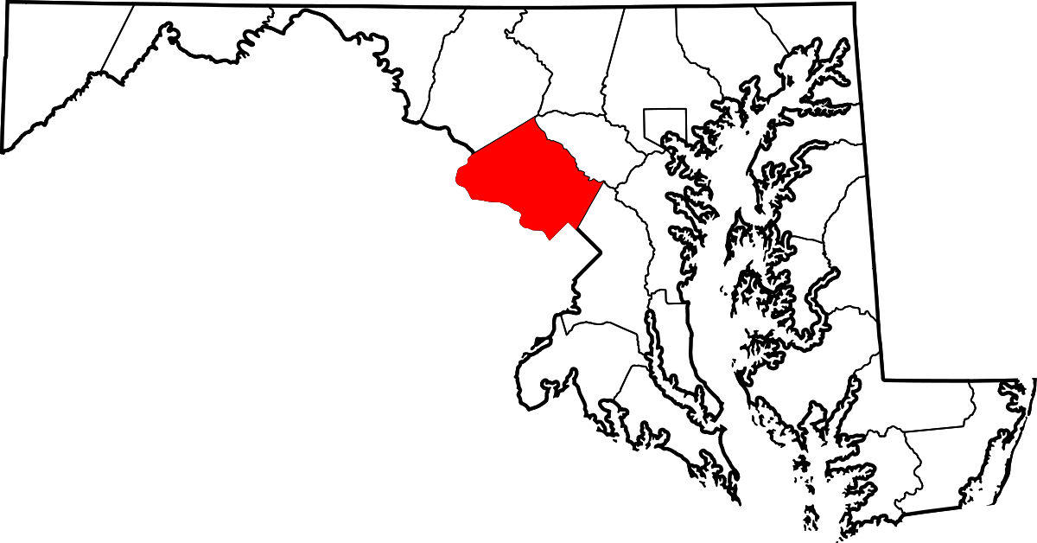
The Battle of Neighborhoods
Finding the best neighborhood to open a Chinese restaurant in Montgomery County of Maryland

Slide 2
Introduction
The Washington D.C. metropolitan area, one of the most educated and most affluent metropolitan areas in the US
Montgomery County, the most populous county in Maryland
Business friendly environment

Slide 3
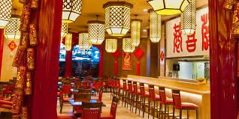
Introduction
Open a Chinese restaurant in Montgomery County:
1. Segmentation of neighborhood
2. Demographics
3. Power of consumption
4. floating people
5. existing competitors

Slide 4
Data
Data1: List of Montgomery County Zip codes
- scope of analysis
Data 2: Maryland AGI by zip code
- power of consumption
Data 3: Maryland Census 2010 Data
- demographics
Data 4: Maryland Political Boundaries Json Data
- coordinates

Slide 5
Methodology
Exploratory Analysis
Foursquare API Analysis
Cluster Analysis

Slide 6
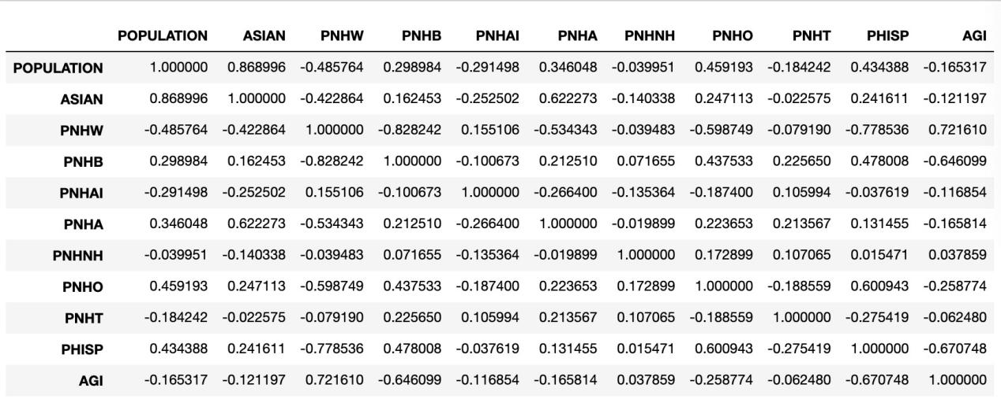
Results
Exploratory Analysis

Slide 7
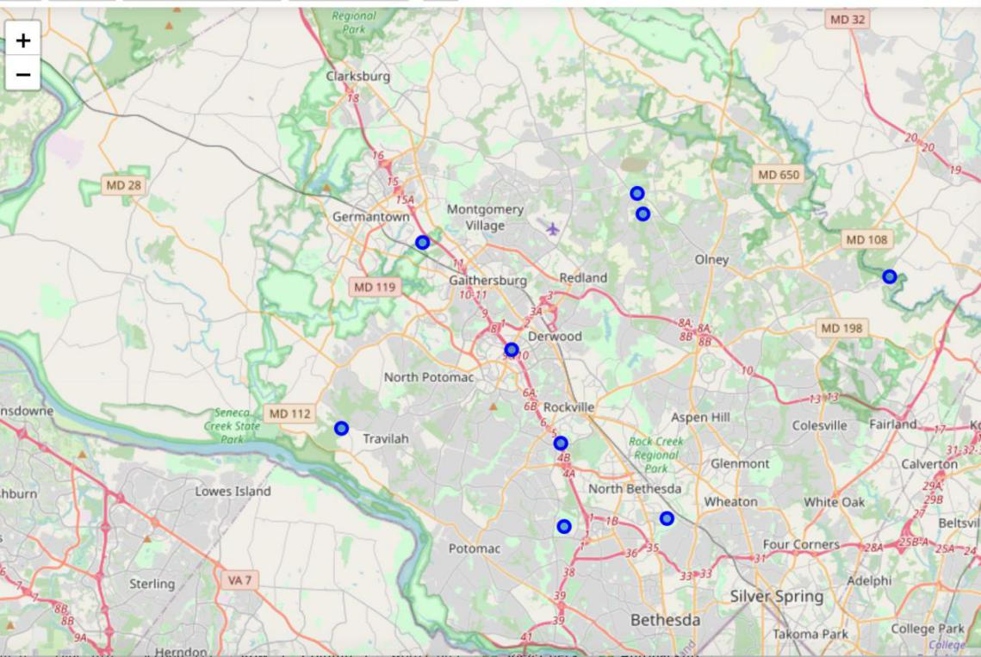
Results
Foursquare API Analysis

Slide 8
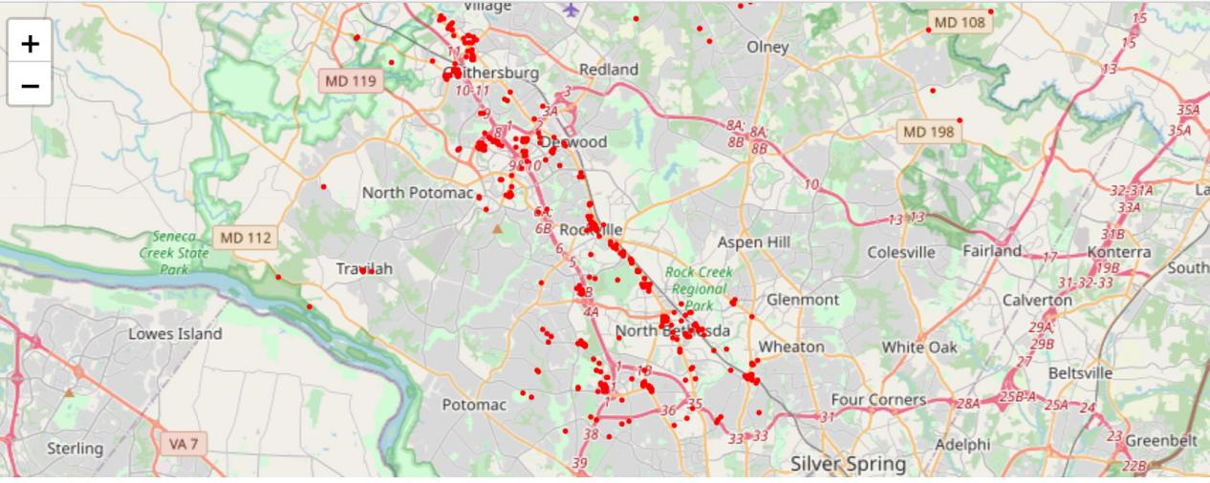
Results
Foursquare API Analysis

Slide 9
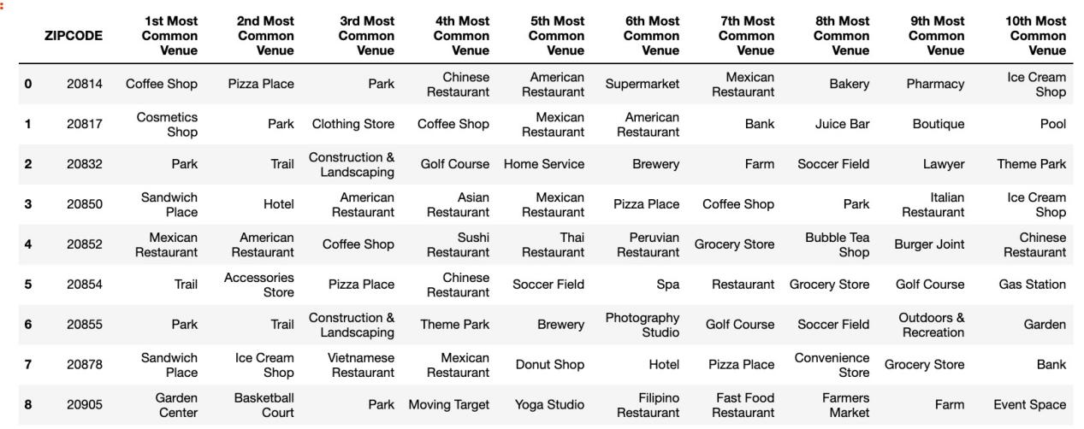
Results
Foursquare API Analysis

Slide 10
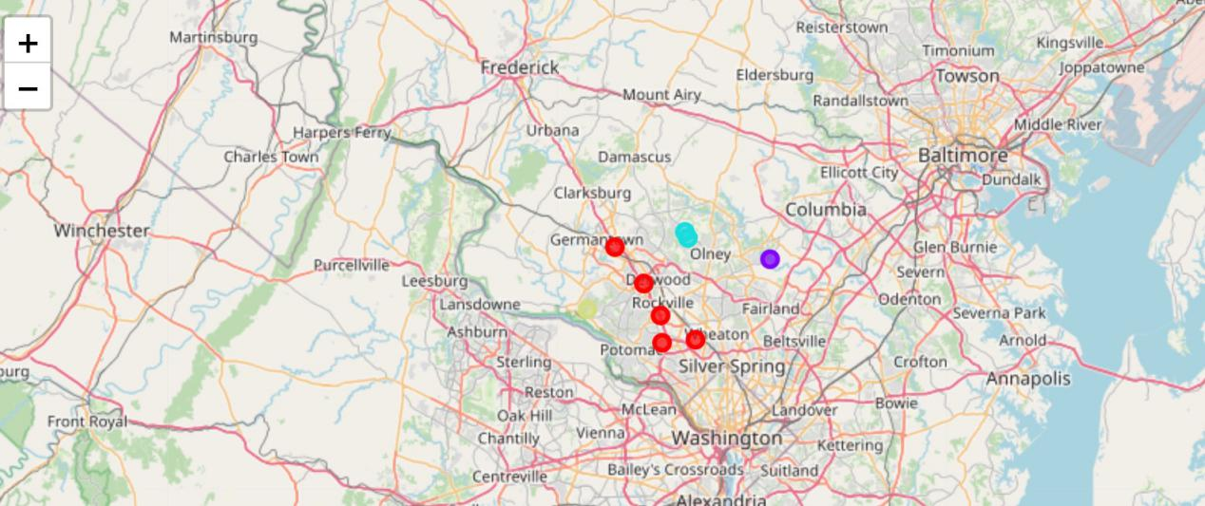
Results
Cluster Analysis

Slide 11
Conclusion
The cluster 0, which contains 5 neighborhoods, is best for our client to open a Chinese restaurant.
Here are the zip codes of these neighborhoods: 20878, 20850, 20852, 20814, 20817.

