Slide 1
Lending Club Demo
Done by Jia Guo

Slide 2
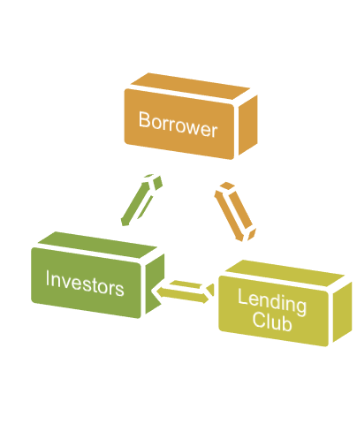
About Lending Club
Lending Club is the world’s largest online lending marketplace.
investors back creditworthy borrowers in exchange for interest income. The investors, who can be ranging from individuals to institutions, select loan in which to invest and can earn monthly returns.
Lending Club plays a key role in the lending circle, they provide a reliable platform to communicate with investors and borrowers, and they are the intermediary to make loans happen.

Slide 3
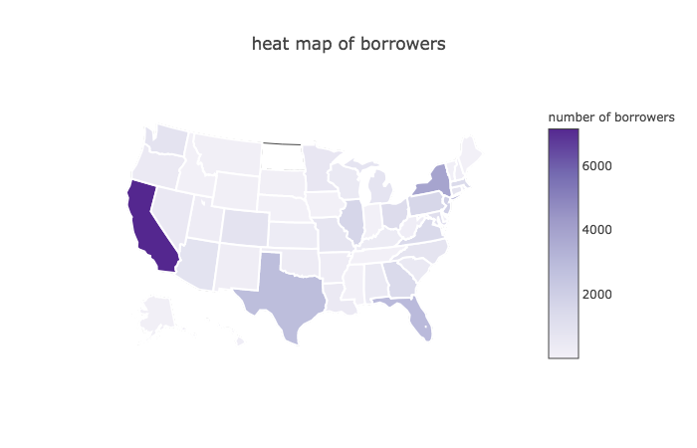

Slide 4
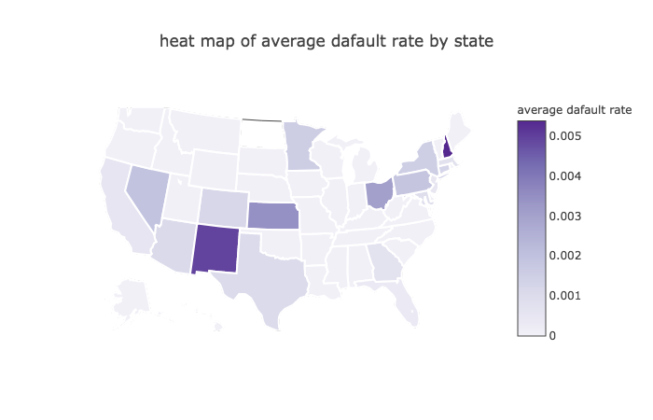

Slide 5
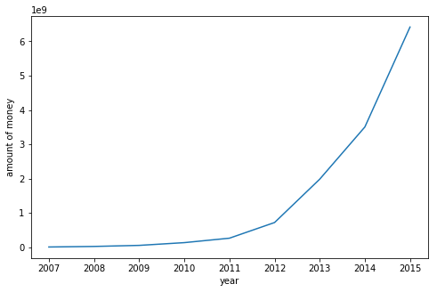
Project Overview
Motivation: As the total amount of lending grows exponentially by years, it also raises the risk of default on loans.Therefore, we need some rules or regulations, in order to reduce the risk of default.
Purpose: predict whether a borrower will be default on a loan.
Benefit (business value): Help investors understand the true cost of lending, potentially reduce their risk of loss and improve their returns.
predict targets: 3 class for identifying default ---> safe, warning, default.

Slide 6
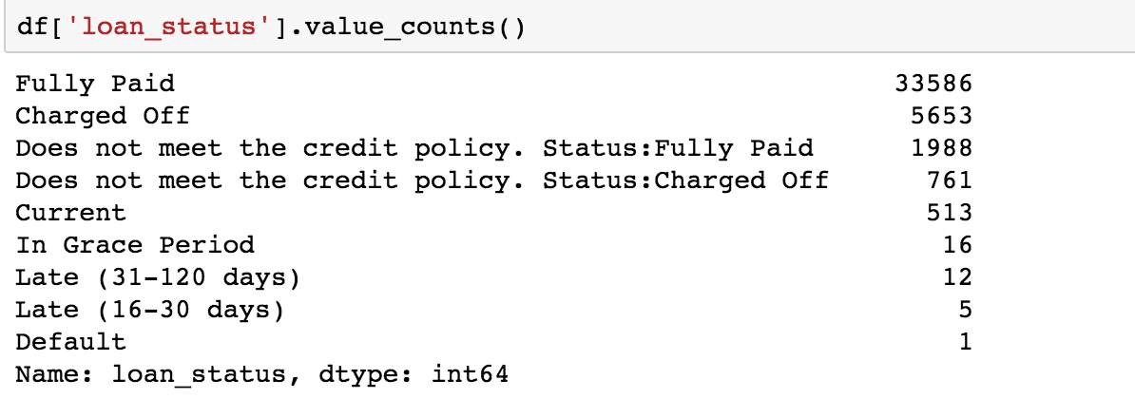
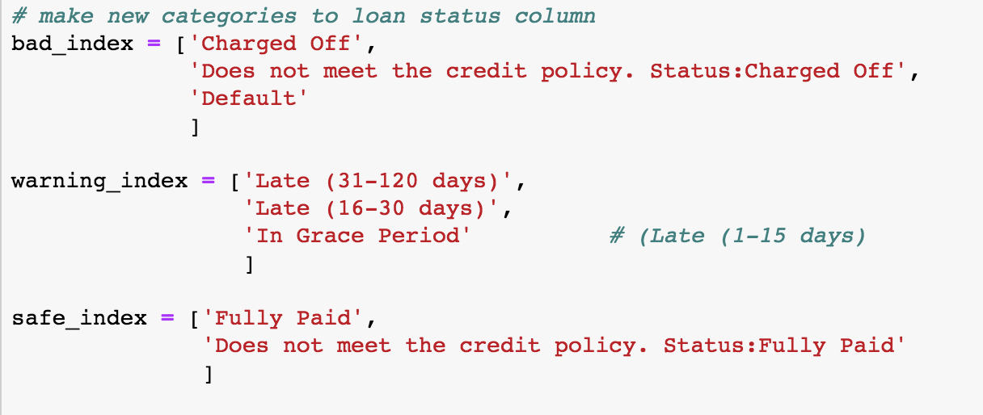

Slide 7
Data: Lending Club loan data. (!!! 5 million data points !!!)
Methodology: Applying machine learning and deep learning techniques, to create a forecasting model. Use deep learning CNN to build model, and validate by random forest.
Approach: using 33 features extracted from raw data, building a predictive model, and optimizing the model through testing and evaluation.

Slide 8
About the Data
The most valuable data sources are:
loan amount , funded amount, highest FICO score, lowest FICO score, number of open accounts, number of credit delinquency in the past two year, debt to income ratio(DTI), home ownership, application type, purpose of the loan, income source verification status, employment length, etc.
Notes:
, after we remove the unnecessary columns and get dummy column for categorical variables, we have total of 140 columns which is ready to build a predictive model.
, after we remove the unnecessary columns and get dummy column for categorical variables, we have total of 140 columns which is ready to build a predictive model.

Slide 9
Steps to find the result
Get Understanding: meaning of each column in the dataset and correct categorization of the data.
Data Cleaning: Removing the data we believe that will not be helpful to build the model.
Feature Engineering: Separating the modified version of dataset (less number of columns with numeric terms only) into feature matrix, and target vector (loan status).
Modeling: Building a model with deep learning based on convolution neural networks, and use random forest technique as a validation algorithm to make better lending decisions.

Slide 10
Result
Imbalance | Deep Learning | Random Forest
Accuracy | 98.27% | 98.2%
Balance | Deep Learning | Random Forest
Accuracy | 98.21% | 98.42%

Slide 11
Let’s go through the code in Jupyter Notebook!

Slide 12
Obstacles of Lending Club Demo
Since the accuracy and confusion matrix show both deep learning and random forest model can learn pretty well in balance and imbalance situations, we need to think about if any overfitting occurs.
After print out the feature importance report from random forest model, I didn’t see any principal feature significantly leads to the target.
Milestone: I will read more paper about building model on financial data, and keep improving the model and fix the potential ‘overfitting’ problem, and give the model more sense in the real-world finance.

Slide 13
Per unit change of soup intergradient, and sensitives , and what is the major contributor of the model?
Correlation may ignore nonlinear correlation, correlation occur in continuous variables

Slide 14
Thank you!

