Slide 1
EPL- Predictive Analytics
Jocelyn John Mascarenhas
501345877

Slide 2
Research Questions & Significance
Static vs. Dynamic Predictors: Which match statistics (e.g., possession, shots, fouls, passes) are the strongest predictors of winning in the EPL?
Home Advantage (HA): How stable and influential is the Home Advantage effect across seasons?
Momentum or Position:Does recent performance (last 5 matches) or average position better predict future match results?

Slide 3
Significance Callout:
Core Contribution: We rigorously validate our model using Time-Series Split Cross-Validation (TSCV), a necessary departure from traditional K-Fold methods, to ensure temporal realism in predictive metrics.
Goal: To empirically demonstrate that Team Momentum (rolling form features) provides significantly more predictive power than static league position or raw pre-match statistics.

Slide 4
Phased Methodology Overview(Modeling Pipeline)
Acquisition & Cleaning: Gathering 10+ seasons of raw match data.
Feature Engineering: Calculating rolling averages for momentum (Form, Goals, Points).
EDA & Baseline: Understanding distributions and setting the performance floor (46.12%).
Advanced Modeling: Training, validation, and optimization using XGBoost.

Slide 5
Methodology Deep Dive: Preventing Temporal Bias
The Issue: Standard K-Fold CV mixes future data into the past (Look-Ahead Bias).
The Solution: TSCV ensures that the Validation set always occurs after the Training set chronologically.
Benefit: Guarantees predictive metrics are temporally realistic and unbiased.

Slide 6
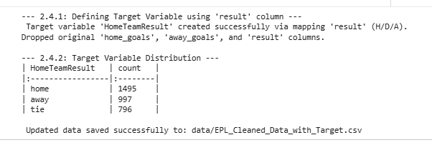
Data and Feature Engineering
Challenge: Static match stats (like Shots Diff) are weak predictors.
Solution: We created Dynamic Features based on rolling averages of the team's performance over the last 5 matches.
Key Features: Rolling Points Average, Recent Goal Difference, Form Streak.

Slide 7
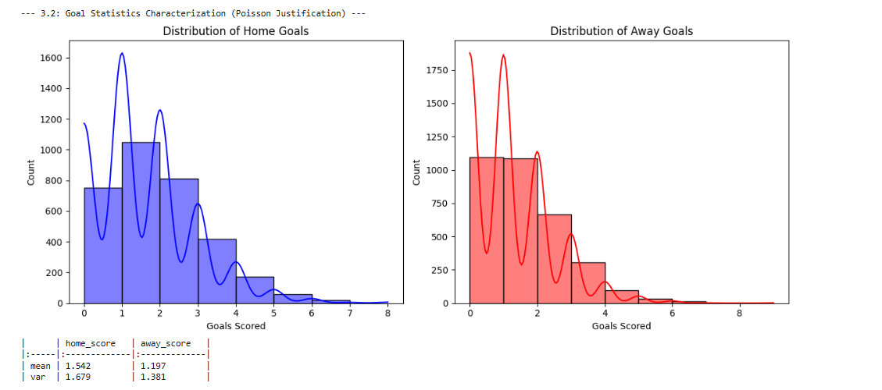
Data Characterization: The Goal-Scoring Process
Finding: Home Goals Mean (1.542) and Variance (1.679) are
approximately equal.
Interpretation:This relationship validates the underlying assumption of a Poisson distribution for goal
scoring.
Implication: It confirms the
Data is suitable for advanced
classification models (like
XGBoost) that handle the
discrete and right-skewed
nature of the target variables.

Slide 8
Finding 1: Performance Floor (Home Advantage)
Home Win is the majority class, confirming the significant influence of Home Advantage (HA).
Our Logistic Regression baseline achieved 46.12% accuracy, meaning it simply predicted "Home Win" every time.
Challenge: Any advanced model must classify the remaining 53.88% (Draw/Away Win) to prove value.

Slide 9
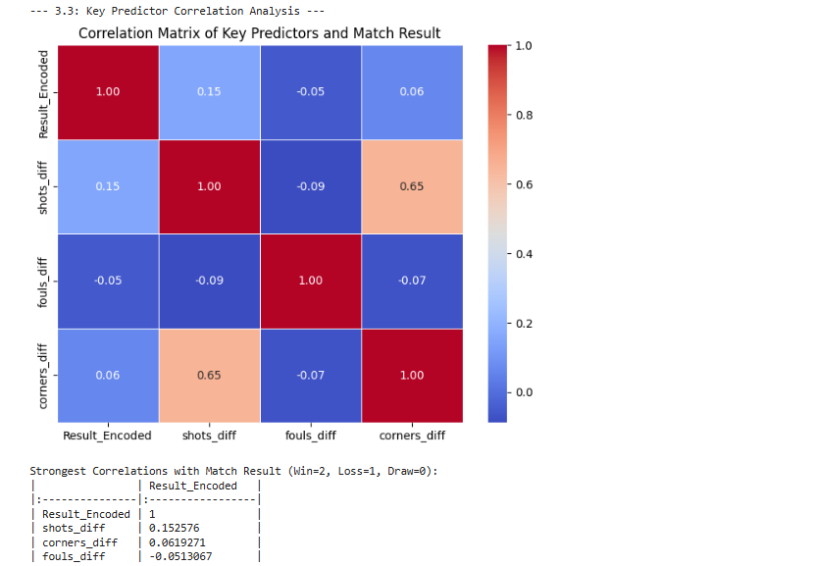
Finding 2: Static Predictors Are Weak
The EDA showed very low linear
correlation between static pre-
match attributes (Shots, Fouls,
Corners) and the final match outcome.
This empirically confirmed the need
to move beyond simple match statistics
and focus entirely on dynamic,
aggregated momentum metrics.

Slide 10
Finding 3: Momentum Proves Superior
Rolling Form Metrics are the Top 3 most influential predictors in the XGBoost model.
The model overwhelmingly relies on features engineered to capture recent form trend and momentum.
Critical Validation: This finding empirically proves the project's core hypothesis: Momentum is a significantly more potent predictor than a team's long-term average position or static stats.

Slide 11
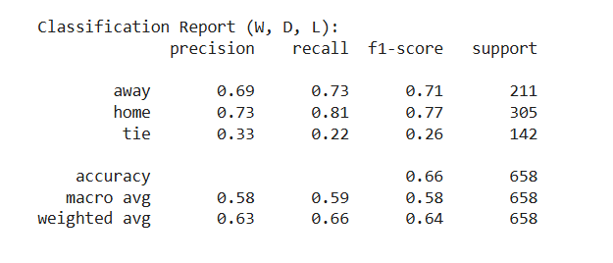
Performance Evaluation: Model Performance & Key Drivers (XGBoost)
Overall Accuracy: 66%
Baseline: 46.12% (Home Win Bias)
Improvement: +20% predictive power over the baseline.
Implication: The model successfully identifies Draw and Away Win scenarios that the baseline misses.
Key Takeaway: The model is highly
effective at predicting Wins/Losses
(F1 ~0.70+) but struggles to
distinguish Draws (F1 0.26), which is a
common challenge in sports analytics.

Slide 12
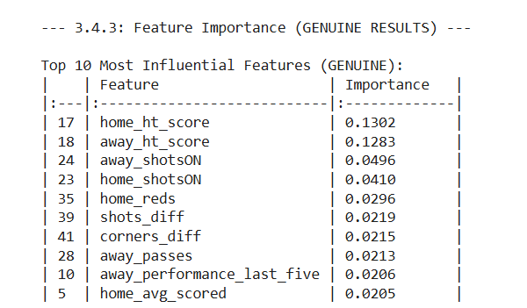
Key Finding: Top Predictive Features
Match State: Half-Time Scores (home_ht_score & away_ht_score) are the number 1 predictors.
Momentum: Shots on Target (shotsON) and Red Cards (reds) significantly impact the final whistle.
Form: Recent performance history
(performance_last_five) validates
the "Momentum" hypothesis.

Slide 13
Study Limitations & Ethical Considerations
Data Granularity: Model lacks crucial data like Expected Goals (xG), player tracking, and injury reports.
Draw Class: Still the most challenging outcome to predict accurately, suggesting more complex features are needed. Ethical Considerations:
Structural Bias: Model may perpetuate existing inequalities by favoring historically dominant teams.
Usage Disclaimer: The output is a statistical probability, not a guaranteed outcome.

Slide 14
Future Work & Recommendations
Feature Integration: Immediately incorporate xG and Player Injury Data to increase predictive power (Reference: Bandara et al., 2024).
Advanced Modeling: Explore LSTMs/RNNs to capture the temporal sequence and order of team momentum more deeply.
Deployment: Develop a user-friendly Streamlit/Flask Demo Application for practical visualization and analysis.

Slide 15
Conclusion: Summary & Implications
Q 1 (Static vs. Dynamic): Momentum features proved superior.
Q 2 (HA): Confirmed as a stable performance floor.
Q 3 (Temporal Integrity): Achieved robust, unbiased metrics via TSCV.
Final Implications:
The XGBoost model provides a stable and temporally valid framework for forecasting EPL outcomes.
Model is suitable for sophisticated analytical applications, financial risk management, and strategic betting models

Slide 16
References
  Bandara, I., Shelyag, S., Rajasegarar, S., Dwyer, D., Kim, E.-J., & Angelova, M. (2024). Predicting goal probabilities with improved xG models using event sequences in association football. PLOS ONE, 19(10), e0312278. https://doi.org/10.1371/journal.pone.0312278
  Constantinou, A. C., & Fenton, N. (2017). Towards smart-data: Improving predictive accuracy in long-term football team performance. *Knowledge-Based Systems, 124*, 93–104. https://doi.org/10.1016/j.knosys.2017.02.017
  Heuer, A., Müller, C., & Rubner, O. (2010). Soccer: Is scoring goals a predictable Poissonian process? EPL (Europhysics Letters), 89(3), 38007. https://doi.org/10.1209/0295-5075/89/38007
  Kosttsakul, G. (2025). Sport analytics data for player performance and financial risk management. Journal of Financial Risk Management, 14(3), 270–284. https://doi.org/10.4236/jfrm.2025.143015
  Pappalardo, L., Cintia, P., Rossi, A., Massucco, E., Ferragina, P., & Giannotti, F. (2019). A public data set of spatio-temporal match events in soccer competitions. Scientific Data, 6(1), 236. https://doi.org/10.1038/s41597-019-0247-7
  Wheatcroft, E. (2021). Forecasting football matches by predicting match statistics. Journal of Sports Analytics, 7(2), 1–48. https://doi.org/10.3233/JSA-200505

Slide 17
THANK YOU
Jocelyn John Mascarenhas
501345877

