Slide 1
Results:
Mouse Lung Data
Human patients 1-9

Slide 2
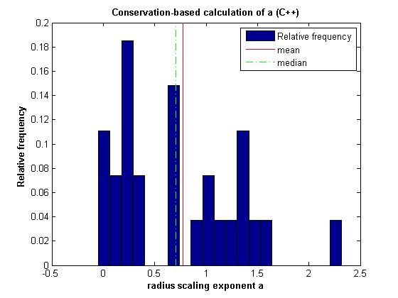
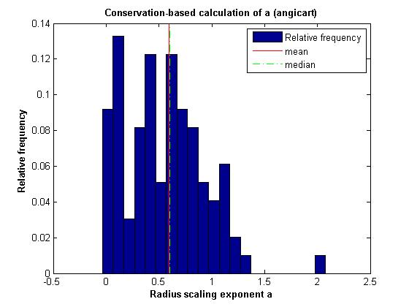
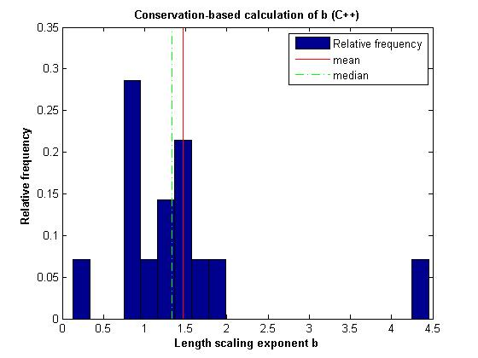
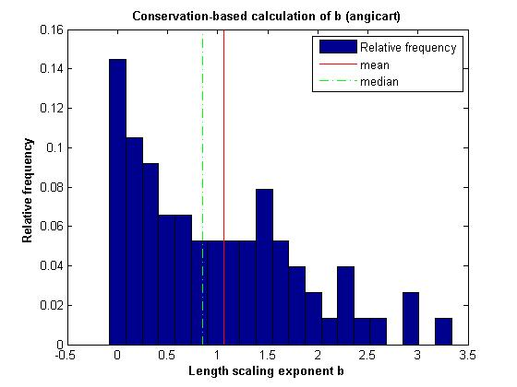
Conservation-based method
Human head and torso: patient 2

Slide 3
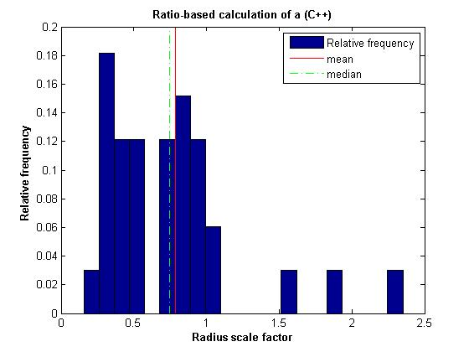
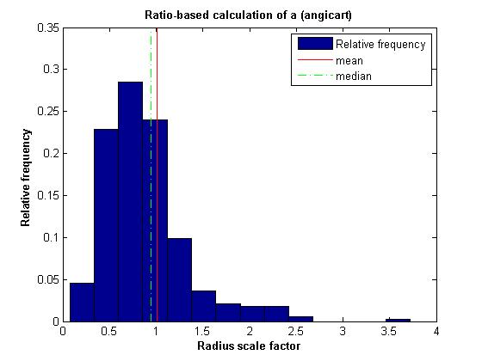
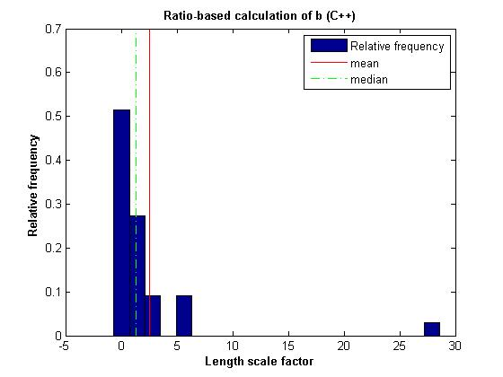
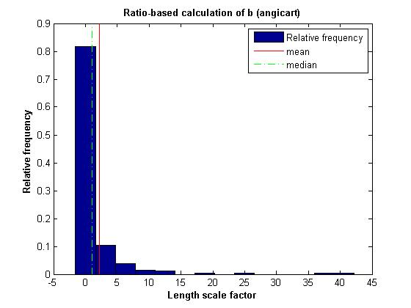
Ratio-based method
Human head and torso: patient 2

Slide 4
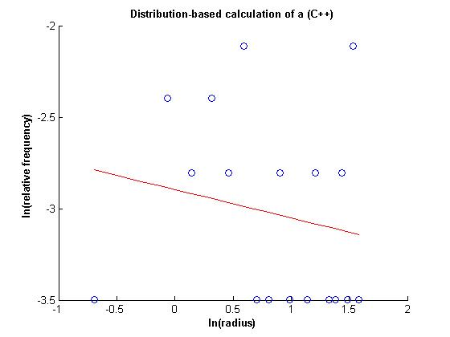
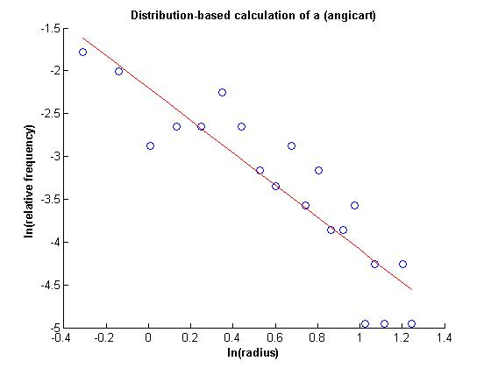
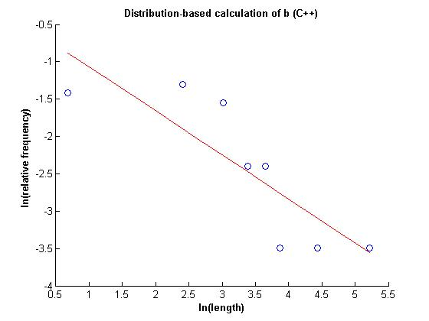
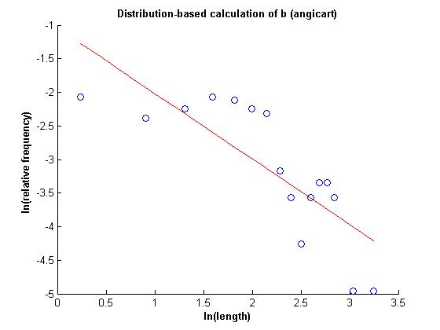
Distribution-based method
Human head and torso: patient 2

Slide 5
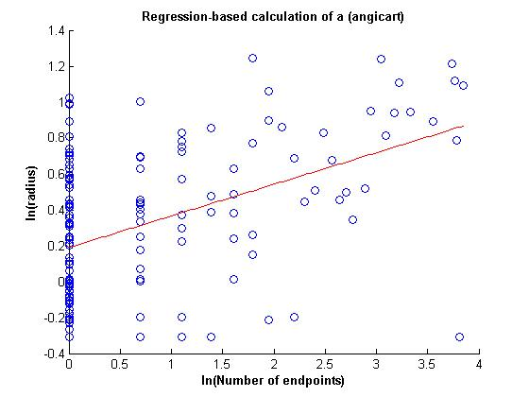
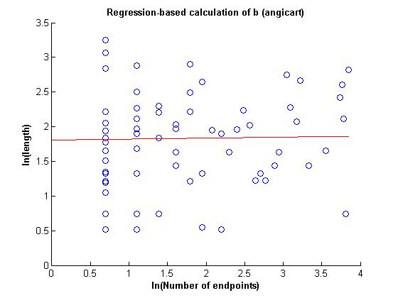
Regression-based method
Human head and torso: patient 2

Slide 6
Human Head and Torso: Patient 2
Radius exponent measures (C++)
 | N | a | 95% CI | σ | R²
Conservation | 27 | 0.78 | 0.22 | 0.6
Ratio | 33 | 0.34 | 0.15 | 0.45
Distribution | 29 | 6.44 | 0.5 |  | 0.04
Regression
Radius exponent measures (Angicart)
 | N | a | 95% CI | σ | R²
Conservation | 97 | 0.6 | 0.08 | 0.38
Ratio | 143 | 0.09 | 0.08 | 0.49
Distribution | 118 | 0.53 | 0.11 |  | 0.76
Regression | 142 | 0.18 | 0.1 |  | -0.64

Slide 7
Human Head and Torso: Patient 2
Length exponent measures (C++)
 | N | b | 95% CI | σ | R²
Conservation | 14 | 1.47 | 0.49 | 0.93
Ratio | 33 | -1.35 | 1.67 | 4.88
Distribution |  | 1.7 |  |  | 0.84
Regression
Length exponent measures (Angicart)
 | N | b | 95% CI | σ | R²
Conservation | 75 | 1.07 | 0.19 | 0.82
Ratio | 143 | -0.73 | 0.31 | 1.9
Distribution | 61 | 1.03 | 0.80 |  | 0.6
Regression | 142 | 0.02 | 0.12 |  | -0.01

Slide 8
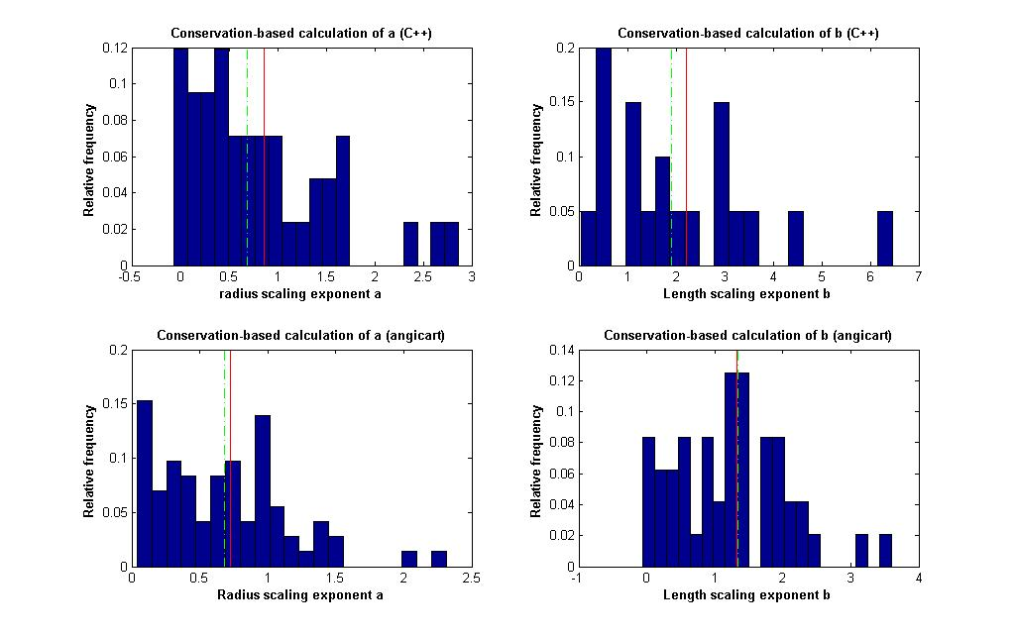
Conservation-based method
Human head and torso: patient 3

Slide 9
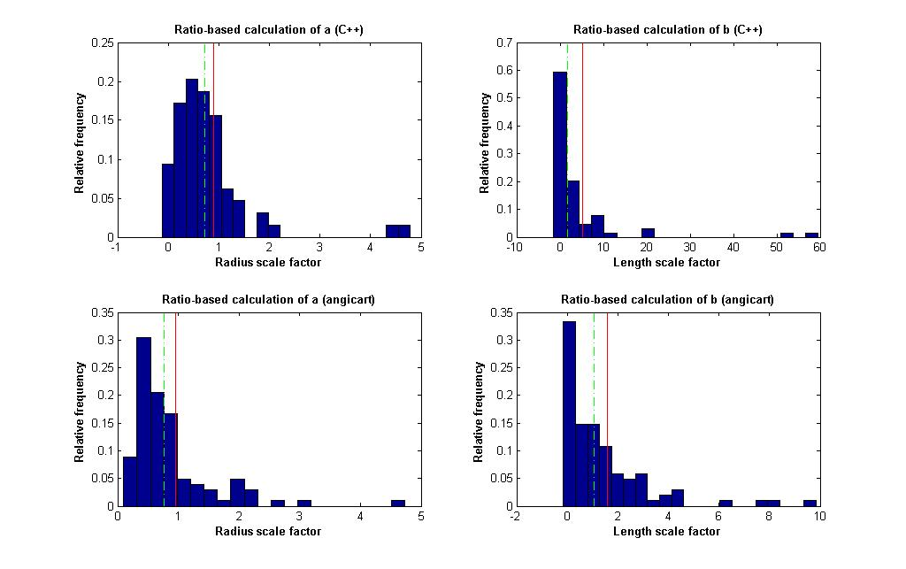
Ratio-based method
Human head and torso: patient 3

Slide 10
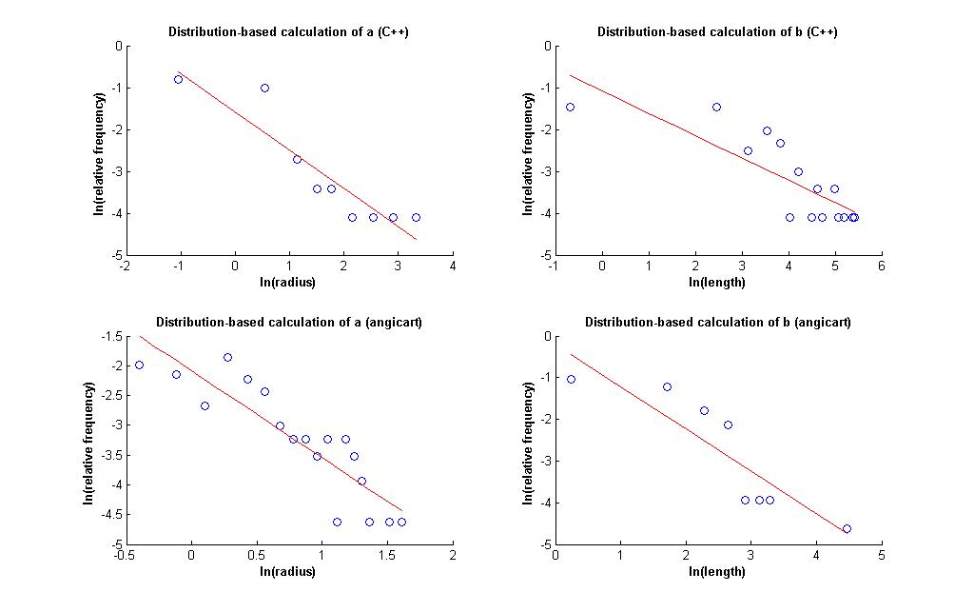
Distribution-based method
Human head and torso: patient 3

Slide 11
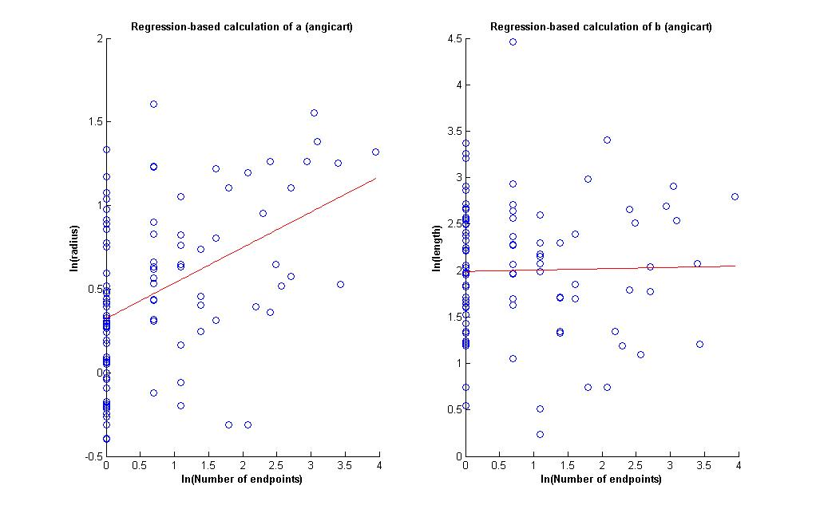
Regression-based method
Human head and torso: patient 3

Slide 12
Human Head and Torso: Patient 3
Radius exponent measures (C++)
 | N | a | 95% CI | σ | R²
Conservation | 42 | 0.87 | 0.22 | 0.72
Ratio | 62 | 0.17 | 0.2 | 0.83
Distribution | 2 | 1.09 | NaN |  | 0.64
Regression
Radius exponent measures (Angicart)
 | N | a | 95% CI | σ | R²
Conservation | 72 | 0.73 | 0.11 | 0.47
Ratio | 102 | 0.06 | 0.13 | 0.67
Distribution | 69 | 0.69 | 0.19 |  | 0.73
Regression | 102 | 0.21 | 0.11 |  | -0.3

Slide 13
Human Head and Torso: Patient 3
Length exponent measures (C++)
 | N | b | 95% CI | σ | R²
Conservation | 20 | 2.21 | 0.68 | 1.55
Ratio | 62 | -2.35 | 2.54 | 10.38
Distribution | 13 | 1.88 | 15.16 |  | -0.11
Regression
Length exponent measures (Angicart)
 | N | b | 95% CI | σ | R²
Conservation | 48 | 1.32 | 0.23 | 0.83
Ratio | 102 | -0.67 | 0.34 | 1.74
Distribution | 1 | 0.98 | NaN |  | 0.88
Regression | 102 | 0.01 | 0.15 |  | 0.0

Slide 14
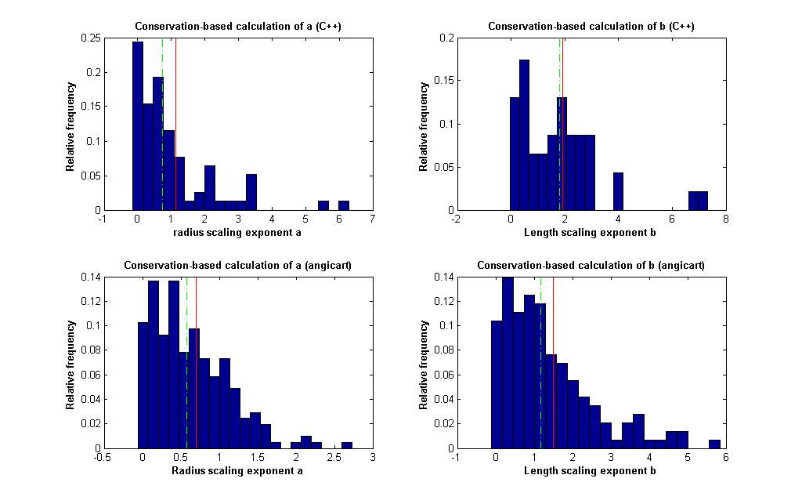
Conservation-based method
Human head and torso: patient 4

Slide 15
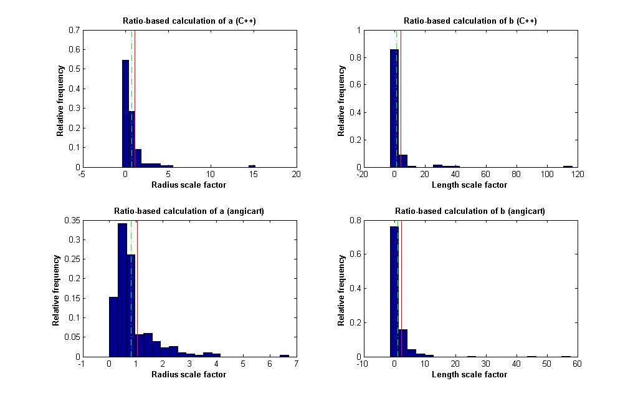
Ratio-based method
Human head and torso: patient 4

Slide 16
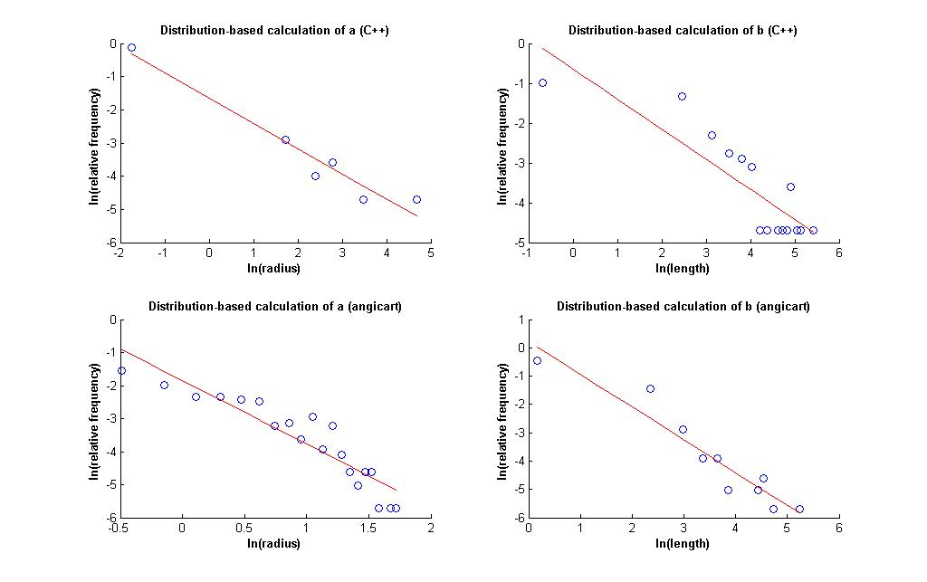
Distribution-based method
Human head and torso: patient 4

Slide 17
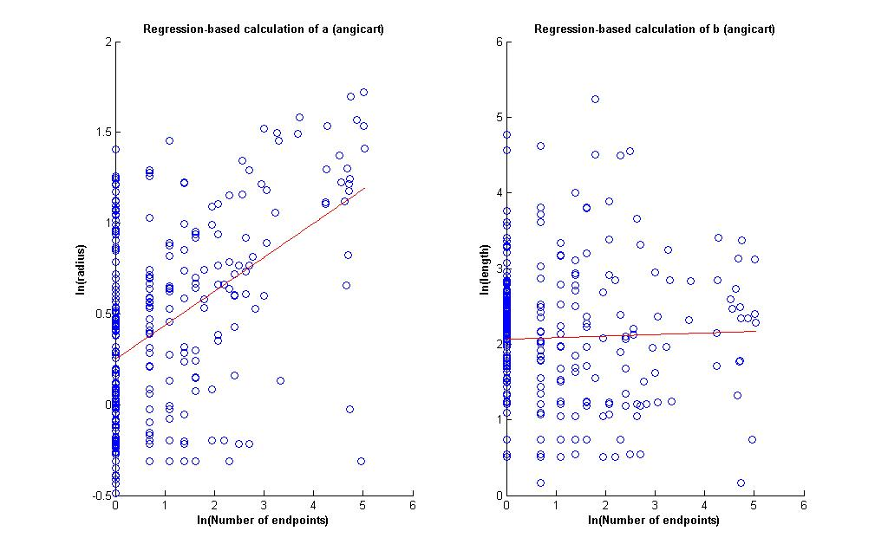
Regression-based method
Human head and torso: patient 4

Slide 18
Human Head and Torso: Patient 4
Radius exponent measures (C++)
 | N | a | 95% CI | σ | R²
Conservation | 78 | 1.15 | 0.27 | 1.21
Ratio | 110 | -0.08 | 0.3 | 1.62
Distribution | 1 | 1.31 | NaN |  | 0.58
Regression
Radius exponent measures (Angicart)
 | N | a | 95% CI | σ | R²
Conservation | 205 | 0.7 | 0.07 | 0.5
Ratio | 302 | -0.04 | 0.09 | 0.78
Distribution | 237 | 0.52 | 0.12 |  | 0.69
Regression | 302 | 0.19 | 0.09 |  | -0.51

Slide 19
Human Head and Torso: Patient 4
Length exponent measures (C++)
 | N | b | 95% CI | σ | R²
Conservation | 46 | 1.91 | 0.44 | 1.54
Ratio | 110 | -2.09 | 2.3 | 12.43
Distribution | 11 | 1.33 | 8.75 |  | -0.25
Regression
Length exponent measures (Angicart)
 | N | b | 95% CI | σ | R²
Conservation | 144 | 1.5 | 0.2 | 1.2
Ratio | 302 | -1.22 | 0.54 | 4.81
Distribution | 2 | 0.86 | NaN |  | 0.51
Regression | 302 | 0.02 | 0.1 |  | -0.01

Slide 20
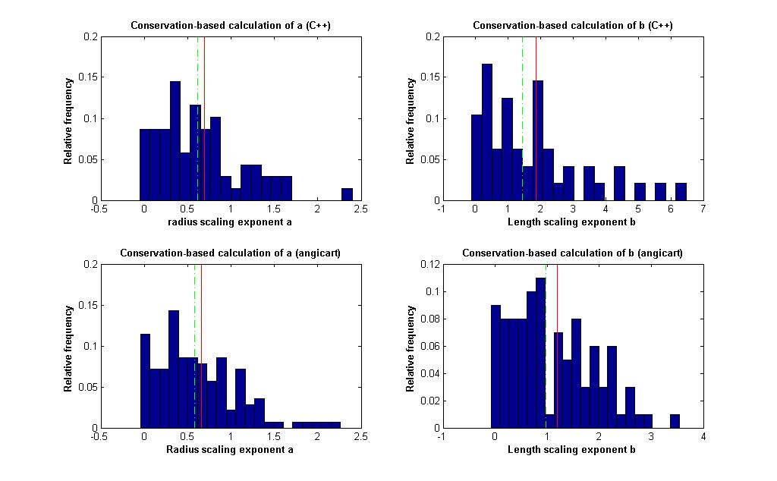
Conservation-based method
Human head and torso: patient 5

Slide 21
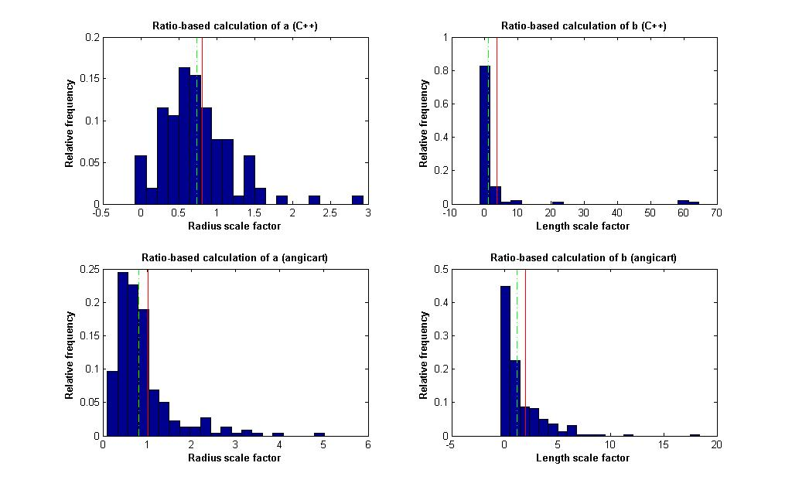
Ratio-based method
Human head and torso: patient 5

Slide 22
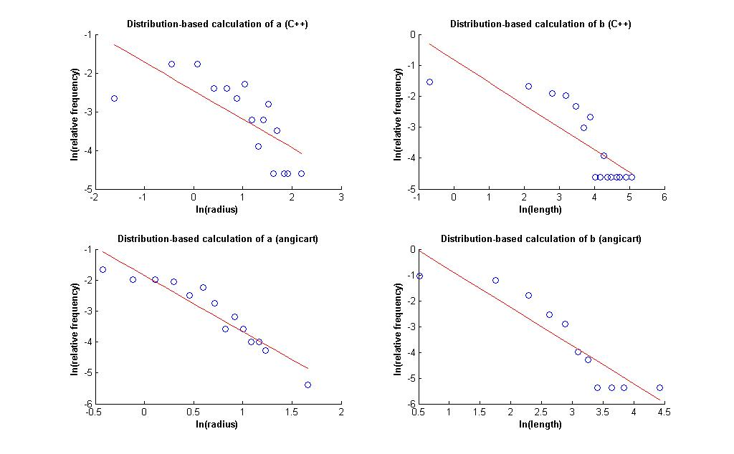
Distribution-based method
Human head and torso: patient 5

Slide 23
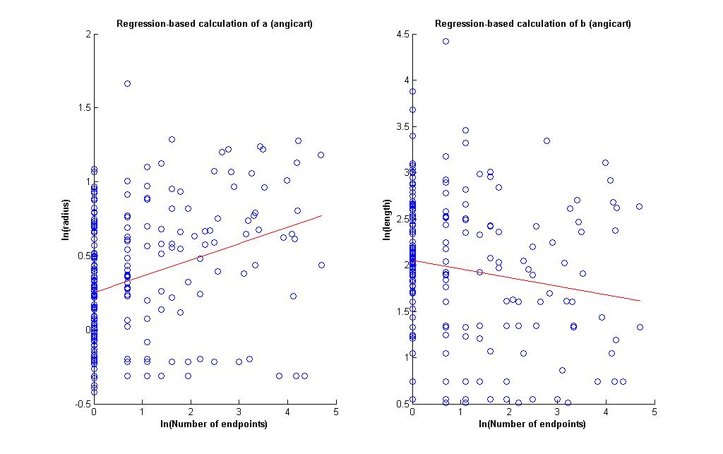
Regression-based method
Human head and torso: patient 5

Slide 24
Human Head and Torso: Patient 5
Radius exponent measures (C++)
 | N | a | 95% CI | σ | R²
Conservation | 69 | 0.69 | 0.12 | 0.49
Ratio | 102 | 0.3 | 0.09 | 0.47
Distribution | 40 | 1.36 | 0.34 |  | 0.5
Regression
Radius exponent measures (Angicart)
 | N | a | 95% CI | σ | R²
Conservation | 140 | 0.66 | 0.8 | 0.47
Ratio | 217 | -0.04 | 0.09 | 0.7
Distribution | 33 | 0.55 | 0.1 |  | 0.89
Regression | 217 | 0.11 | 0.1 |  | -0.18

Slide 25
Human Head and Torso: Patient 5
Length exponent measures (C++)
 | N | b | 95% CI | σ | R²
Conservation | 48 | 1.87 | 0.44 | 1.57
Ratio | 102 | -1.82 | 2.02 | 10.5
Distribution | 22 | 1.38 | 5.92 |  | 0.03
Regression
Length exponent measures (Angicart)
 | N | b | 95% CI | σ | R²
Conservation | 100 | 1.19 | 0.16 | 0.81
Ratio | 217 | -0.95 | 0.3 | 2.25
Distribution | 2 | 0.68 | Inf |  | 0.79
Regression | 217 | -0.09 | 0.11 |  | -0.11

Slide 26
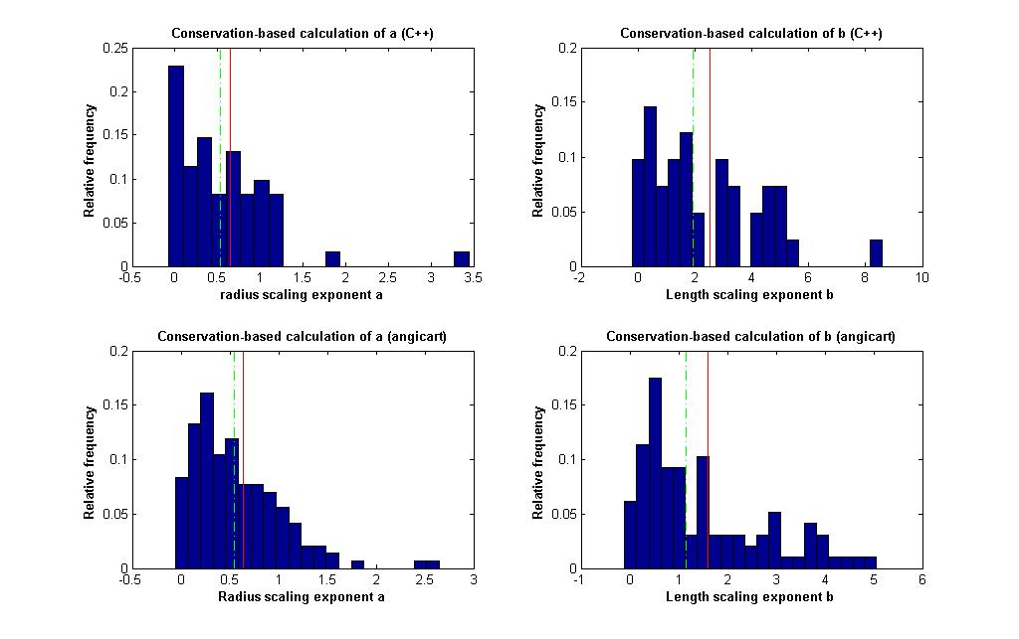
Conservation-based method
Human head and torso: patient 7

Slide 27
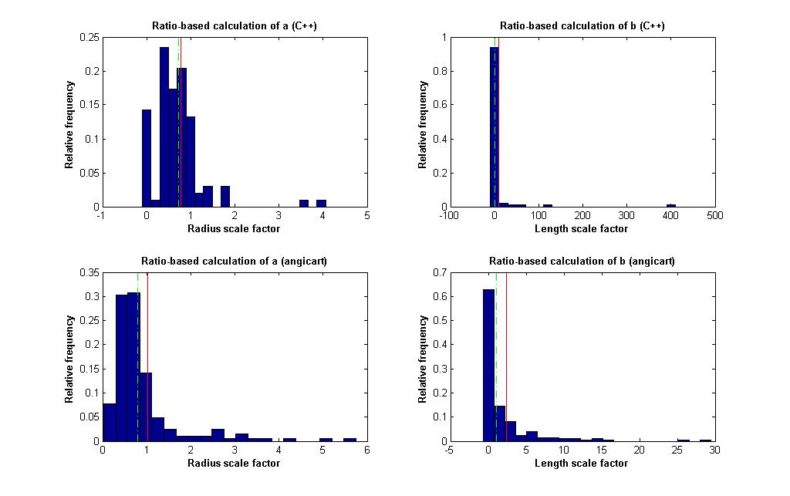
Ratio-based method
Human head and torso: patient 7

Slide 28
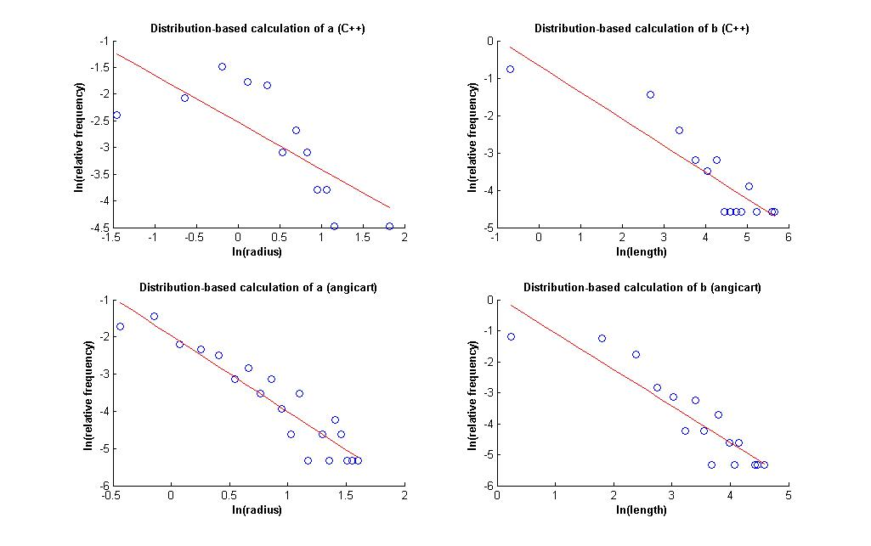
Distribution-based method
Human head and torso: patient 7

Slide 29
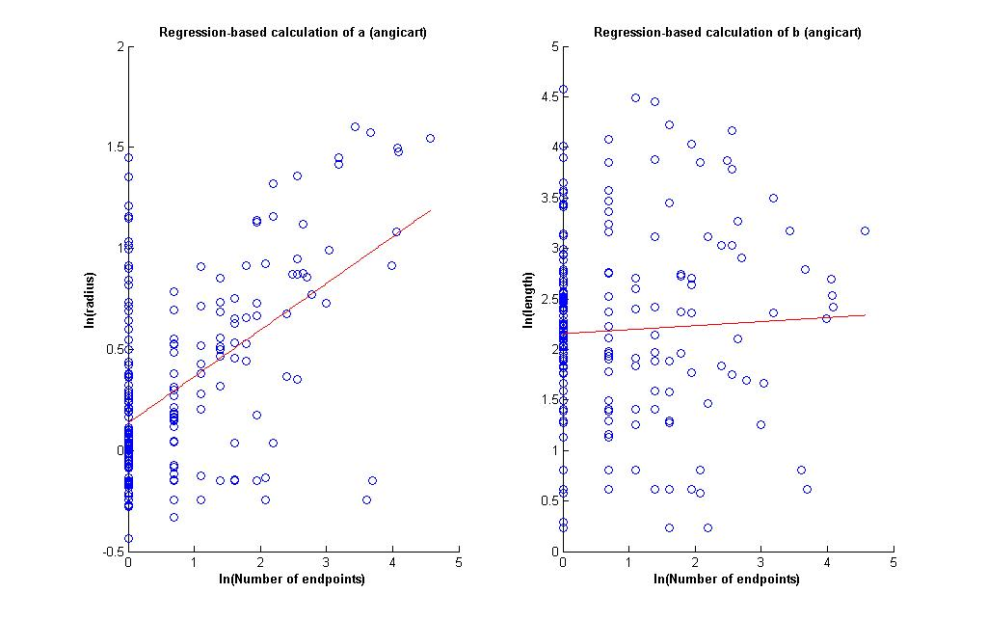
Regression-based method
Human head and torso: patient 7

Slide 30
Human Head and Torso: Patient 7
Radius exponent measures (C++)
 | N | a | 95% CI | σ | R²
Conservation | 61 | 0.64 | 0.14 | 0.56
Ratio | 96 | 0.37 | 0.12 | 0.62
Distribution | 4 | 1.13 | 0.39 |  | 0.75
Regression
Radius exponent measures (Angicart)
 | N | a | 95% CI | σ | R²
Conservation | 143 | 0.64 | 0.08 | 0.46
Ratio | 205 | -0.03 | 0.11 | 0.81
Distribution | 168 | 0.49 | 0.12 |  | 0.65
Regression | 205 | 0.23 | 0.09 |  | -0.78

Slide 31
Human Head and Torso: Patient 7
Length exponent measures (C++)
 | N | b | 95% CI | σ | R²
Conservation | 41 | 2.54 | 0.6 | 1.96
Ratio | 99 | -3.19 | 8.21 | 42.11
Distribution | 8 | 1.4 | 12.86 |  | -0.26
Regression
Length exponent measures (Angicart)
 | N | b | 95% CI | σ | R²
Conservation | 97 | 1.61 | 0.25 | 1.28
Ratio | 205 | -1.25 | 0.53 | 3.9
Distribution | 28 | 0.85 | 0.9 |  | 0.17
Regression | 205 | 0.04 | 0.12 |  | -0.03

Slide 32
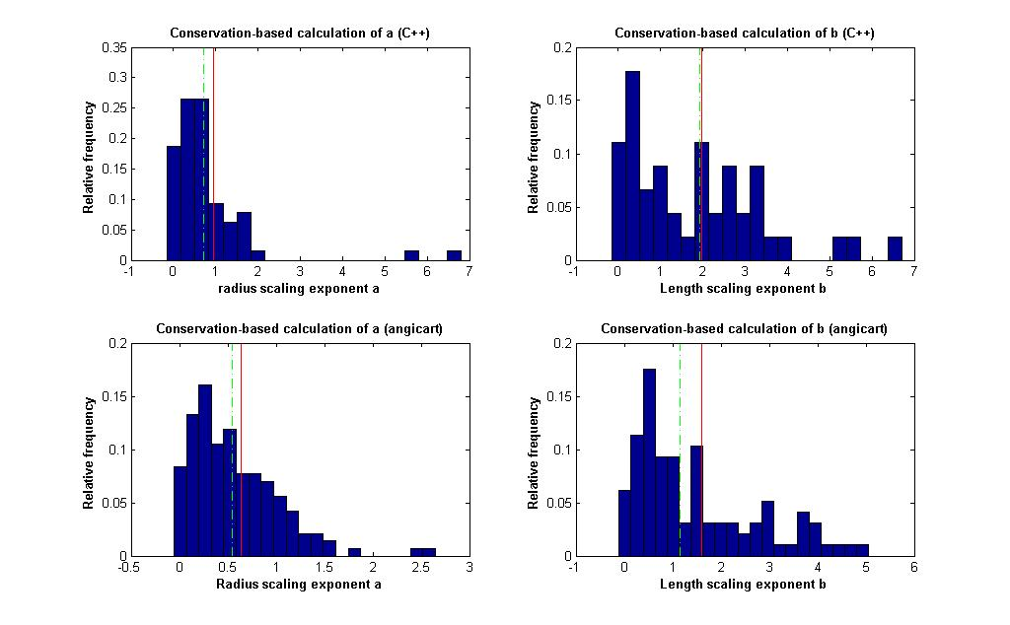
Conservation-based method
Human head and torso: patient 8

Slide 33
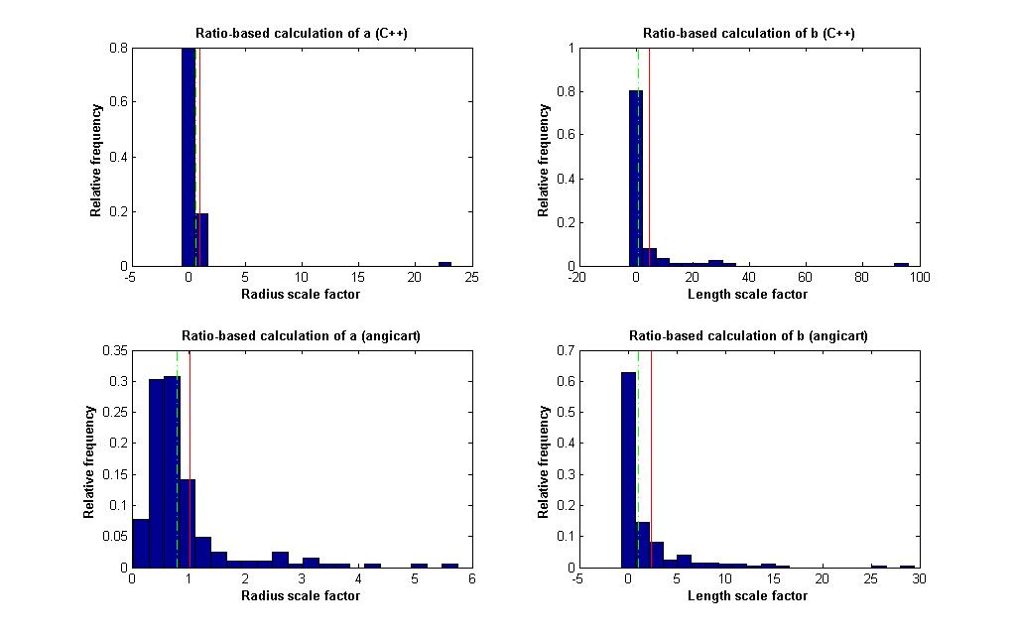
Ratio-based method
Human head and torso: patient 8

Slide 34
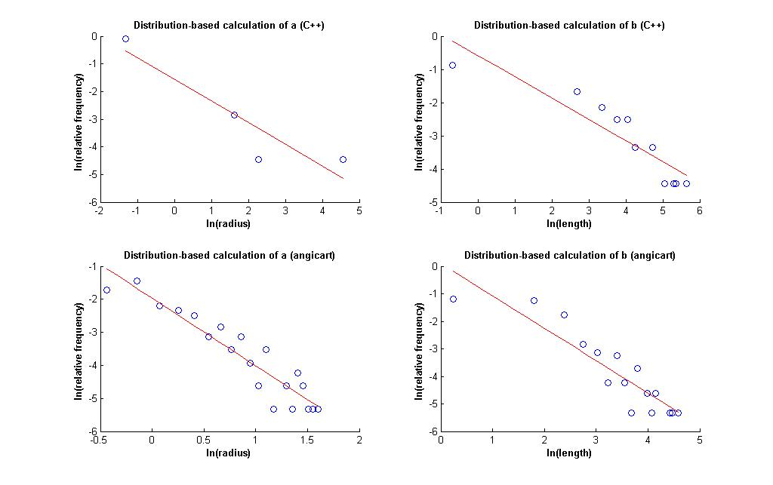
Distribution-based method
Human head and torso: patient 8

Slide 35
Regression-based method
Human head and torso: patient 8

Slide 36
Human Head and Torso: Patient 8
Radius exponent measures (C++)
 | N | a | 95% CI | σ | R²
Conservation | 64 | 0.95 | 0.27 | 1.08
Ratio | 87 | 0.0 | 0.49 | 2.36
Distribution | 1 | 1.27 | NaN |  | 0.84
Regression
Radius exponent measures (Angicart)
 | N | a | 95% CI | σ | R²
Conservation | 143 | 0.64 | 0.08 | 0.46
Ratio | 205 | -0.03 | 0.11 | 0.81
Distribution | 168 | 0.49 | 0.12 |  | 0.65
Regression | 205 | 0.23 | 0.09 |  | -0.78

Slide 37
Human Head and Torso: Patient 8
Length exponent measures (C++)
 | N | b | 95% CI | σ | R²
Conservation | 45 | 1.98 | 10.45 | 1.56
Ratio | 84 | -2.2 | 2.54 | 12.04
Distribution | 4 | 1.56 | 22.9 |  | 0.32
Regression
Length exponent measures (Angicart)
 | N | b | 95% CI | σ | R²
Conservation | 97 | 1.61 | 0.25 | 1.28
Ratio | 205 | -1.25 | 0.53 | 3.9
Distribution | 28 | 0.85 | 2.25 |  | 0.17
Regression | 205 | 0.04 | 0.12 |  | -0.03

Slide 38
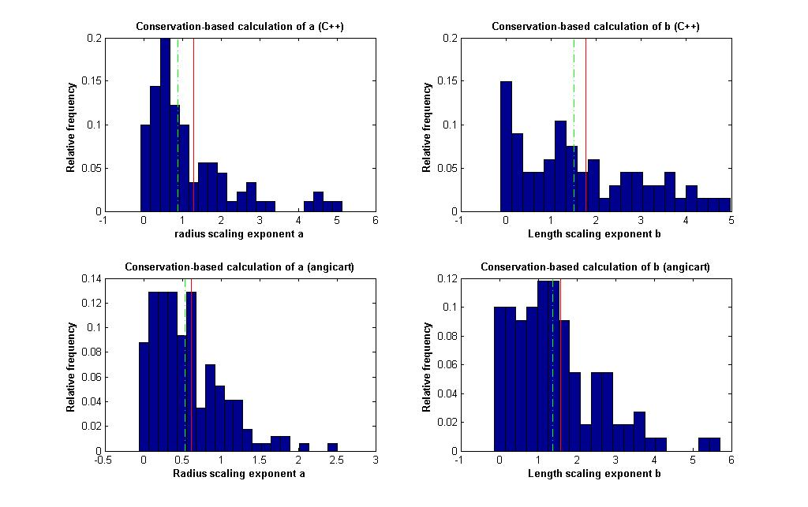
Conservation-based method
Human head and torso: patient 9

Slide 39
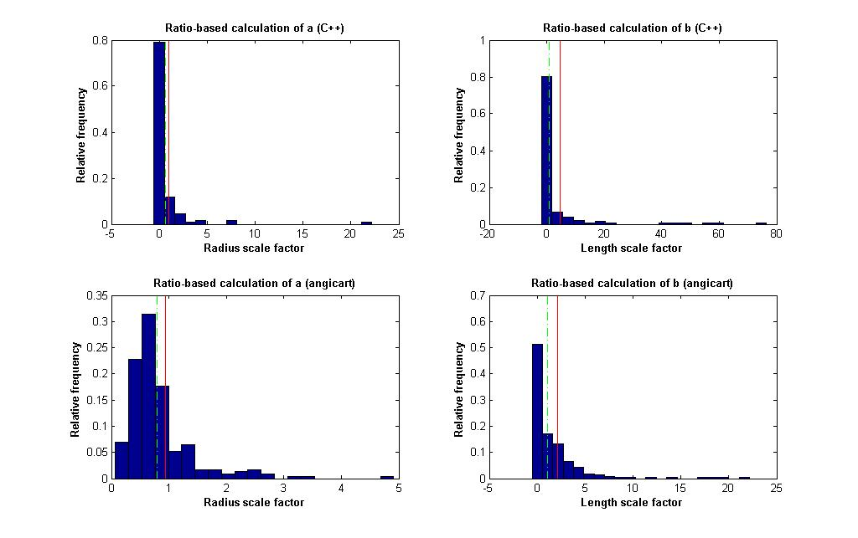
Ratio-based method
Human head and torso: patient 9

Slide 40
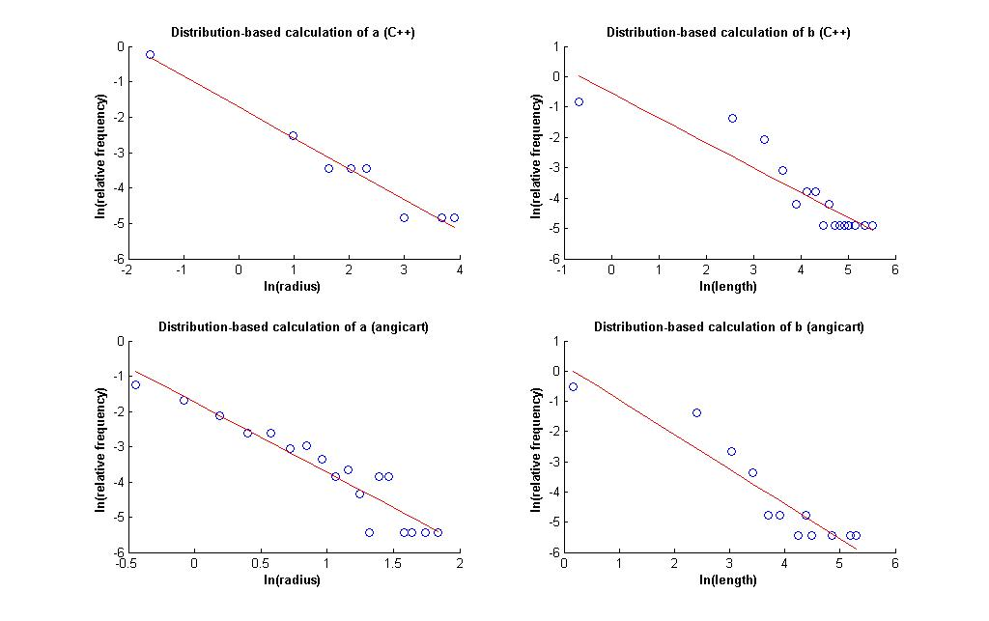
Distribution-based method
Human head and torso: patient 9

Slide 41
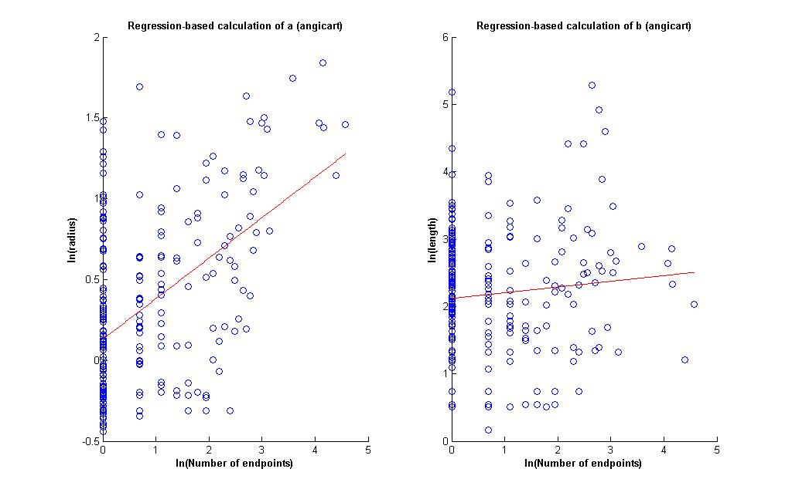
Regression-based method
Human head and torso: patient 9

Slide 42
Human Head and Torso: Patient 9
Radius exponent measures (C++)
 | N | a | 95% CI | σ | R²
Conservation | 90 | 1.31 | 0.24 | 1.14
Ratio | 132 | -0.04 | 0.36 | 2.15
Distribution | 2 | 1.15 | Inf |  | 0.52
Regression
Radius exponent measures (Angicart)
 | N | a | 95% CI | σ | R²
Conservation | 171 | 0.62 | 0.07 | 0.45
Ratio | 232 | 0.09 | 0.08 | 0.59
Distribution | 94 | 0.5 | 0.14 |  | 0.7
Regression | 232 | 0.25 | 0.08 |  | -0.75

Slide 43
Human Head and Torso: Patient 9
Length exponent measures (C++)
 | N | b | 95% CI | σ | R²
Conservation | 67 | 1.78 | 0.33 | 1.36
Ratio | 134 | -2.24 | 2.01 | 11.96
Distribution | 16 | 1.22 | 7.69 |  | -0.47
Regression
Length exponent measures (Angicart)
 | N | b | 95% CI | σ | R²
Conservation | 110 | 1.58 | 0.21 | 1.14
Ratio | 232 | -1.08 | 0.41 | 3.15
Distribution | 4 | 0.87 | 6.37 |  | 0.22
Regression | 232 | 0.08 | 0.11 |  | -0.06

Slide 44
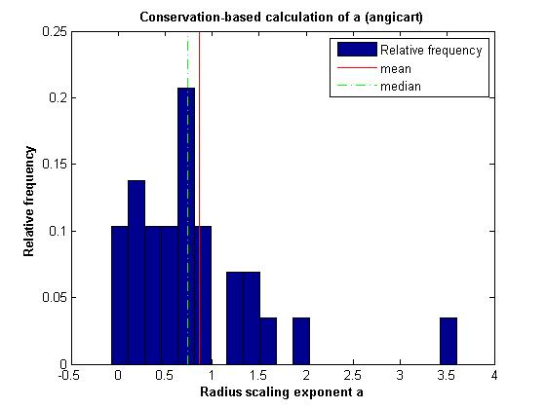
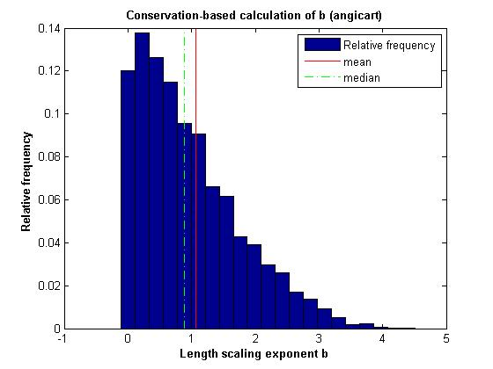
Conservation-based method
Mouse Lung

Slide 45
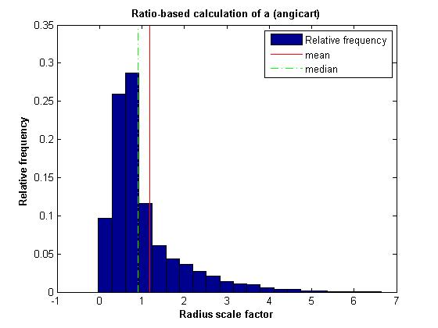
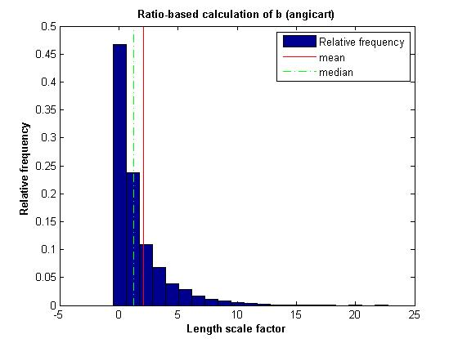
Ratio-based method
Mouse Lung

Slide 46
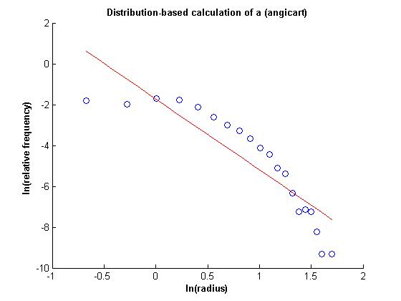
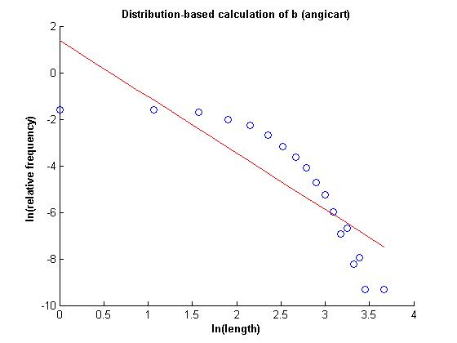
Distribution-based method
Mouse Lung

Slide 47
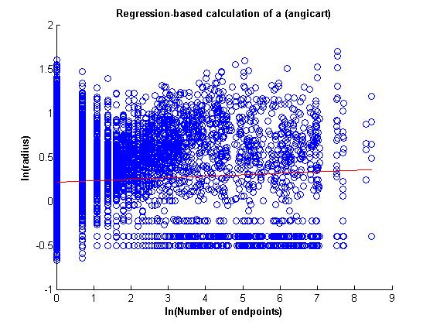
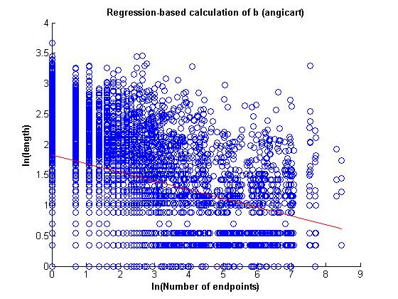
Regression-based method
Mouse Lung

Slide 48
Mouse Lung (20 bins)
Radius exponent measures (Angicart)
 | N | a | 95% CI | σ | R²
Conservation | 6449 | 0.64 | 0.01 | 0.5
Ratio | 11195 | 0.56 | 0.00 | 0.2
Distribution | 9338 | 0.29 | 0.01 |  | 0.70
Regression | 11195 | 0.02 | 0.02 |  | -0.01

Slide 49
Mouse Lung (20 bins)
Length exponent measures (Angicart)
 | N | b | 95% CI | σ | R²
Conservation | 4409 | 1.07 | 0.02 | 0.8
Ratio | 11195 | 0.88 | 0.01 | 0.24
Distribution | 4586 | 0.41 | 0.08 |  | 0.51
Regression | 11195 | -0.14 | 0.02 |  | -0.71

Slide 50
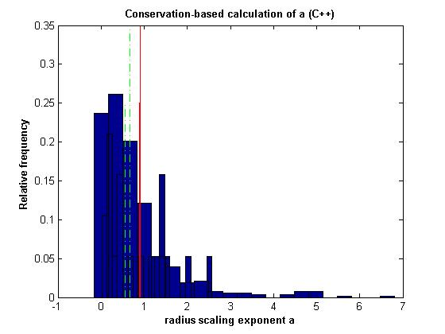
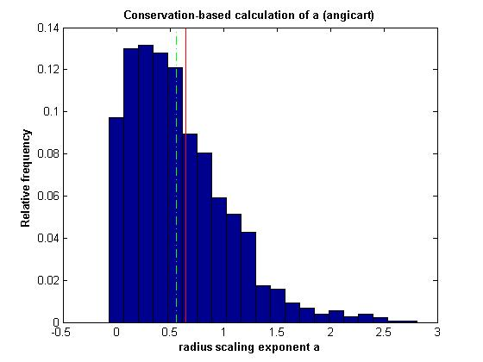
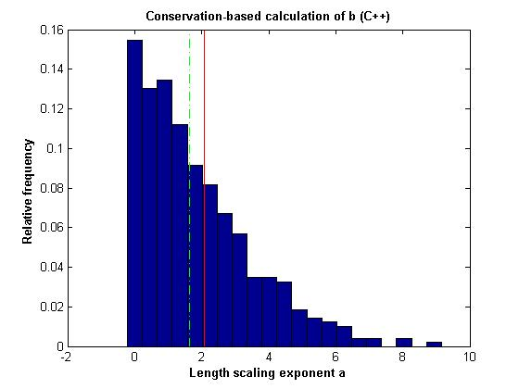
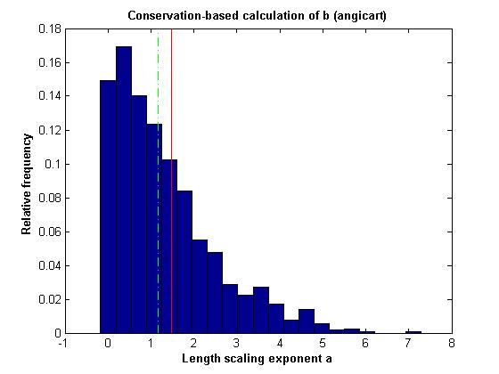
Conservation-based method

Slide 51
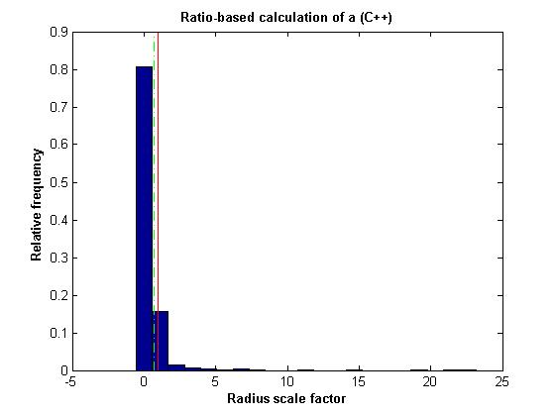



Ratio-based method

Slide 52




Distribution-based method

Slide 53




Regression-based method

Slide 54
Human Head and Torso
Radius exponent measures (C++)
 | N | a | 95% CI | σ | R²
Conservation | 763 | 0.92 | 0.01 | 0.91
Ratio | 1051 | 0.07 | 0.01 | 1.46
Distribution | 11 | 0.59 | 1.68 |  | 0.01
Regression | 1058 | 0.4 | 0.4 |  | 0.2
Radius exponent measures (Angicart)
 | N | a | 95% CI | σ | R²
Conservation | 1776 | 0.65 | 0.02 | 0.46
Ratio | 2585 | -0.02 | 0.01 | 0.75
Distribution | 20 | 0.27 | 3.77 |  | 0.5
Regression | 2585 | 0.26 | 0.26 |  | 0.3

Slide 55
Human Head and Torso
Length exponent measures (C++)
 | N | b | 95% CI | σ | R²
Conservation | 491 | 2.07 | 0.01 | 1.67
Ratio | 1084 | -2.7 | 0.00 | 26.87
Distribution | 15 | 1.02 | 0.98 |  | 0.02
Regression | 1089 | 0.99 | 0.99 |  | 0
Length exponent measures (Angicart)
 | N | b | 95% CI | σ | R²
Conservation | 1213 | 1.48 | 0.01 | 1.19
Ratio | 2585 | -1.15 | 0.00 | 3.8
Distribution | 19 | 0.73 | 1.37 |  | 0.31
Regression | 2585 | 0.83 | 0.83 |  | 0

