Slide 1
Biomathematics:
Comparing Healthy and Diseased Vascular Networks to Better Understand Pathologies

Slide 2

Personal Background
Interested in:
Biomechanical engineering
Robotics
Biology
Computer science
Software design
I became interested in this program because I really love math, computer science, and biology, so biomathematics seemed like the best fit.

Slide 3
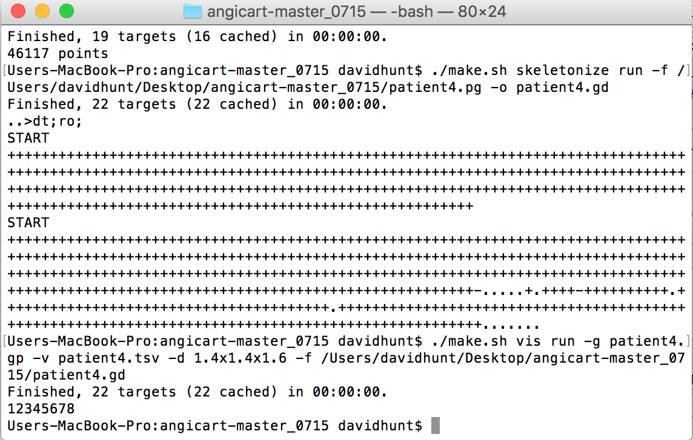
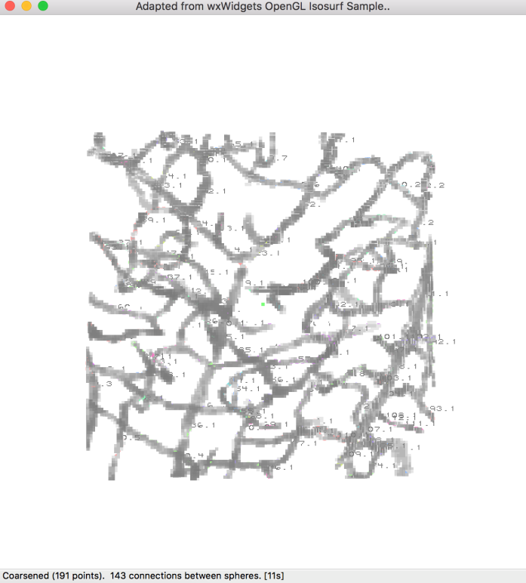
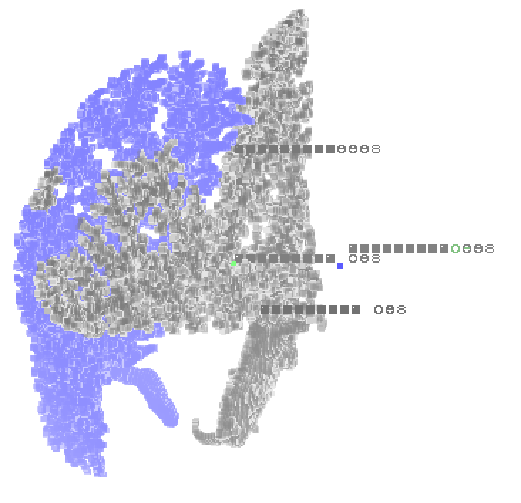
Vascular networks
Why scaling relationships within vascular networks are important:
Can be used to calculate metabolic rate, drug delivery rate, tumor growth, and could potentially reveal insight on stroke recovery
Tasks:
Learned about scaling exponents, original models, and original methods of vessel extraction (obtaining data on physical properties of a vascular network i.e. radius and length of vessels)
Compared data from two software, which utilize image processing to obtain data on vascular networks: Angicart and a version written in C++

Slide 4
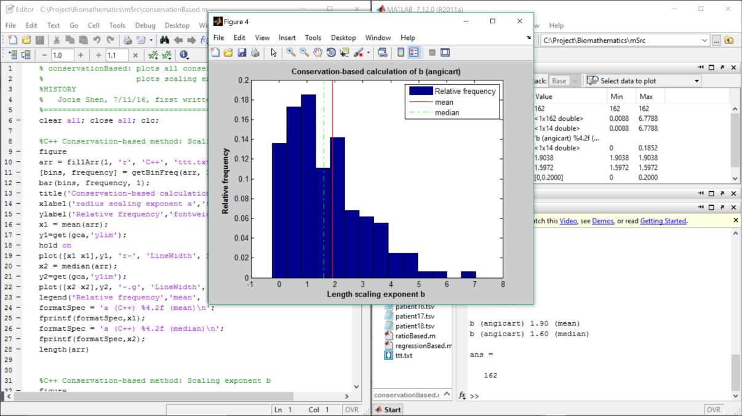
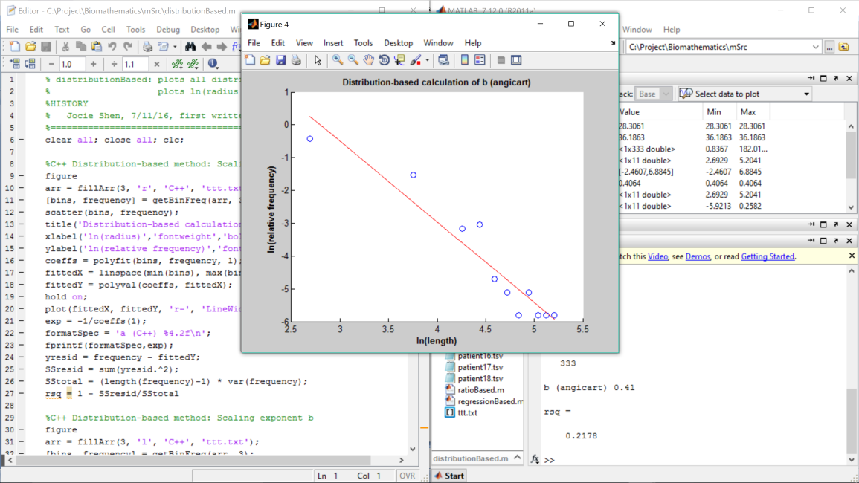
Vascular networks
Learned about the four different methods to calculate scaling exponents:
Conservation-based
Ratio-based
Distribution-based
Regression-based
Wrote MATLAB scripts to plot data and determine scaling exponents based on these four methods

Slide 5
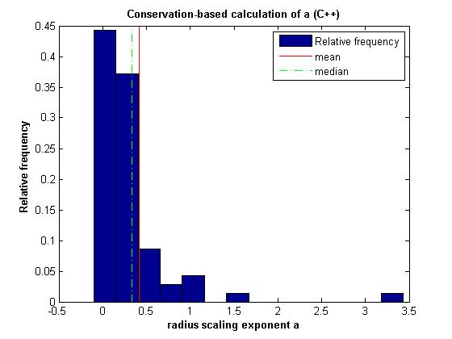
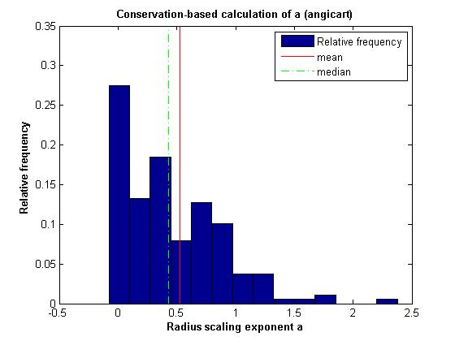
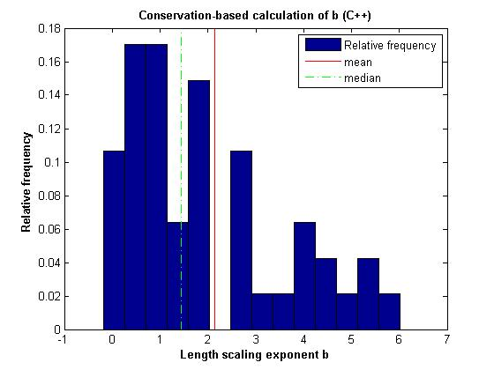
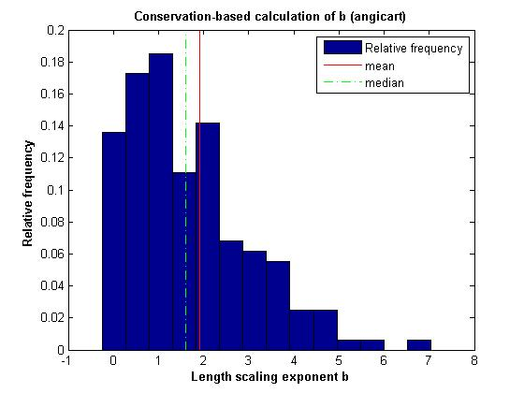
Conservation-based method
Sample Data

Slide 6
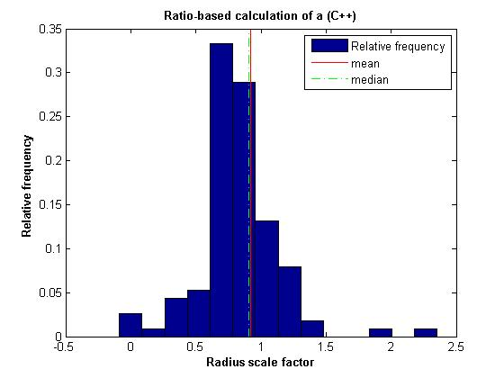
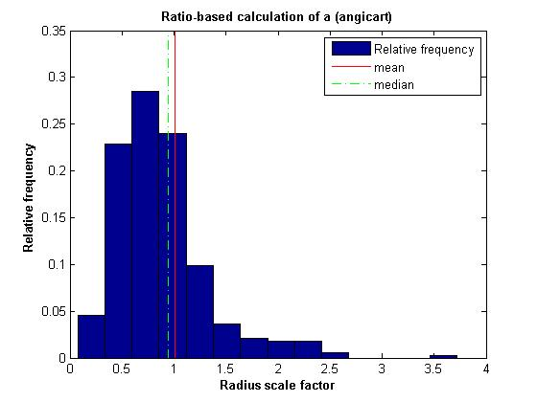
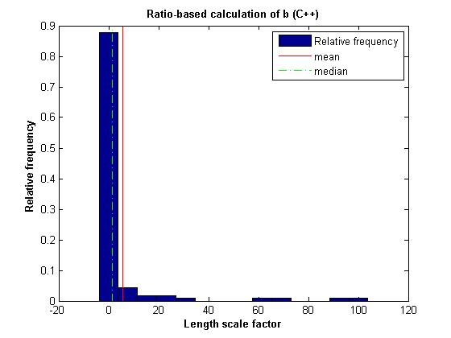
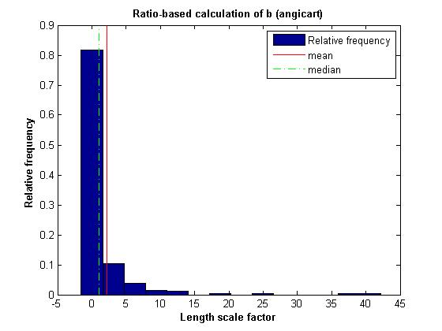
Ratio-based method
Sample Data

Slide 7
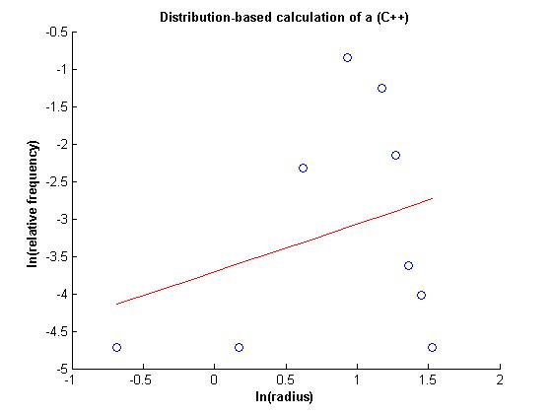
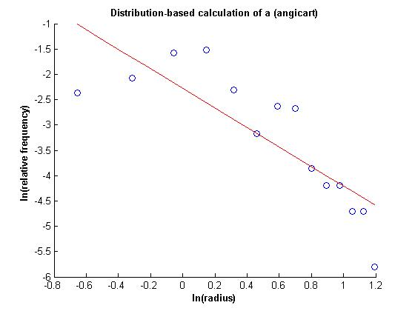
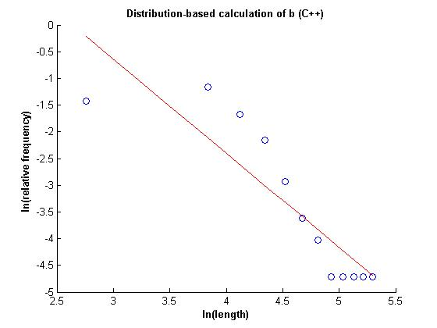
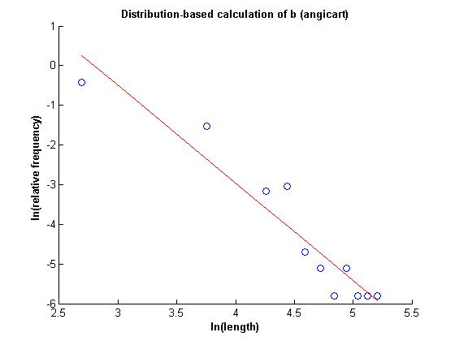
Distribution-based method
Sample Data

Slide 8
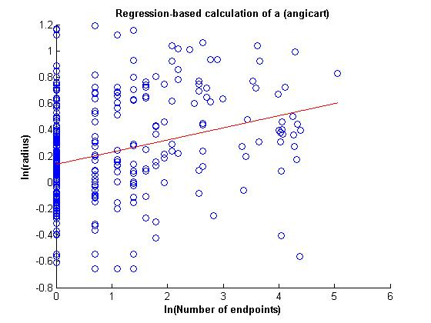
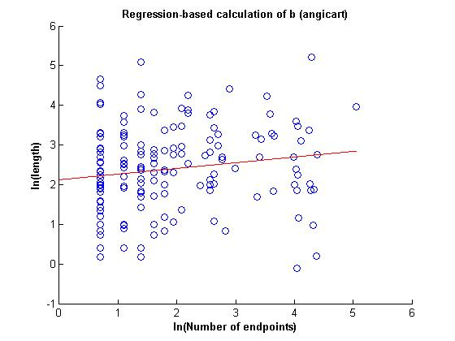
Regression-based method
Sample Data

Slide 9
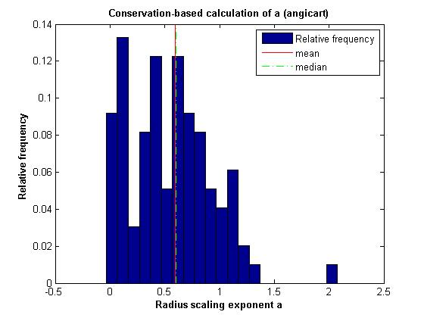
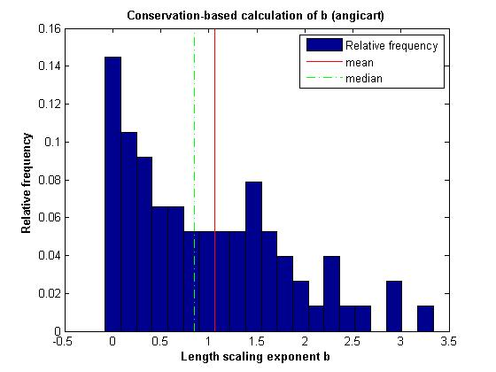
Conservation-based method
Human head and torso: patient 2

Slide 10
Radius exponent measures (C++)
 | N | a | 95% CI | σ | R²
Conservation
Ratio
Distribution
Regression
Radius exponent measures (Angicart)
 | N | a | 95% CI | σ | R²
Conservation | 98 | 0.6 | 0.0755 | 0.3814
Ratio
Distribution
Regression

Slide 11
Length exponent measures (C++)
 | N | b | 95% CI | σ | R²
Conservation
Ratio
Distribution
Regression
Length exponent measures (Angicart)
 | N | b | 95% CI | σ | R²
Conservation | 76 | 1.06 | 0.1851 | 0.8233
Ratio
Distribution
Regression

Slide 12
Radius exponent measures (C++)
 | N | a | 95% CI | σ | R²
Conservation | 70 | 0.42 | 0. 1091 | 0.4657
Ratio | 72 | 0.38 | 0.1079 | 0.4639
Distribution | 112 | -1.57 |  |  | -0.1707
Regression
Radius exponent measures (Angicart)
 | N | a | 95% CI | σ | R²
Conservation | 189 | 0.53 | 0.0602 | 0.4220
Ratio | 189 | 0.47 | 0.0602 | 0.4220
Distribution | 333 | 0.52 |  |  | 0.7068
Regression | 333 | 0.09 |  |  | -0.2223

Slide 13
Length exponent measures (C++)
 | N | b | 95% CI | σ | R²
Conservation | 47 | 2.14 | 0.4782 | 1.6727
Ratio | 49 | 1.49 | 0.4695 | 1.6597
Distribution | 112 | 0.57 |  |  | 0.4357
Regression
Length exponent measures (Angicart)
 | N | b | 95% CI | σ | R²
Conservation | 162 | 1.9 | 0.2101 | 1.3644
Ratio | 162 | 1.42 | 0.2101 | 1.3644
Distribution | 333 | 0.41 |  |  | 0.2178
Regression | 333 | 0.14 |  |  | -0.0805

Slide 14
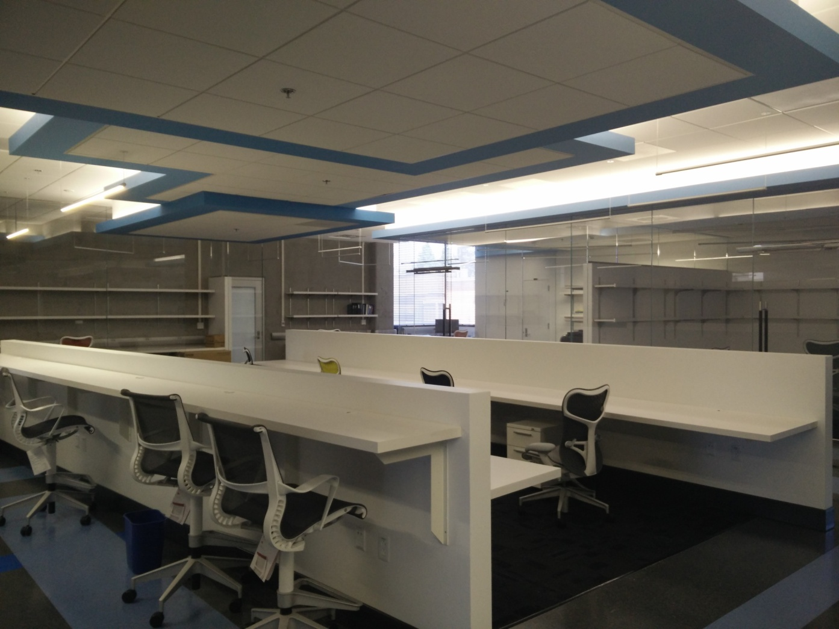
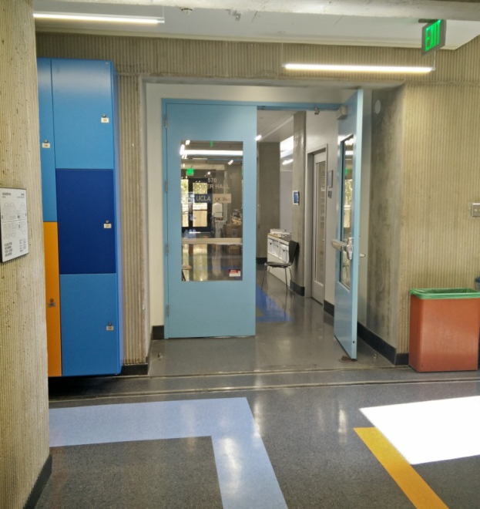
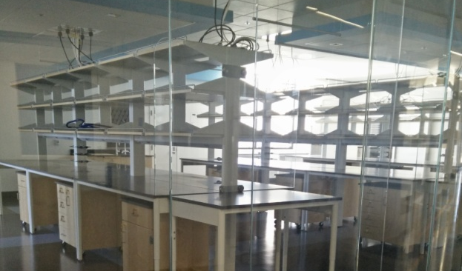
Workplace: Boyer Hall

Slide 15
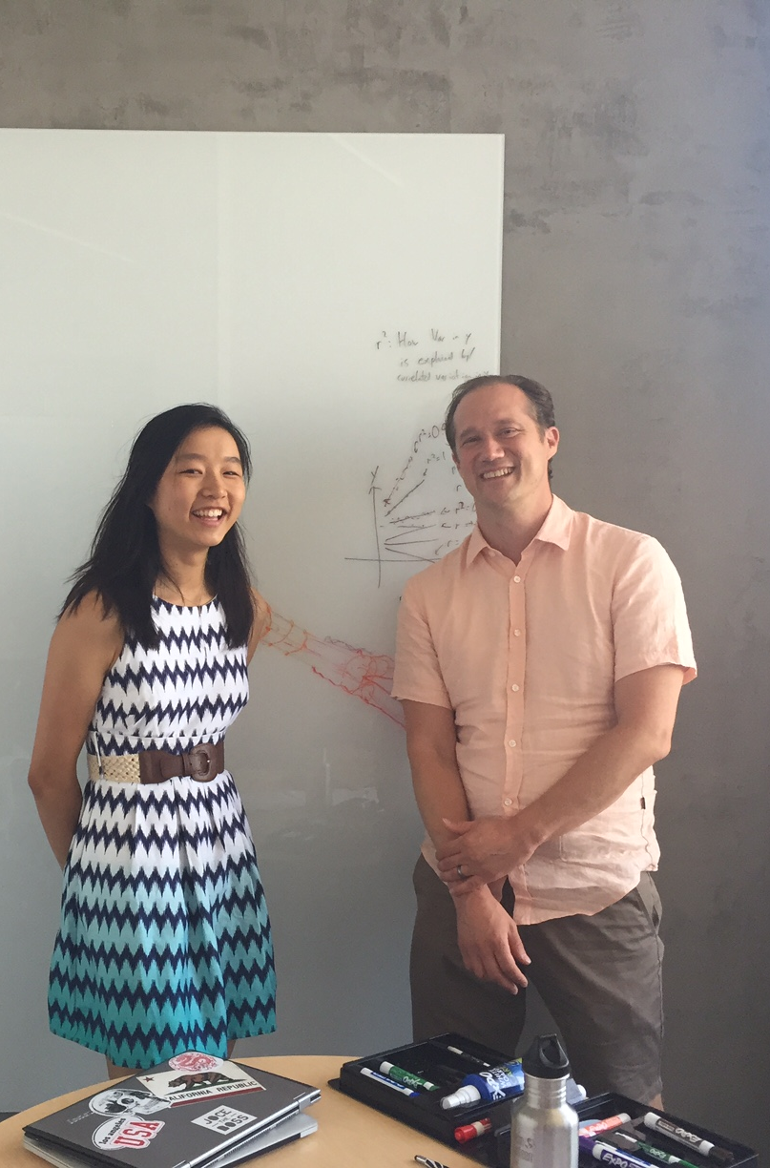
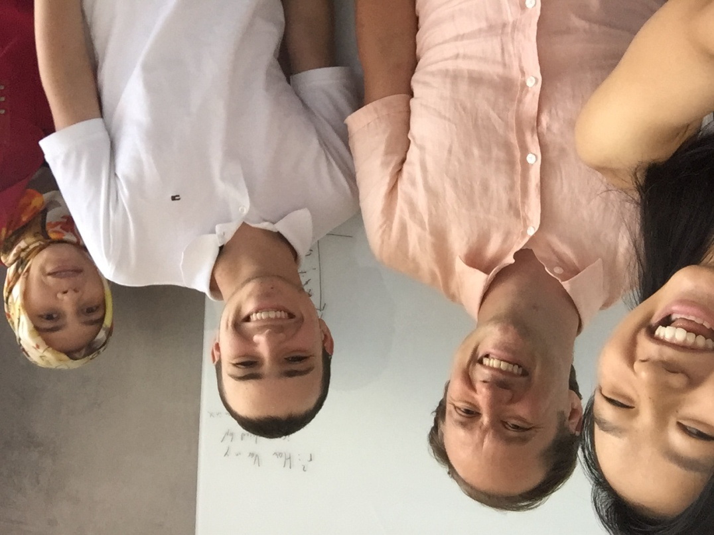
Acknowledgements
Thanks to my mentors, Dr. Savage and Elif for helping with this research. I appreciate the time and resources you spent teaching me.

