Slide 1
Comparing Healthy and Diseased Vascular Networks to Better Understand Pathologies

Slide 2
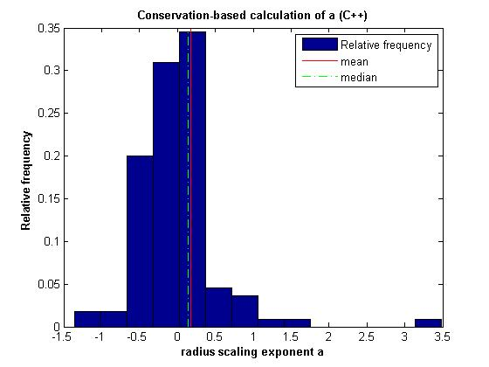
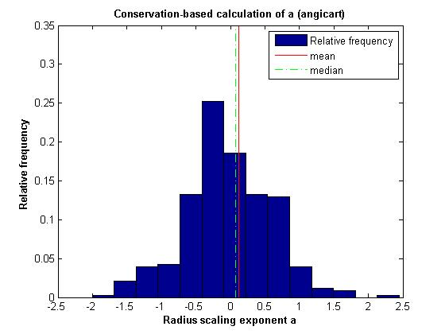
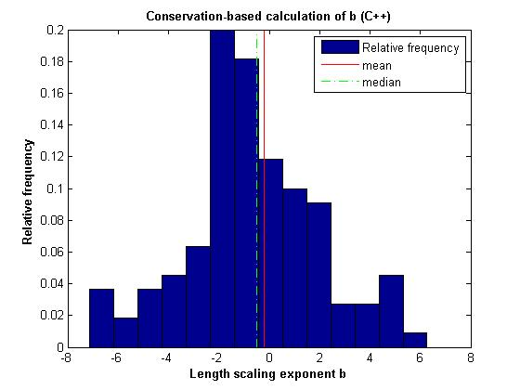
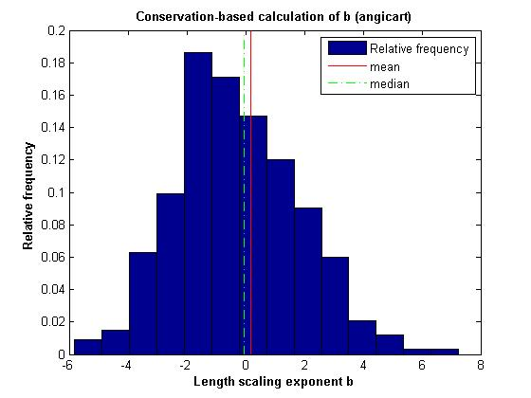
Conservation-based method
Sample Data

Slide 3
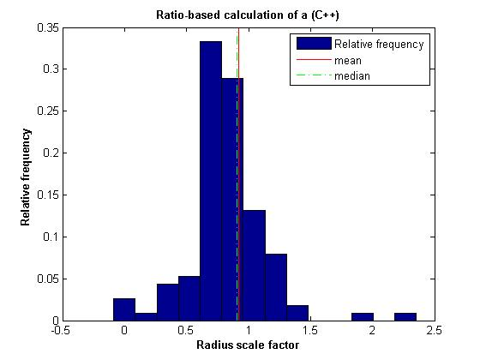
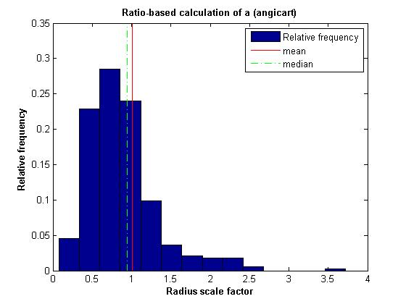
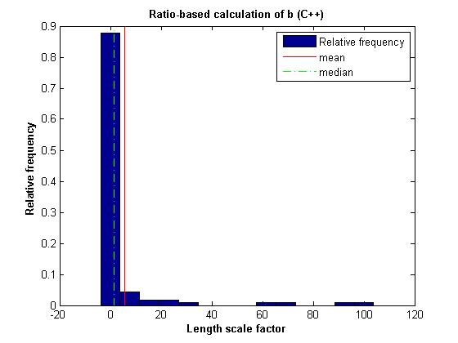
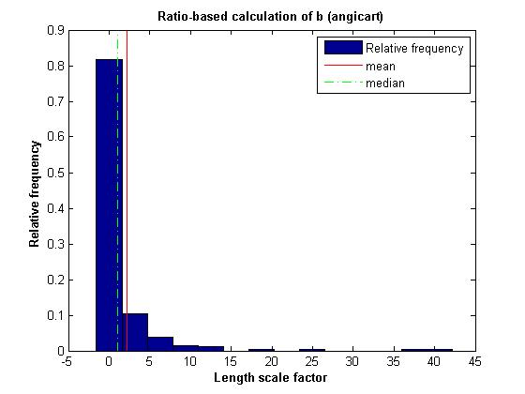
Ratio-based method
Sample Data

Slide 4
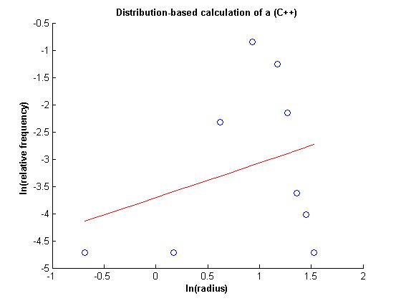
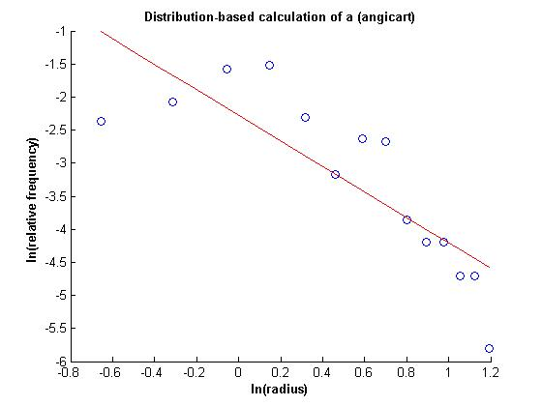
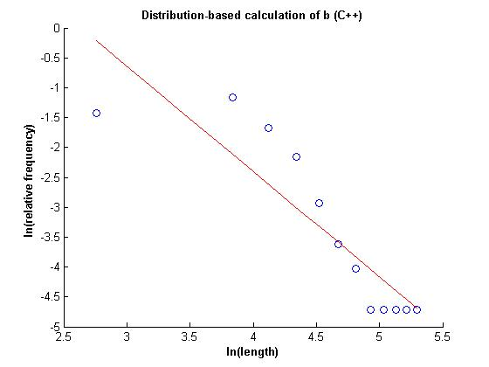
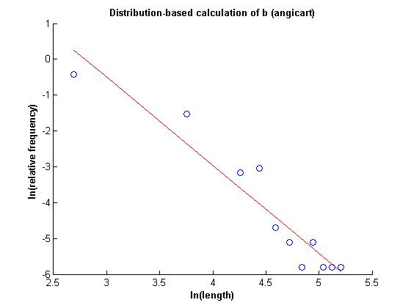
Distribution-based method
Sample Data

Slide 5
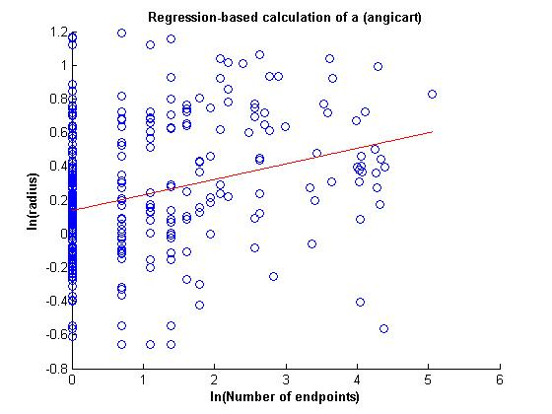
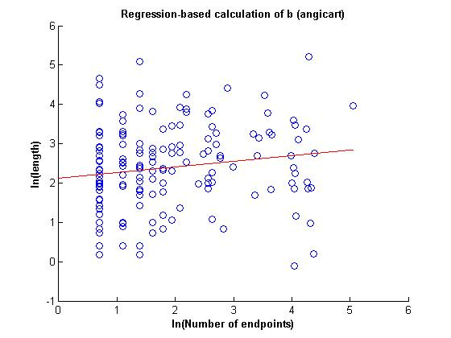
Regression-based method
Sample Data

Slide 6
Radius exponent measures (C++)
 | N | a | 95% CI | σ | R²
Conservation |  | 0.17
Ratio |  | 0.12
Distribution |  | -1.57
Regression
Radius exponent measures (Angicart)
 | N | a | 95% CI | σ | R²
Conservation |  | 0.12
Ratio |  | -0.01
Distribution |  | 0.52
Regression |  | 0.09

Slide 7
Length exponent measures (C++)
 | N | b | 95% CI | σ | R²
Conservation |  | -0.21
Ratio |  | -2.54
Distribution |  | 0.57
Regression
Length exponent measures (Angicart)
 | N | b | 95% CI | σ | R²
Conservation |  | 0.19
Ratio |  | -1.15
Distribution |  | 0.41
Regression |  | 0.14

