Slide 1
Calculating scaling exponents
using the ratio-based method and the regression-based method

Slide 2
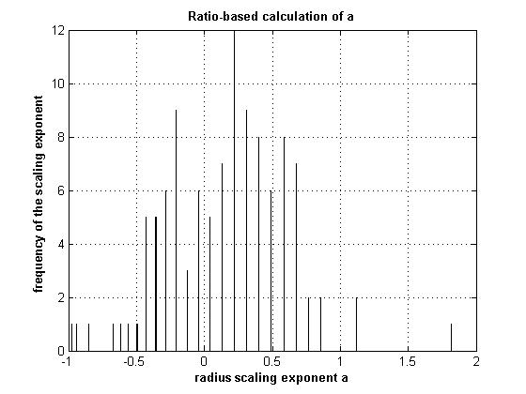
Scaling exponent a using Method 1

Slide 3
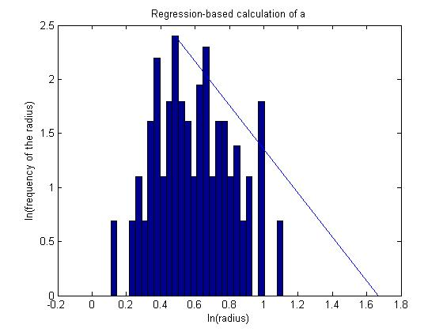
Scaling exponent a using Method 3

Slide 4
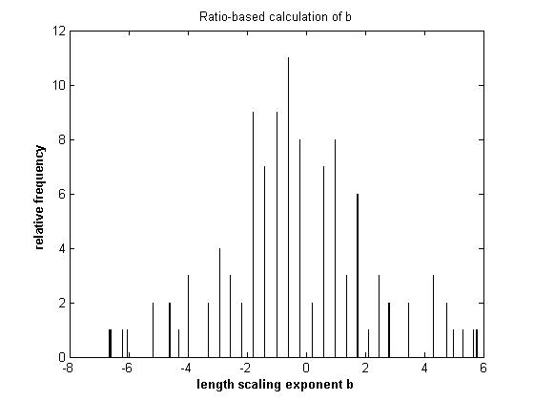
Scaling exponent b using Method 1

Slide 5
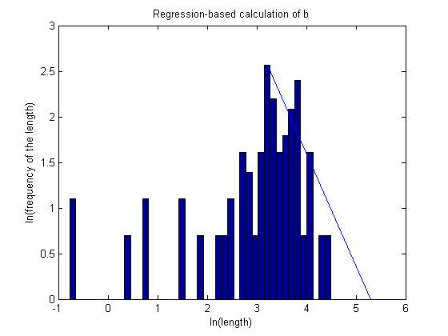
Scaling exponent b using Method 3

