Slide 1
Calculating scaling exponents
using the ratio-based method and the regression-based method

Slide 2
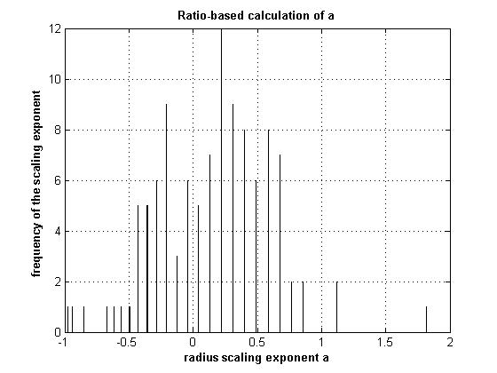
Scaling exponent a using Method 1

Slide 3
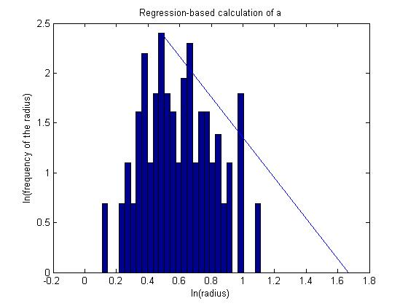
Scaling exponent a using Method 3

Slide 4
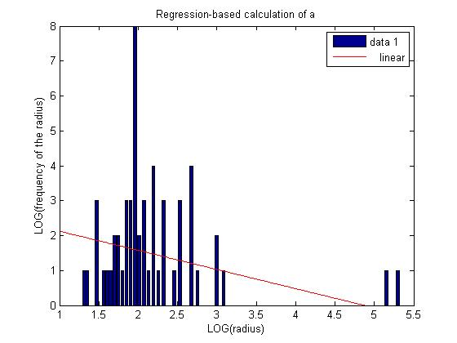
Scaling exponent a using Method 3

Slide 5
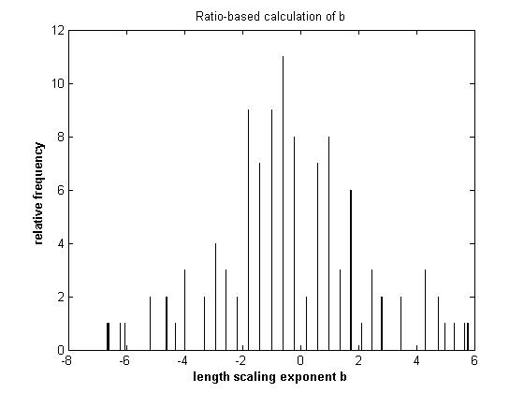
Scaling exponent b using Method 1

Slide 6
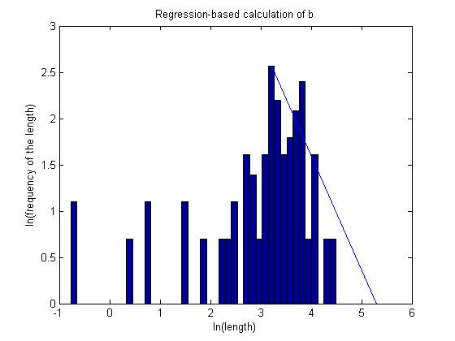
Scaling exponent b using Method 3

Slide 7
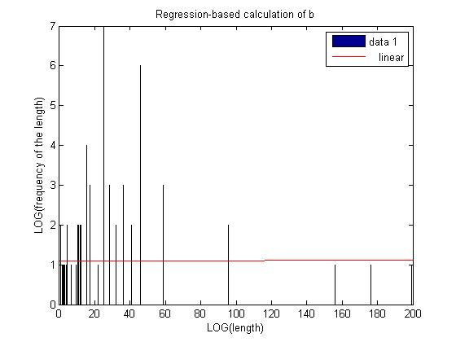
Scaling exponent b using Method 3

Slide 8
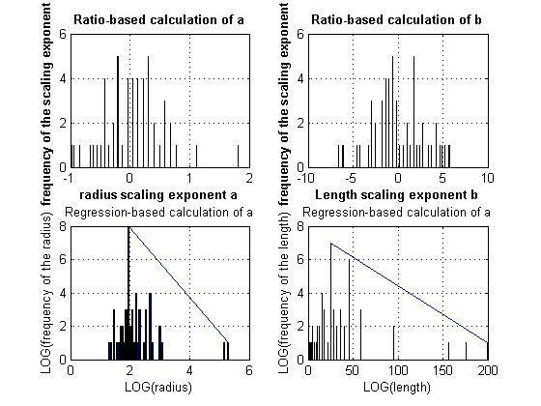

Slide 9
Method 1
Vascular System | Radius scaling exponent, a (angicart) | Length scaling exponent, b (angicart) | Radius scaling exponent, a (C++) | Length scaling exponent, a (C++)
Sample Data | 0.1198 | 0.1932 | 0.1904 | -0.2093
Mouse-lung
Method 3
Vascular System | Radius scaling exponent, a (angicart) | Length scaling exponent, b (angicart) | Radius scaling exponent, a (C++) | Length scaling exponent, a (C++)
Mouse lung | X | X | X | X

