Slide 1
Results:
Mouse Lung Data
Human patients 1-18

Slide 2
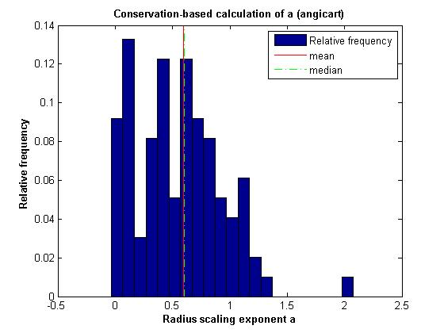
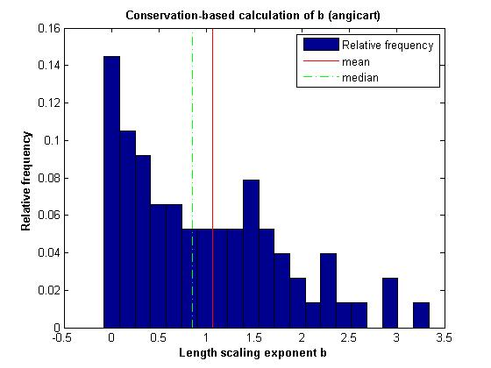
Conservation-based method
Human head and torso: patient 2

Slide 3
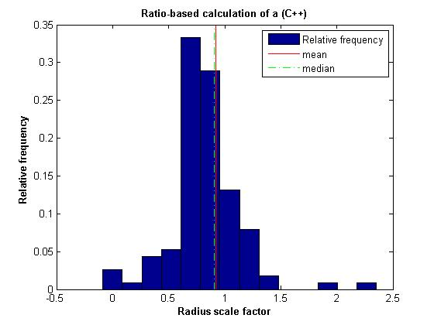
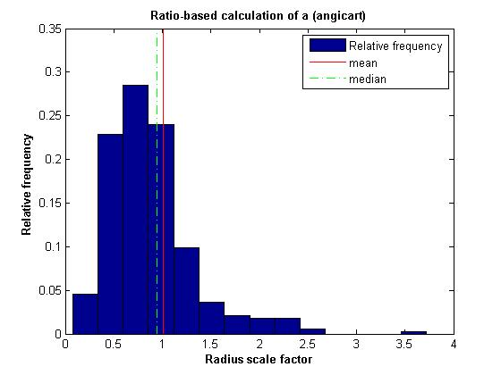
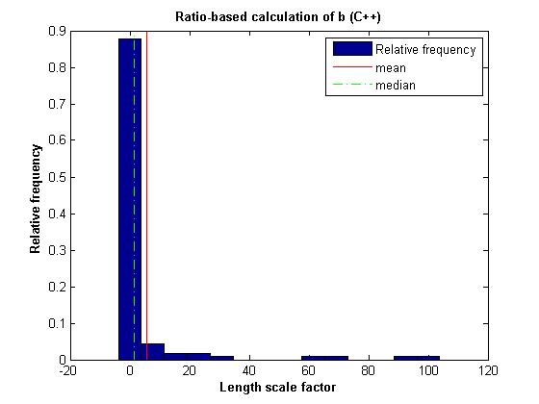
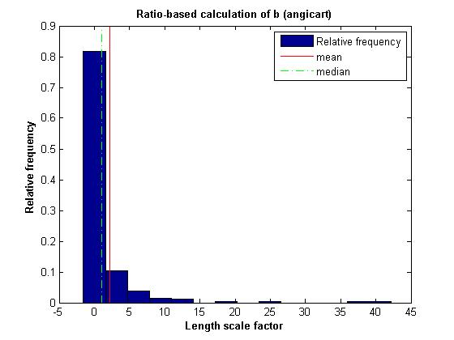
Ratio-based method
Human head and torso: patient 2

Slide 4
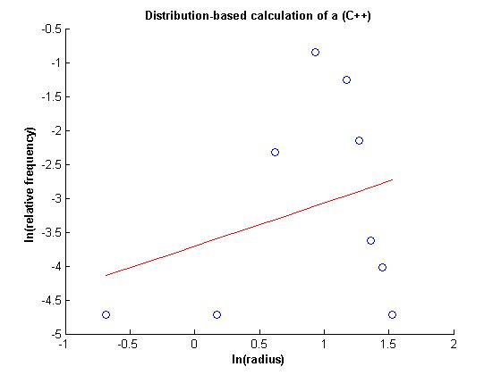
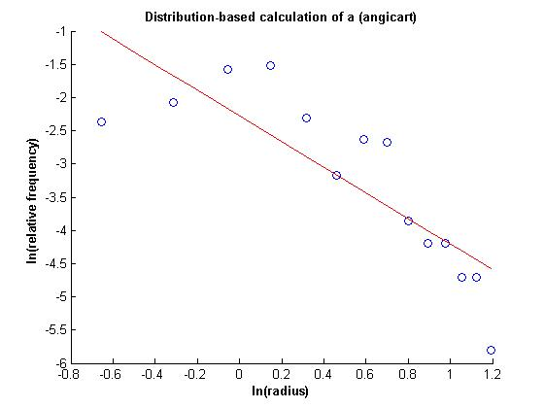
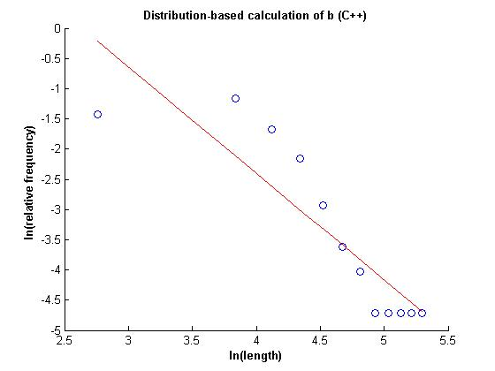
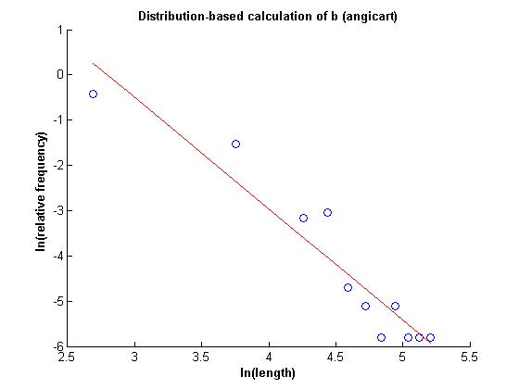
Distribution-based method
Human head and torso: patient 2

Slide 5
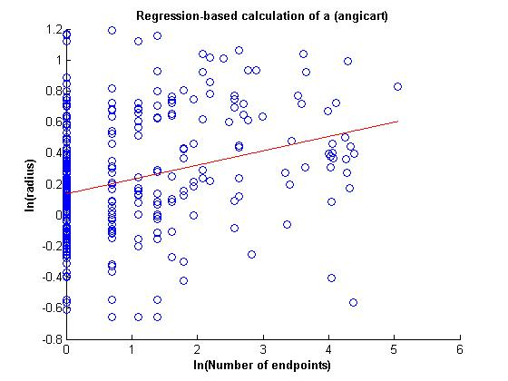
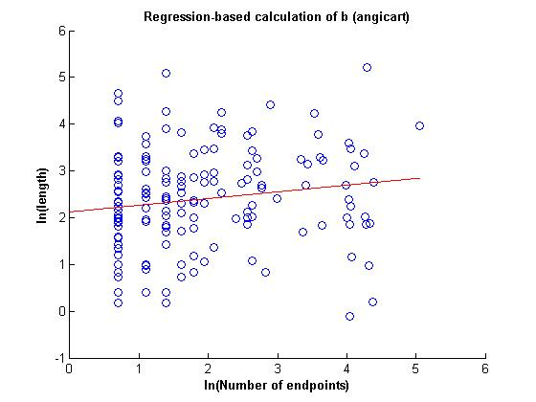
Regression-based method
Human head and torso: patient 2

Slide 6
Human Head and Torso: Patient 2
Radius exponent measures (C++)
 | N | a | 95% CI | σ | R²
Conservation
Ratio
Distribution
Regression
Radius exponent measures (Angicart)
 | N | a | 95% CI | σ | R²
Conservation | 98 | 0.6 | 0.08 | 0.38
Ratio
Distribution
Regression

Slide 7
Human Head and Torso: Patient 2
Length exponent measures (C++)
 | N | b | 95% CI | σ | R²
Conservation
Ratio
Distribution
Regression
Length exponent measures (Angicart)
 | N | b | 95% CI | σ | R²
Conservation | 76 | 1.06 | 0.1851 | 0.8233
Ratio
Distribution
Regression

Slide 8
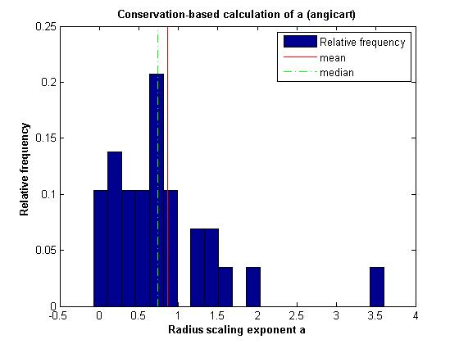
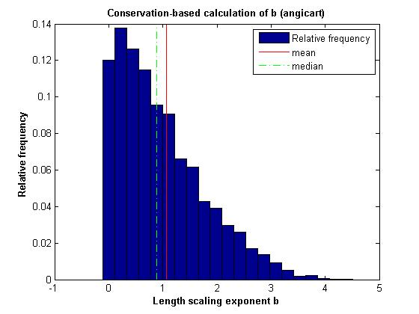
Conservation-based method
Mouse Lung

Slide 9
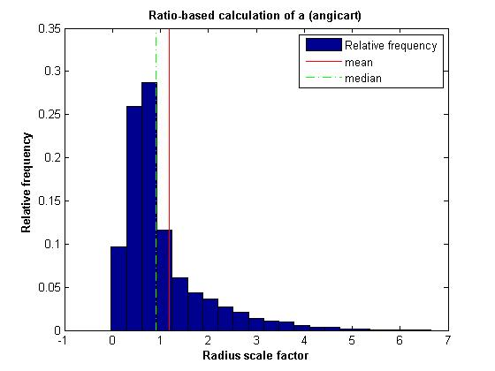
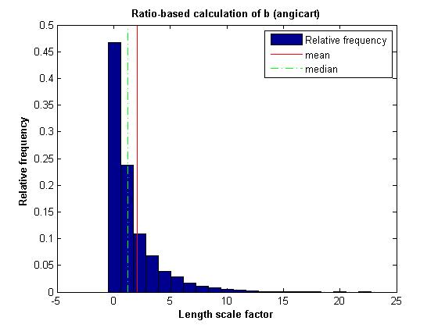
Ratio-based method
Mouse Lung

Slide 10
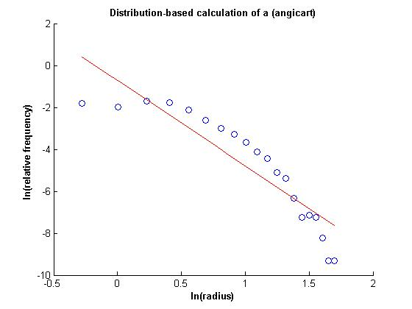
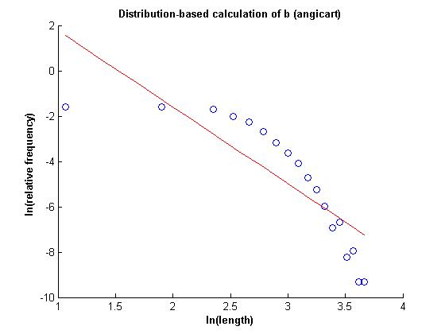
Distribution-based method
Mouse Lung

Slide 11
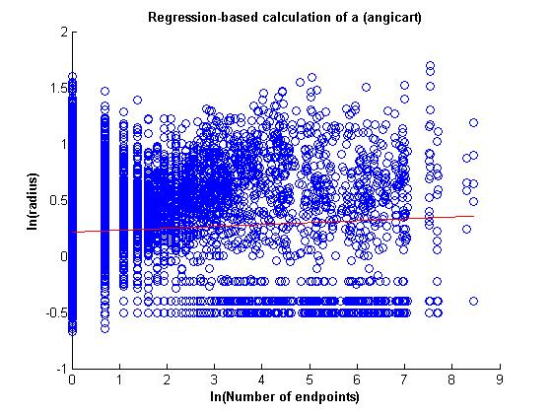
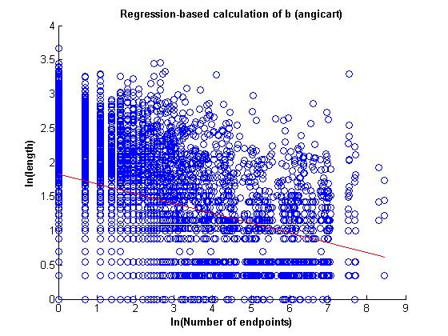
Regression-based method
Mouse Lung

Slide 12
Mouse Lung (20 bins)
Radius exponent measures (C++)
 | N | a | 95% CI | σ | R²
Conservation
Ratio
Distribution
Regression
Radius exponent measures (Angicart)
 | N | a | 95% CI | σ | R²
Conservation | 6449 | 0.64 | 0.01 | 0.5
Ratio | 11195 | 0.56 | 0.00 | 0.2
Distribution | 9339 | 0.25 | 0.01 |  | 0.74
Regression | 11195 | 0.02 | 0.02 |  | -0.01

Slide 13
Mouse Lung (20 bins)
Length exponent measures (C++)
 | N | b | 95% CI | σ | R²
Conservation
Ratio
Distribution
Regression
Length exponent measures (Angicart)
 | N | b | 95% CI | σ | R²
Conservation | 4409 | 1.07 | 0.02 | 0.8
Ratio | 11195 | 0.88 | 0.01 | 0.24
Distribution | 4587 | 0.3 | 0.08 |  | 0.4
Regression | 11195 | -0.14 | 0.02 |  | -0.71

