Slide 1
Comparing Healthy and Diseased Vascular Networks to Better Understand Pathologies

Slide 2
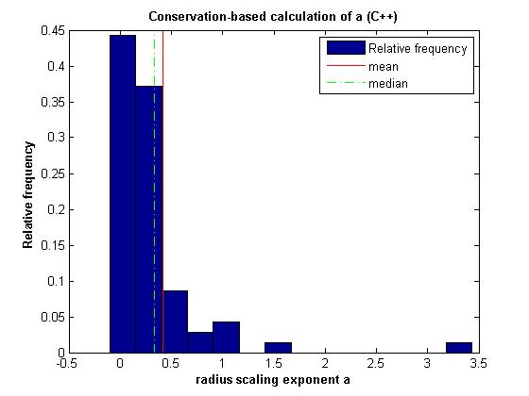
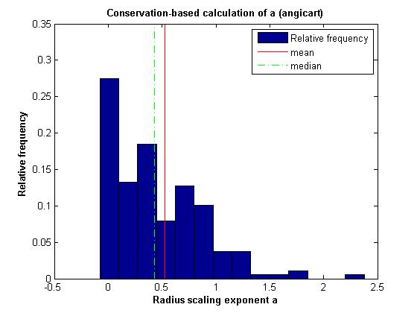
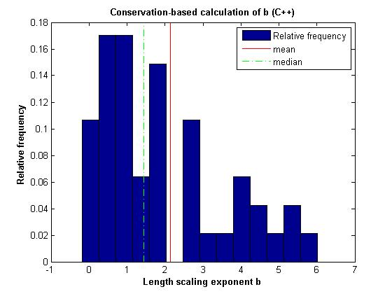
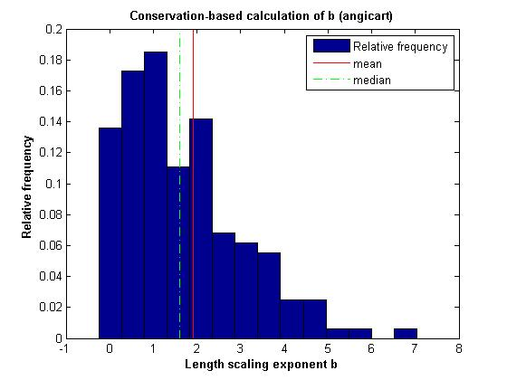
Conservation-based method
Sample Data

Slide 3
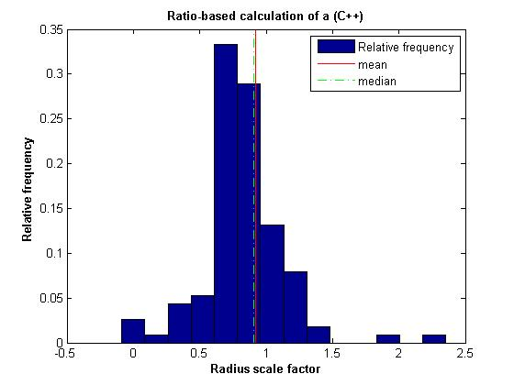
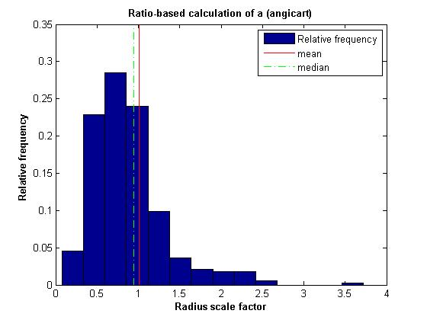
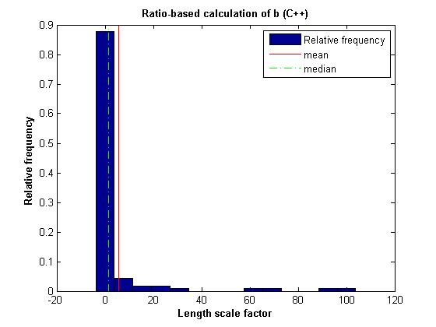
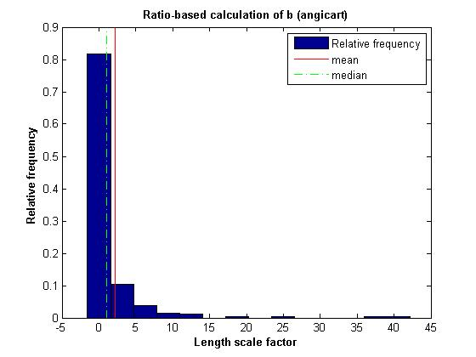
Ratio-based method
Sample Data

Slide 4
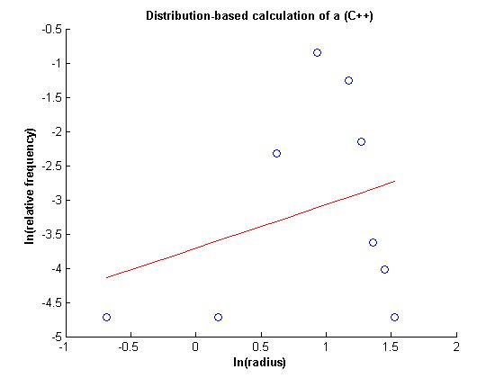
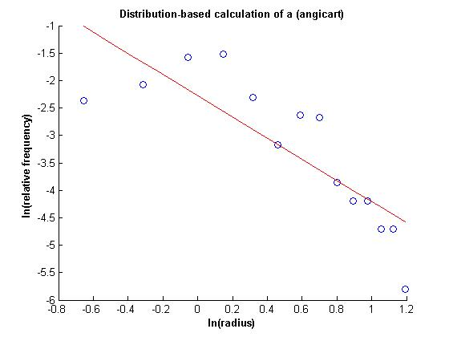
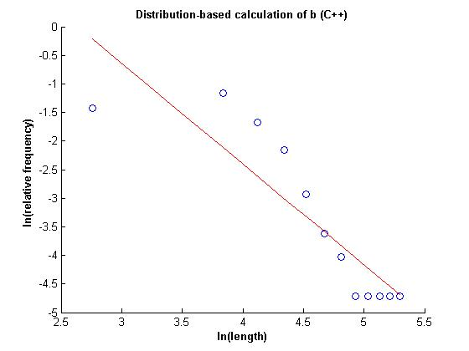
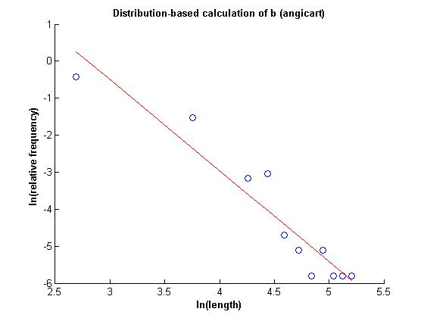
Distribution-based method
Sample Data

Slide 5
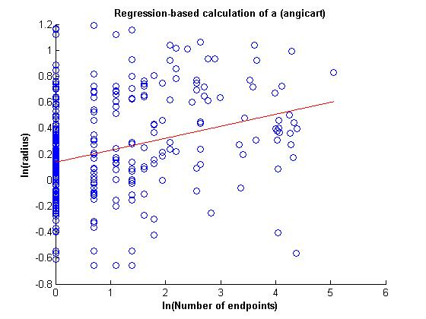
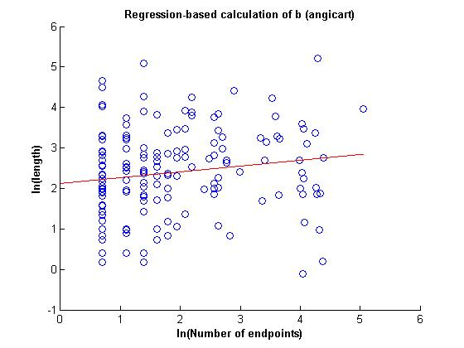
Regression-based method
Sample Data

Slide 6
Radius exponent measures (C++)
 | N | a | 95% CI | σ | R²
Conservation | 70 | 0.42 | 0. 1091 | 0.4657
Ratio | 72 | 0.38 | 0.1079 | 0.4639
Distribution | 112 | -1.57 |  |  | -0.1707
Regression
Radius exponent measures (Angicart)
 | N | a | 95% CI | σ | R²
Conservation | 189 | 0.53 | 0.0602 | 0.4220
Ratio | 189 | 0.47 | 0.0602 | 0.4220
Distribution | 333 | 0.52 |  |  | 0.7068
Regression | 333 | 0.09 |  |  | -0.2223

Slide 7
Length exponent measures (C++)
 | N | b | 95% CI | σ | R²
Conservation | 47 | 2.14 | 0.4782 | 1.6727
Ratio | 49 | 1.49 | 0.4695 | 1.6597
Distribution | 112 | 0.57 |  |  | 0.4357
Regression
Length exponent measures (Angicart)
 | N | b | 95% CI | σ | R²
Conservation | 162 | 1.9 | 0.2101 | 1.3644
Ratio | 162 | 1.42 | 0.2101 | 1.3644
Distribution | 333 | 0.41 |  |  | 0.2178
Regression | 333 | 0.14 |  |  | -0.0805

