Slide 1
Best-Practices for Reproducible Workflows
Naming things: files, objects, outputs
Cleaning up (other peoples’) bad variable names
File organization: keeping it tidy
Adopted from Jenny Bryan (Reproducible Science Workshop) and datacarpentry.org
Notes:
prepared by Jenny Bryan for Reproducible Science Workshop
https://datacarpentry.org/rr-organization1/

Slide 2
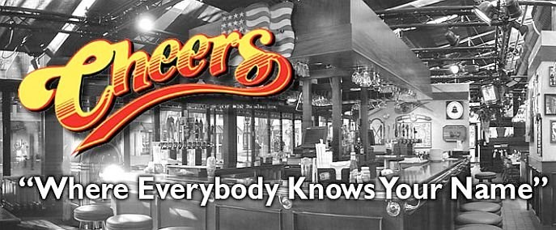
Names matter
Coding requires you to make a lot of personal naming choices (it is after all an expression of language). In order to effectively collaborate with others, some best-practices (naming conventions, file organization, etc.) are helpful to keep the focus on what the code does (produce results and visualizations).

Slide 3
NO
File names
myabstract.docx
Joe’s Filenames Use Spaces and Punctuation.xlsx figure 1.png
fig 2.png JW7d^(2sl@deletethisandyourcareerisoverWx2*.txt
YES
2014-06-08_abstract-for-sla.docx
joes-filenames-are-getting-better.xlsx
fig01_scatterplot-talk-length-vs-interest.png fig02_histogram-talk-attendance.png
1986-01-28_raw-data-from-challenger-o-rings.txt

Slide 4
Three principles for file names:
machine readable
human readable
plays well with default ordering

Slide 5
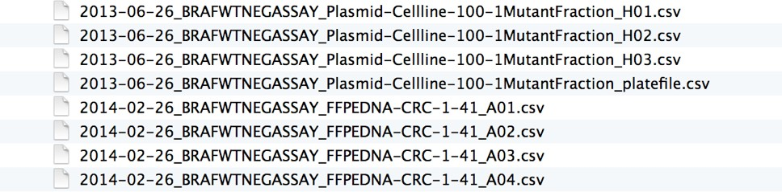
Awesome file names :)
Notice that they are descriptive; without knowing anything about the project you can guess at what the files contain

Slide 6
“machine readable”
Regular expression and globbing friendly
In computer programming, glob patterns specify sets of filenames with wildcard characters (. * ? etc.)
avoid spaces, punctuation, accented
characters, case sensitivity
Easy to compute on
deliberate use of delimiters
Notes:
Regular expressions are patterns used to match character combinations in strings.
Case sensitivity takes up a surprising amount of brain power to deconstruct; like reading, your brain is constantly trying to make sense of information contained in case

Slide 7
Excerpt of complete file listing:
Example of globbing to narrow file listing:
Jennifers-MacBook-Pro-3:2014-03-21 jenny$
ls *Plasmid*
2013-06-26_BRAFWTNEGASSAY_Plasmid-Cellline-100-1MutantFraction_A01.csv 2013-06-26_BRAFWTNEGASSAY_Plasmid-Cellline-100-1MutantFraction_A02.csv 2013-06-26_BRAFWTNEGASSAY_Plasmid-Cellline-100-1MutantFraction_A03.csv 2013-06-26_BRAFWTNEGASSAY_Plasmid-Cellline-100-1MutantFraction_B01.csv
....
2013-06-26_BRAFWTNEGASSAY_Plasmid-Cellline-100-1MutantFraction_H03.csv
2013-06-26_BRAFWTNEGASSAY_Plasmid-Cellline-100-1MutantFraction_platefile.csv

Slide 8
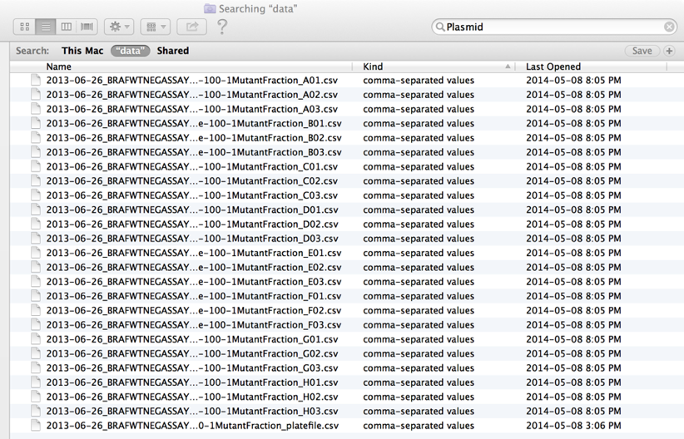
Same using Mac OS Finder search facilities:

Slide 9
Same using R’s ability to narrow file list by regex:
>
list.files(pattern = "Plasmid")
%>% head
[1]
"2013-06-26_BRAFWTNEGASSAY_Plasmid-Cellline-100-1MutantFraction_A01.csv"
[2]
"2013-06-26_BRAFWTNEGASSAY_Plasmid-Cellline-100-1MutantFraction_A02.csv"
[3]
"2013-06-26_BRAFWTNEGASSAY_Plasmid-Cellline-100-1MutantFraction_A03.csv"
[4]
"2013-06-26_BRAFWTNEGASSAY_Plasmid-Cellline-100-1MutantFraction_B01.csv"
[5]
"2013-06-26_BRAFWTNEGASSAY_Plasmid-Cellline-100-1MutantFraction_B02.csv"
[6] "2013-06-26_BRAFWTNEGASSAY_Plasmid-Cellline-100-1MutantFraction_B03.csv"
Notes:
Regex=regular expression

Slide 10
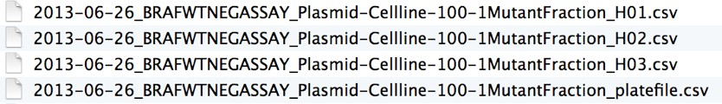
Deliberate use of “_”and “-” allows us to recover meta- data from the filenames.
flist <-
list.files(pattern = "Plasmid")
%>% head
stringr::str_split_fixed(flist, "[_\\.]", 5) [,1] [,2] [,3]
[,4]
[,5]
[1,] | "2013-06-26" | "BRAFWTNEGASSAY" | "Plasmid-Cellline-100-1MutantFraction" | "A01" | "csv"
[2,] | "2013-06-26" | "BRAFWTNEGASSAY" | "Plasmid-Cellline-100-1MutantFraction" | "A02" | "csv"
[3,] | "2013-06-26" | "BRAFWTNEGASSAY" | "Plasmid-Cellline-100-1MutantFraction" | "A03" | "csv"
[4,] | "2013-06-26" | "BRAFWTNEGASSAY" | "Plasmid-Cellline-100-1MutantFraction" | "B01" | "csv"
[5,] | "2013-06-26" | "BRAFWTNEGASSAY" | "Plasmid-Cellline-100-1MutantFraction" | "B02" | "csv"
[6,] | "2013-06-26" | "BRAFWTNEGASSAY" | "Plasmid-Cellline-100-1MutantFraction" | "B03" | "csv"
date assay sample set well
This happens to be R but also possible in the shell, Python, etc.

Slide 11
flist <- list.files(pattern = "Plasmid") %>% head
stringr::str_split_fixed(flist, "[_\\.]", 5)
 | [,1] | [,2] | [,3] | [,4] | [,5]
[1,] | "2013-06-26" | "BRAFWTNEGASSAY" | "Plasmid-Cellline-100-1MutantFraction" | "A01" | "csv"
[2,] | "2013-06-26" | "BRAFWTNEGASSAY" | "Plasmid-Cellline-100-1MutantFraction" | "A02" | "csv"
[3,] | "2013-06-26" | "BRAFWTNEGASSAY" | "Plasmid-Cellline-100-1MutantFraction" | "A03" | "csv"
[4,] | "2013-06-26" | "BRAFWTNEGASSAY" | "Plasmid-Cellline-100-1MutantFraction" | "B01" | "csv"
[5,] | "2013-06-26" | "BRAFWTNEGASSAY" | "Plasmid-Cellline-100-1MutantFraction" | "B02" | "csv"
[6,] | "2013-06-26" | "BRAFWTNEGASSAY" | "Plasmid-Cellline-100-1MutantFraction" | "B03" | "csv"
“_” underscore used to delimit units of meta-data I want later
“-” hyphen used to delimit words so my eyes don’t bleed

Slide 12
“machine readable”
easy to search for files later
easy to narrow file lists based on names
easy to extract info from file names, e.g. by splitting
Be kind to yourself and avoid:
spaces in file names
punctuation
accented characters (don’t translate well across other languages)
different files named “foo” and “Foo”

Slide 13
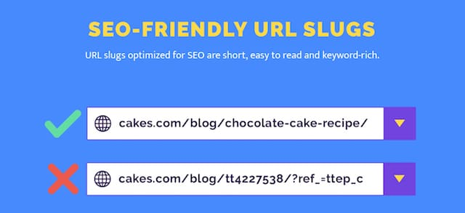
“human readable”
File names should contain info on content
Connects to concept of a slug from semantic URLs
Slug is the part of a URL that identifies a page in human-readable keywords. It is usually the end part of the URL, which can be interpreted as the name of the resource, similar to the basename in a filename or the title of a page.

Slide 14
“human readable”
Jennifers-MacBook-Pro-3:analysis jenny$
01_marshal-data.md 01_marshal-data.r 02_pre-dea-filtering.md 02_pre-dea-filtering.r
03_dea-with-limma-voom.md 03_dea-with-limma-voom.r 04_explore-dea-results.md 04_explore-dea-results.r
90_limma-model-term-name-fiasco.md 90_limma-model-term-name-fiasco.r Makefile
figure
helper01_load-counts.r helper02_load-exp-des.r helper03_load-focus-statinf.r helper04_extract-and-tidy.r tmp.txt
ls -1
01.md 01.r
02.md 02.r
03.md 03.r
04.md 04.r
90.md 90.r
Makefile figure helper01.r helper02.r helper03.r helper04.r tmp.txt
Which set of file(name)s do you want at 3 a.m. before a deadline?

Slide 15

“human readable”
01_marshal-data.r
02_pre-dea-filtering.r
embrace the slug
03_dea-with-limma-voom.r
04_explore-dea-results.r
90_limma-model-term-name-fiasco.r helper01_load-counts.r helper02_load-exp-des.r helper03_load-focus-statinf.r helper04_extract-and-tidy.r

Slide 16
“human readable”
Easy to figure out what the heck something is, based on its name

Slide 17
“plays well with default ordering”
put something numeric first
left pad numbers with zeros (two-digit)
use the ISO 8601 standard for dates

Slide 18
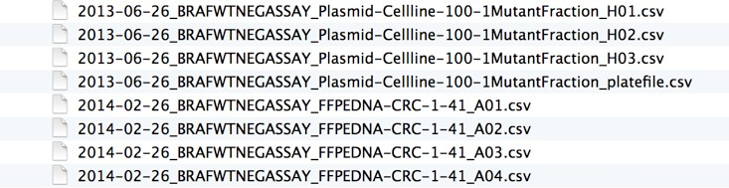
“plays well with default ordering”
chronological order
01_marshal-data.r 02_pre-dea-filtering.r
03_dea-with-limma-voom.r 04_explore-dea-results.r
90_limma-model-term-name-fiasco.r helper01_load-counts.r helper02_load-exp-des.r helper03_load-focus-statinf.r helper04_extract-and-tidy.r
logical order

Slide 19
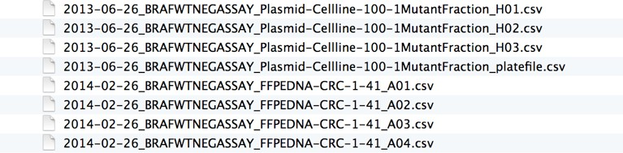
“plays well with default ordering”
01_marshal-data.r 02_pre-dea-filtering.r
03_dea-with-limma-voom.r 04_explore-dea-results.r
90_limma-model-term-name-fiasco.r helper01_load-counts.r helper02_load-exp-des.r helper03_load-focus-statinf.r helper04_extract-and-tidy.r
put something numeric first

Slide 20
“plays well with default ordering”
use the ISO 8601 standard for dates
YYYY-MM-DD

Slide 21
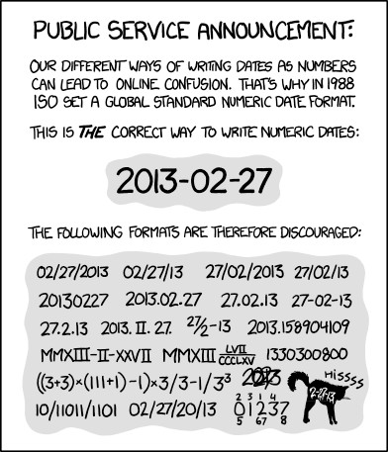
http://xkcd.com/1179/

Slide 22

Comprehensive map of all countries in the world that use the MMDDYYYY format
https://twitter.com/donohoe/status/597876118688026624

Slide 23
left pad other numbers with zeros
01_marshal-data.r 02_pre-dea-filtering.r
03_dea-with-limma-voom.r 04_explore-dea-results.r
90_limma-model-term-name-fiasco.r helper01_load-counts.r helper02_load-exp-des.r helper03_load-focus-statinf.r helper04_extract-and-tidy.r
if you don’t left pad, you get this:
10_final-figs-forpublication.R 1_data-cleaning.R
2_fit-model.R
which is just sad

Slide 24

File name discipline
Easy to implement NOW
Payoffs accumulate as your skills evolve and projects get more complex
Much easier to get help from others and more experienced coders
This is part of being a good collaborator and working on a team

Slide 25
go forth and use awesome file names :)
01_marshal-data.r 02_pre-dea-filtering.r
03_dea-with-limma-voom.r 04_explore-dea-results.r
90_limma-model-term-name-fiasco.r helper01_load-counts.r helper02_load-exp-des.r helper03_load-focus-statinf.r helper04_extract-and-tidy.r

Slide 26
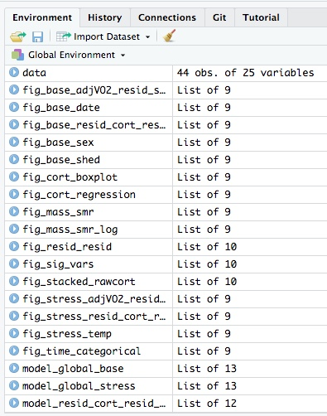
Naming convention for objects
Many of the same naming principles apply
Maybe even more important to be consistent as you will end up with dozens of objects in each project.
Notes:
Object names might become gnarly; your future self will thank you when you are trying to remember how the code worked.

Slide 27
Naming convention for objects (suggestions)
Rather than having objects in R environment start with a number, I start them with object type:
data_CORT_baseline
table_CORT_summary_stats
fig_mean_by_group
model_regress_height_vs_weight
Notes:
Order of objects change as you add more analyses;
Note that figures and tables are output in a meaningful order; the order they are discussed in the results.

Slide 28
Naming convention for objects
I tend to prefer hierarchical naming with meaningful differences highlighted as suffixes.
For ‘final’ publication-quality figures and tables, OK to output them with numerical order as that is how they are presented in manuscript. (e.g. Figure 1, Figure 2, etc.)
Notes:
Object names might become gnarly; your future self will thank you when you are trying to remember how the code worked.
This isn’t the best example, but it works for me. (compromise between myself and collaborators)

Slide 29

For next time:
Make sure you have made a Github account. Probably want to use your gmail, yahoo, etc. address rather than APSU (long-term stability).
We will use Github for a majority of the semester.
github.com

Slide 30
Part 2: Cleaning Data and File Management
Tips: the from_joe directory
Let’s say my collaborator and data producer is Joe.
He will send me data with weird space-containing file names, data in Microsoft Excel workbooks, etc.
It is futile to fight this, just quarantine all the crazy here. I rename things and/or export to plain text and put those files in my data directory.
Whether I move, copy, or link to file depends on the situation.
Whatever I did gets recorded in a README or in comments in my R code – whatever makes it easiest for me to remind myself of a file’s provenance, if it came from the outside world in a state that was not ready for programmatic analysis.
Notes:
https://datacarpentry.org/rr-organization1/02-file-organization/index.html

