Slide 1
CyberCoach Project
Advanced Software Engineering 2015
Amanda Karavolia – Michael Jungo – Jocelyn Thode – Simon Brulhart – Fisnik Mengjiqi – Andrea Liechti

Slide 2
Basic Idea
Our website will be a meeting spot for people to teach others and learn from others
Users can be coaches or trainees or both
As a coach, he can offer lessons and he can advertise his lessons to all users subscribed to the same sport
As a trainee, he can subscribe to a lesson offered by a coach, thus a partnership is created

Slide 3
Training Sessions
A training session is created by a coach
It has a map
It is for one specific sport
It shows a route or location depending on the sport
It can be cancelled by either the coach or the trainee up to a certain amount of time in advance
It has a date, which can be exported to a google calendar if desired
It shows how much the trainee will have to pay for it

Slide 4
User
A user has a profile
He can subscribe to one or several sports and view advertisements made concerning this sport
He has a calendar view to show him the training sessions that concern him (either as a coach or as a trainee)
And export this calendar to Google Calendar
He can cancel training sessions

Slide 5
Coach
If a user wants to be a coach, he can offer training sessions
He can advertise them for all users subscribed to the sport type and he can post the advertisement to facebook
He can post content for all trainee’s he has formed partnerships with

Slide 6
Trainee
As a trainee, a user can subscribe to a sport and check for offered training sessions
He can subscribe to a coach, and by doing that create a partnership
Then he can apply for a session by the coach

Slide 7
Search Engine
The search engine of the web application will make it easier to find training sessions offered

Slide 8
Rating
After the training session has taken place, the trainee can rate the coach, this will show up on the coache’s profile

Slide 9
E-Mail Reminder
Before the training session, the user and the coach will be reminded by e-mail

Slide 10
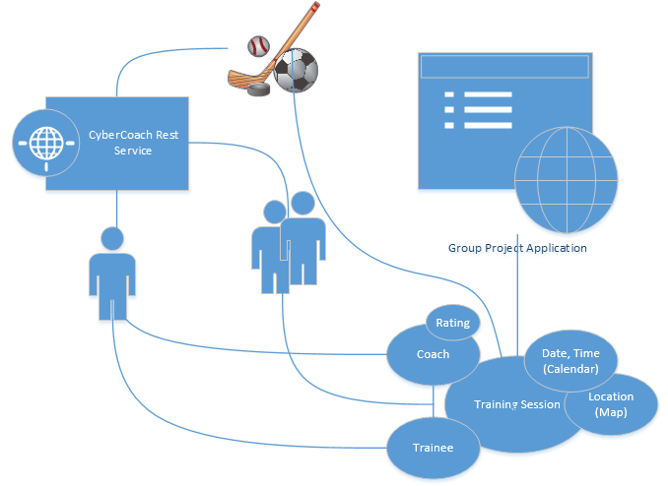

Slide 11
Planning
For bug tracking we will use GitHub
For the milestones we will use GitHub
We will try to start using Trello and link it to GitHub

Slide 12
Planning
Sprint 1 – 20. October
User authentication, user profiles, basic training session model, view and controller
Sprint 2 – 3. November
Training session with map and calendar, functionality to form partnership and apply for training session, remove application for training session
Sprint 3 – 17. November
Calendar View, calendar export, advertisement and facebook sharing, e-Mail reminder, search engine
Sprint 4 – 1. December
Rating of coaches, coach can inform all his trainees, first test sessions and bug fixing
Sprint 5 – 11. December
Testing and bug fixing

