Slide 1
Tomcat Native 2
Using our own JNI wrapper for OpenSSL in Tomcat and Undertow
Workshop R&D - Red Hat
Supervisors : Jean-Frederic Clere & Rémy Maucherat
Team : Jocelyn Thode & Simon Brulhart

Slide 2
Summary
Overview
What has been done
Changes to the Workplan
What needs to be done
What may be done

Slide 3
Current State: Tomcat + Tomcat Native
“An optional component for use with Apache Tomcat“
Better performance and compatibility with OS
Uses encrypted sockets through Apache Portable Runtime (APR)
Uses OpenSSL APIs through APR
Notes:
Remind what is APR

Slide 4
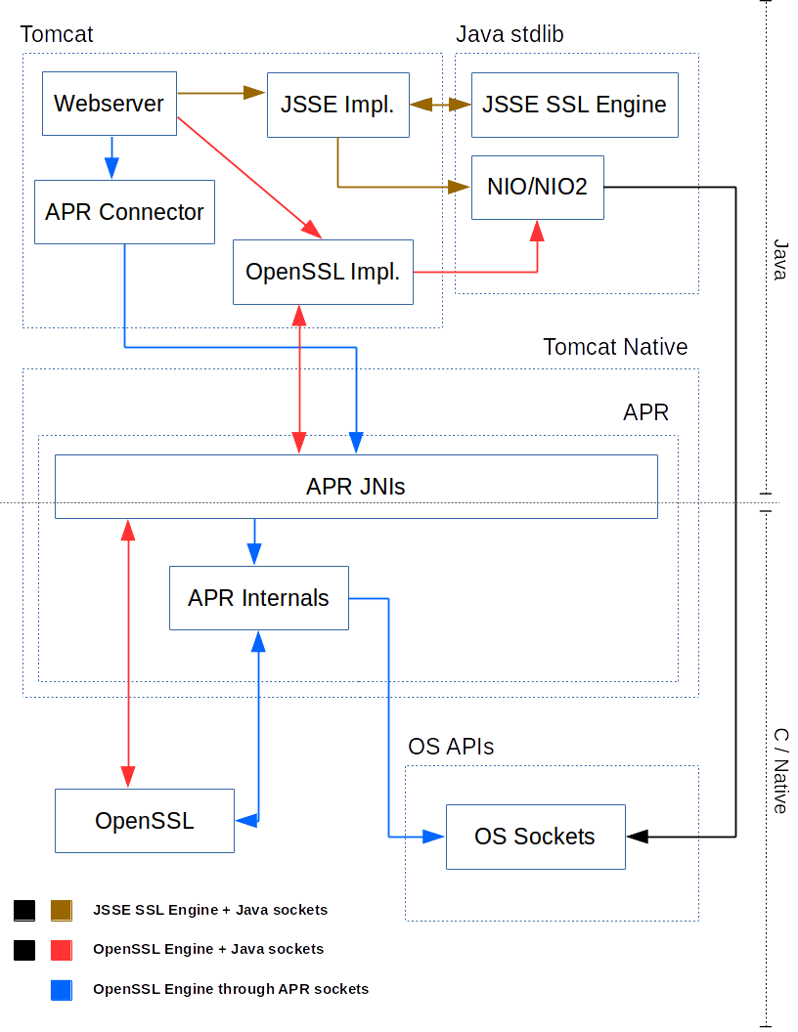
Current State : Ways to Use SSL
Notes:
Tomcat
JSSE SSL Engine + Java sockets
OpenSSL Engine through APR sockets
Old way
OpenSSL Engine + Java sockets
Numa’s OpenSSL Engine

Slide 5
Projected State : Tomcat Native 2
Tomcat + Tomcat Native 2
Reduces dependencies (no APR)
Reduces project complexity
Native/Java bridge with JNI+Homebrewed code
Undertow + Tomcat Native 2
Brings OpenSSL
Small dependencies (no APR)
Native/Java bridge with JNI+SPI

Slide 6
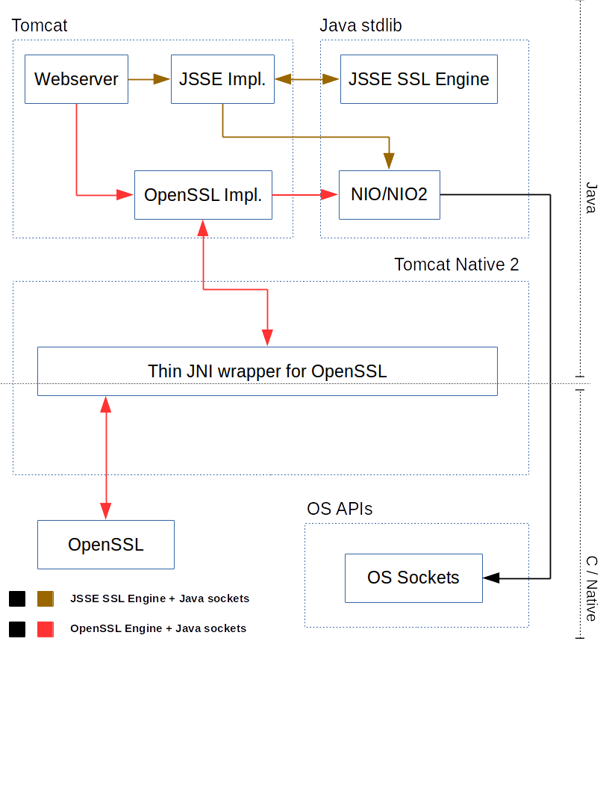
What has been done : APR Removal

Slide 7
What has been done (2)
Prototype tested (informally) by Rémy Maucherat
No performance regression!
Experiment with dynamic linking
Prior work in Undertow was doing it
Not planned beforehand
Evaluation of the changes needed to port Tomcat Native 2 to Undertow
Notes:
Benchmark didn’t give any negative stuff
Maybe we can discuss here what dynamic linking was about, and in the next section only mention that it is planned as an optional last task

Slide 8
Changes to the Workplan
Tomcat-Native now compatible with OpenSSL 1.1
Merge upstream changes in Tomcat Native 2 down the road
Prior work on Undertow used dynamic loading
Experiment with dynamic loading in Tomcat Native 2
OpenSSL classes from Tomcat and Undertow could not be reconciled
Different philosophies
Notes:
Dynamic linking takes some time + changes in OpenSSL 1.1
Maybe merge this slide with “What needs to be done ? (1)” ? We could simply mention in the slide that some tasks weren’t planned beforehand
Philosophies between SPI and Tomcat way not the same

Slide 9
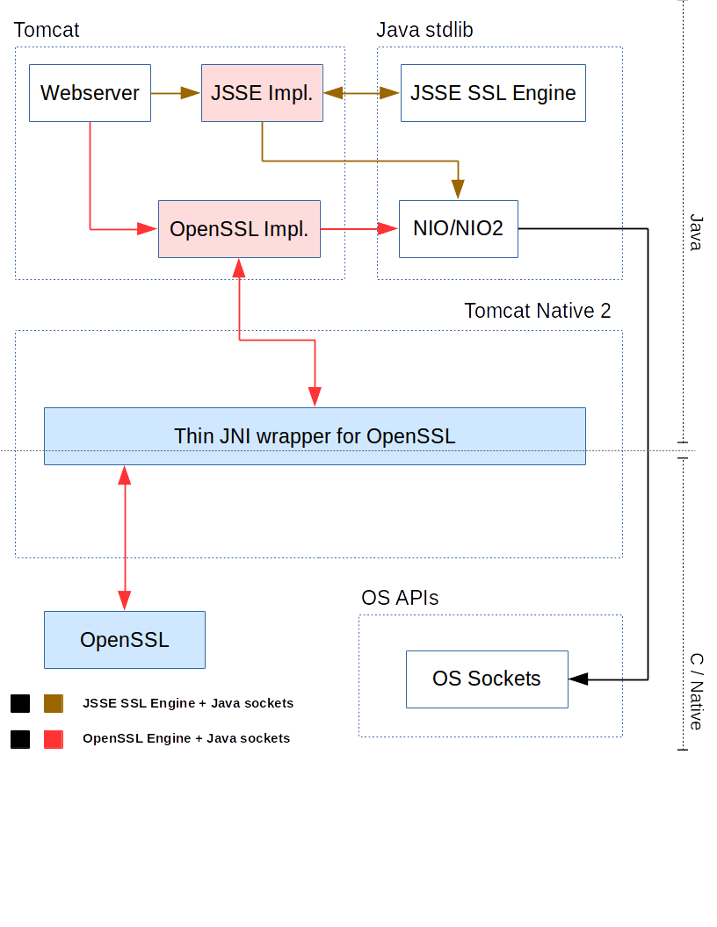
What needs to be done (1)
Common code
Forked code
Notes:
Add a legend ?
Put this slide after “Changes to the workplan” or after “What needs to be done” ?

Slide 10
What needs to be done (2)
Integrate Tomcat Native 2 in Undertow
Fix ALPN in Tomcat with Tomcat Native 2
Required for HTTP/2
Re-use code from Stuart’s OpenSSL experiment
Merge changes related to OpenSSL 1.1
Run benchmarks

Slide 11
What may be done
Finish prototype using dynamic linking
Need to support both OpenSSL 1.0.2 and 1.1.0
Could be complicated
Support for OpenSSL handshake callback
Currently using a hack
Support for large frames
More support for security options

Slide 12

Questions

