Slide 1
Tomcat Native 2
Using our own JNI wrapper for OpenSSL in Tomcat and Undertow
Workshop R&D - Red Hat
Supervisors : Jean-Frederic Clere & Rémy Maucherat
Team : Jocelyn Thode & Simon Brulhart

Slide 2
Summary
Overview
What has been accomplished
Benchmarks
Issues
Future Works

Slide 3
Undertow & Tomcat
Undertow and Tomcat are very similar, they:
Are Web servers
Are Servlet containers using JSSE
Can use JSSE SSL Engine

Slide 4
Old State: Tomcat + Tomcat Native
“An optional component for use with Apache Tomcat“
Better performance and compatibility with OS
Uses encrypted sockets through Apache Portable Runtime (APR)
Uses OpenSSL APIs through APR
Notes:
Remind what is APR
They both can provide SSL through different means
In Undertow only one way but we’ll come back to that later

Slide 5
Old State: Undertow + JSSE
Can only use JSSE SSL Engine
Only Java Code
SSL/TLS performance aren’t great
Already some work done to port Tomcat Native
Helps us port Tomcat Native 2 to Undertow

Slide 6
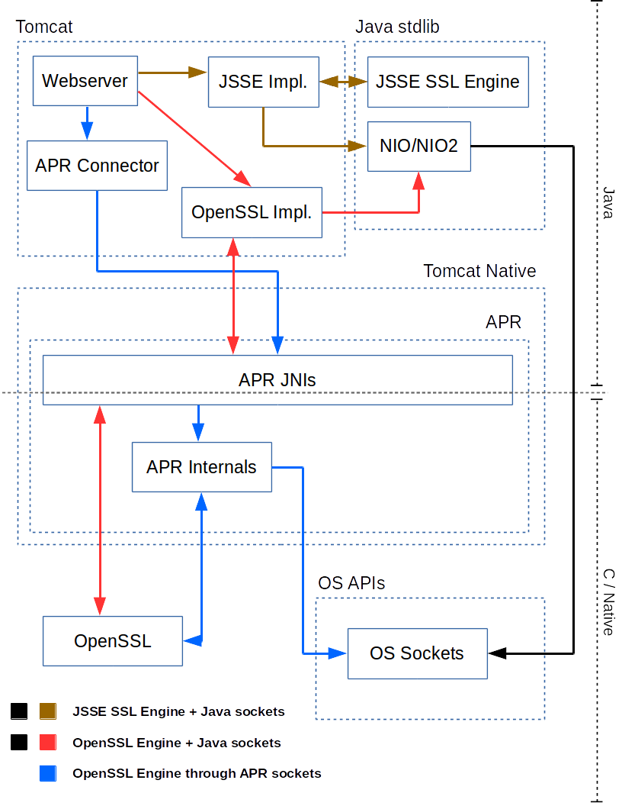
Old State: Ways to Use SSL
Notes:
Tomcat
JSSE SSL Engine + Java sockets
OpenSSL Engine through APR sockets
Old way
OpenSSL Engine + Java sockets
Numa’s OpenSSL Engine

Slide 7
New State : Tomcat Native 2
Tomcat + Tomcat Native 2
Reduces dependencies (no APR)
Reduces project complexity
Native/Java bridge with JNI+Homebrewed code
Undertow + Tomcat Native 2
Brings OpenSSL
Small dependencies (no APR)
Native/Java bridge with JNI+SPI

Slide 8
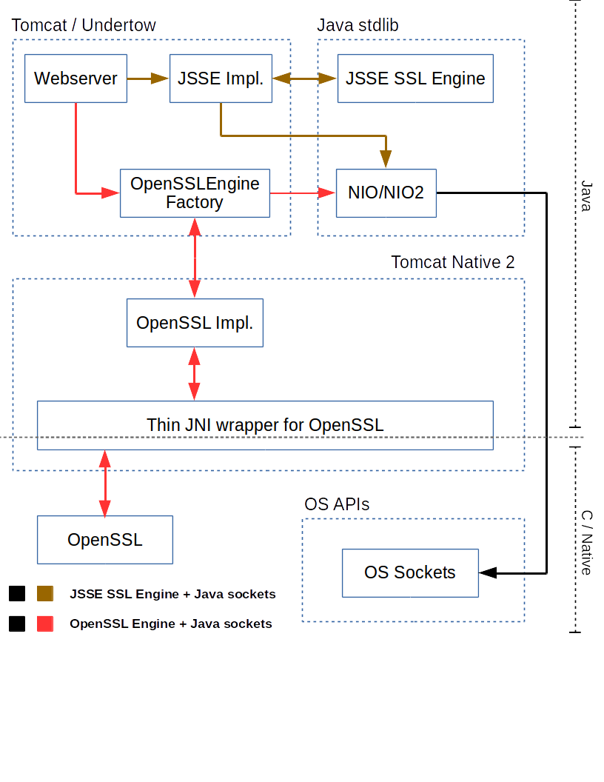
Tomcat Native 2 in Tomcat/Undertow

Slide 9
What has been accomplished (2)
Integrate Tomcat Native 2 in Undertow
Merge changes to Tomcat Native in Tomcat Native 2
OpenSSL 1.1
Write documentation on how to build and run Tomcat Native 2
Run Benchmarks
Notes:
Benchmark didn’t give any negative stuff
Maybe we can discuss here what dynamic linking was about, and in the next section only mention that it is planned as an optional last task

Slide 10
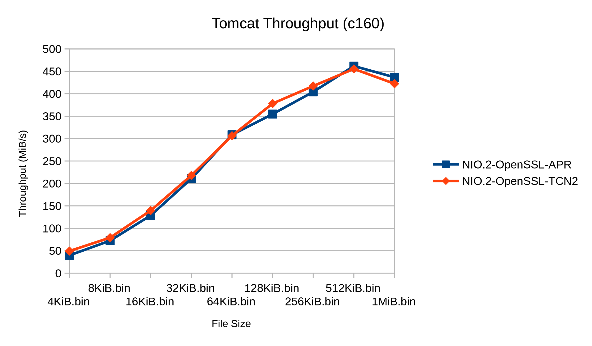
Benchmarks : Tomcat

Slide 11
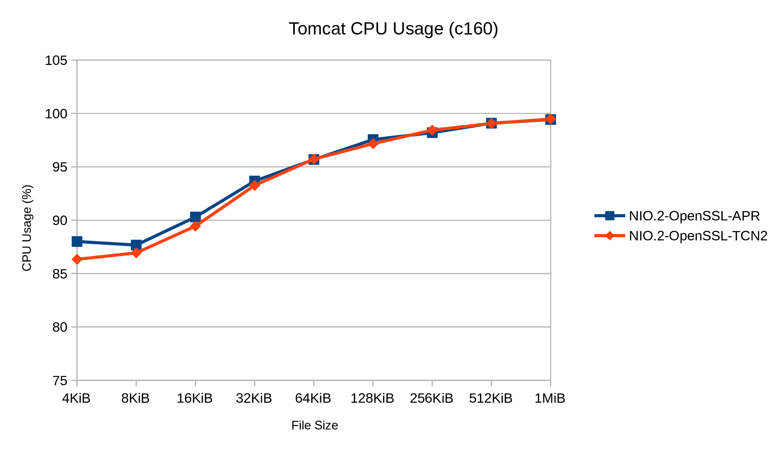
Benchmarks : Tomcat

Slide 12
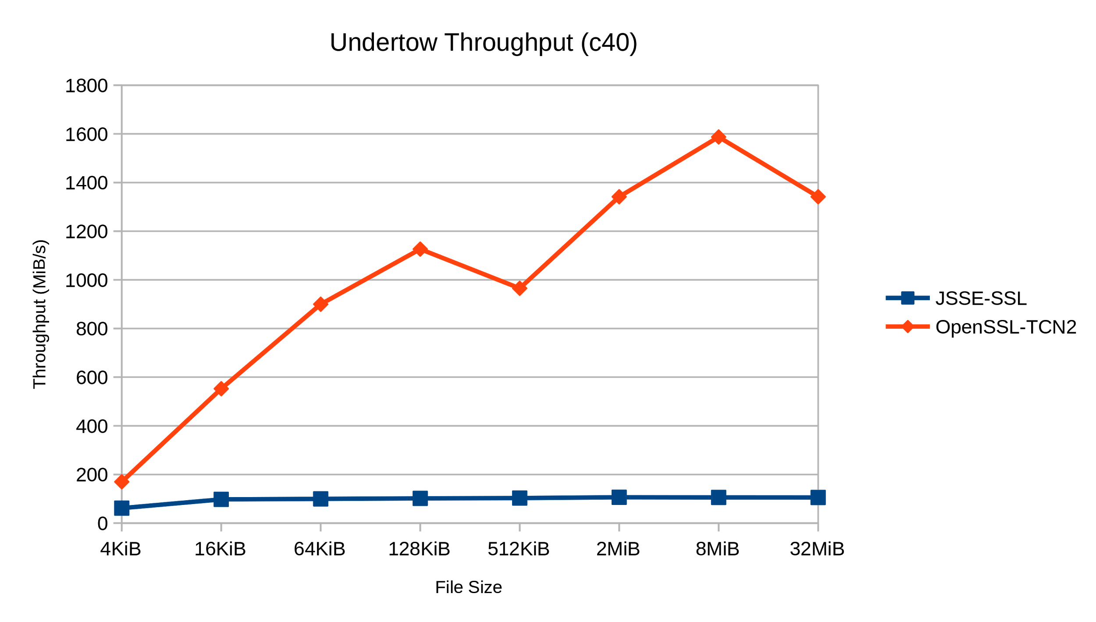
Benchmarks : Undertow

Slide 13
Issues
Dynamic Linking
Bug during implementation
Took more time than wanted
Debugging would be too long
Diverging Philosophies
Tomcat and Undertow maintainers didn’t agree on everything
Modify architecture to accommodate this divergence

Slide 14
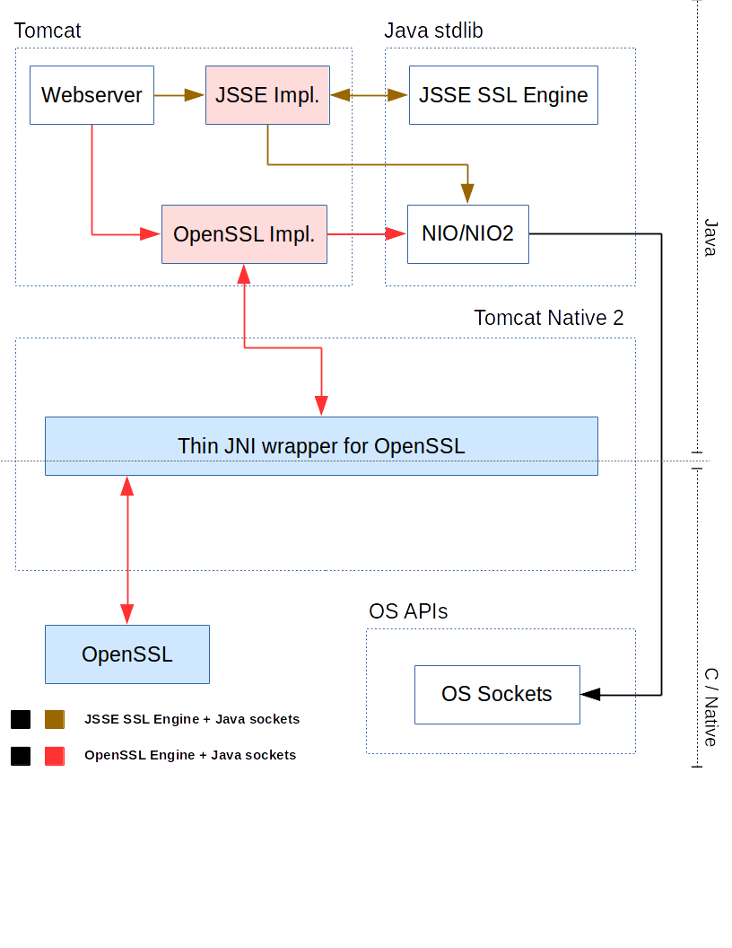
Issues: Diverging Philosophies
Common code
Forked code
Notes:
Add a legend ?
Put this slide after “Changes to the workplan” or after “What needs to be done” ?

Slide 15
Future Work (1)
Implement Dynamic Loading
Big boon for the project
Implement TLS Sessions
Can only be done in Undertow for now
Was not important for a prototype
Implement OpenSSL handshake callback
Do not rely on a hack

Slide 16
Future Work (2)
Better integration with Undertow
ALPN callback always accept H2
Multi platform support
Only compatible with POSIX platforms

Slide 17

Questions

