Slide 1
Tomcat Native 2
Using our own JNI wrapper for OpenSSL in Tomcat and Undertow
Workshop R&D - Red Hat
Supervisors : Jean-Frederic Clere & Rémy Maucherat
Team : Jocelyn Thode & Simon Brulhart

Slide 2
Summary
Overview
What has been accomplished
Issues
Benchmarks
Future Work

Slide 3
Undertow & Tomcat
Undertow and Tomcat are very similar, they:
Are Web servers
Are Servlet containers using JSSE
Can use JSSE SSL Engine

Slide 4
Old State: Tomcat + Tomcat Native
“An optional component for use with Apache Tomcat“
Better performance and compatibility with OS
Uses encrypted sockets through Apache Portable Runtime (APR)
Uses OpenSSL APIs through APR
Notes:
Remind what is APR (Historically compat+perf)
But now only perf needed and don’t need apr
They both can provide SSL through different means
In Undertow only one way but we’ll come back to that later

Slide 5
Old State: Undertow + JSSE
Can only use JSSE SSL Engine
Only Java Code
SSL/TLS performance is not great
Already some work done to port Tomcat Native
Helps us port Tomcat Native 2 to Undertow

Slide 6
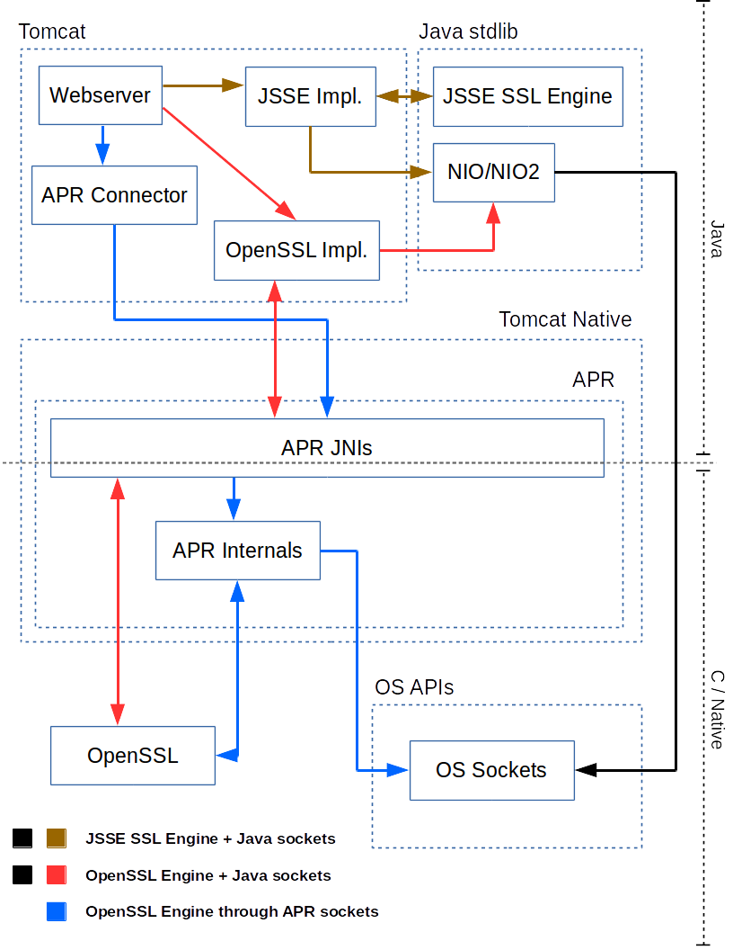
Old State: Ways to Use SSL
Notes:
Tomcat
JSSE SSL Engine + Java sockets
OpenSSL Engine through APR sockets
Old way
OpenSSL Engine + Java sockets
Numa’s OpenSSL Engine

Slide 7
New State: Tomcat Native 2
Tomcat + Tomcat Native 2
Reduces dependencies (no APR)
Reduces project complexity
Native/Java bridge with JNI+Homebrewed code
Undertow + Tomcat Native 2
Brings OpenSSL
Small dependencies (no APR)
Native/Java bridge with JNI+SPI
Notes:
APR big dependency we only use a small part nowadays (Numa’s work removed a lot of part)

Slide 8
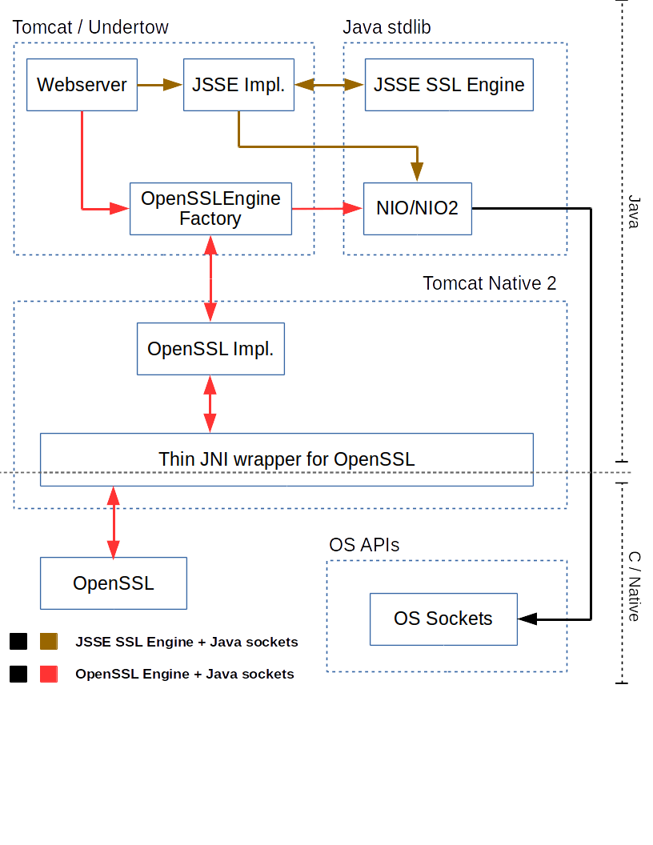
What has been accomplished: Tomcat Native 2 in Tomcat/Undertow

Slide 9
What has been accomplished
Integrate Tomcat Native 2 in Undertow
Merge changes to Tomcat Native in Tomcat Native 2
OpenSSL 1.1
Write documentation on how to build and run Tomcat Native 2
Run Benchmarks
Notes:
Benchmark didn’t give any negative stuff
Maybe we can discuss here what dynamic linking was about, and in the next section only mention that it is planned as an optional last task

Slide 10
Issues
Dynamic Loading
Took more time than wanted
More complex since OpenSSL v1.1.0 compatibility
Diverging Philosophies
Tomcat and Undertow maintainers didn’t agree on everything
Modify architecture to accommodate this divergence

Slide 11
Tomcat Native 2 in Tomcat/Undertow
Not shared

Slide 12
Benchmarks
Many concurrent HTTP requests
Measure server throughput (and CPU load)
Try with different file sizes
Test bed
Tomcat: RedHat cluster
Undertow: personal desktop computer
Notes:
Benchmark didn’t give any negative stuff
Maybe we can discuss here what dynamic linking was about, and in the next section only mention that it is planned as an optional last task

Slide 13
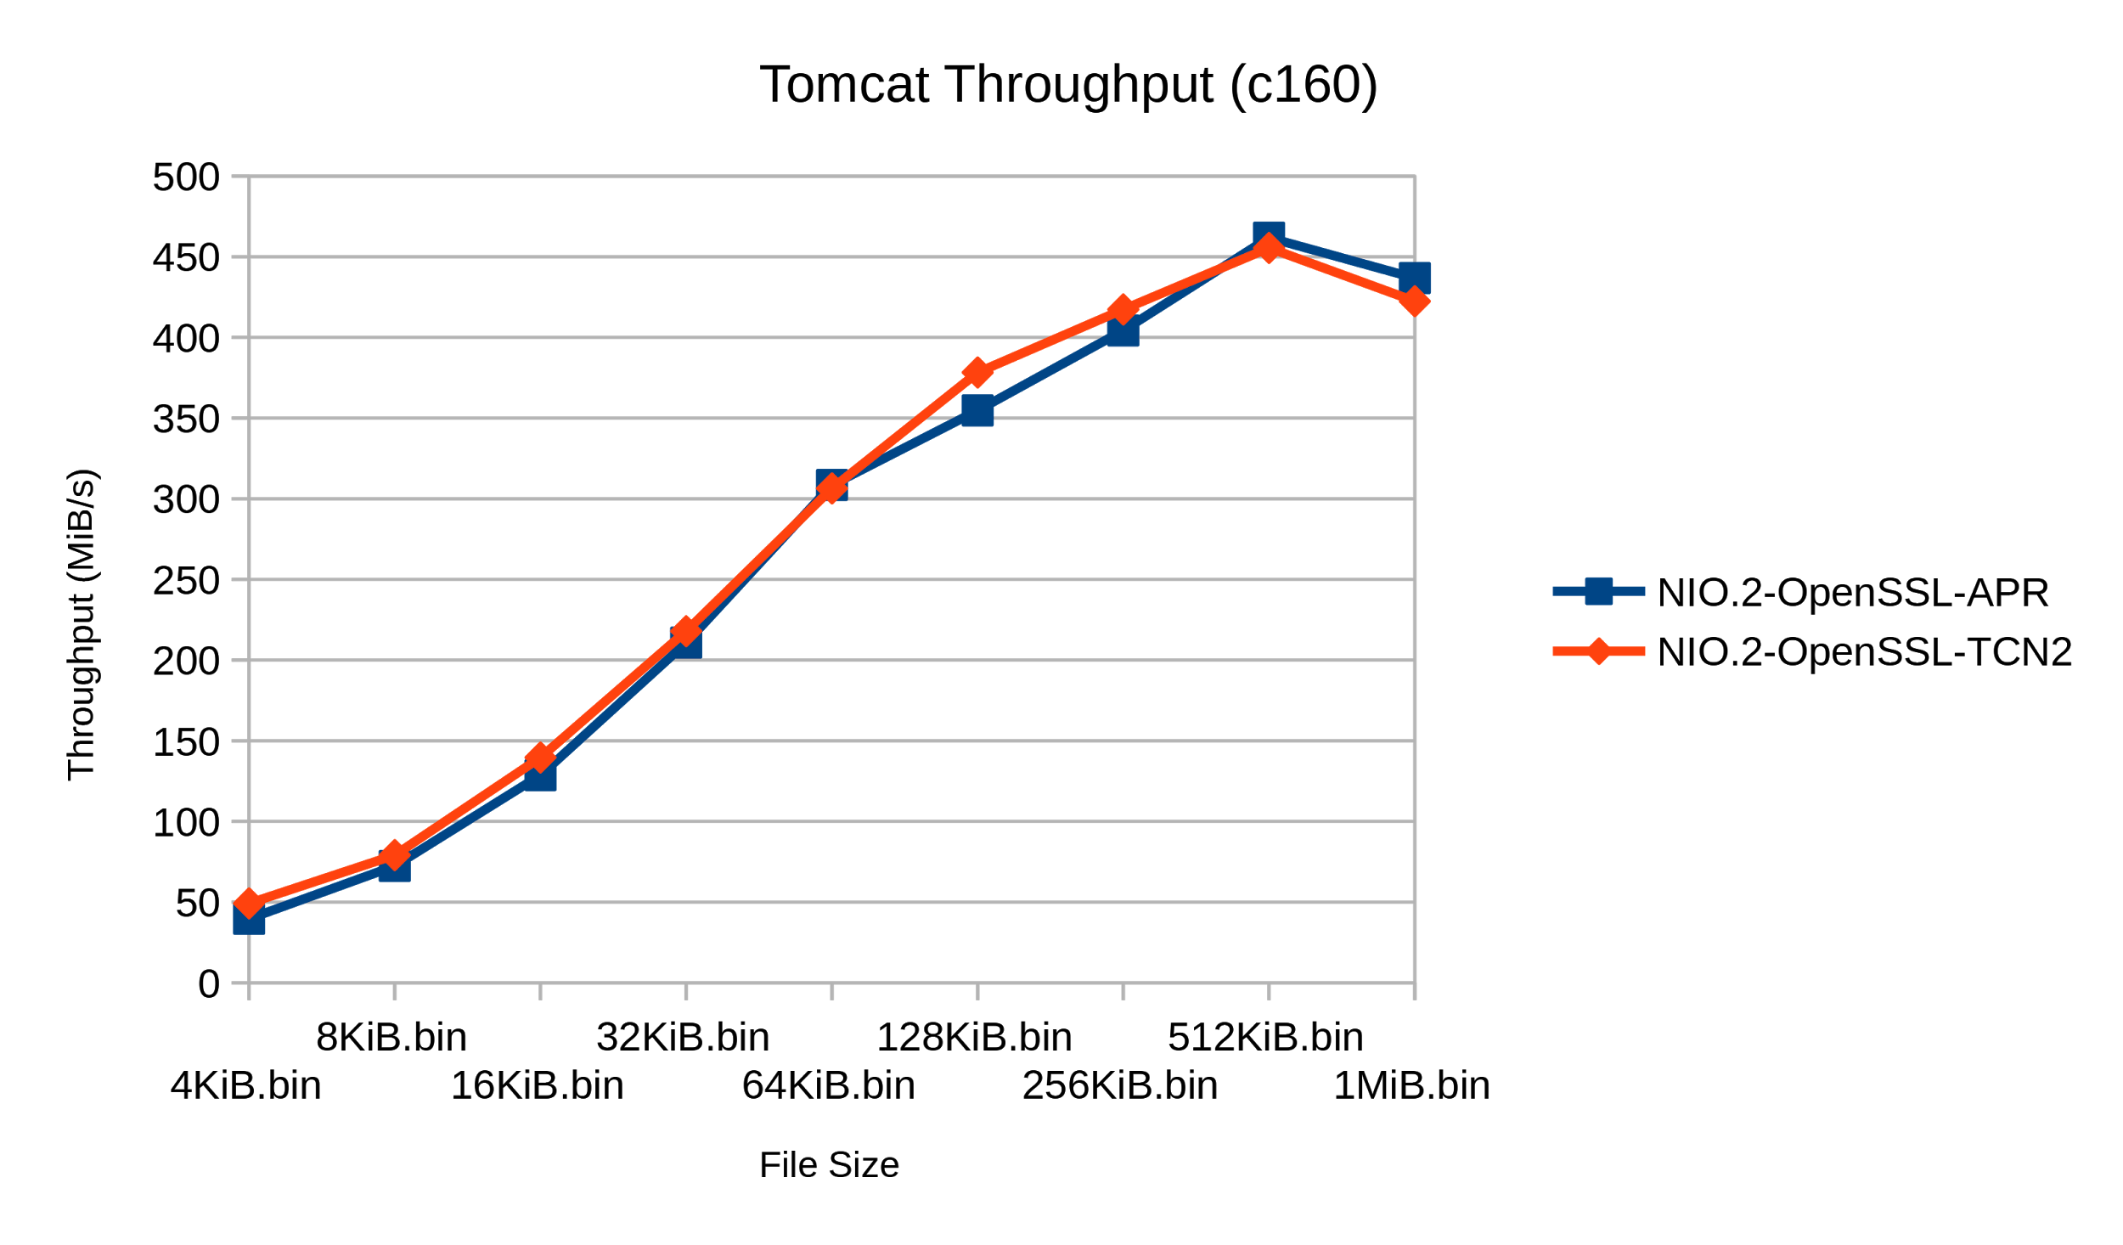
Benchmarks : Tomcat

Slide 14
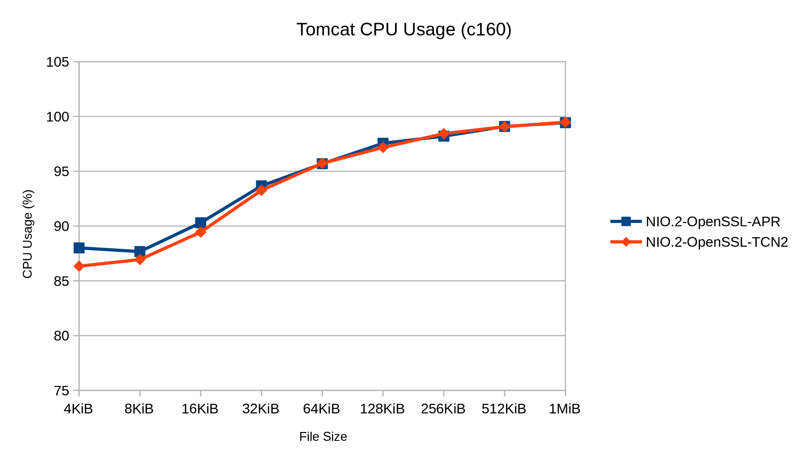
Benchmarks : Tomcat

Slide 15
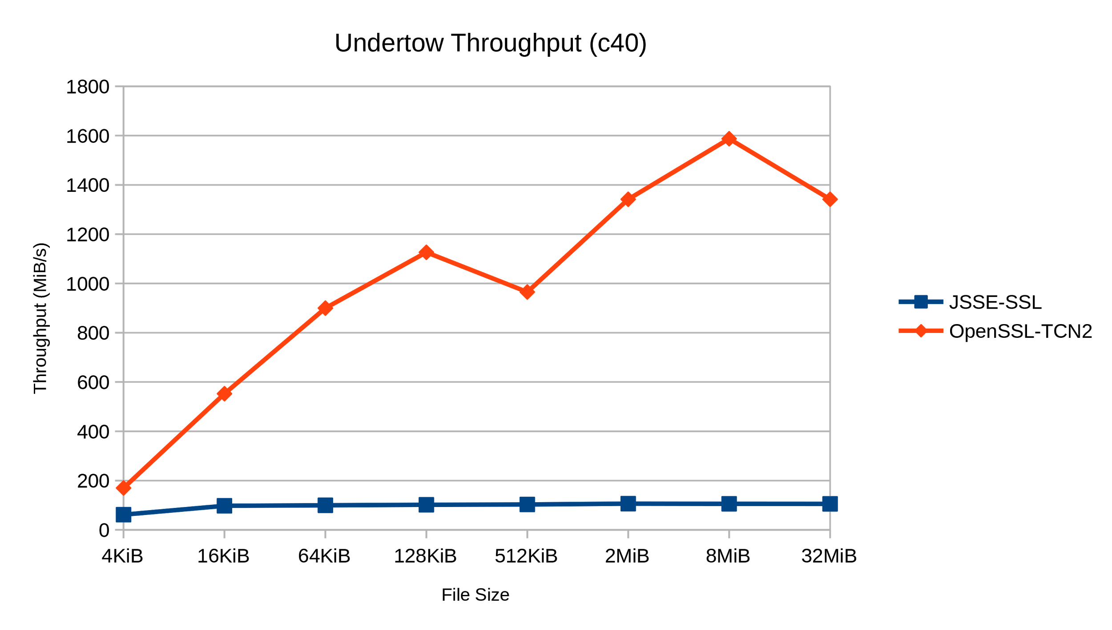
Benchmarks : Undertow

Slide 16
Future Work (1)
Implement Dynamic Loading
Big boon for the project
Implement TLS Sessions
Incomplete support in current Tomcat-Native
Was not important for a prototype
Better integration with Undertow
ALPN callback always prefers H2
SSL client mode unsupported

Slide 17
Future Work (2)
Implement OpenSSL handshake callback
Do not rely on a hack
Cross-platform support
Currently only compatible with POSIX platforms
Target same platforms as original Tomcat Native

Slide 18

Questions

